Slide 1
Management Accounting
Marginal costing

Slide 2
Marginal Costing

Slide 3
Marginal costing
A costing technique where the marginal cost/ variable cost is charged to unit costs while the fixed cost is written off as period costs against contribution
Relevant costs …

Slide 4
Types of cost
It is important to understand three types of cost
Fixed costs are those costs that do not change with levels of sales activity
Variable costs are those cost that do change with sales activity – the more units sold, the more variable costs per unit incurred
Semi-variable costs are those costs that are a mix of the two. However, we will not be using these for our calculations

Slide 5
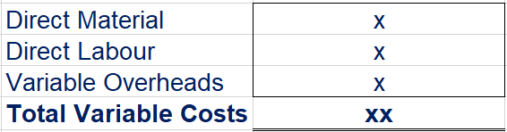
Marginal Costing
Classifies costs into two categories, Variable and Fixed Costs
Variable costs are costs that increase when quantity increase (examples)
Inventory is valued at variable cost i.e excludes fixed costs
Fixed Costs are written off as period costs in the period in which they are incurred (examples)

Slide 6
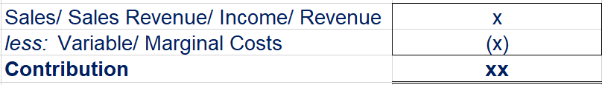
Marginal Costing – contribution calculation
Shows contribution (decision making point):
- Contribution is therefore the excess of revenue over variable costs
This is contribution to:
      First - payment of fixed costs (e.g rent)
      Then - earning profit

Slide 7
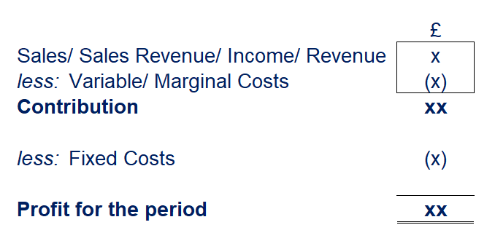
Marginal Costing – profit calculation

Slide 8
Marginal Costing – Let’s work this example together
Q. Hub Limited sold 400 bolts in July 2021 at £4 each. The following information was recorded for the same month:
Variable costs (bolts purchase, packaging material per bolt) £500
Fixed Overheads £700
Required:
Calculate the total contribution
Calculate the profit for the month
Solution
Sales (400 x £4) £1,600
less: Variable Costs (£500)
Contribution £1,100
less: Fixed Overheads (£700)
Profit £400

Slide 9
Marginal Costing – Individual task (2 minutes)
Q. It is recorded that the selling price per loaf is £2, variable costs are £1.20 and fixed costs covering rent and salaries is £1,000.
Required:
Calculate the contribution per loaf
Solution
Selling Price £2.00
less: Variable Costs (£1.20)
Contribution per loaf £0.80
NB: Fixed costs are not considered in the calculation of contribution since they are period costs.

Slide 10
Marginal Costing – Short-term decisions with marginal costing 5 minutes
Shelly’s Massage Bar set their selling prices after considering full cost per massage session. Shelly expects to serve 30 clients per month and monthly fixed overheads are £300 i.e £10 per client. Shelly’s data is set out below:
Like other businesses, Shelly Massage Bar has also been affected during the COVID-19 lockdown. Although now allowed to operate, business is low this month, no sales have been made but rent payment date is approaching. Lizzy walks into Shelly’s Bar and offered to pay £28 for a massage. Should Shelly accept this offer? Individual task
Direct materials (oils, disposable towels etc) | £5
Cost of Labour | £15
Share of Fixed Overheads | £10
Total cost per massage | £30
Price charged | £40

Slide 11
Marginal Costing – Short-term decisions with marginal costing
Cont…
Lizzy’s offer will result in a £2 loss as shown above if full cost is considered. Since it’s a loss, Shelly would not accept Lizzy’s offer.
However, if Shelly applies marginal costing to assess Lizzy‘s once-off offer, the offer will be accepted as it will give a positive contribution of £8 as shown below.
This £8 will contribute towards covering Shelly’s monthly fixed costs. It is important though to note that this price will not be viable in the long-run since if every client pays £28, fixed costs will not be covered hence will lead to a loss. Lizzy might also invite her friends who might approach Shelly offering to pay £28 which is not viable.
 | Normal | Lizzy’s Offer
Price | £40 | £28
Less: Total Cost | (£30) | (£30)
Profit/ (Loss) | £10 | (£2)
Price | £28
Direct Materials | (£5)
Direct Labour Cost | (£15)
Total Variable Costs | (£20)
Contribution (Price – Total Variable Cost) | £8

Slide 12
Marginal Costing – Short-term make or buy decisions with marginal costing.
Nigel, a mechanic manufactures a component (Washer) for use in car servicing. He currently produces 10,000 units. Cost of one washer has been recorded as follows:
Nigel could buy the washers from Global Metalworks at £5.50 per washer. Considering marginal costs, should Nigel make the washers in-house or buy them from Global Metalworks?
Raw materials | £1.00
Direct Labour | £1.50
Variable overheads | £2.50
Fixed overheads | £2.00
Total cost per washer | £7.00

Slide 13
Marginal Costing – Short-term make or buy decisions with marginal costing (Solution discussion – 5 minutes)
Examine the costs in the cost summary, deduct fixed costs (£2) from the total cost then compare the result with the £5.50 which Nigel could buy the washer for.
The total variable costs is £5.00 therefore Nigel should continue to make the washers in-house.
Raw materials | £1.00
Direct Labour | £1.50
Variable overheads | £2.50
Fixed overheads | £2.00
Total variable costs per washer | £5.00

Slide 14
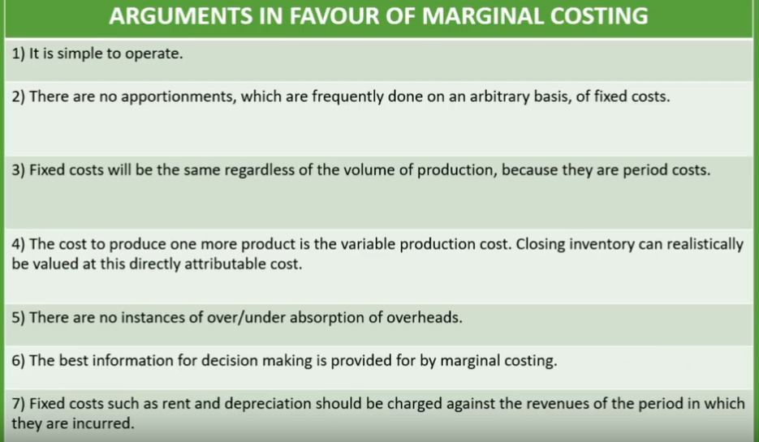

Slide 15
Non-financial factors to consider in decision making
Most non-financial factors will be directly related to the business or the decision being considered. Potential aspects for consideration include:
• Quality of materials and labour
• Qualifications and experience
• Alternatives
• Compromises
• Short and long term considerations
• Using a combination of different strategies or approaches
• Reputation
• Reliability of the financial data

Slide 16
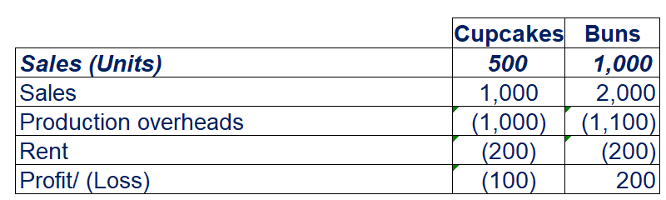
Marginal Costing – Takeaway question. Please share your answers on MS Teams
Jones Bakery produces cupcakes and buns. The following operating statement has been produced based on actual results.
Required:
Calculate the contribution per unit for each product
Jones’ Management are considering stopping production of buns because it is showing a loss. Apply Marginal Costing and advise Jones’ Management on what they should do.

Slide 17
End of this session
Questions welcome
Reading:
Drury, J. C., 2018. Management and Cost Accounting (10th Edition) Cengage Learning. Hampshire. ISBN 978 1 4737 4887 3
Seal, W., Rohde, C., Garrison R. H., Noreen E. W. 2019. Management Accounting (6th Edition) McGraw Hill. London IBSN 978 0 0771 8553 4
Next session…
Please study and prepare for Cost-Volume-Profit Analysis

