Slide 1
Academic Study Skills For Students
ECGE4001R
Claire Kat Davies 1805414
Ten-minute individual presentation on a topic of the student’s choice related to their own academic and/or professional skills development.

Slide 2
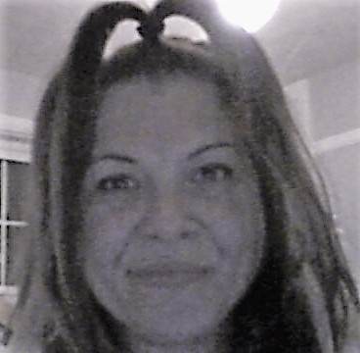
Claire K Davies
12th of August 1977
Started Primary Education in 1980
Started Secondary Education in 1988
Started to LEARN in 2007

Slide 3
Neil Fleming’s VAK/VARK model (Honey and Mumford, 1992) is one of the most widely used tool for defining what type of learner you are, he believed that visual learners have an easier time learning from pictures or diagrams and in more modern times, PowerPoint. If you were an auditory learner then you would greatly benefit from lectures, taped lessons or even better, through discussion. With the kinesthetic learner, Flemming suggested that in order to absorb information the learner needs to feel, see and do, in example, Practical tasks, where by the learner must use a more sensory approach to achieve the knowledge. https://binged.it/2EeeUhS

Slide 5
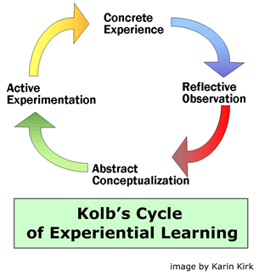
Kolb's Experiential Learning
David A. Kolb (Kolb and Fry 1975) created his famous model of experiential learning out of four key pillars,
concrete experience
observation and experience followed by
forming abstract concepts followed by
testing in new situations
The learning cycle can begin at any of these stages
but must flow onto the next pillar in a
spiral motion.
https://d32ogoqmya1dw8.cloudfront.net/images/introgeo/enviroprojects/kolb_cycle.gif

Slide 6
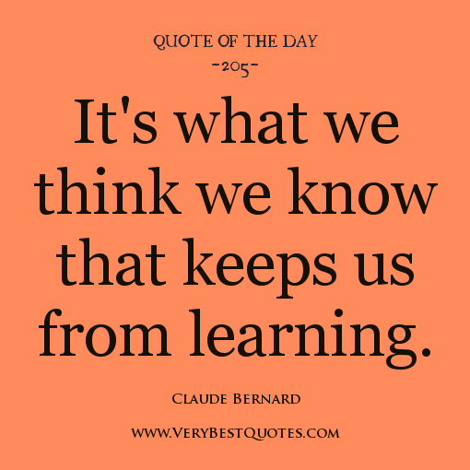

Slide 7
References
David L, "Experiential Learning (Kolb)," in Learning Theories, February 13, 2007, https://www.learning-theories.com/experiential-learning-kolb.html.
http://www.riomarvillages.com/adult-dissertation-learning-style.html
Maslow, A. (1973). Dominance, self-esteem, self-actualization. Monterey, Calif.: Brooks/Cole Pub. Co.
Piaget, J. The psychology of intelligence.

