Slide 1
Business name: Body Sculpt Pro
Angel Investor Pitch
BMSW4011 Managing Enterprise
Student Name:
Student ID:

Slide 2
Content:
Introduction
Business Overview
Mission, Aims, Objectives and USP
Location
Human Resources
Financial Overview
12 Months Marketing Plan
Marketing Examples
Reasons to invest in my business
Conclusion
References

Slide 3

Introduction
This presentation is about a potential business named Body Sculpt Pro. The purpose of this presentation is to present the business idea, its potential for growth and how to ensure its success. We are also looking for £59,468 Angel Investment to cover a part of the start-up costs.
Notes:
My purpose today is to present Body Sculpt Pro to you. This presentation demonstrates an achievable and significant business opportunity within the non-invasive aesthetics market. I developed Body Sculpt Pro based on my observations about body confidence struggles among friends, family members, and clients. My research revealed that many individuals prefer non-surgical treatments because they seek safer and cost-effective solutions. Your contribution of £59,468 will enable us to fund part of the start-up costs and launch this exclusive business with great potential.

Slide 4
Business Overview
Name: Body Sculpt Pro
Story: The business idea came up after years or seeing people struggling with losing weight. The services offered are permanent, painless and non-invasive, and cheaper than a surgery.
Services: Cryolipolysis, Ultrasound, Radiofrequency
Notes:
Body Sculpt Pro is built around a simple idea: Our mission is to enable people to gain confidence about their appearance through non-surgical treatments. Our main non-invasive treatments include Cryolipolysis as well as Ultrasound and Radiofrequency. Medical experts recognize these technologies because they help eliminate stubborn fat and improve skin texture as shown by Doe (2018). Clients can achieve permanent results without surgery because these treatments are pain-free, economical and very effective. The American Society of Plastic Surgeons (2021) reported that non-surgical procedure demand has increased by over 20% during recent years. After observing for several years how poor body image diminishes confidence we developed this service as a solution.

Slide 5
Mission, Aims, Objectives and USP
Mission: Get back your confidence with non-invasive treatments!
Aims: create an online presence, break-even in the first 8 month and generate sales of £72,000 in 12 months.
Long-term objectives: Expand and collaborate with multiple gym locations across UK.
USP: Body treatments and fitness packages.
Notes:
Our goal is to assist clients in reaching their perfect body shape through personalized treatments that ensure safety (Smith, 2010). Our Year 1 target is to achieve £72,000 in revenue and reach break-even status by the eighth month. In the future we will grow our business by collaborating with gyms and franchising throughout the nation (Shridharani et al., 2018). Our Unique Selling Point consists of being located within a popular gym where customers can both exercise and receive treatments together for convenience and time efficiency. The Grand View Research (2021) study shows convenience together with non-invasive appeal as essential components that propel market growth.

Slide 6

Location
Notes:
The first location we have in mind is inside the local PureGym. We will have access to their members, people who are already interested in their physical health. Sigman and Zara (2017) found that gyms build trust and credibility which we can use to establish a loyal customer base and achieve rapid growth. Opening a business inside a gym lowers operational expenses and ensures a ready group of customers (LaingBuisson, 2020).

Slide 7
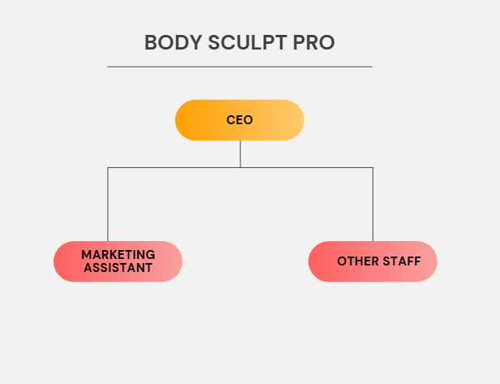
Human Resources
Notes:
To start with we will form a team consisting of me as the beauty therapist and an additional part-time marketing assistant. Our team expansion plan includes certified therapists and client support staff as we continue to grow. Every team member receives training in technical skills alongside customer service education. The Care Quality Commission (2021) mandates that every procedure must adhere to stringent safety and hygiene regulations. The organization will prioritize staff development continuously to satisfy regulatory requirements while maintaining superior service standards.

Slide 8
Financial Overview
Start-up cost: £89,468
Personal investment: £30,000
Angel Investment: £59,468
Estimated profit in the first 3 years:
YEAR1 | YEAR 2 | YEAR 3
£5,336 | £69,866 | £128,206
Notes:
I have already invested £30,000 and need £59,468 in angel funding to start. We aim to achieve profitability in Year 1 through effective marketing and cost controls, with a projected profit of more than £120,000 by year 3. The funds will be used to support training initiatives, purchase new equipment, and rent expenses (Smith & Wachowicz Jr., 2015). Our financial strategy is characterized by lean operations that minimize variable expenses while maximizing profitability.

Slide 9
12 Months Marketing Strategy
Social media post showing before and after pictures
Implement a Digital Marketing strategy: post daily, 2-3 stories per day ,1 funny video posted weekly, 1 educational video weekly, minimum 5 video posted about the benefits of the treatment, results, behind the scene etc.
Discount for holding a gym membership and students
Special offers and packages
Engagement with gym members every Thursday, which is the busiest day at gym
Notes:
The goal of our digital marketing strategy is to reach out to our target audiences through platforms such as Facebook, Instagram, and TikTok, which are known to be leading in the aesthetics industry. We will also work with fitness influencers and post educational videos, seasonal promotions, and seasonal content. According to studies, beauty influencer marketing can boost conversions by 30%. In addition, we will engage with gym members by offering discounts and direct contact during certain times of the week.

Slide 10
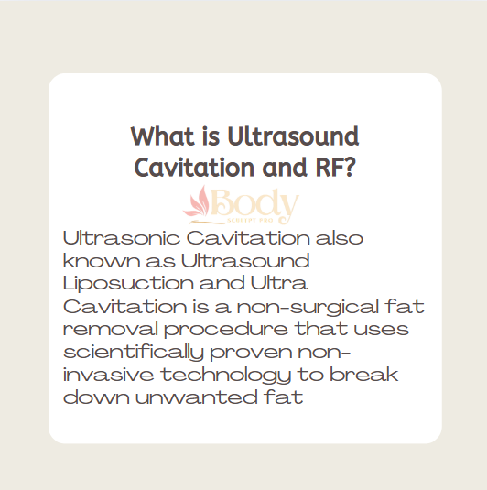
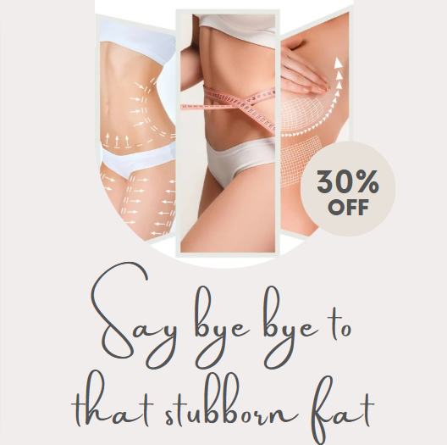
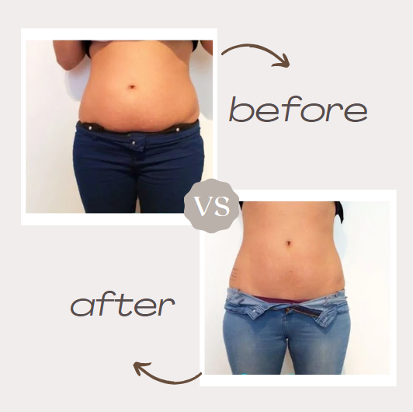
Marketing examples
Notes:
Promotional flyers, social media posts, and advertisements will be distributed to gyms. The campaign materials exhibited our brand's trustworthiness, as well as emphasized our approach to transformation. The International Association of Aesthetic Medicine stated in 2018 that visual marketing played a significant role in making decisions when it came to choosing cosmetic procedures.

Slide 11
Reasons to invest in my business
Trained & qualified
Experienced
Learning business skills to understand how to manage the business properly
Professional sculpting machines
Excellent location
Profitable business
Notes:
The market demands affordable non-invasive treatment options while Body Sculpt Pro provides a business model that scales effectively with minimal overhead costs and high return prospects. The gym-based model grants us an edge over traditional clinics while generating automatic customer flow. The combination of my experience and enthusiasm along with your backing will ensure this business achieves both growth and success. Mintel's 2020 report indicates consumer demand for swift and personalized treatment options which our company specifically provides.

Slide 12
Conclusion
Strong brand identity born from a true desire to help others
High demand for non-invasive treatments
Professional and high-quality equipment
High potential for growth – profitable business
Notes:
Body Sculpt Pro represents a fusion of innovative approaches with passionate execution and a robust business structure. This business model fulfils a genuine market demand through professional equipment and effective treatments within a community-based environment. Investing in us will enable us to achieve greater success while helping numerous people gain body confidence.
Thank you for your time!

Slide 13
References
American Society of Plastic Surgeons. (2021). Body Contouring. [online]. Available at: https://www.plasticsurgery.org/cosmetic-procedures/body-contouring. [Accessed on 5 March 2025].
Care Quality Commission. (2021). Registering as a new provider: How to apply for registration. [online]. Available at: https://www.cqc.org.uk/guidance-providers/registration/registering-new-provider-how-apply-registration. [Accessed on 5 March 2025].
Doe, J. (2018). Non-Invasive Body Contouring: A Review of Technologies and Efficacy. Journal of Aesthetic Medicine, 3(2), 45-57.Nursing, 8(3), 148-154.
Grand View Research. (2021). Global Body Contouring Market: By Invasiveness: Non-Invasive Contouring, Minimally Invasive Contouring, Invasive Contouring; By End Use: Clinical Research Organizations, Hospitals, Medical Spa, Clinics; Regional Analysis; Historical Market and Forecast (2018-2028); Market Dynamics; Competitive Landscape; Industry Events and Developments. [online]. Available at: https://www.expertmarketresearch.com/reports/body-contouring-market. [Accessed on 5 March 2025].
International Association of Aesthetic Medicine. (2018). Aesthetic medicine market trends, size & share 2018-2023. [online]. Available at: https://www.iaam.co.in/industry-reports/aesthetic-medicine-market-trends-size-share-2018-2023/. [Accessed on 5 March 2025].
LaingBuisson. (2020). Private healthcare market report 2020. [online]. Available at: https://www.laingbuissonevents.com/assets/Uploads/PHMR2020-Final.pdf. [Accessed on 5 March 2025].
Mintel. (2020). Body Contouring. [online]. Available at: https://reports.mintel.com/display/1022195/. [Accessed on 5 March 2025].
Shridharani, S. M., Broyles, J. M., & Matarasso, A. (2018). Non-Invasive Body Contouring: A Comprehensive Review. Plastic and Reconstructive Surgery, 141(4S), 7S-21S. doi: 10.1097/prs.0000000000004273.
Sigman, S. J., & Zara, J. N. (2017). The impact of gyms and fitness centers on property values. Journal of Real Estate Research, 39(4), 471-489. doi: 10.1080/10835547.2016.1227942.
Smith, J. (2010). Body Contouring: Art, Science, and Clinical Practice. New York: Springer.
Smith, J. A., & Wachowicz Jr, J. M. (2015). Capital budgeting and long-term financing decisions. John Wiley & Sons.

