Slide 1
Misrepresentations of Youth…
Joanne Davies

Slide 2
Activity 1
Representations of Young People
Think about all the words you know that describe the period of youth.
What are some of the things we call young people?

Slide 3
Activity 2
Spend a few minutes writing down all the negative things that you have heard regarding young people recently.
For example think of how young people are depicted in terms of violent activity, involvement in gangs, teenage pregnancy, binge drinking etc.
Then write a list of all the positive things you have heard regarding young people in recent weeks.

Slide 4
Activity 2
Compare your two lists. Was one easier to put together than the other? Do you have more or less on your negative or positive list? If so why do you think this is?
Have your own thoughts and feelings regarding young people been challenged or confirmed during this activity?

Slide 5
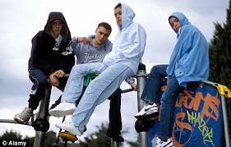
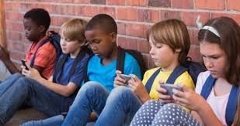
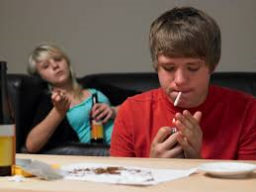
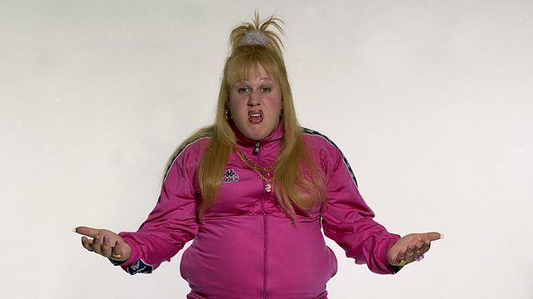
Representations of Youth
There appears to be a wealth of literature that explores the lives of young people and a vast amount of observers believe that today’s young people are ‘excessive drinkers’, ‘lazy’ ‘violent’, ‘drug abusers’, ‘involved in risky sexual behaviour’ and ‘incapable of using their free time wisely’
(Adams and Berzonsky, 2006, p. xxii).

Slide 6
Youth and ‘moral panics’
When we think about constructs such as youth, it is often coupled with a discussion that explores this period as a time of heightened risk and threat around which ‘moral panics’ may emerge.
Cohen (1972) defines the occurrence of a moral panic as: A condition, episode, person or group of persons (who) emerged to become defined as a threat to societal values and interest.

Slide 7
Youth and ‘moral panics’
Mods, Rockers and Moral Panics
https://www.youtube.com/watch?v=r61ks18Bd7I
Hoodies https://www.youtube.com/watch?v=-pzeYcDy7vE
What other more recent Moral Panics about young people can you identify?

Slide 8
Youth and ‘moral panics’
Cohen is not saying here that a particular issue, risk or threat does not exist but that it may be exaggerated out of proportion by those such as the media, politicians, or other viewed as in authority or as ‘experts’.

Slide 9
Youth and ‘moral panics’
Feelings around a particular issue become heightened, and ‘solutions’ to problems abound in ways that are disproportionate to the actual issues.
He goes on to discuss how the panic may disappear, linger almost as folklore, or lead to change in policy and law.

Slide 10
Youth and ‘moral panics’
All of this revolves around the emergence of new panics to replace the old.
This can result in an issue being exaggerated to such an extent that it becomes more difficult to debate and discuss.
It becomes surrounded by myth and misinformation.

Slide 11
Is Youth Culture Disappearing?
Young Blood: Exploration into British Youth Culture Youth In Transition
https://www.youtube.com/watch?v=uvvFE1fj88Q
Where have All the Subcultures Gone?
https://www.youtube.com/watch?v=dwMNyig6FJ8

Slide 12
Youth and ‘moral panics’
The issue itself can sometimes become a taboo subject, which may lead to misinterpretation and individual and groups become uniformed or misinformed about the facts.
This can lead to the creation of stereotypes and prejudices that result in what is often termed Knee-jerk policy reaction or overly disproportionate initiatives to tackle the issue.

Slide 13
Youth and ‘moral panics’
As this lecture has highlighted, much of the debate around young people tends to focus on negative images and behavior.
Young people are often portrayed by the media, politics and society in general as troubled and troublesome, politically apathetic, risk takers and as self interested.

Slide 14
Youth and ‘moral panics’
In actual fact many young people are actively engaged as citizens in their local, national and international communities in positive action for change working towards better rights and an improved way of life for themselves and others.
This has been supported by research such as that carried out by Kar & Devi (2018)
We will now undertake a reading exercise on this research
`

Slide 15
What Issues do Young People Face in the UK Today?
Discuss…
Social Media
Bullying (incl cyber bullying)
Trolling
School
Uncertain Futures
Young Carers
Consumerism
Globalisation
And that is without the added issues associated with the pandemic

Slide 16
How Have Perceptions of ‘Youth’ Changed in the 21st Century?
Discuss…

Slide 17
Hoodies can be Goodies
Watch the following clip, read the following article and discuss
https://vimeo.com/189317752
https://www.theguardian.com/society/2009/apr/15/stereotypes-young-people

Slide 18
Youth Leading the Way???
New research from The National Lottery Community Fund shows that almost three quarters of people in the UK feel part of their local community, and that safety on the streets, young people and mental health are amongst their priorities for their community in 2022:
Over seven in ten (73%) say they feel part of their local community - 68% say it’s important to them to feel like this
Young people are leading the way – 18 to 24 year olds are more likely to feel connected to their local community, more likely to see this as important and more likely to volunteer or help out in 2022
(Community Fund, 2022)

Slide 19
References
Adams, G. R. & Berzonsky. M. D. (Eds.) (2006) Blackwell Handbook of Adolescence Oxford: Blackwell Publishing
Cohen, S. (1978) Folk Devils and Moral Panics, London: MacGibbon and Kee
Community Fund (2022) 2022: Upswing in people feeling part of their community, with young people leading the way Available at: https://www.tnlcommunityfund.org.uk/news/press-releases/2022-01-11/2022-upswing-in-people-feeling-part-of-their-community (Accessed: 27 January 2022).
Kar, S. & Devi, R (2018) ‘Pro social tendency among adolescents: An exploratory study’ PEDAGOGIKA.SK, Vol. 9,.(4), pp.196-205
Mitchell et al (2009) 'It seems that we can only be interesting if we are smoking, snorting or stabbing’ The Guardian Available at: https://www.theguardian.com/society/2009/apr/15/stereotypes-young-people (Accessed: 20 November 2020)
Phillips, L. (2008) Mischief: Hoodies Can Be Goodies Available at: https://vimeo.com/189317752 (Accessed: 20 November 2020)

