Slide 1
LCMB7024
Brand Strategies and
Corporate Branding
Week 7 – Session 1

Slide 2
Content of the Sessions
Brands
How Does Branding Works?
Building Strong Brands
  Brand positioning
  Brand Name Selection
  Brand Sponsorship
  Brand Development
    Line extensions
    Brand extensions
    Multi-brands
    New Brands
Corporate Branding
Managing Brands

Slide 3
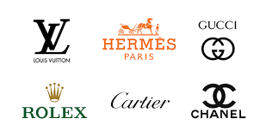
Brands
Brands are among the most valuable intangible assets of a firm, and it is incumbent upon marketers to manage their value effectively.
Building a strong brand is both an art and a science, requiring continuous effort.
For marketers, it is an ongoing process that never truly ends.

Slide 4

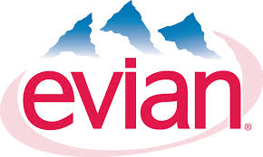



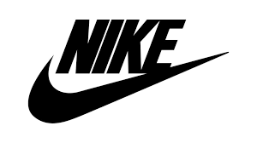

How Does Branding Work?
The most distinctive skill of professional marketers is their ability to create, maintain, enhance, and protect brands.

Slide 5
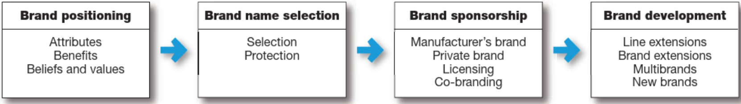
Building Strong Brands
Brand are powerful assets that must be carefully developed and managed. As this figure suggests, building strong brands involves many challenging decisions.
(Kotler, P. et al., 2020)

Slide 6
Brand Positioning
Brand positioning can occur at three levels:
    Product attributes (e.g., quality, selection)
    Benefits (e.g., convenience, efficiency)
    Beliefs/values (emotional connections)
Emotional connections drive strong brands.
For example, Whirlpool uses storytelling to highlight the emotional impact of its products in family life. Lovemark brands like Disney, Apple, and Nike create deep, lasting emotional bonds.
Notes:
Clarity in brand messaging is crucial. A brand should define a mission, vision, and promise that resonates with customers. For example, Formula 1 hotels emphasize affordability and cleanliness, while Ritz-Carlton focuses on luxury without promising low prices.

Slide 7
Brand Name Selection
A good brand name can significantly contribute to a product’s success. However, finding the right name is a challenging task.
The process begins with a thorough review of the product and its benefits, the target market, and the proposed marketing strategies.

Slide 8

Let’s look into these brand Best Global Brands - The 100 Most Valuable Global Brands and see what do you think are the characteristics of the brand names?

Slide 9
Brand Name Selection
According to Kotler et al. (2019), a good brand name should:
Suggest product benefits (e.g., Silentnight, Slimfast).
Be easy to pronounce, recognize, and remember (e.g., iPad, Google).
Be distinct (e.g., Rolex, UGG).
Be extendable (e.g., Amazon started with books but expanded).
Be easily translatable into other languages.
Be legally registrable and protectable.

Slide 10
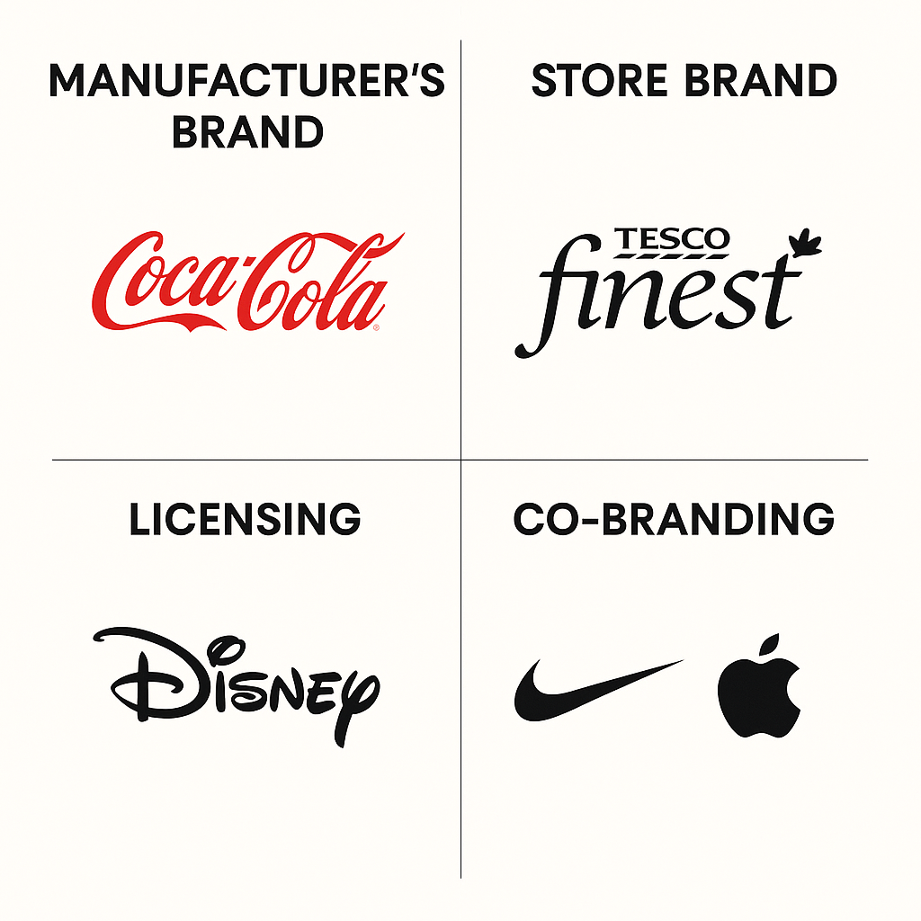
Brand Sponsorship
(1 of 4)
Manufacturers brands
Store brands
Licensing
Co-Branding

Slide 11
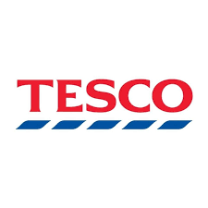

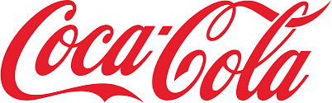
Manufacturers Brands
Versus Store Brands (2 of 4)
Store brands (private labels) have grown significantly, with consumers increasingly choosing them over manufacturer brands.
Studies indicate that private brands now account for 20-25% of sales.

Slide 12
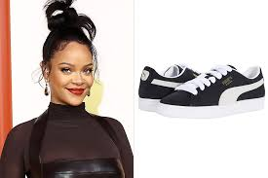
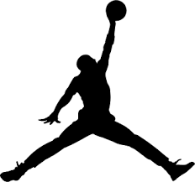
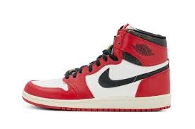
Licensing (3 of 4)
Most manufacturers spend years and millions to create their own brand names. However, some companies license names or symbols previously created by other manufacturers.
Other options are to licence names of well-known celebrities or characters from popular movies and books.

Slide 13

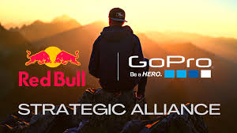
Co-Branding (4 of 4)
Co-branding is the practice of using the established brand names of two different companies in the same product.
It allows companies to leverage the complementary strengths of both brands.
For example, Nike and Apple, Red Bull and Go Pro, Starbucks and Sportify.

Slide 14
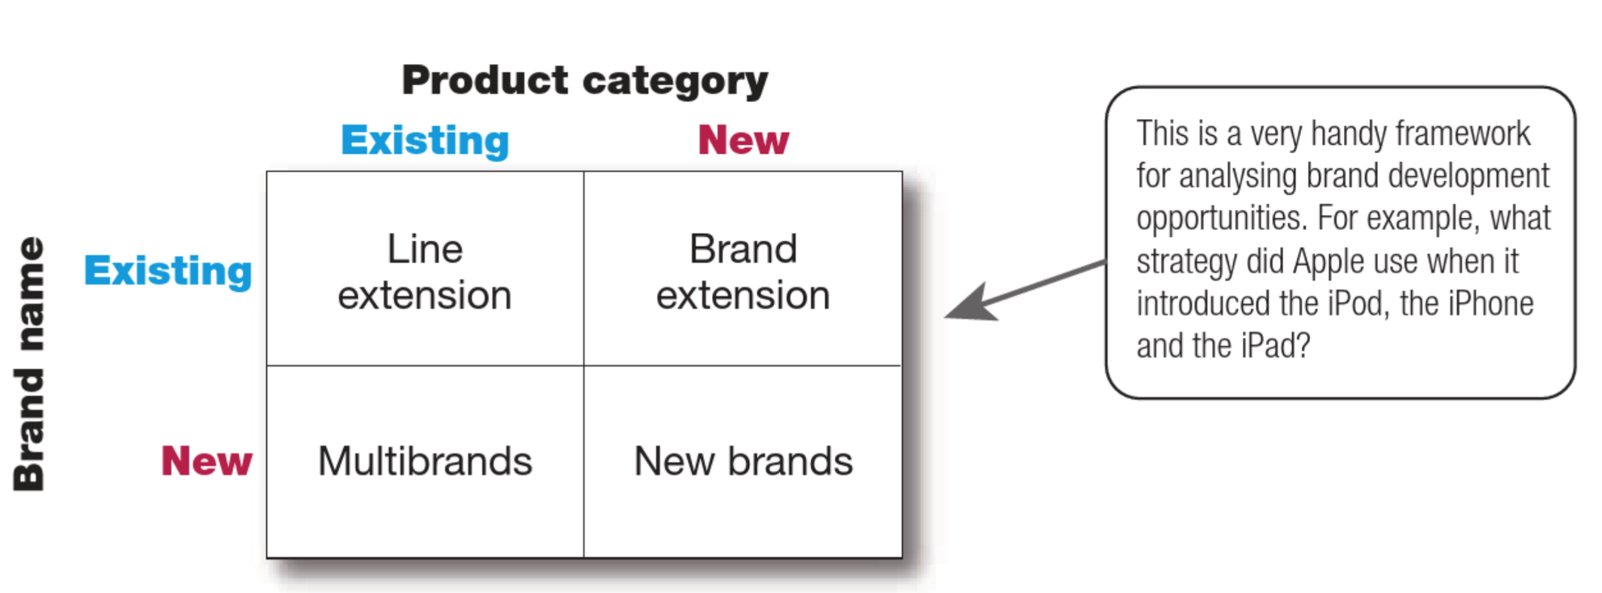
Brand Development
(1 of 6)
(Kotler et al., 2020)

Slide 15
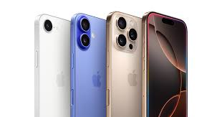
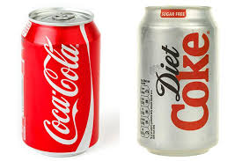
Line Extension
(2 of 6)
A company extends an existing brand name to new forms, colours, sizes, ingredients, or flavours within the same product category.
Risks: Excessive extensions may confuse consumers, dilute brand meaning, or take shelf space away from more successful products.
Notes:
KFC: Originally known for bone-in fried chicken, KFC expanded its lineup to include grilled chicken, boneless fried chicken, chicken tenders, hot wings, popcorn nuggets.
McDonald's: In an attempt to serve different customer needs, McDonald's expanded its menu extensively. However, this led to a cluttered menu that slowed service, prompting recent efforts to simplify offerings.

Slide 16
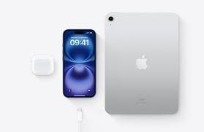
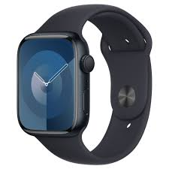
Brand Extension
(3 of 6)
A brand extension occurs when a company uses an existing brand name to launch a new or modified product in a different product category. Successful brand extensions leverage existing brand equity to attract consumers in a new category.
Risks: Poorly executed extensions can dilute the brand, create confusion, or fail if they don’t align with consumer expectations.
Notes:
Starbucks: Expanded beyond coffee shops by launching packaged supermarket products such as ready-to-drink coffee, coffee beans, and the Verismo coffee machine.
Ferrari: Leveraged its luxury sports car brand into theme parks, fashion, and accessories.
Kellogg’s: Moved from breakfast cereals into snack bars and protein shakes.

Slide 17
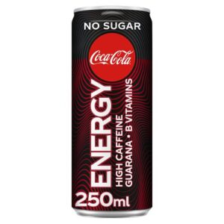
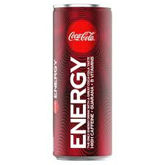
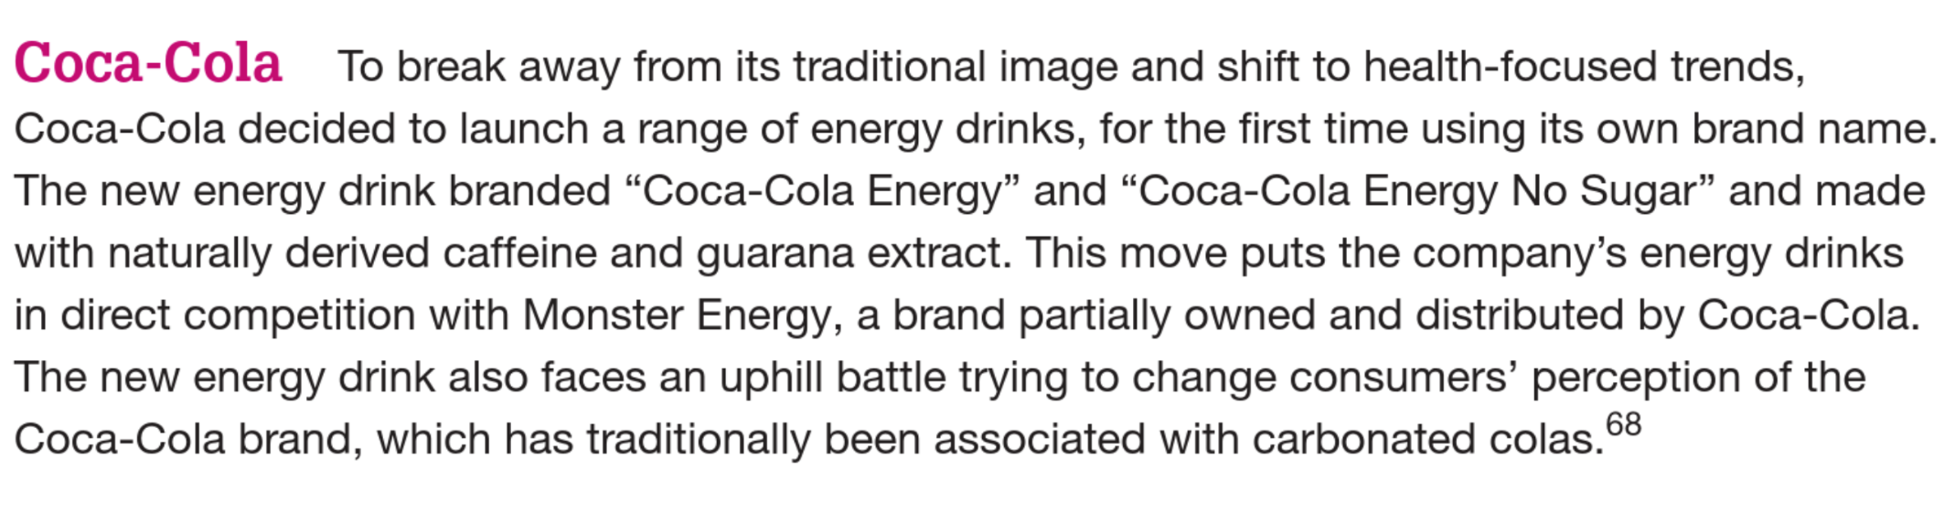
Brand Extension - Example
(Kotler et al., 2021)
Notes:
Read and discuss:
What potential advantages could Coca-Cola gain from a brand extension, and how might these benefits impact its market positioning, brand identity, and competitive landscape?

Slide 18
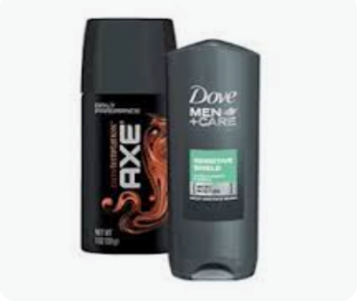
Multi-brands
(4 of 6)
Multi-branding is a strategy where companies market multiple brands within the same product category to appeal to different customer segments, secure more shelf space, and increase market share.
Risks: a downside is that each brand may only capture a small market share, leading to inefficiencies. To counter this, some companies streamline their brand portfolio.
Notes:
For example, in the early 2000s, Unilever reduced its brands from 1,600 to 400, focusing on high-profit core brands such as:
Food brands (e.g., Ben & Jerry’s, Lipton Teas)
Personal care (e.g., Dove, Lynx)
Home care (e.g., Persil, Comfort)
In the U.S, PepsiCo markets:
8 soft drink brands
3 sports and energy drink brands
4 bottled tea and coffee brands
3 bottled water brands
9 fruit drink brands

Slide 19

New Brands
(5 of 6)
Companies may create new brand names when their existing brand loses strength or when entering a new product category where their current brands are not suitable.
Risks: launching too many new brands can stretch company resources too thin. In industries like consumer-packaged goods, too many similar brands can confuse consumers and retailers.
Notes:
As a result, major companies like P&G and PepsiCo are now focusing on megabrand strategies, eliminating weaker brands and prioritizing those with strong market potential.
Toyota introduced:
Lexus for luxury car consumers
Scion for Millennial consumers
Amazon introduced:
Amazon Basics for affordable everyday products (electronics, home goods, cables, etc.).
Amazon Fresh for grocery stores and meal delivery services.

Slide 20
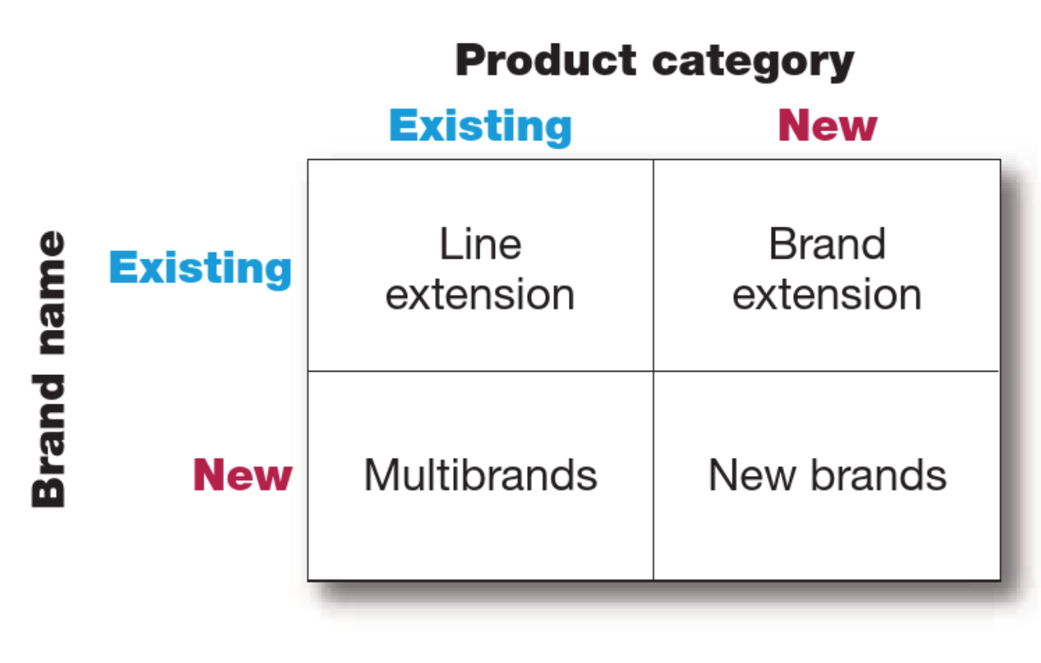
Brand Development
(6 of 6)

Slide 21
Corporate Branding
Corporate branding is a strategic practice aimed at establishing a business in the market and promoting its core values across various distribution channels.
It highlights the company’s identity and encompasses all actions and strategies implemented to ensure its success.

Slide 22
Objectives of Corporate Branding
To make the company stand out from the competition.
To differentiate the company from its competitors.
To support publicity, advertising, sales, and other promotional activities.
To reinforce the company’s position in the market.
To maintain the quality of products and customer service.
To build a strong reputation.
To foster brand loyalty.

Slide 23
Types of Corporate Branding
Personal Branding
Product Branding
Geographical Branding
Cultural Branding
Service Branding
Internet Branding
Notes:
Personal Branding: This refers to branding an individual, such as an entrepreneur or professional, to create a unique personal identity.
Product Branding: This involves promoting and establishing the identity of a single product in the market.
Geographical Branding: This focuses on promoting a company based on the unique characteristics of a specific region.
Cultural Branding: This emphasises promoting a company based on the unique traits of a particular culture.
Service Branding: This refers to efforts aimed at improving user experience and customer service to best resonate with the target market.
Internet Branding: This involves positioning a company in the digital space, including online platforms and social media.

Slide 24
Summary
Branding Essentials: Strong brands are valuable intangible assets, requiring continuous effort to create, maintain, and protect.
Building Strong Brands: Includes brand positioning, brand name selection, brand sponsorship, and brand development.
Brand Development Strategies: Includes line extensions (new variations within the same category), brand extensions (applying a brand to a new category), multi-brands (multiple brands within a category), and new brands(created for distinct market needs).
Brand Management: Effective branding requires advertising, customer engagement, internal branding, and regular audits to sustain brand relevance and competitive advantage.

Slide 25
Group Activity
Individually, choose a company and develop a brand development strategy.
Then, complete the STP (Segmentation, Targeting, and Positioning) for the brand development strategy chosen.
Company examples: Nike, Samsung, Nutella, Innocent Drinks, Red Bull, Mercedes, Nissan, HP, Apple, Zara.
Note: You must choose one strategy – Line Extension, Brand Extension, Multi-Brand, or New Brand – and provide a justification for your choice.

Slide 26
References
Hague, P (2019) The Business Models Handbook: Templates, Theory and Case Studies. London, United Kingdom; New York, Ny, Kogan Page Limited.
Kotler, P., Armstrong, G., Harris, L. and Piercy, N. (2020) Principles of marketing. 8th European edn. Harlow: Pearson.
Kotler, P., Keller, K. and Chernev, A. (2021) Marketing management. 16th ed.

