Slide 1
Time Management

Slide 2
Success
Learning to Manage your time effectively is a key skill.
Effective Time Management is a Key to Success in:
Getting Assignments in on time
Living a Healthy Balanced Life.
Notes:
Most people feel that they do not make good use of the time in a day!

Slide 3
Manage your Time to Achieve your Goals:
Goals
Time

Slide 4
Be Positive & Pro-Active
The only person that can manage your time is YOU.
You are in complete control of what you focus on.
Time is in your hands, it is up to you how you use it.
It is SOOO Easy to get distracted these days and whereas there is nothing at all wrong with this in itself, learning to focus on what really matters most is key to achieving what you really want in life.

Slide 5
Full Time Study = Full Time Job
9am to 5pm | 8 hours per day
5 Days a Week | 40 hours per week
Lunch hour! -5 | 35 hours per week
5/6 Modules per Course | 7 or 6 Hours per Module, per Week

Slide 6
Full Time Study
For Example
If you have 6 Modules
6 hours per Module per week. E.g:
Web Authoring Lecture/tutorial for 2 hours
Personal Study for 4 hours per module per week.

Slide 7
Full Time Study
In order to balance your University, Working and Social life, it is recommended that students spend a minimum of 2, and typically 4 hours a week on Personal Study for each module per week.
All University course documents are designed and validated around these typical figures.

Slide 8
Each week you should make 2-4 hrs available for each Module outside University.
Use this time to read around what you are studying in the module and/or work on the Assignment.
Not only will this enhance you knowledge and skills it will allow you to complete your Assignments/Exams with Ease...
It will greatly reduce stress during submission time and Allow for a Healthy Balanced life with time to work(i.e. Be productive/creative )and also time to Rest and Play.

Slide 9
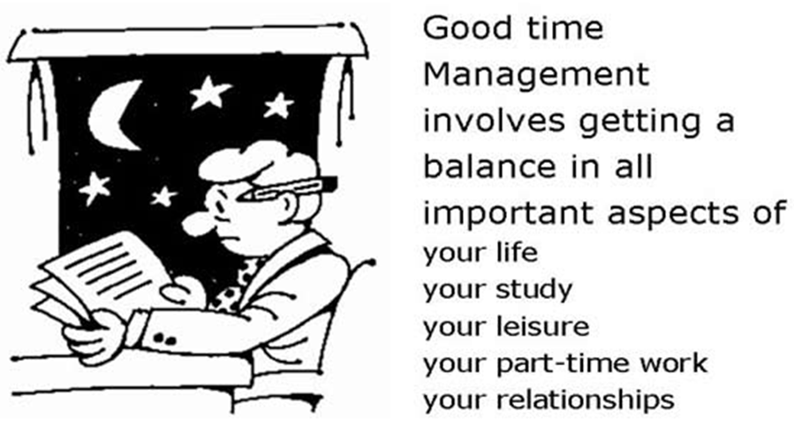
Achieving Balance

Slide 10
Activity
Think about the things/habits that lead to you wasting your time?
e.g. perhaps you spend too much time on certain things (watching TV or Youtube?), or procrastinating, to not knowing your Goals or having enough Self-Confidence or Personal Will-Power at this time. Each person is different.

Slide 11
Other Common Time Wasters
Interruptions - telephone, personal visitors
Procrastination and indecision
Inability to say "No“
Inadequate knowledge
Acting with incomplete information
Too much information
Unclear objectives and priorities
Stress and fatigue
Desk management and personal disorganization.

Slide 12
Prioritising activities
A widely used technique is to make a list of the things you have/want to do.
Then categorise them: Then do them in the order of most priority.
A- Very Important
DO IT NOW!
B - Important
Do it if you can.
C- Needed but Not Important
D - Not needed or important
Do it when you have time.
Do It last, or just don’t Do it!

Slide 13

Goals
Part of Time Management is setting goals and organising time to achieve those goals.
You have set yourself a goal, to get a Degree or HND and the only way you are going to achieve that is to organise your time to complete everything that is asked of you.

Slide 14
Classifying Goals via Time
Generally broken down into timescales, e.g.:
Short term goals (things to do today, this week or maybe this month?)
Medium term goals (thing to achieve over months or maybe a year?)
Long term goals (perhaps 3-10 years?)
Lifetime goals – what are your ultimate aims in life?
Longer timescale goals are generally achieved through a series of shorter timescale ones, so work backwards!
Notes:
Time Management is setting goals and organising time to achieve those goals.
 Time management and goal setting as inter-related, without goals to work towards we don’t have to managed our time, and without managing our time we won’t achieve any goals.
You have set yourself a goal, to get a degree or HND and the only way you are going to achieve that is to organise your time to complete everything that is asked of you.
Just as balance in your life is motivating, understanding your long term goals is very motivating. If you know what it is that you really want to achieve in five years or ten years time or maybe in the course of your life, this will really help you to stick to some of the things that you have set yourself to do, it gives you energy, it motivates you and you can carry them out whilst being satisfied with how you're using your time.
Most people don't like thinking about long term goals, so I'm going to get you to do an exercise which is to look at your five year goal perhaps, and ask yourself what is at least one thing I want to have achieved in five years time. So do that now - it doesn't matter if it's not the best thing that you could ever think of, just write something down that you think you would like to achieve within the next five years.

Slide 15
Student Task
Understand what motivates you - why are you here? What do you ultimately want out of life?
Identify 2 or 3 short/medium term goals that you want to implement
Break down your goal(s) into small chunks, small stepping stones that will help you plan the steps needed to achieve these goals. Produce an action plan, with enough detail and timescales to let you achieve these goals – remember to use S.M.A.R.T
Notes:
Time Management is setting goals and organising time to achieve those goals.
 Time management and goal setting as inter-related, without goals to work towards we don’t have to managed our time, and without managing our time we won’t achieve any goals.
You have set yourself a goal, to get a degree or HND and the only way you are going to achieve that is to organise your time to complete everything that is asked of you.
Just as balance in your life is motivating, understanding your long term goals is very motivating. If you know what it is that you really want to achieve in five years or ten years time or maybe in the course of your life, this will really help you to stick to some of the things that you have set yourself to do, it gives you energy, it motivates you and you can carry them out whilst being satisfied with how you're using your time.
Most people don't like thinking about long term goals, so I'm going to get you to do an exercise which is to look at your five year goal perhaps, and ask yourself what is at least one thing I want to have achieved in five years time. So do that now - it doesn't matter if it's not the best thing that you could ever think of, just write something down that you think you would like to achieve within the next five years.

Slide 16
Student Task
Example. You decide that your health and fitness aren’t what they should be, so your goal (or aim) is to ‘Get fit, eat healthily and lose some weight’
You now need to break this general aim down into more specific objectives that follow SMART
Notes:
Time Management is setting goals and organising time to achieve those goals.
 Time management and goal setting as inter-related, without goals to work towards we don’t have to managed our time, and without managing our time we won’t achieve any goals.
You have set yourself a goal, to get a degree or HND and the only way you are going to achieve that is to organise your time to complete everything that is asked of you.
Just as balance in your life is motivating, understanding your long term goals is very motivating. If you know what it is that you really want to achieve in five years or ten years time or maybe in the course of your life, this will really help you to stick to some of the things that you have set yourself to do, it gives you energy, it motivates you and you can carry them out whilst being satisfied with how you're using your time.
Most people don't like thinking about long term goals, so I'm going to get you to do an exercise which is to look at your five year goal perhaps, and ask yourself what is at least one thing I want to have achieved in five years time. So do that now - it doesn't matter if it's not the best thing that you could ever think of, just write something down that you think you would like to achieve within the next five years.

Slide 17

Setting Goals
Specific
Measurable
Attainable
Realistic
Time-Limited

Slide 18
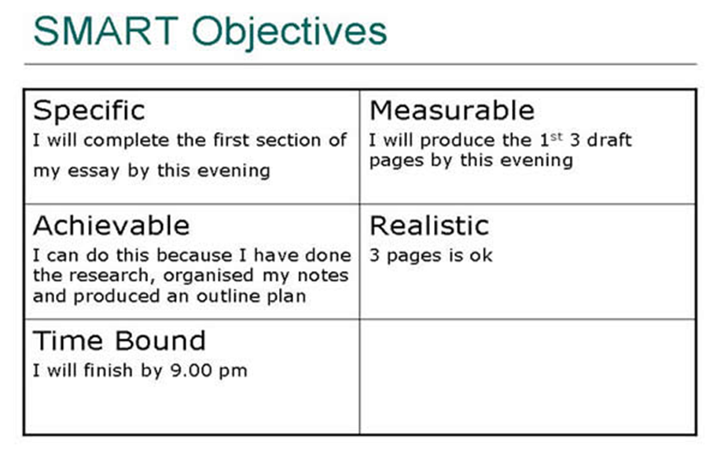
Notes:
SMART objectives
A vague goal might be, 'I'm going to write an essay'. A smart goal would be, 'I'll complete the first section of my essay by this evening'. That's very specific.
It's achievable, you can say to yourself, 'I think I can do this because I've done my research, made notes and produced an outline plan'. So you have checked whether it's achievable.
It's measurable because for instance you can set yourself to produce the first three drafts pages by this evening.
It's realistic because you've probably checked that 3 pages is ok, that's the number of pages I could write in one evening. It's got a timetable that 'I'll finish that by 9 o'clock this evening' so rather than a vague goal of 'I'm going to write my essay this evening' you can turn that into a smart goal.
The interesting thing about the difference between vague goals and smart goals is that vague goals allow you to let yourself down. For example, 'I'm going to be the best read student on my course'. It's a nice idea as it sets your aim high but it's something that you can't measure whether you have achieved or not. 'I'm going to read the ten most important articles about the subject I'm studying by Christmas' is specific, realistic, achievable and measurable within a time limit. That's something you can check whether or not you are achieving that goal, and how you are progressing to it; something that you can alter your view about. In other words, if you've only read two articles by November and you can see that you're not going to read the next eight by December you can therefore reschedule.
So smart goals are reschedulable - you can check your progress and therefore they empower you, they make you feel as though you're really working towards something.
When we talked about satisfaction about the use of time, how you set your targets will help you feel satisfied or can lead you to feeling dissatisfied with your use of time.
Short term goals/tasks
So we've talked about long term goals and how to make goals smarter, inevitably on a day to day basis you have a number of short term tasks that you have to do. Sometimes they are set by other people. It might be that you have to hand your essay in by Friday, or it might be that you have to do a presentation and your group has to meet and discuss it.
You not only have long term goals that you've made into short term tasks by breaking them down, but you add into that mixture all your other short term goals and tasks. It's often useful to pause and think about how those two things balance.
Just stop now and write down a list of all the things you can think of that you need to do over the next two weeks, things that you've got deadlines for.

Slide 19
Example
‘Get fit, eat healthily and lose some weight’
Specific objectives:
1) Perform research to discover what constitutes an optimal diet. Devise a shopping list, clear out all the old junk in the cupboards so that by December 1st, the new diet can start.

Slide 20
Example
‘Get fit, eat healthily and lose some weight’
Specific objectives:
2) join the ‘park run’ scheme by the end of the week. Read the ‘couch to 5K’ training schemes. Use Google calendar to schedule the training runs so that I will do my first 5K run in the 1st week of January.
Keep training to achieve a sub 30 min 5K by April next and sub 20 min within 12 months of starting.

Slide 21
Example
‘Get fit, eat healthily and lose some weight’
Specific objectives:
3) Weight is 100Kg now. Weigh at the end of every week. Keep a record in the form of am excel spreadsheet. Aim to get to 90Kg by June 1st next summer.
(perhaps produce a more detailed breakdown of your goals for a weekly/daily food plan to do this?)

Slide 22
What is Your Goal?
Just as balance in your life is motivating, understanding your long term goals is very motivating. If you know what it is that you really want to achieve in five years or ten years time or maybe in the course of your life, this will really help you to stick to some of the things that you have set yourself to do in the short-term, it gives you energy, it motivates you and you can carry them out whilst being satisfied with how you're using your time.
Most people don't like thinking about long term goals, but its good practice to look at your five year goal, and ask yourself what is at least one thing I want to have achieved in five years time.
So do that now - it doesn't matter if it's not the best thing that you could ever think of, just write something down that you think you would like to achieve within the next five years/

Slide 23
Short term goals/tasks
Think of the things you need and want to do this semester.
What are your deadlines?
Do your short term tasks align with or support your long term goals?
Do you need to prioritise?
Notes:
So we've talked about long term goals and how to make goals smarter, inevitably on a day to day basis you have a number of short term tasks that you have to do. Sometimes they are set by other people. It might be that you have to hand your essay in by Friday, or it might be that you have to do a presentation and your group has to meet and discuss it.
You not only have long term goals that you've made into short term tasks by breaking them down, but you add into that mixture all your other short term goals and tasks. It's often useful to pause and think about how those two things balance.
Just stop now and write down a list of all the things you can think of that you need to do over the next two weeks, things that you've got deadlines for.

Slide 24
Semester, week and daily planning
Use a Diary, Smartphone or Computer App to
Put your tasks and deadlines into a Calendar/diary or wall chart
Work back from deadlines
Identify Priority/pressure points (e.g. Family/Friends birthdays, Washing/Ironing, Shopping).
Write a list of tasks for each week
Weekly lists will need revisiting each week and prioritising
Keep a notebook/e-notebook to write ideas and plans in
Notes:
Term, weekly and daily plans
One of the crucial time management skills is to work backwards from deadlines, identify pressure points such as 'it's your friends birthday' or you 'have to go on a trip with the university', you're going to have to 'do all your washing because you've got nothing to wear to the party on Saturday night'.
Once you have got your sub-tasks, you can then organise them around the natural rhythm of your life and that's why it helps to break them down into small tasks. You could have say half an hour here and an hour there and you couldn't possibly have sat down to write your whole essay in that short piece of time. By knowing that you've got a small task like planning your essay you can do it in that half and hour and that will get you started.
It's important to be able to write down all the things that you are thinking about in terms of your tasks and managing your time, so even before you start thinking of using a diary or a planner having some paper around so that when you're on the bus travelling and thinking of things you must do you can write them down and even plan how you're going to do it and when you have a moment you can look in your diary to find the bits of time that you need for this.

Slide 25
Google Calendar
An app such as Google Calendar is a powerful and useful tool.
See the additional links on the Moodle page for examples on how to use it.

Slide 26
Biorhythms
When do you work best?
Match task to time
  Use prime time for difficult tasks
  Use non-prime time for more routine tasks
Take breaks and refresh yourself
Factor in Exercise
Eat regularly & healthily
Get optimum sleep
Notes:
Take a look now at a computer diary. It's a page of my diary and you'll see in it a variety of features. You'll see that it's marked where my time is committed; when I've got meetings and I can do nothing else other than attend that meeting. You'll see that I've used a different colour scheme to show where I've planned to do certain bits of activity. The usefulness of my computer diary is that I can clearly see how much time I've got and I can estimate how long tasks are going to take, and I try to schedule difficult and longer tasks into my prime time which happens to be in the morning, and I try to schedule things like telephone conversations, meetings and so on into afternoons because they use my non prime time more effectively.
So have a look at that diary page and see some of the features of it.

Slide 27
Prioritising
Each day look at your plans and prioritise
A - those jobs it is critical to do today
B - those jobs would be good to do today
C - those which will wait
At the end of the day review and reschedule those jobs you have not done
Remember to be flexible
Google ‘to do list’ and find a suitable template.
Notes:
When you're putting your tasks into your diary an important thing to do is also to prioritise. It's one thing to plan according to your biorhythms and your prime time, but it's also important to check that the plan you've got for the day ensures that you are going to do your top priority tasks by the end of the day. So it's useful to indicate which ones those are.
So go back and check against your task. What are the priority tasks for today and mark them A. Those things that would be good if they were done today could be marked as B, and those things that would just wait if necessary because things have taken longer could be marked as C.
The important thing then is to review and reschedule all the jobs you haven't done because inevitably that'll happen. We always underestimate the amount of time we need to put in and we don't have enough foresight as to the events that are going to happen during the day that are going to take us away form our plan. The point about planning is not that you have a fixed plan that you stick to, but that you have a flexible plan that you reschedule and are in control of so that you always end up doing the priority things. So remember to be flexible and use a flexible planning system, using a pencil so you can rub it out and put elsewhere is a good idea. I used to use little clear post it notes that I could rip out of my diary and stick into different positions and I find using a computer diary is brilliant because I can just drag and drop tasks into new times.

Slide 28
Planning and Reviewing Times
Be flexible: Review and reschedule every few days/day.
Even a spending a few seconds making a to do list every day will help.
Using an electronic ‘to do list’ on your smartphone or computer is often convenient
Notes:
Planning and reviewing times
Now I come to a really important bit which is that planning and reviewing are almost the most important part of sticking to your plans and no matter what else you get right or wrong if you don't review your plan I can probably guarantee you won't stick to it and it will have been a waste of time to do.
So when I've asked students who do this sort of thing they say, 'Well, we plan at the weekend for the next week and then we might review at the end of the week when we've done it', which is fantastic. But the idea is that you can plan each day and often will need to re-plan each day no matter how good your planning is and how long you've been doing it, and then reschedule. Therefore you need to review probably the night before so that you know what you've got to get up for and that might help you to get out of bed. You want to review first thing in the morning what it is that you've got to do and what bits you should get started on. You could review at lunchtime to see how you are sticking to your plan for the day and then here is a really big tip, review at least an hour before the end of your day which in my case of a working day I try to review at about an hour before the time I think I'm going to go home because no matter what I can usually get my top priority thing done in that last hour or make an important phone call and renegotiate the deadline into a live line.
If you leave that until you're going home and you suddenly realise you haven't done it then you've probably let somebody else down. So it's really good to review before the end of a day.
You can review again in the course of the evening to know what it is that you've got to do the next day and prepare for it making sure you've got what you need for your committed time. Have you got your things to read on the bus? Have you got printed off that draft essay that you are going to talk to your flatmate about so they can give you some hint as to whether you have been reasonably clear in your writing? If you haven't printed it off then you can't talk to them about it, so keeping an eye on what it is that you are going to do at each part of the day and making sure that you are scheduling yourself and getting the resources ready is really helpful.
Planning and reviewing are fundamental strategies for time management and making sure that you ask yourself frequently, 'Why am I doing what I am doing right now?, how is this contributing to what I want to achieve?'. That will help you develop your sense of satisfaction with time.

Slide 29
Procrastination
We all get stuck! Sometimes completely, sometimes just on one or two things
We all put things off (procrastinate)
We procrastinate because:
A task is unpleasant
You think you are not good at it
You don't know how to do it
It ‘seems’ too big
It has no clear deadline or the deadline is far off
You are too tired or you are panicking
Notes:
Procrastination
No matter how well you develop some of your time management strategies there is always one thing that you will still get caught out by and that is procrastination. We all procrastinate, we all get stuck, sometimes completely and sometimes on just one or two things. Procrastination is just putting things off, you know that you're procrastinating because something that has been on your to do list just keeps turning up on it for a week, two weeks, two months or six months and you still haven't done it. So another time management strategy is learning how to beat procrastination. We usually procrastinate because a task is particularly unpleasant or you think you're not good at it or you don't know how to do it, you think it's too big and there's no clear deadline or the deadline is very far off, that's a killer. Or maybe you're too tired or panicky.
So if you know why you're procrastinating, it might be possible for you to think of the right strategy to beat that particular reason for procrastinating.

Slide 30
Tips
Don't spend time in regret - look forward and get motivated
Finish things - get jobs off your lists
When panicking, prioritise and do one job at a time
Ask yourself frequently 'Is this the best use of my time now?’
Make decisions and try to stick to them.
Apply psychological manipulation on yourself!
Reward yourself for each little achievement.
Treat Yourself for doing Well.
If overwhelmed or in need, Ask for help –Student services are there for you
Notes:
There are a few other hints and tips that are worth mentioning on time management. Don't spend time spending time in regret. Things that haven't been done just haven't been done. Look forward and try to motivate yourself for the things that are still possible.
If you are overwhelmed and it's to do with your study, it's really important that you speak to your tutor to see what can be rescheduled or what can be managed or what can be got round.
Another strategy is to double up on committed time. If you do a lot of travelling it's possible that you'll be able to listen to some Skills Centre pod casts on the way and be able to think about different strategies for writing, reading and brushing up on a whole range of strategies to help you study better. But you can also revise whilst you are on the train, you can re-read a draft or make corrections, a whole range of things that we can now do because of the technology that's available to us in our committed time.
Another thing is not to waste time. We can get quite trapped into wasting our time by, for instance, searching for something that's not going to be found. A good strategy is to say to yourself, 'I'm going to give myself 15 minutes to find it, if I can't find that file or that object I'll think of a way of getting round without it or getting another one.'
A really important strategy to remember is the question, 'Is the best use of my time right now?'. Ask yourself that frequently, just stop and think and be mindful of how you are using your time. Small adjustments can make a big difference to how the day finishes overall.
One area which students often ask me about is, 'how do we cope with interruptions such as my friends going to the pub and I want to go with them?'. And what I tell them is to try and turn your interruptions into rewards wherever you can, I'll be with you in another hour and a half when I've just finished page 3 of the first draft of my essay. That way you get the best of both worlds.
One last thought, when you're seriously overwhelmed it's often a good idea to take decisions about things that have been hanging on in your mind. 'I don't know if I'm going to do the project on that issue or whether I should write that essay or that other one that seems to be a bit easier.' What's really important is to just to take the decision and go for it, because that way you can reduce your stress levels, stop your procrastinating and help you to achieve what you want to in the time that you've got available.

Slide 31
Principles
There are some basic time management principles you can use to assist you:
Identify "Best Time" for Studying
Study Difficult Subjects First
Make Sure the Surroundings are Conducive to Studying
Take breaks for Entertainment and Relaxation
Make Sure you make Time to Sleep and Eat Properly
Always define your objectives as clearly as possible
Reflect and improve your use of time
Plan/Manage your time
Balance: Be Positive /Pro-Active but also learn to go with the Flow.

