Slide 1
Effective teamwork & communication
Elisha Ross 1808862, Mohammad Ali Hassan 1808236, Syeda Hashmi 1809061, Shakita Williams 1715920

Slide 2
Introduction
We are Right Way and our company offers consultation services to GP surgeries wishing to incorporate team working into their workplace. We are here today to take you through the stages of effective teamwork and explain to you how your organisation can benefit through putting this in to practice.

Slide 3
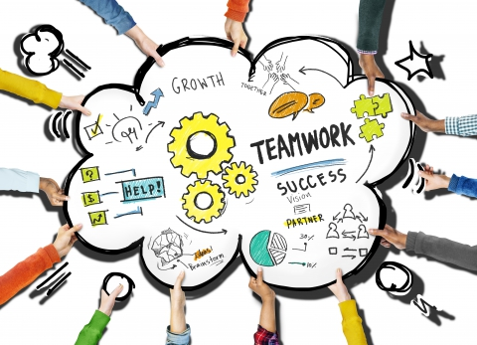
Benefits of team working
Below are the key benefits of team working:
Boosts productivity
Creates better network support
Inspires innovation
Improves morale
Helps to establish strong relationships

Slide 4
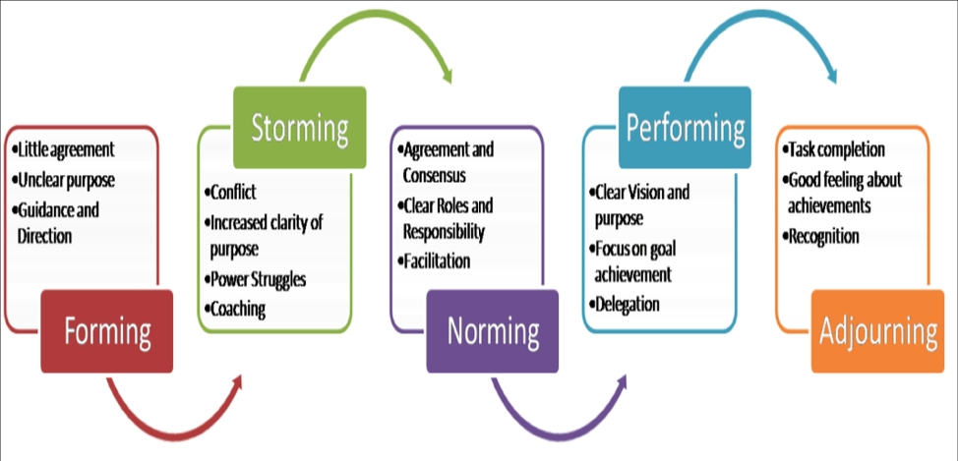
Stages of team development
In 1965 Tuckman identified a 5 stage process which describes the formation of groups. These 5 stages are:
Forming
Storming
Norming
Performing
Adjourning
Tuckman, B. W., & Jensen, M. A. C. (1977). Stages of small-group development revisited. Group & Organization Studies, 2(4), 419-427.

Slide 5

Managing conflict
All workplace’s will encounter conflict at some point but here are our 10 steps to best managing conflict:
Be aware that conflict occurs
Set the ground rules
Learn about destructive conflicts
Stop conflict when it happens
Get the whole story
Meet for resolutions
Discuss both sides of a perspective
Make compromise
Avoid falling into groupthink
Don’t try to change a team member

Slide 6
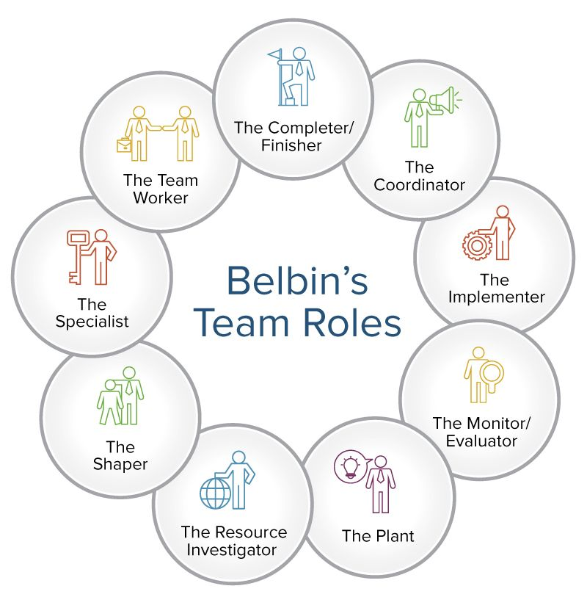
Team roles
Team roles is all about having a team of individuals with different roles. Every team needs a team leader who provides guidance, instruction, direction and leadership to a group of individuals. Then there are the other team players, each team member takes part to equally support the group, each team member has their individual responsibilities. The benefits of team roles are:
Each individual will discover their strengths
Less stress than working on your own
Helps to improve communication skills
Greater sense of achievement
The support is given
It is vital to success
Belbin, R. M. (2012). Team roles at work. Routledge

Slide 7
Conclusion
To conclude we would say that effective teamwork plays a major part in all workforces and incorporating this in to your practice can make a big difference. We hope you enjoyed our presentation today and below are our contact details:
Right Way Consultation Services
163 Brownmere Industrial Estate
Birmingham
B6 7HR
01212435576
rightway.consultation@gmail.com

Slide 8
Any questions?

