Slide 1
Logan Evans
268764
Role:
Testing
Notes:
Hello, as part of my role, I will be discussing the testing of the application, as well as discussing the system and user requirements as part of helping to evaluating the overall application’s successes and failures based off the testing results.​

Slide 2
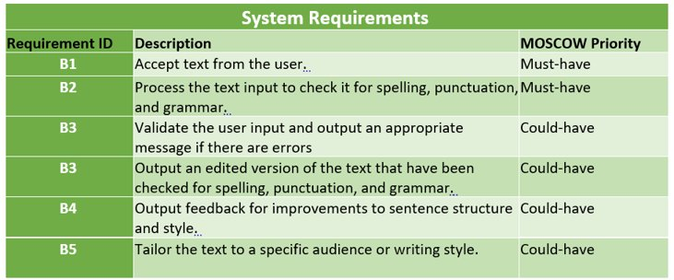
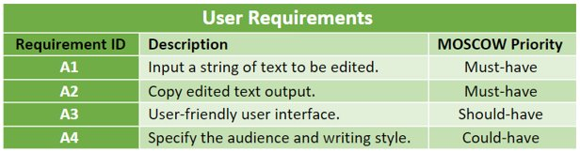
User and system requirements
Notes:
The user and system requirements were set after everyone in the group had discussed what we needed to complete to achieve the goal of developing a text parsing tool with Ai, which was mainly led by the Project manager for determining what was required. Of these requirements, the must-have requirements will be the focus here, as these are the parts which concern the testing.
The user requirements of inputting a string of text had been achieved, however there was no way for the system to be used for copying the edited text other than copying it through the terminal manually, as the functionality had not been implemented as we had run into difficulty with the development of the system requirements.
The system requirements were close to being met, with the system being able to accept user text, however while the system could attempt to check the spelling, punctuation and grammar, I will now demonstrate how this resulted

Slide 3
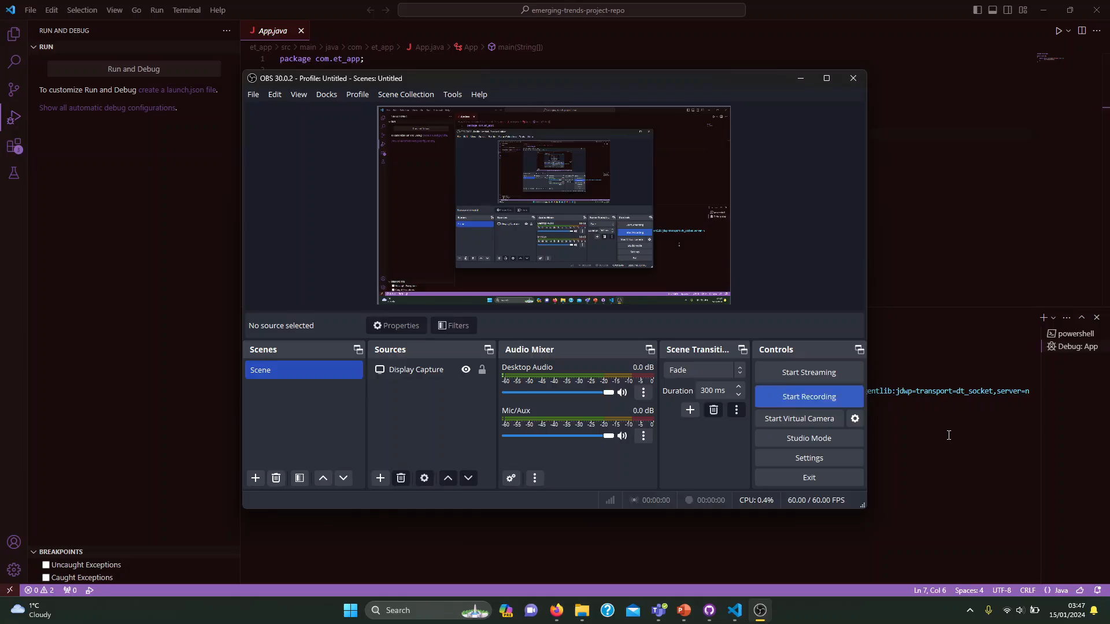
A demonstration of the final tool
Notes:
This demonstration had some fairly simple text, using the phrase "This is only slightly wrong, so it should corect the sentence corectly." only having two words entered incorrectly, which were “correct” and “correctly”​
​
the tool had fixed the first correct, but it had managed to merge the final 2 words, and added and additional Y to the end of correctly where it only needed to add an R. This helps conclude that what we had produced was a failure, and we did not manage to develop what we had set out to do. ​
the reason we had started using language tool was that we had run into a roadblock with OpenNLP regarding the fact that it did not meet the requirements of what we needed upon testing the capabilities that OpenNLP had provided, notably that the OpenNLP was unable to provide the functionality that we required of it on its own, due to the lack of ability to modify the text in the way we required.(1) This had been caused due to being provided a false sense of security regarding the fact that we had found a tutorial utilising open NLP, which we had not realised at the time would not provide us with the main functionality we required of it, which was to edit the text. ​
As a result, the option to use an additional library known as language tool for out final development. (2)​
there were a large range of problems with the tool, as it simply didn’t work properly, with the most egregious result being the example shown in the demonstration. ​
(1)Baeldung, “Intro to OpenNLP”, 8th January 2024 (accessed 17/01/2024) available at: https://www.baeldung.com/apache-open-nlp ​
(2) languagetool, “Write. Correct. Paraphrase.” (accessed 17/01/2024) available at: https://languagetool.org/

Slide 4
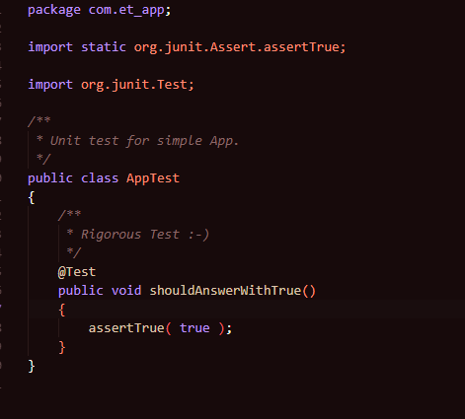

Unit testing-Junit
Potential ways unit testing could have been implemented on a more completed development:
Providing the ability to check for null, to make sure that text is entered into the application
Checking for symbols that language tool is unable to identify and change, to stop errors from occurring.
⁽⁴⁾
Notes:
The first method of testing that will be discussed is a form of automated unit testing. Junit is a framework which is utilised for performing unit tests⁽³⁾ and within maven, there is a Junit test sample in the default code, which provides a demonstration of asserting true, which is an assertion that makes sure that the output or parts of the code meets a certain condition when running.
Using this alone, Junit could have been utilised if the development had been in a more functional state would have been ensuring that the text that is entered was not blank and had not contained any invalid symbols that would not be able to be checked by the system, as they fall outside of the range for the language tool’s understanding.
The final product had contained a sentence detector, which did not require any automated testing due to it simply splitting each of the sentences to see where the sentences start and end, and the language tool was inconsistent to a point where the use of automated testing
didn’t have enough code within it to justify the utilisation of Junit. (5)
However, if the development had reached a stage of being nearer to completion, it is likely that Junit would have been applied to add some parameters which would have been discussed with the project manager to determine what tests would be required to ensure the software is able to meet the requirements.
(3) California State University, “unit testing with Junit” (accessed 17/01/2024) available at: https://home.csulb.edu/~pnguyen/cecs277/lecnotes/Unit%20Testing%20with%20JUnit.
available at: https://home.csulb.edu/~pnguyen/cecs277/lecnotes/Unit%20Testing%20with%20JUnit.pdf
(4) Junit, “Junit” (accessed 17/01/2024) available at:https://junit.org/junit4/
(5) Junit, “Junit 5 User Guide” (accessed 17/01/2024) available at: https://junit.org/junit5/docs/current/user-guide/#overview

Slide 5
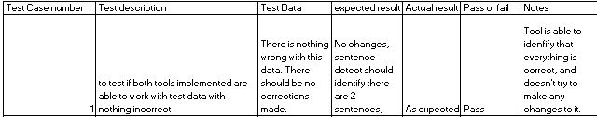
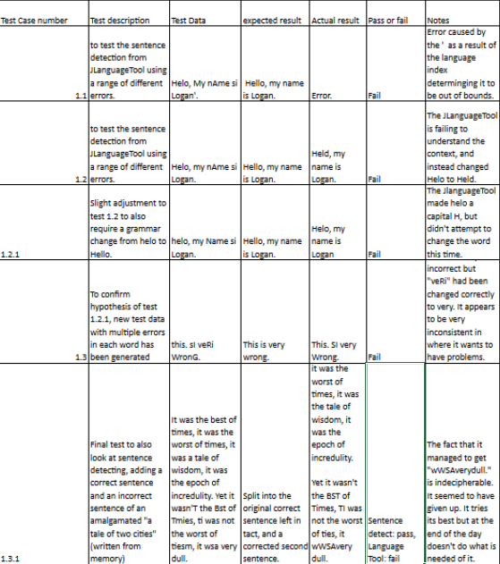
Acceptance testing- Evaluating the test results
Notes:
The main form of testing that had been utilised for the final product is acceptance testing, where the application is tested through identifying whether the final product is suitable for use by the users. This will focus on the system requirement to check the spelling, punctuation and grammar.
The final tool does not work well for the original use case that had been set out of using it to edit and improve text that is presented to it as shown in the demonstration. A range of different manual tests were conducted to identify how effective the tool was, and not only were there errors occurring from symbols determined to be out of bounds by the language tool, but there was not one case of the language tool successfully editing the text in a way that makes sense grammatically, with it focusing on attempting to change non-words to valid words from any language.
Of all the different things that had been reviewed, at it would be best if the tool was used for learning and had instead been implemented as a tool that can help improve the learner's understanding of how a sentence is structured by breaking down sentences into digestible sections.
This is something that had been concluded as a potential use of Core NLP⁽⁶⁾ during the development stage, where a major part of it was that there was a demo available to show how it was used, where it neatly showed each part of the text and how it was constructed
Another potential option would have been to attempting to conduct further research into potential libraries, as there are a wide range of libraries and APIs available that could have been implemented such as TextBlob⁽⁷⁾ and WebSpellChecker ⁽⁸⁾ to name some examples, as languagetool failed.
(6) StanfordNLP, “Core NLP” (accessed 17/04/2024) available at: https://stanfordnlp.github.io/CoreNLP/
(7) Loria S, “TextBlob” (accessed 17/01/2024) available at:https://textblob.readthedocs.io/en/dev/
(8)WebSpellChecker, “WebSpellChecker” (accessed 17/01/2024) available at:https://github.com/WebSpellChecker

Slide 6
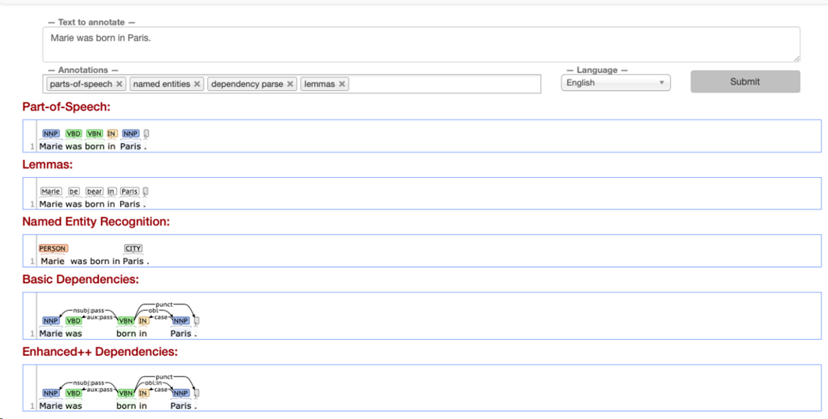
Core NLP demo
(9)
Notes:
This demo presents what we should have aimed for with our tool, which breaks down a simple sentence into different forms to help the user understand the text more, providing explanations to each of the different connections that are present within the short sentence in great detail.⁽⁹⁾
(9) StanfordNLP, “Demo” (accessed 16/01/2024) available at: https://stanfordnlp.github.io/CoreNLP/demo.html

Slide 7
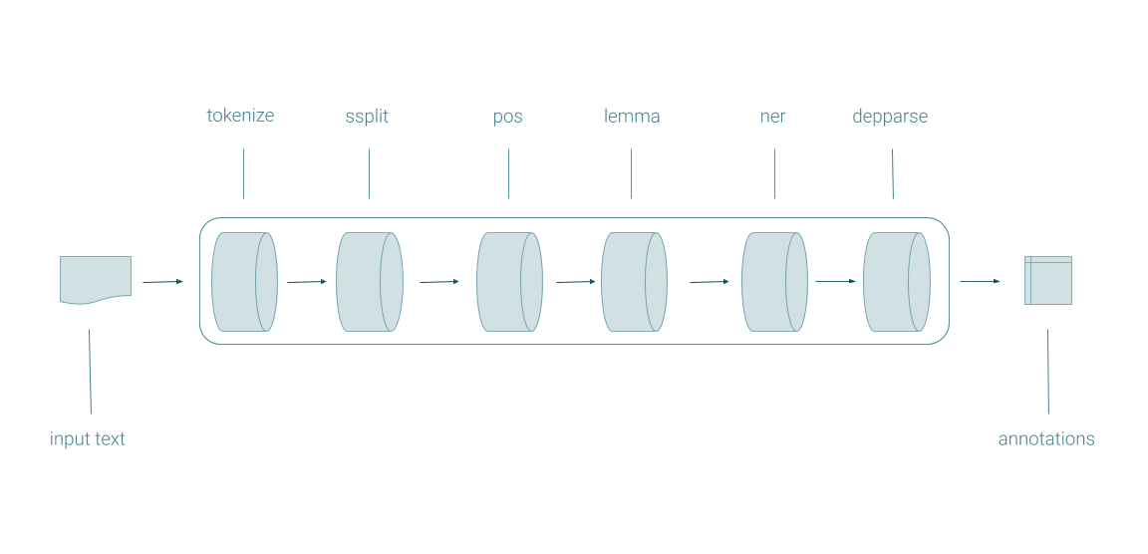
Evaluation of testing- How we could have avoided failure
The main problem we had faced was that we had aimed to develop a tool that is able to edit and manipulate text.
However, this is not what a NLP is typically meant for, as the NLP investigated, (open NLP and core NLP) as they do not natively have this functionality.
NLP Pipeline (Core NLP)⁽⁶⁾
Notes:
The main issue with what we had set out to do was that we did not fully understand the capabilities of the NLP libraries that we had investigated.
A great example of this is looking into the pipeline from Core NLP. The pipeline presents what the tool is capable of, and notably is only able to break down the text into different chunks to provide context for the sentences provided. Notably, it does not contain any text editing functionality on its own, which may have led us astray regarding our overall goal. By attempting to build a tool which can take text and having the tool edit the text instead of purely parsing the text, we started to stray from the path that would lead to a completed NLP tool and instead ended up with a tool far from what we had aimed to generate.
(6) StanfordNLP, “Core NLP” (accessed 17/04/2024) available at: https://stanfordnlp.github.io/CoreNLP/
(10)Manning C, Surdeanu M, Bauer J, Finkel J, Bethard S and McClosky D, “The Stanford CoreNLP Natural Language Processing Toolkit” (accessed 17/01/2024) available at: https://nlp.stanford.edu/pubs/StanfordCoreNlp2014.pdf

Slide 8

Conclusion of testing the application
Notes:
Overall, the main aim of this project was to identify how difficult the use of a NLP library for the task was,
and the answer which had been concluded through the testing was that if certain libraries are used, the task we had set ourselves had very difficult to complete and required external tools. However, if we focused on what the NLPs were capable of over attempting to make it do something it could not, which provided us with the realisation that without a complete understanding of a tool’s capabilities, it may have been easier to develop the ai text parsing tool.

Slide 9
Bibliography
(1)Baeldung, “Intro to OpenNLP”, 8th January 2024 (accessed 17/01/2024) available at:https://www.baeldung.com/apache-open-nlp
(2) languagetool, “Write. Correct. Paraphrase.” (accessed 17/01/2024) available at: https://languagetool.org/
(3) California State University, “unit testing with Junit” (accessed 17/01/2024) available at: https://home.csulb.edu/~pnguyen/cecs277/lecnotes/Unit%20Testing%20with%20JUnit.
(4) Junit, “Junit” (accessed 17/01/2024) available at: https://junit.org/junit4/
(5) Junit, “Junit 5 User Guide” (accessed 17/01/2024) available at: https://junit.org/junit5/docs/current/user-guide/#overview
(6) StanfordNLP, “Core NLP” (accessed 17/04/2024) available at: https://stanfordnlp.github.io/CoreNLP/
(7) Loria S, “TextBlob” (accessed 17/01/2024) available at:https://textblob.readthedocs.io/en/dev/
(8)WebSpellChecker, “WebSpellChecker” (accessed 17/01/2024) available at:https://github.com/WebSpellChecker
(9) StanfordNLP, “Demo” (accessed 16/01/2024) available at: https://stanfordnlp.github.io/CoreNLP/demo.html
(10)Manning C, Surdeanu M, Bauer J, Finkel J, Bethard S and McClosky D, “The Stanford CoreNLP Natural Language Processing Toolkit” (accessed 17/01/2024) available at: https://nlp.stanford.edu/pubs/StanfordCoreNlp2014.pdf

