Slide 1
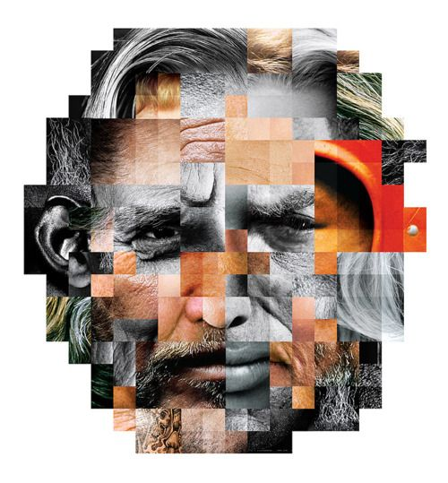
A different kind of ethnography. For art and design practice.
Kylie Boon

Slide 2
What is ethnography?

Slide 3

Ethnography is a type of qualitative research that involves immersing yourself in a particular community or organisation to observe their behaviors and interactions up close.
The word ‘ethnography’ also refers to the written report of the research that the ethnographer produces afterwards.
Ethnography is a flexible research method that allows you to gain a deep understanding of a group’s shared culture, conventions, and social dynamics.
The study of people in a real environment.

Slide 4

It is a useful approach for learning first-hand about the behavior and interactions of people within a particular context.
By becoming immersed in a social environment, you may have access to more authentic information and spontaneously observe dynamics that you could not have found out about simply by asking.

Slide 5
Quotes from: Research-Through-Design: Exploring a design-based research
paradigm through its ontology, epistemology, and methodology
C. Grey Isley
“resulted in researchers adopting methodologies from established research paradigms as a means to validate their diverse research. These methods can often be inadequate for the design fields and as such demonstrate the necessity for the establishment of specific methodologies that contribute directly to design research. (Clemente et al., 2017)”
“This current state within design research demonstrates Kuhn’s(1996) discussion with regards to
emerging paradigms. (Gaver, 2012; Kjørup, 2012) Until a research community has widespread
adoption of an agreed upon paradigm, practitioners will draw upon different philosophical
foundations that are oriented towards the field in varying ways. This borrowing of philosophy
requires researchers to establish the rationale behind their approach every time they seek to make a
contribution. This need to continuously justify methods would be greatly reduced with the
establishment of a paradigm. Currently within design research, there are concerns that design does
not have a theoretical tradition and that design research pertaining to the process and creation of
objects currently does not have a shared paradigm. (Gaver, 2012; Koskinen, Zimmerman, Binder,
Redstrom, & Wensveen, 2011)
This document is on Teams

Slide 6
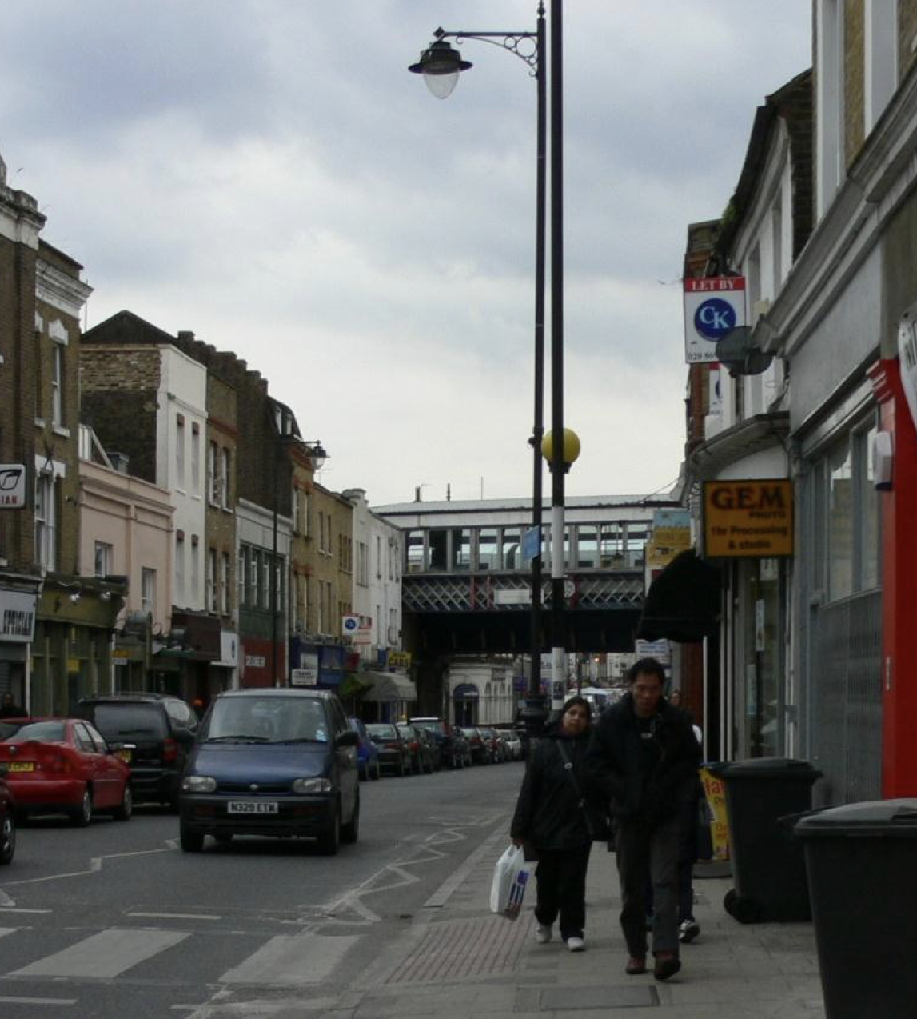
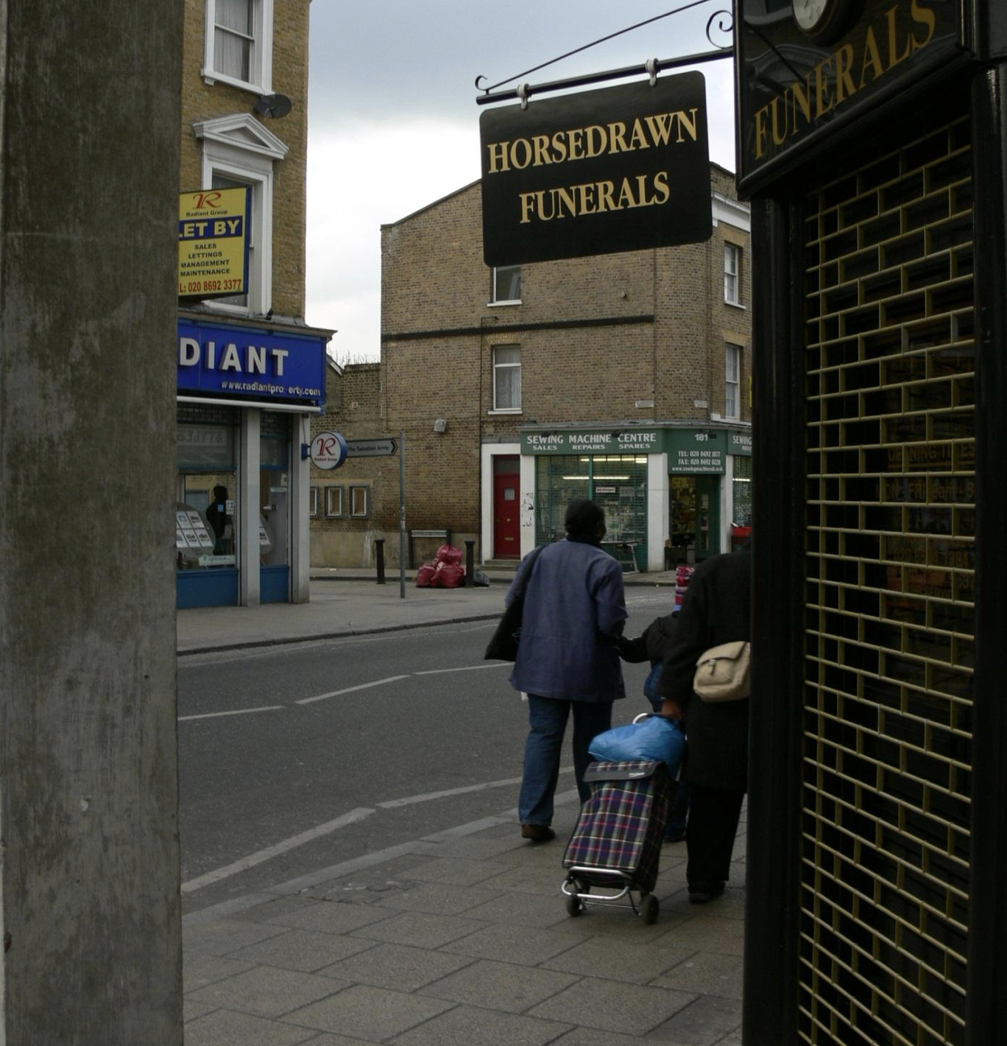
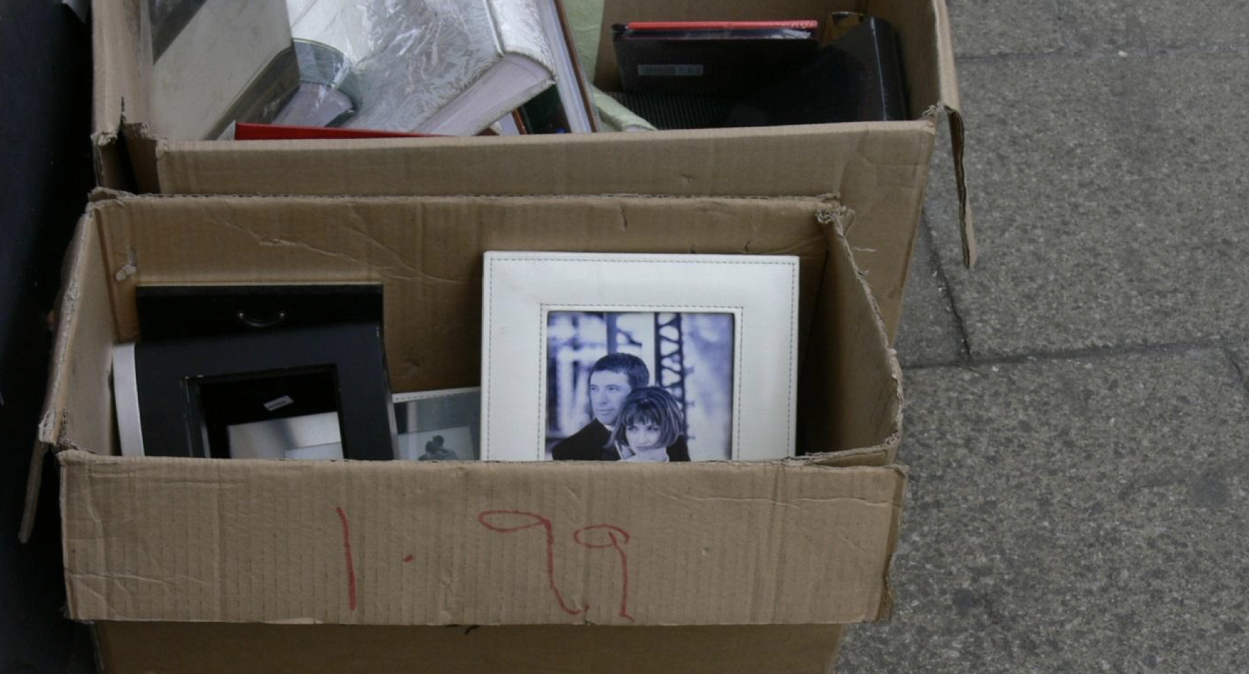
Visual Ethnography
Visual ethnography, is ethnographic research incorporating photography, and video.
https://orca.cardiff.ac.uk/id/eprint/52491/1/Experiment%20in%20Visual%20Ethnography.pdf

Slide 7

https://youtu.be/hY26uST84iE

Slide 8
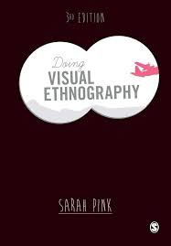
Doing visual ethnography images, media and representation in research
Sarah Pink.

Slide 9
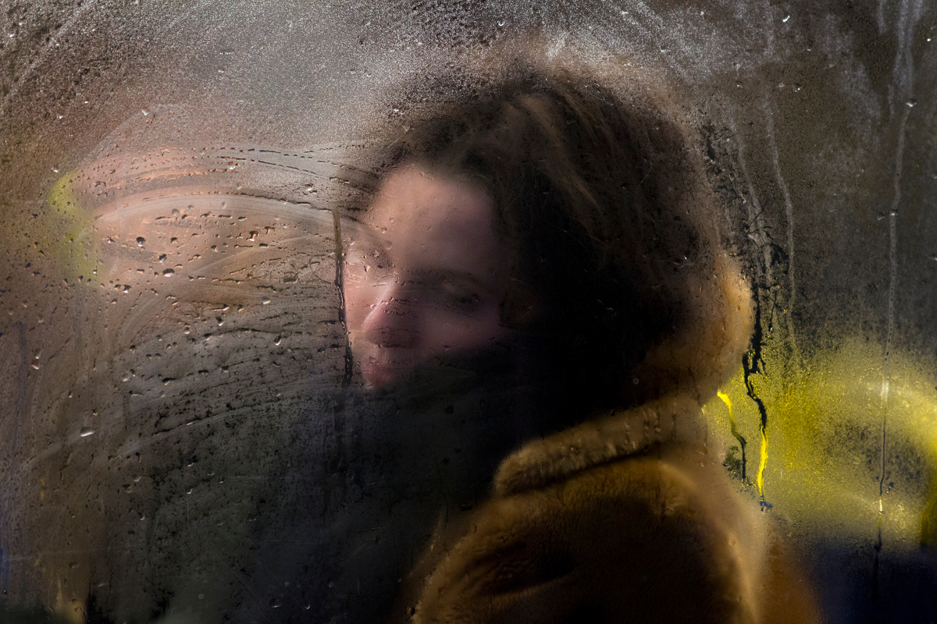
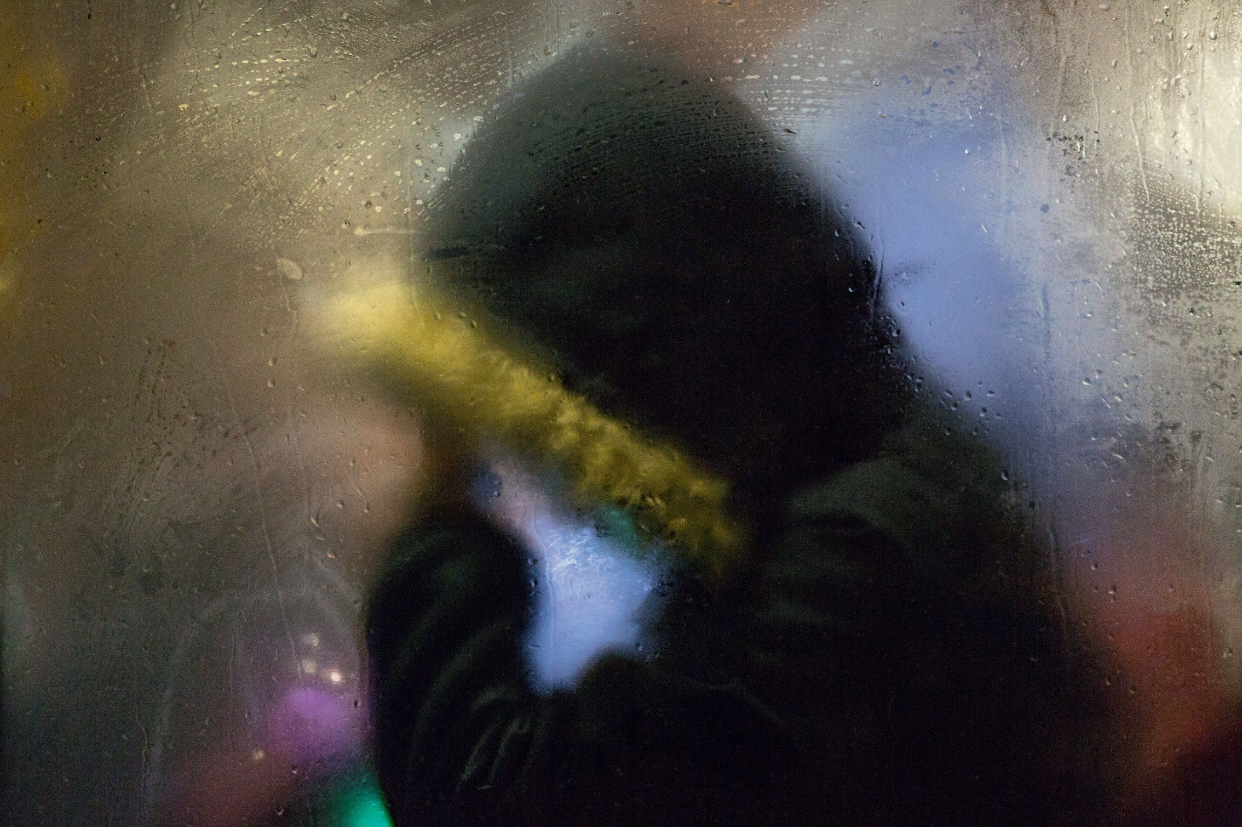
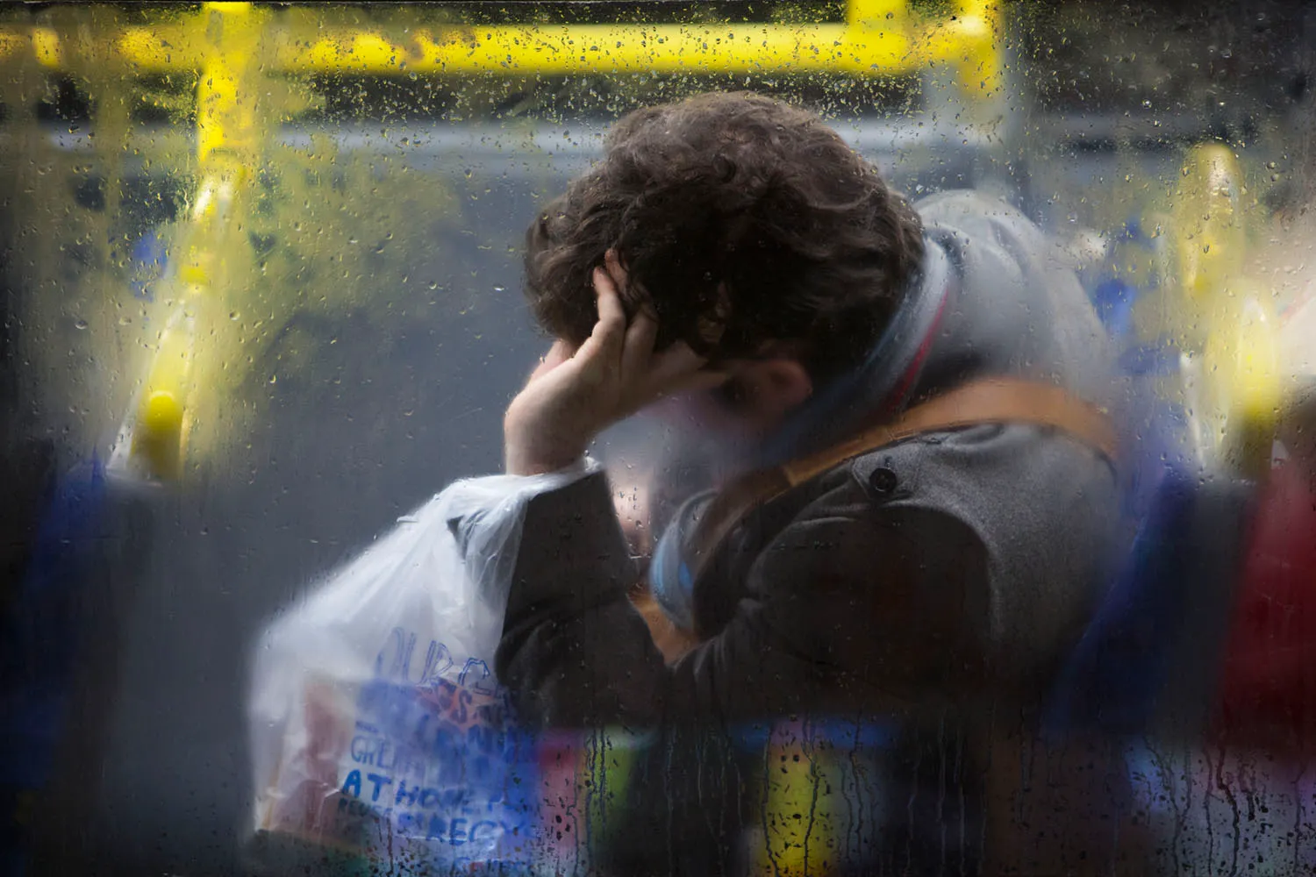
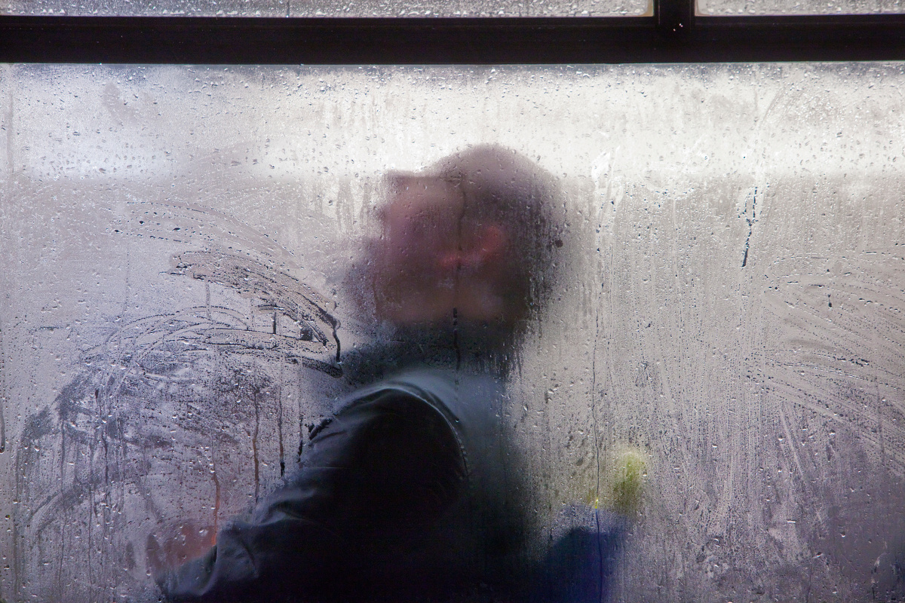
Is this street photography visual ethnography?
"It was a cold, wet night and I quickly noticed how beautiful this observed mundane scene was through the window of the café.
Every time a bus pulled in, it was like a survey or study of the types of people who commute every evening on London’s buses. On just one bus, you’d see all ages and classes sitting together, ranging from businessmen and students to the elderly. It was extraordinary to me and I knew there had to be a device or project here that could form a series of portraits of Londoners.”
https://amateurphotographer.com/technique/interviews/the-street-photography-of-nick-turpin/

Slide 10
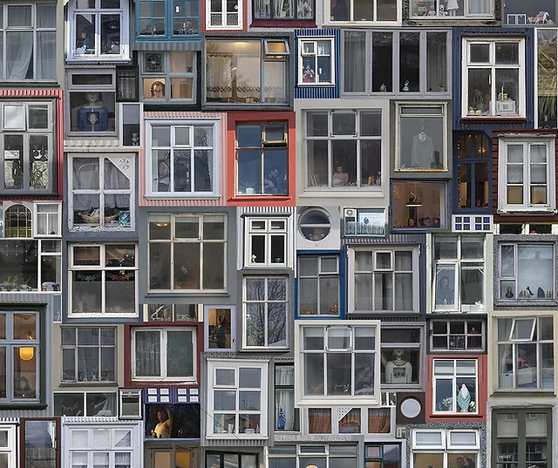
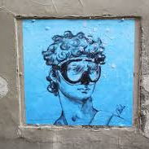
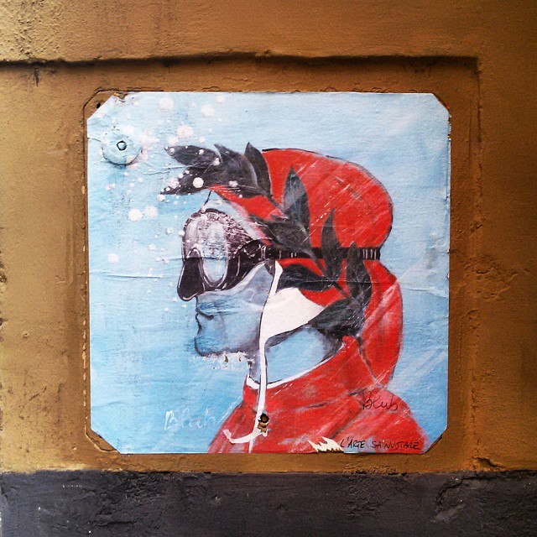
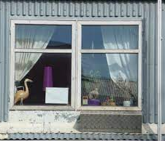
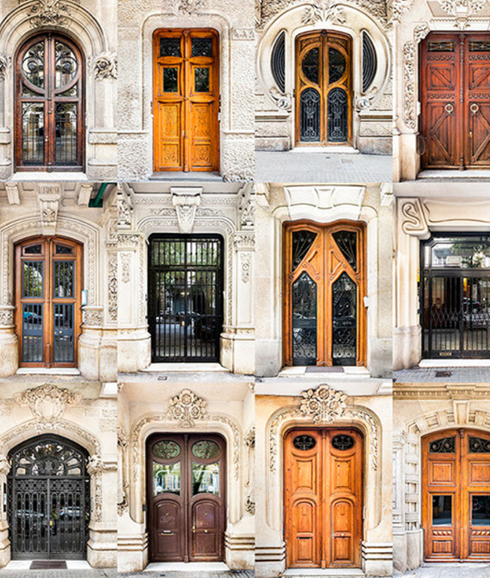
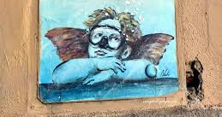
Documenting the unseen

Slide 11
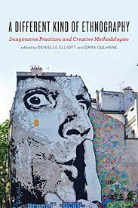
A Different Kind of Ethnography
https://www.google.co.uk/books/edition/A_Different_Kind_of_Ethnography/rpGGDQAAQBAJ?hl=en&gbpv=1&dq=GOOGLE+BOOKS+A+DIFFERENT+KIND+OF+ETHNOGRAPHY&printsec=frontcover

Slide 12
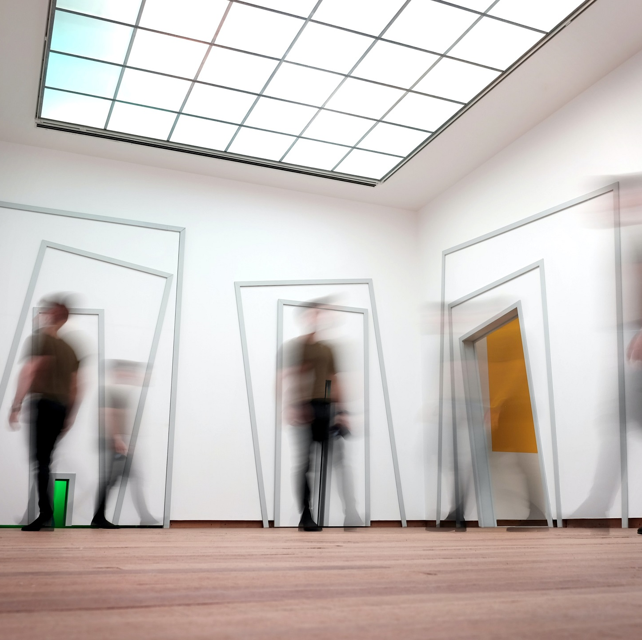
Innovating Methodologies
What creative options are there?
Experimental ethnographic writing
Sensory ethnography study
Visual ethnography
Sound study ethnography

Slide 13
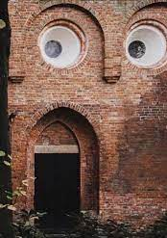
Experimental ethnographic writing
Experimental ethnographic writing is a creative and unconventional approach to ethnography that challenges traditional academic writing styles. It blurs the boundaries between art, literature, and social science to explore how lived experiences, cultures, and identities can be represented in more immersive, reflexive, and innovative ways.
Experiment with structure and style – while remaining committed to ethnographic narrative.
Ethnographic poetry, creative nonfiction, fictional ethnography and memoirs.

Slide 14
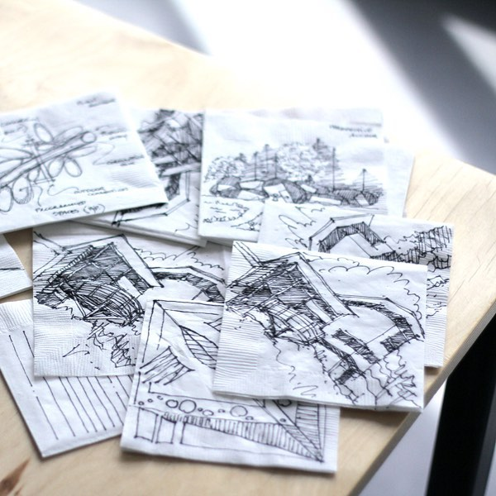
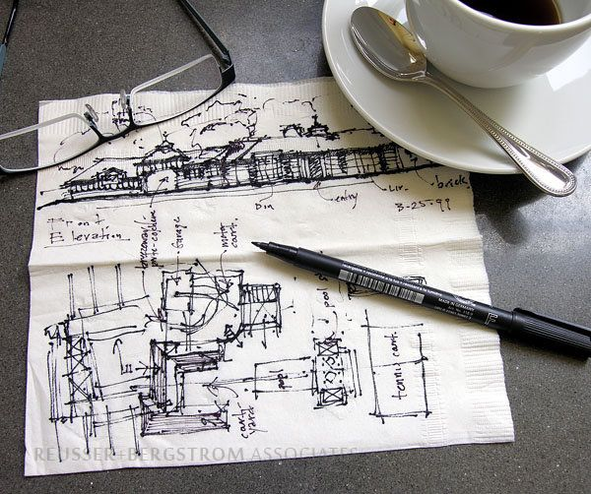
Visual ethnography
Drawing what we see and experience during field work and research requires a different sort of attention to the world.(take notice of subtle and not-so-subtle everyday life).
Collect observational sketches of the environment, behaviors and interactions.

Slide 15
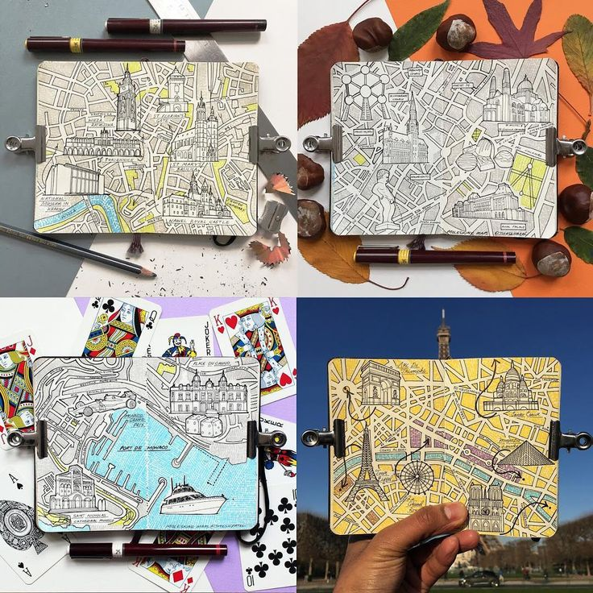
Mapping spaces
This could be…
A map of your emotional responses.
An energy map.
An observational map.

Slide 16
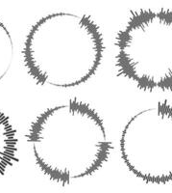

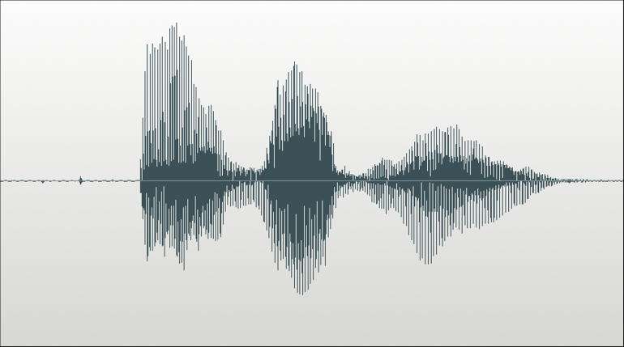
Sound study ethnography
Documenting the non visible.
Collect audio recording, of environments.
This could result in visual data, in the form of soundwaves.
Or soundscape practice.

Slide 17
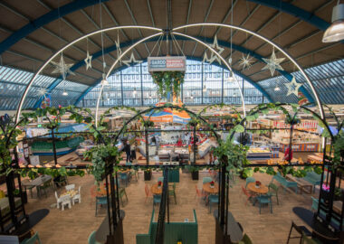
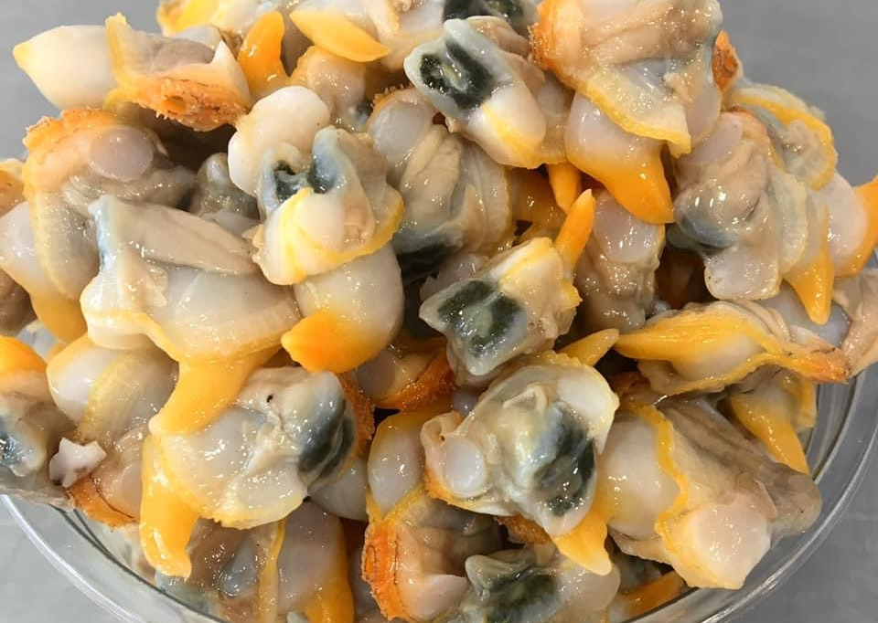
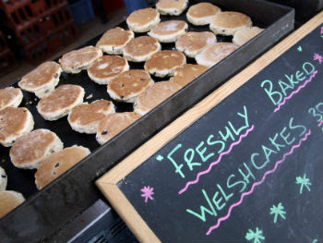
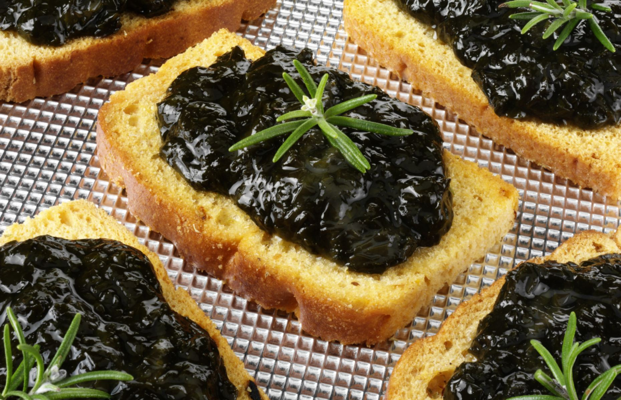
Sensory ethnography study
Collecting experiences.
Written field notes, images, audio recordings.
For example, a collection of experiencing focusing on local cuisine.
write down what you are…
Seeing
Hearing
Smelling
Tasting
touching

Slide 18

Can you think of any other creative ways to gather data?

Slide 19
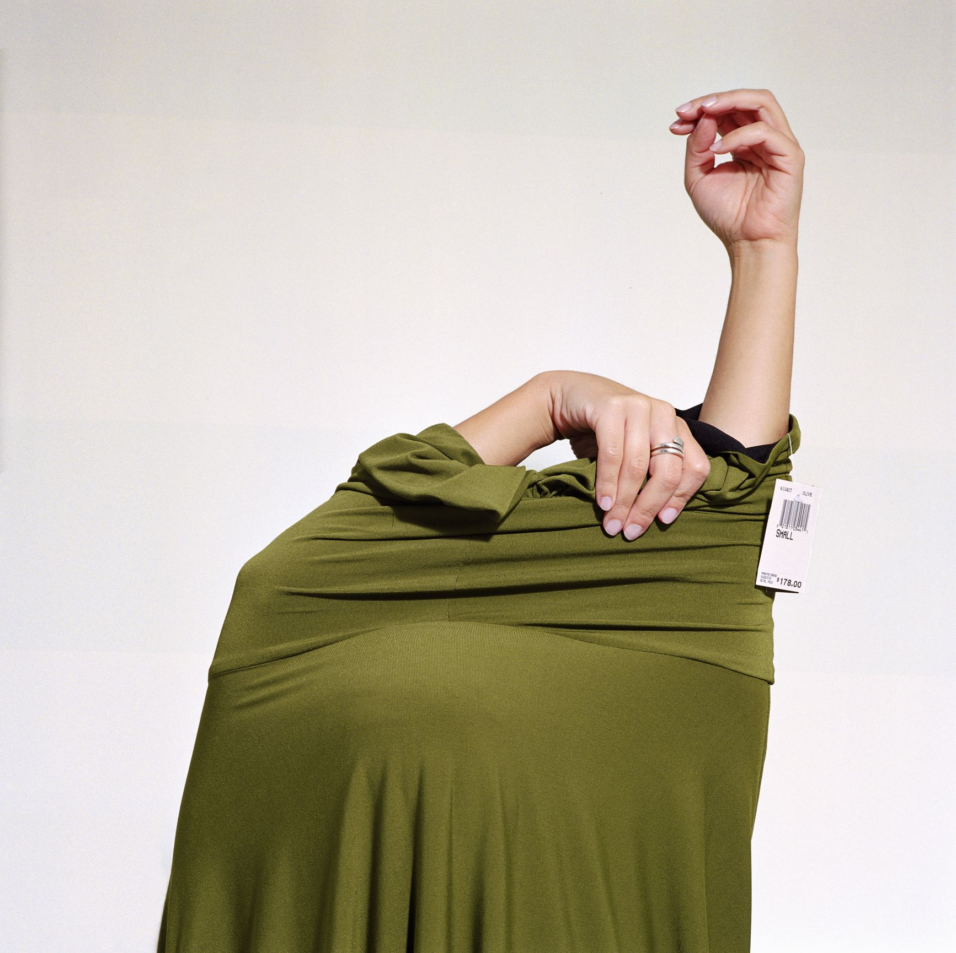
How could you apply ethnography, or a ‘different kind of ethnography such as visual ethnography
to your own research area?

Slide 20

Application Task
Practicing a ‘different kind’ of ethnography.

Slide 21
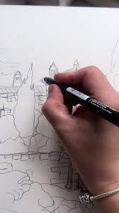
Task
On Campus Fieldwork
You will spend 45 minutes conducting ethnographic fieldwork inside and around the building. You are not expected to produce polished artwork. Your drawings and maps are fieldnotes, not illustrations.
Notes:
1887

Slide 22
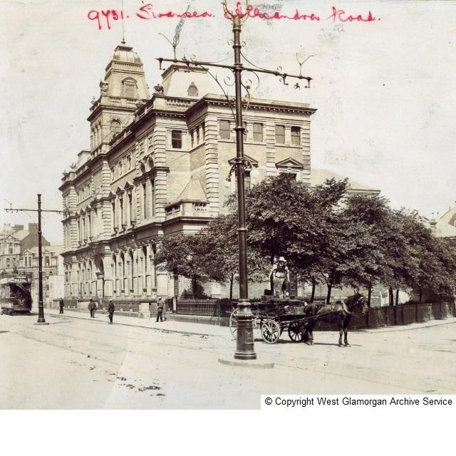
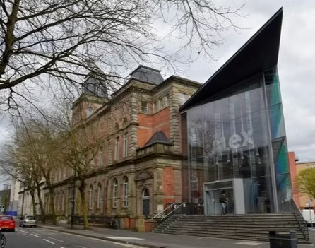
Your Research Focus Today
Your fieldwork will be guided by the following research question:
How is this building experienced, felt, and inhabited in everyday life, and what traces of its past remain present today?
You are encouraged to think about memory, atmosphere, and what might linger in the space.
You may also keep the following prompts in mind:
What emotions seem to gather in particular spaces?
How do people move through the building? Where do they pause, linger, or rush?
What feels lively, tense, calm, empty, or unsettling?
Are there moments or spaces that feel out of time, forgotten, or strangely charged?

Slide 23
You Will Produce Observational Sketches
Your drawings are analytic, not artistic.
Create a series of quick sketches that capture what you notice during your fieldwork. These may include:
Physical environments (rooms, corridors, entrances, corners)
Human behaviours and interactions
Movement, stillness, crowding, or absence
Your own bodily or emotional responses to the space
You may annotate your sketches with words, arrows, brief notes, or questions.
Focus on attention rather than accuracy.

Slide 24
Tips:
slow down looking
force selective attention (what matters?)
reveal the drawer’s perspective
sketching moments, not “pretty scenes”
drawing movement, not just objects
annotating drawings with words, arrows, or questions

Slide 25
You Will Produce Data Maps
Create at least one drawn map of the building or part of it. Your map does not need to be to scale.
Your map should represent interpretive information, not just physical layout. You may choose one or more of the following approaches:
Emotional Map
Showing where different emotions seem to cluster (e.g. calm, stress, boredom, comfort, unease).
Energy Map
Indicating levels of noise, movement, intensity, or stillness.
Observational Map
Tracing routes, pauses, interactions, bottlenecks, or avoidance.
You are encouraged to be experimental. Use symbols, shading, words, colour, or lines to communicate meaning.

Slide 26
Tips:
Ideas on what to capture in your drawings:
Emotional maps
Where do people seem tense, calm, bored, rushed?
Where do you feel watched, relaxed, unsettled?
Energy maps
Loud/quiet, fast/slow, crowded/empty, flowing/stuck
Observational maps
Routes, pauses, bottlenecks, places of interaction or avoidance
Temporal maps (how a space changes over 10–20 minutes)
Invisible maps (rules, power, surveillance, exclusions)

Slide 27
These drawings and maps are your fieldnotes
(your data)

Slide 28
Ethical Considerations
Do not draw identifiable facial features or names
Avoid intrusive observation
Focus on spaces, interactions, and atmospheres rather than individuals

Slide 29
Ethnography is not defined by methods alone (fieldnotes, etc.), but by:
sustained attention to everyday life
situated observations
reflexivity (awareness of the observer or you the researcher)
interpretation of meaning in context

