Slide 1
LCHS4001
Academic and Employability Skills
Reflection

Slide 2
Discussion
Discuss and answer these questions with a partner.
What does 'reflection' mean to you?
Have you ever kept a diary or a journal before? If so, what kind of things did you write in it? How old were you? Do you still keep one now? Why or why not?
Have you ever reflected on something before? If so, what was it? What did you learn?

Slide 3
What is reflection?
Reflection or Critical reflection is defined as:
Reflecting means thinking carefully about past experiences, thoughts, and actions. The aim is to learn from them, understand them better, and use that insight to guide what we do now and in the future. It can help us question our usual ways of thinking and doing things, and may shape our choices, beliefs, and understanding of ourselves (University of Edinburgh, 2024)

Slide 4
What is reflective thinking?
In an academic context, reflective thinking usually involves:
Looking back at something (often an event/idea, something that happened).
Analysing the event or idea (thinking in depth and from different perspectives, and trying to explain, often with reference to a model or theory from your subject).
Thinking carefully about what the event or idea means for you and your ongoing progress as a learner and/or practising professional.

Slide 5
Why Reflect?
Why do you think reflection can be important in personal, academic, and professional life?
People often reflect when experiences are negative – do you think reflecting on positive experiences can also be worthwhile? Why or why not?

Slide 6
Why Reflect?
“It is not sufficient simply to have an experience in order to learn. Without reflecting upon this experience, it may quickly be forgotten, or its learning potential lost. It is from the feelings and thoughts emerging from this reflection that generalisations or concepts can be generated.”
(Gibbs, 1988, p.9)

Slide 7
Common Frameworks (models) of Reflection
Gibb’s ‘Reflective Cycle’ (1988)
Kolb’s ‘Experiential Learning Cycle’ (1984)
Driscoll’s Model of Reflection (1994)
…..there are more reflective frameworks! For your Task 2 Reflective Report (Part A of Task 2), you can use any established model of reflection to reflect on an academic skill you’ve learnt in this module. We will go into more detail about Task 2A later on in the term, so don't worry for now!
For now, what do you think we mean when we say you must use an established model?
Notes:
Give out handouts (Gibb’s Reflective Cycle, Kolb’s Experiential Learning Cycle, Driscoll’s What Model) - https://www.repository.cam.ac.uk/bitstream/handle/1810/265159/MEM_ReflectivePracticeHandout_V4_20170616.pdf?sequence=1

Slide 8
Common Frameworks (models) of Reflection
It doesn’t really matter which established model of reflection you use!
The key is to make sure you adequately address each stage of whatever model you use (you can't skip stages!)
Most models follow the same basic framework of reflection, whether they break this into 3 stages (Driscoll) or 6 (Gibbs)!

Slide 9
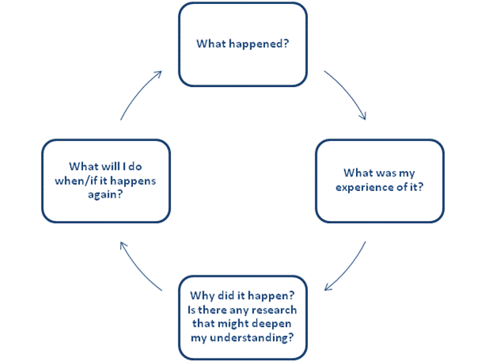
Most models follow this basic cycle…
Image source: https://www.bradford.ac.uk/wimba-files/skill-space/Reflective_Writing_HTML/page_04.htm

Slide 10
Basically...
What (happened?)
How (did I feel? did it go?)
Why (did I feel this way? did the experience go that way?)
What (did I learn? will I do differently or the same next time?)
Please note: ALL stages are important, but for graded Academic Reflection, Stage 4 is VERY important for your teacher to see evidence of.

Slide 11
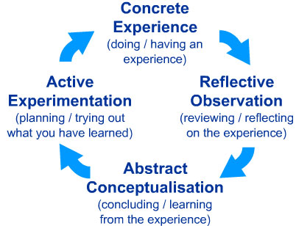
Kolb’s ‘Experiential Learning Cycle’ (1984)
Image source: http://cei.ust.hk/files/public/simplypsychology_kolb_learning_styles.pdf

Slide 12
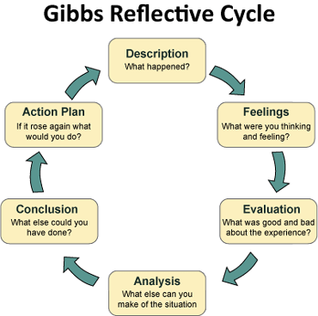
Gibbs’ Reflective Cycle (1988)
(Structural Learning, 2023)

Slide 13
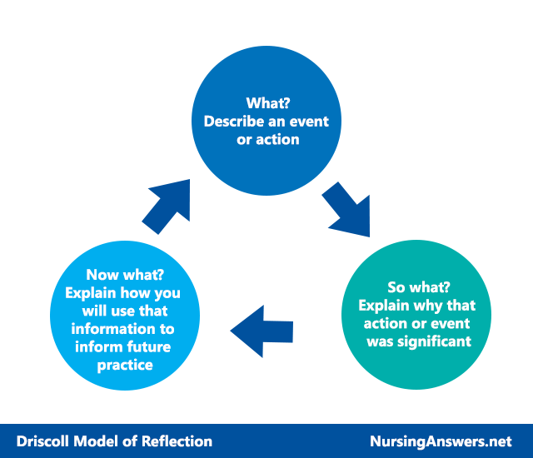
Driscoll’s Model of Reflection (1994)
(Nursing Answers, 2024)

Slide 14
The Description Stage
In this part, for any reflective model, you describe an experience from the past. Consider the questions: who, what, where, when, why, how.
At this stage you simply describe what happened.
(Kolb, 1984)

Slide 15
Evaluative Stage
This is the stage in which you reflect deeply on what has happened in that situation.
You can talk about your feelings and answer questions such as:
What worked?
What failed?
Why did others and I behave in a certain way?
(Kolb, 1984)

Slide 16
Analytical Stage
This is the stage in which you try to understand a situation better.
Questions to answer include:
What could have I done better or differently? Why?
Why did I feel/act this way? Why was my experience negative or positive?

Slide 17
‘To the Future!’ Stage
In this stage you answer the following questions:
What will I do differently in the future?
How can I improve my performance in the future? (Kolb, 1984)
This should be specific steps. Instead reflecting on a presentation, instead of “I should have practiced more, so I will practice more in the future”, consider what needed to be practiced more (e.g. do timings need more practice? Tone? Pace? Specific content? More practice with notes? More practice in front of people? How much more should you practice in the future?) DETAIL IS IMPORTANT IN THIS STAGE

Slide 18
Why is Reflection Important...
...for university students:
Improves understanding and retention – solidifies knowledge and connects theory to real life.
Enhances academic skills – identifies strengths and areas to improve (e.g., writing, time management).
Promotes personal growth – builds self-awareness, resilience, and adaptability.
Prepares for professional life – develops critical thinking and self-evaluation for future careers.
Can you think of a specific example where a student might benefit from reflecting? Discuss with a partner.
Notes:
Example: A student who receives feedback on an essay could reflect on where they lost marks, think about how to avoid similar mistakes in future assignments, and develop a more effective writing process for upcoming projects.

Slide 19
Why is Reflection Important...
For those who work in health and social care...
Improves patient care – refines practice for safer, more effective care.
Supports ethical and empathic practice – ensures respectful, sensitive treatment.
Facilitates ongoing learning – encourages adapting to new evidence and techniques.
Builds resilience and well-being – helps manage stress and avoid burnout.
Can you think of a specific example where a healthcare professional might benefit from reflecting? Discuss with a partner
Notes:
Example: A nurse who faced a difficult patient interaction might reflect on their response and consider how to handle similar situations in the future. By identifying alternative approaches or recognizing any personal biases that came into play, the nurse can be better prepared to manage similar encounters empathetically and professionally.

Slide 20
Group Activity
What Makes a ‘Good’ vs. ‘Bad’ Reflection?
Now that you understand what a reflection is and what it includes, work with your group to brainstorm two lists:
Effective Reflection: What actions, behaviours, or elements do you think contribute to a strong, thoughtful reflection? What details would be necessary to include if you’re demonstrating your ability to reflect to others?
Ineffective Reflection: What common mistakes or missing elements result in a weak or unhelpful reflection?
Write down your ideas for each list and be prepared to discuss them with the class.
Notes:
Lecturers, when you take this up, please note that positive experiences are worth reflecting on as well!

Slide 21
Some Possible Answers
Effective Reflection (Good Reflection)
Specific & Detailed – Clearly explains thoughts, feelings, and experiences.
Connects to Learning – Relates personal experiences to key concepts or lessons learned.
Self-Aware & Honest – Shows genuine self-assessment and willingness to improve.
Includes Growth & Next Steps – Identifies areas for improvement and how to apply lessons in the future.
Balanced Perspective – Acknowledges both successes and challenges rather than just focusing on one.
Ineffective Reflection (Bad Reflection)
Vague & Generalised – Lacks specific details, making it unclear or unhelpful.
Doesn’t Connect to Learning – Just summarizes events without linking them to lessons or personal growth.
Avoids Challenges – Only focuses on positives or avoids acknowledging areas for improvement.
Too Short or Superficial – Lacks depth or critical thinking.
Blames External Factors – Doesn’t take personal responsibility or reflect on one’s own role in the experience

Slide 22
Why it matters
Discuss with a partner/partners:
Even though you will not need to submit a reflection until Week 11, why do you think we teach you the importance of reflection in Week 1?

Slide 23
Individual task
Think about a your Admissions Interview for UWTSD.
Write a short reflection about this experience which clearly follows any of the 3 models of reflection we’ve discussed today.
  Try to write at least 200 words
  Make sure to show each stage with a heading
  Make sure your reflection includes some ideas about what you would do differently in the future (even though you did get in!)

Slide 24
References (and further resources!)
Gibbs, G. (1988) Learning by doing: a guide to teaching and learning methods. [London]: FEU.
Leeds Beckett University (2015) Content Preview: Models for structuring reflection. Available at: https://skillsforlearning.leedsbeckett.ac.uk/preview/content/models/02.shtml (Accessed: 8th July 2019).
Kolb, D. A. (1984) Experiential learning: experience as the source of learning and development. Englewood Cliffs; London: Prentice-Hall.
Nursing Answers (2024) Driscoll’s Model of Reflection. Available at: https://nursinganswers.net/reflective-guides/driscoll-model-of-reflection.php (Accessed: 18th December 2024)
Structural Learning (2023) Gibbs’ Reflective Cycle. Available at: https://www.structural-learning.com/post/gibbs-reflective-cycle (Accessed: 8th January 2025)
University of Edinburgh (2024) Reflection Toolkit. Available at: https://reflection.ed.ac.uk/ (Accessed: 10th January 2025)
Further Resources:
Open University. (n.d.). Reflective Learning. Available at: https://help.open.ac.uk/strategic-study-techniques/reflective-learning (Accessed 3 Feb. 2025)
University of Cambridge. (n.d.). Reflective Writing - Reflective Practice Toolkit. Available at: https://libguides.cam.ac.uk/reflectivepracticetoolkit/reflectivewriting (Accessed 20th Feb. 2025)
University of Edinburgh (2024) Reflection Toolkit. Available at: https://reflection.ed.ac.uk/ (Accessed: 10th January 2025)

