Slide 1
ENTERPRISE NETWORK SECURITY
Securing the Enterprise Network with Check Point GAIA Appliances
Centralized policy management with a Security Management Server (A-SMS), SmartConsole administration, and an enforced enterprise firewall rule base on A-GW.
Presented by: Md Ekram Hossain (user: ekram2523284)
Submitted to: Renuga Jayakumar
Environment: Check Point R81.20 · Gaia OS · SmartConsole

Slide 2
AGENDA
What this presentation covers
01
Task Recap & Objectives
02
Updated Topology
Marking criteria and what a secure enterprise deployment needs to demonstrate
Adding the A-SMS management server to the Part One deployment
03
Build & Licensing
04
Connectivity Proof
Installing A-GW / A-SMS / A-GUI, SmartConsole, and license verification
SmartConsole ↔ SMS and host ↔ gateway reachability
05
Firewall Policy
06
Install, Publish & Verify
Enterprise rule base: design rationale and rule-by-rule justification
Policy install workflow and log-based verification
2

Slide 3
ARCHITECTURE
Updated topology — adding A-SMS
A-SMS is introduced as a dedicated management appliance, reachable from the admin workstation (A-GUI) via SmartConsole, and from A-GW over a secure control channel.
A-GUI
SmartConsole (mgmt)
A-SMS
SIC (policy push / logs)
A-GW
Admin workstation
SmartConsole client
Security Mgmt Server
10.1.1.101 · Gaia
Security Gateway
10.1.1.1 · Gaia
intSWA / ExtLCD adapters
Host-only adapter (VirtualBox) provides the isolated management network used to reach A-SMS at 10.1.1.101.
Swansea Network
A-GW carries a Host-only mgmt adapter, two Internal Network adapters (intSWA, ExtLCD) and a NAT adapter for outbound access.
Enterprise LAN
(internal + external)
3

Slide 4
BUILD
Appliance & IP addressing plan
Appliance | Role | OS / Version | IP Address | Key Adapters
A-GUI | Admin workstation running SmartConsole | Windows / user profile | DHCP (mgmt segment) | Host-only → mgmt network
A-SMS | Security Management Server | Gaia, R81.20 | 10.1.1.101 | Host-only (mgmt)
A-GW | Security Gateway (firewall enforcement point) | Gaia, R81.20 | 10.1.1.1 | Host-only (mgmt) · Internal 'intSWA' · Internal 'ExtLCD' · NAT
4

Slide 5
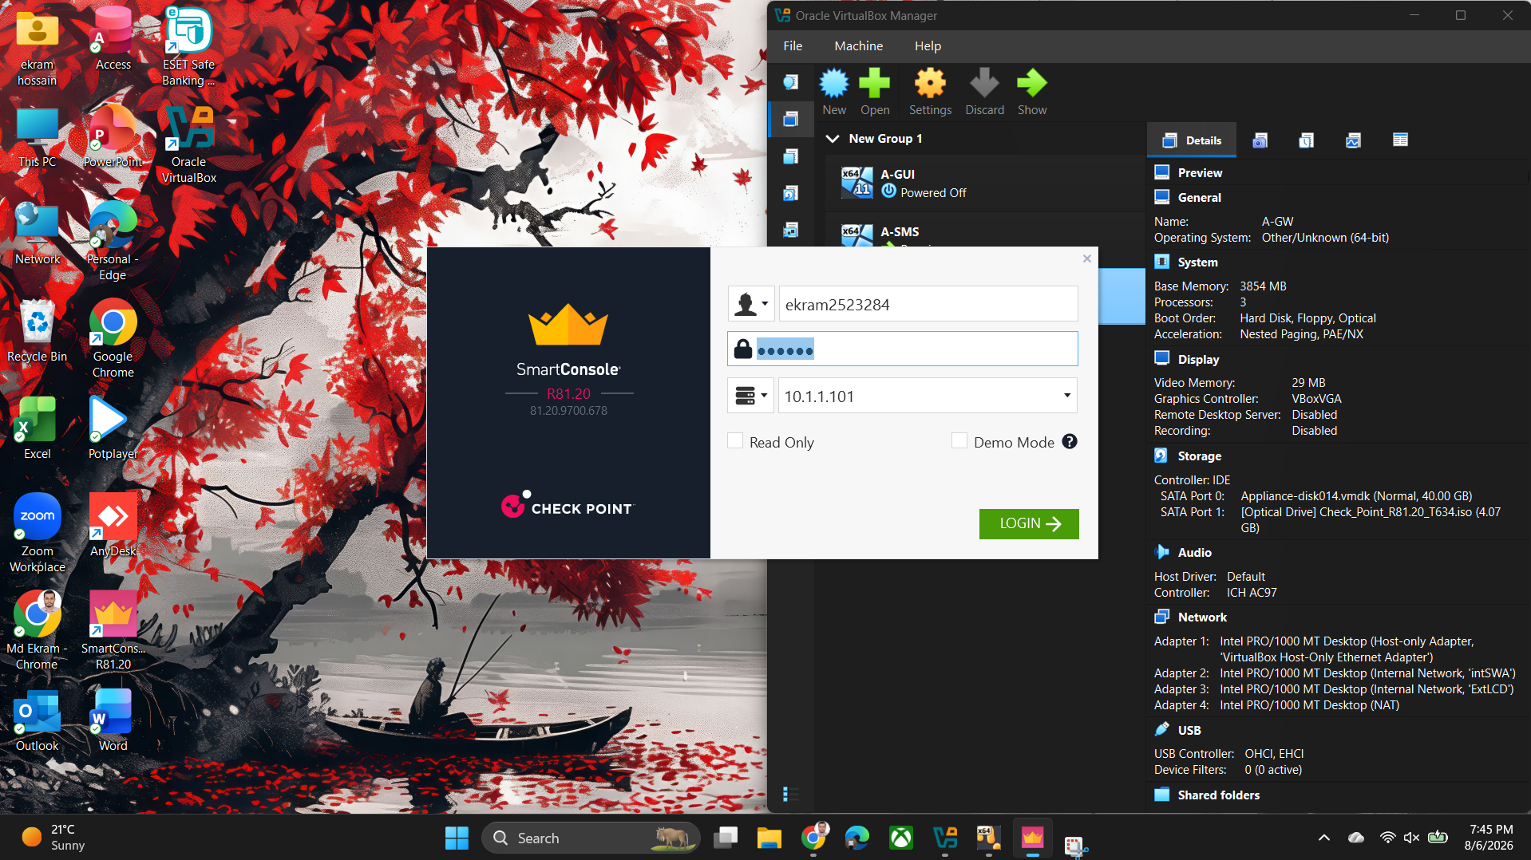
BUILD
Installing SmartConsole & connecting to A-SMS
1.
Install SmartConsole R81.20
2.
Authenticate to A-SMS (10.1.1.101)
3.
Establish SIC trust with A-GW
4.
Verify session in Gateways & Servers
SmartConsole login — R81.20, user ekram2523284, target 10.1.1.101
5

Slide 6
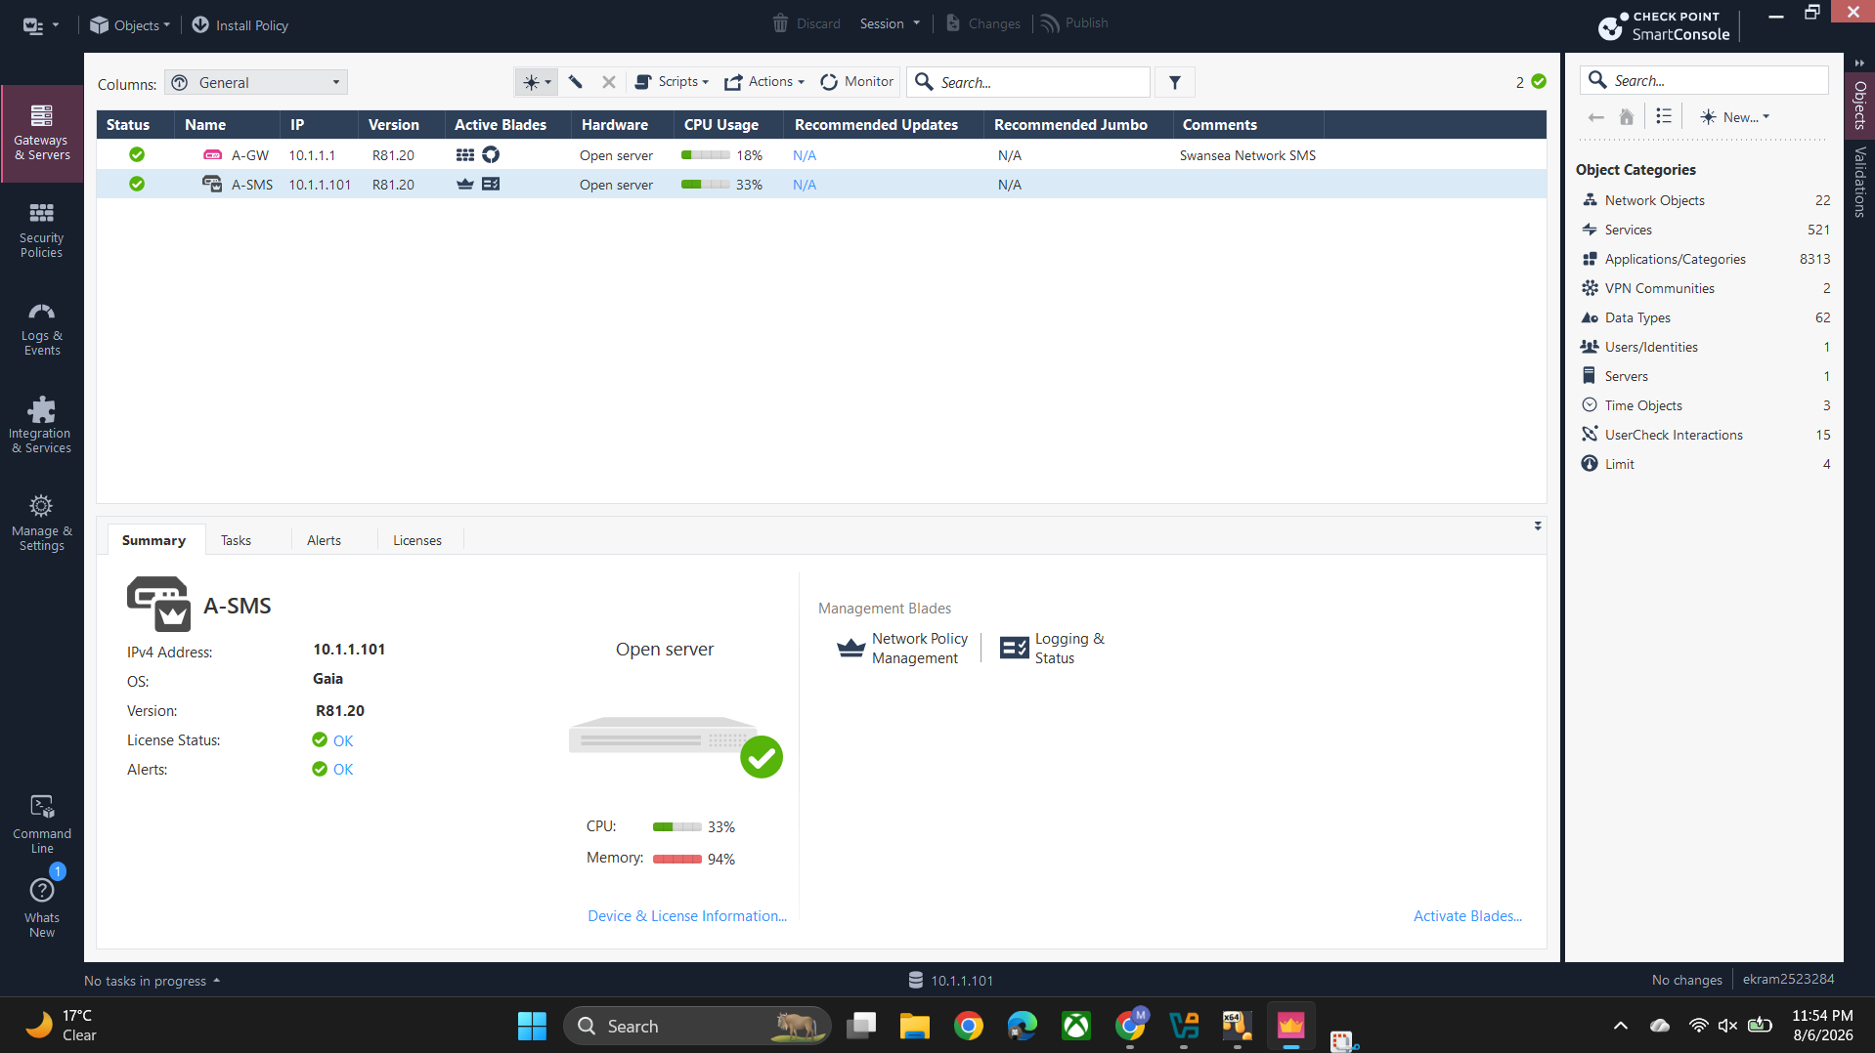
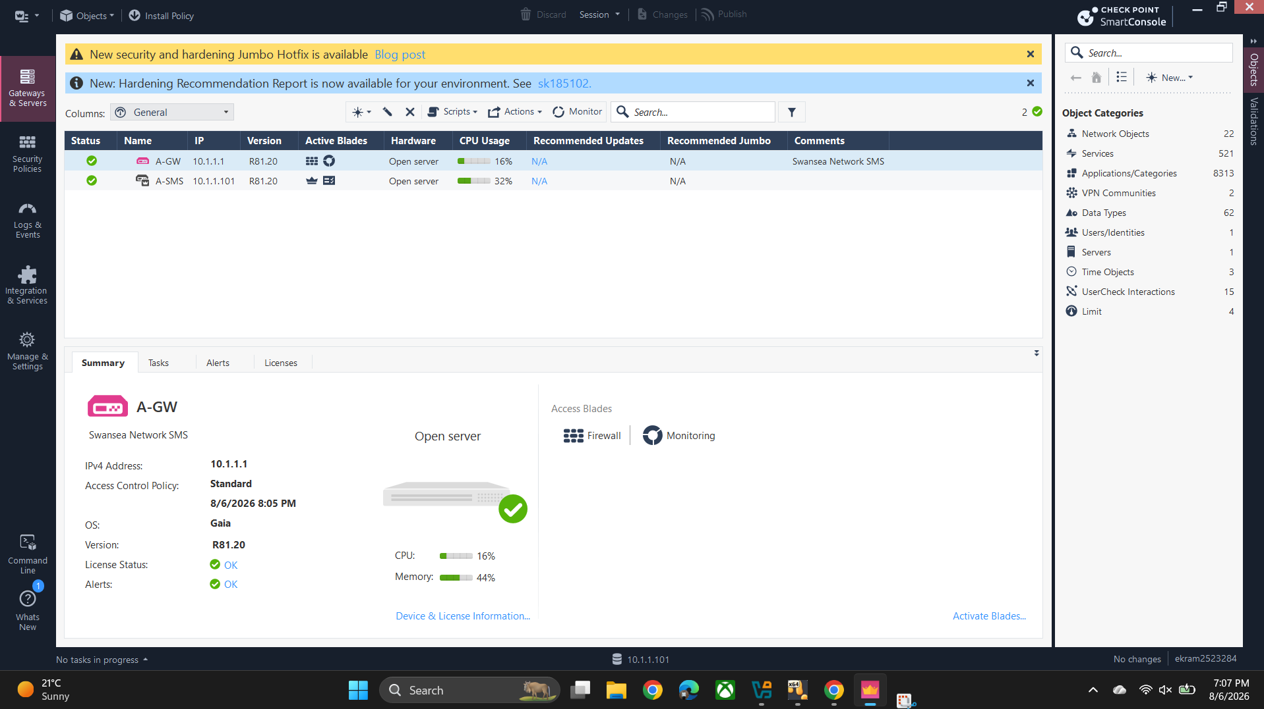
COMPLIANCE
Licensing A-GW & A-SMS
Both appliances require valid Check Point licenses tied to their IP address before Access Control / Threat Prevention blades can enforce policy.
Verified via Gateways & Servers → Device & License Information: green status, License Status = OK, entitled blades active on both appliances.
Appliance | License | Blades | Alerts
A-GW | OK | Firewall, Monitoring | OK
A-SMS | OK | Management, Monitoring | OK
A-SMS summary — IPv4 10.1.1.101, License Status OK, Alerts OK, R81.20
Gateways & Servers — A-GW status, IP 10.1.1.1, R81.20
6

Slide 7
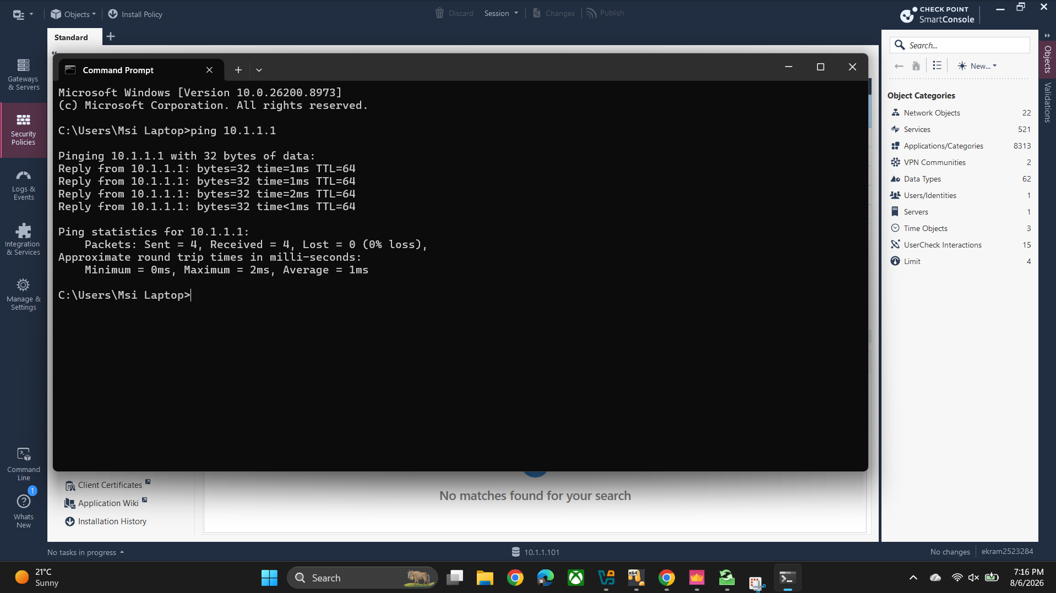
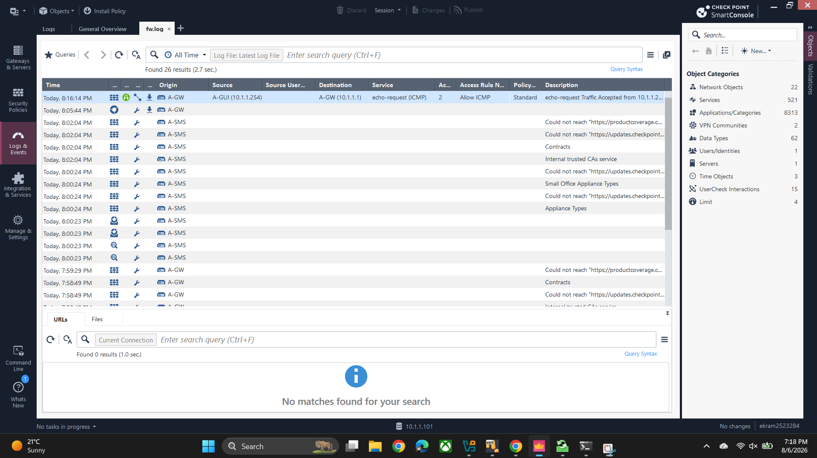
VERIFICATION
Connectivity proof: workstation ↔ A-GW ↔ A-SMS
Management reachability: SmartConsole authenticates to A-SMS and lists A-GW as managed & licensed.
Network reachability: Ping to A-GW (10.1.1.1): 4/4 replies, 0% loss, ~1ms RTT.
Policy reachability: Same ping logged as an accepted echo-request — network meets enforced policy.
Command Prompt — ping 10.1.1.1, 4 sent / 4 received, 0% loss
fw.log — echo-request Accepted, A-GUI → A-GW
7

Slide 8
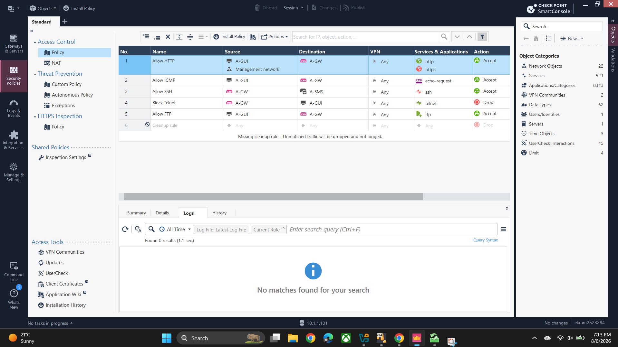
FIREWALL POLICY
A-GW Standard access control policy
# | Name | Source | Destination | Service | Action
1 | Allow HTTP | A-GUI, Mgmt network | A-GW | http, https | Accept
2 | Allow ICMP | A-GUI | A-GW | echo-request | Accept
3 | Allow SSH | A-GW | A-SMS | ssh | Accept
4 | Block Telnet | A-GW | A-GUI | telnet | Drop
5 | Allow FTP | A-GUI | A-GW | ftp | Accept
6 | Cleanup rule | Any | Any | Any | Drop
Security Policies → Standard rule base (6 rules)
8

Slide 9
RULE JUSTIFICATION
Rules 1–2 · Admin access & health checks
RULE 1
RULE 2
Allow HTTP / HTTPS
Allow ICMP (echo-request)
A-GUI, Mgmt network → A-GW
A-GUI → A-GW
Gaia WebUI admin access, scoped to the management network only — not internet- or LAN-exposed.
Enables ping-based diagnostics; restricted to A-GUI so ICMP can't be used enterprise-wide for recon.
Rule 1 'Allow HTTP' in the Standard policy
ICMP echo-request Accepted log entry
9

Slide 10
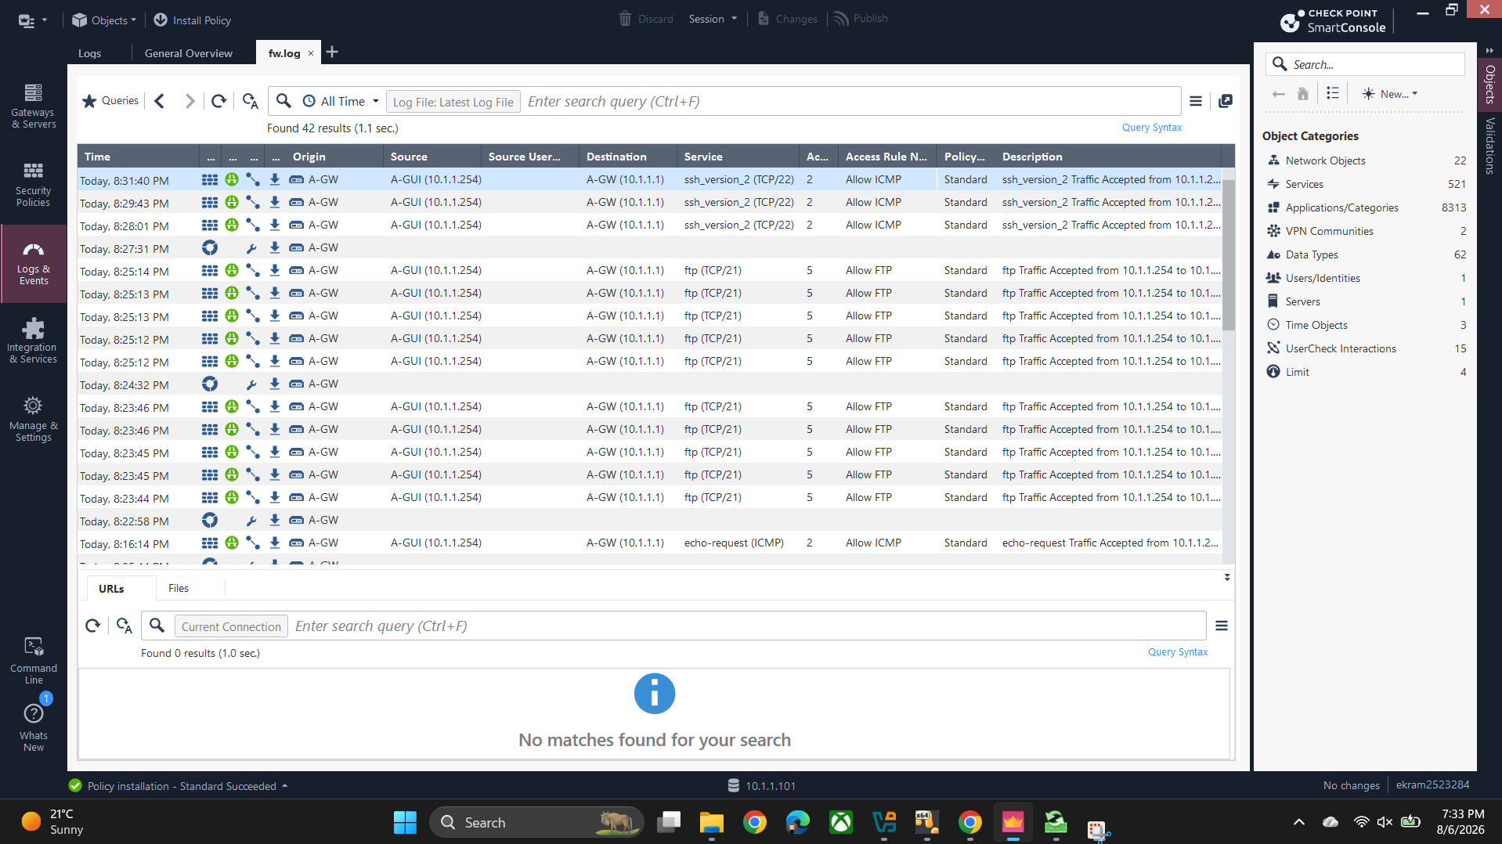
RULE JUSTIFICATION
Rules 3–4 · Secure vs. insecure remote access
RULE 3
RULE 4
Allow SSH
Block Telnet
A-GW → A-SMS
A-GW → A-GUI
Encrypted admin channel to the management server; only A-GW may reach A-SMS on port 22.
Telnet sends credentials in clear text; an explicit Drop rule documents and logs the decision.
SSH traffic Accepted, A-GUI → A-GW logs
Rule 4 'Block Telnet' in the Standard policy
10

Slide 11
RULE JUSTIFICATION
Rules 5–6 · File transfer & default deny
RULE 5
RULE 6
Allow FTP
Cleanup Rule (default deny)
A-GUI → A-GW
Any → Any
Controlled file transfer for config/backup workflows; 42 matched sessions give a clear audit trail.
Anything unmatched by rules 1–5 is dropped and logged — explicit default-deny, not just implicit.
FTP Accept logs (42 results)
Cleanup rule row in the Standard policy
11

Slide 12
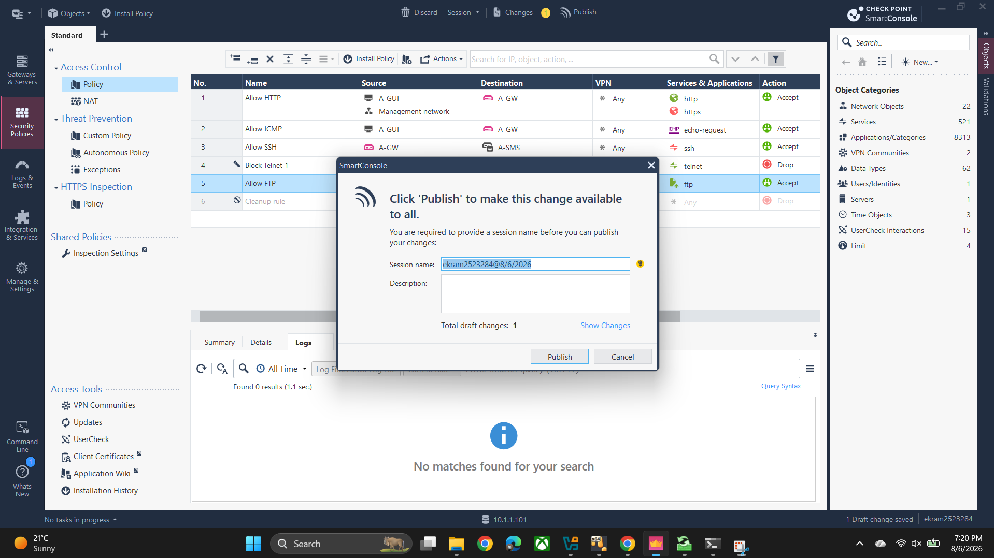
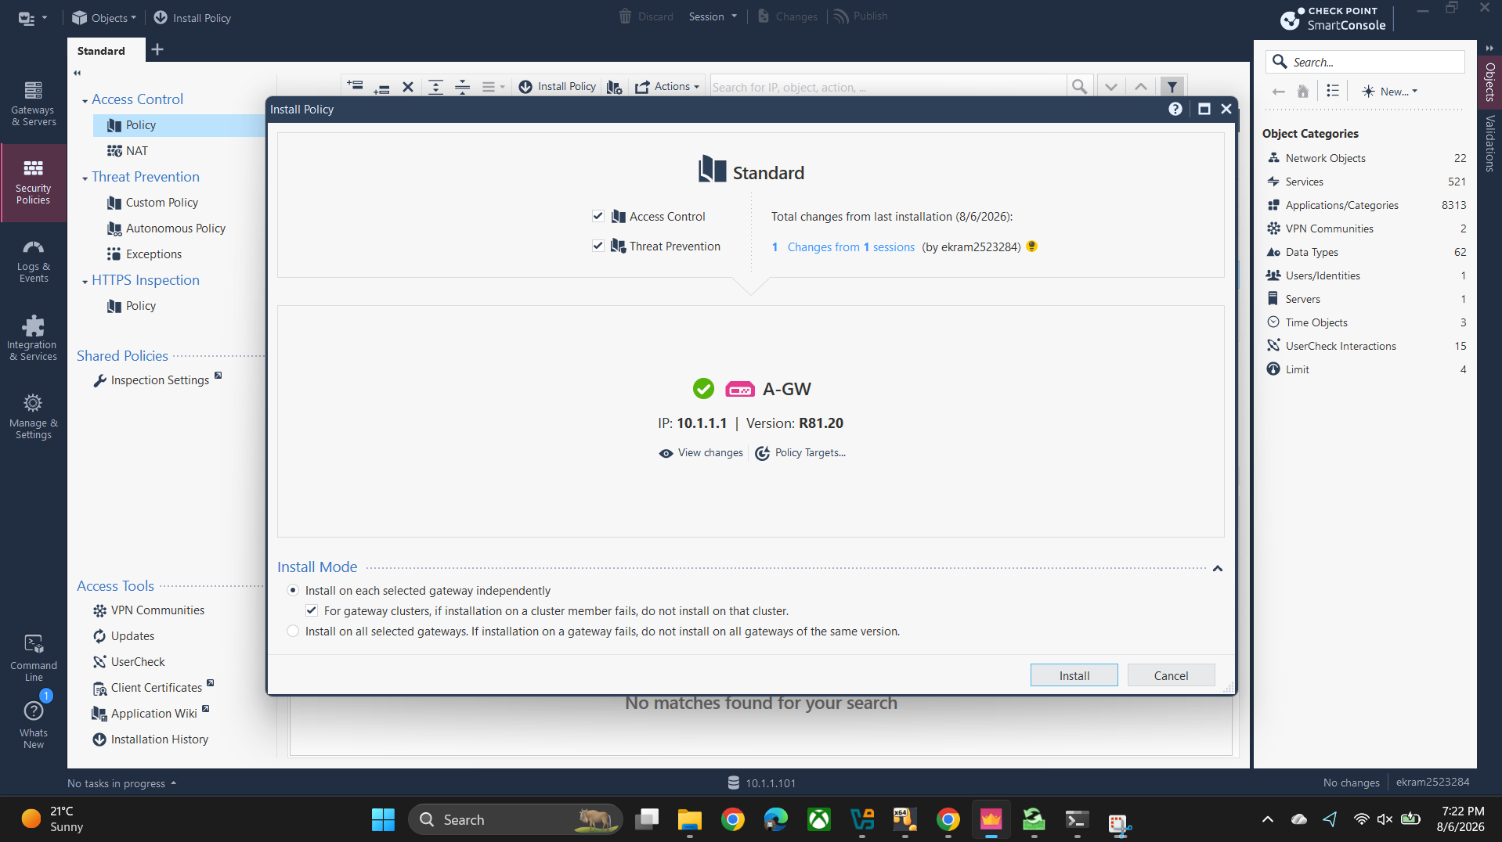
CHANGE MANAGEMENT
Publishing & installing the policy
→
→
→
1. Edit
2. Publish
3. Install Policy
4. Confirm
Publish dialog — session name & draft change count
Install Policy — A-GW target, R81.20, Access Control + Threat Prevention
12

Slide 13
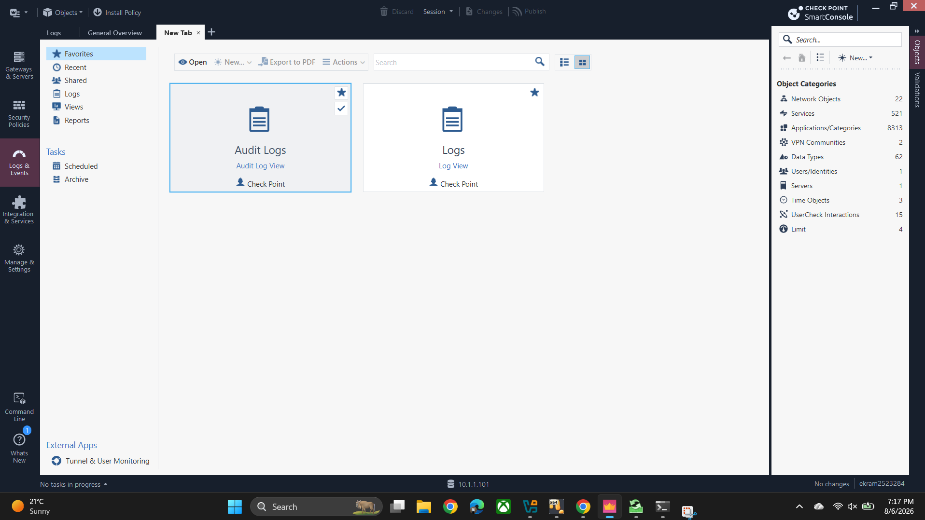
VERIFICATION
Proving enforcement with Logs & Events
Every permitted and blocked flow is logged — concrete evidence the intended policy is what's actually running.
SSH accepted — A-GUI → A-GW, port 22
FTP accepted — 42 log entries
ICMP accepted — echo-request logged
SMS housekeeping — licensing / CA checks OK
fw.log — SSH & FTP Accept, 42 results
Logs & Events — Audit Logs / Logs views
A-SMS log entries — licensing / trusted-CA checks
13

Slide 14
Live Demonstration & Q&A
SmartConsole walkthrough · policy install · log verification
DEMONSTRATION VIDEO
https://drive.google.com/file/d/1VIklx9UnP2S9FdJRHSliv9vgVhcS-bli/view?usp=sharing
Thank you — questions welcome.

