Slide 1
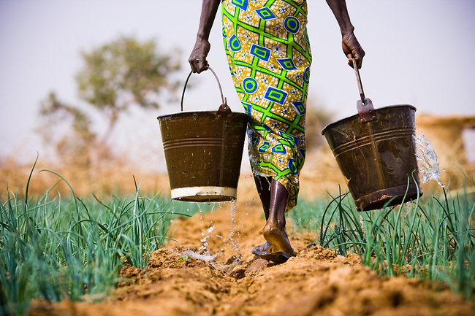
Subsistence

Slide 2
Subsistence/economy/environment
Methods
Tools and technology
Social ideas
Subsistence
Conditions

Slide 3
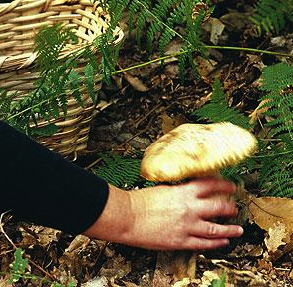
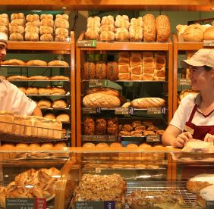
Engels (1875):
2 main subsistence types
Collectors
Producers

Slide 4
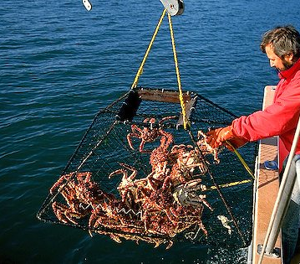
4 main methods of getting dinner
Gathering and hunting
Pastoralism
Horticulture
Industrial (agriculture)

Slide 5
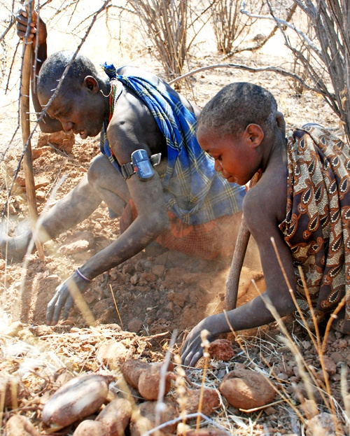
Gatherers who hunt
2 types:
Immediate return
  No storage
  No ‘bank’
  Property = songs, spells
Delayed return
  Some storage (Inuit)
Notes:
G/H’s:
Food harvested as it grows; no construction
Relies on knowledge of where ecological components best thrive and movement towards those locations
Consequently bands are very mobile.
To be mobile, on needs portable structures and little property or baggage
60/70% of food is gathered in only about 15 hours per week (original affluent society – Sahlins)
All food (and things) are shared
The band is one thing; a body – psychologically, benefit cannot be singularly understood. Sharing is not seen as sacrifice or difficult. To not share might be understood as trying to exclude one part of your body – a sort of nonsense.
Minimal gender roles, egalitarian, no chiefs but elders are listen to. Discussion used to deal with conflict, ruled by consensus and ostracism (the power of disapproval).
Examples: San !Kung, Aust. aborigines

Slide 6
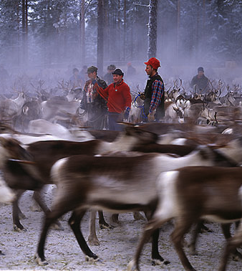
Pastoralists
Domestication:
  Relationships with other animals and plants
  Food processing for storage
Seasonal storage
Exchange possible
Notes:
Nomadic – follow herds
Larger groups
High protein diet
Religion and ritual are key social institutions
Property – owning things (herd, land, homes etc) means things need protecting
Skills necessary; experts (specialisms) created. Life’s tasks can be split between group members
Examples: Sami, Massai

Slide 7
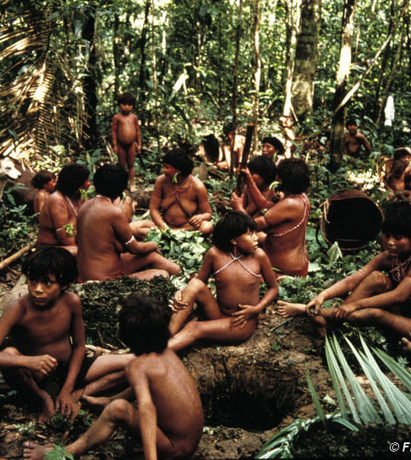
Horticulturalists
Manipulation of the land with tools
Knowledge of plants
Storage possible if necessary (location dependent)
Exchange possible due to high productivity
Notes:
Settled
Owning the land alters idea of the land and demands protection of one’s patch
More gender divide between task
Specialisms and skills (tool use)
Big people change with renown – relationships are vital
Examples: Yanomami, Trobriand Islanders

Slide 8
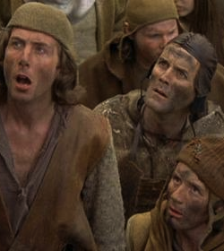
Peasants (Europe till 1850)
Produce from land and home
Land owned by families
Production for exchange
Payment of taxes
Lots of work – knackered!
Storage – of stuff and ideas (writing)
Notes:
This is Hobbes’ world – Brutish and short life.
For 6000 years people were differentiated and defined as unequal. This was due to birth. Only a few could own and have money. Most were ‘less than’ the hierarchy and were expected to work very hard to support them (hence taxes)
Royalty, leaders of the state – people to obey.
Families are important

Slide 9
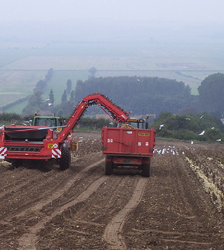
Industrial
Major diversity to production possible
Huge amount of work but now done by machines
Wealth inequality magnified
Property is individually owned
Energy – carbon not animals

Slide 10
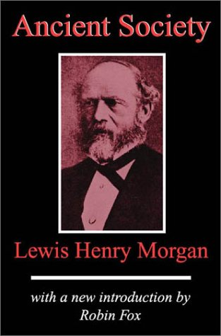
Lewis Henry Morgan’s social evolutionism
As it is undeniable that portions of the human family have existed in a state of savagery, other portions in a state of barbarism, and still others in a state of civilization, it seems equally so that these three distinct conditions are connected with each other in a natural as well as necessary sequence of progress
(Morgan Ancient Society 1877:3)

Slide 11
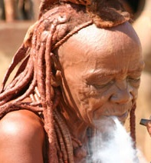
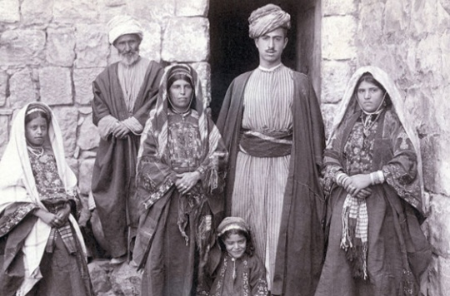
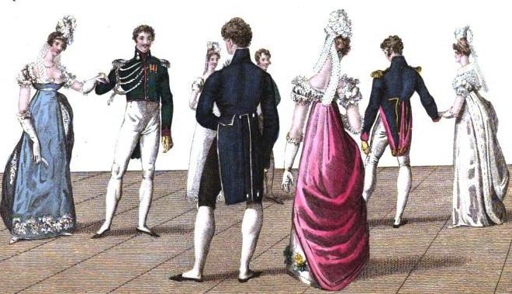
Social evolutionism
linked subsistence methods to evolutionary scale claiming human societies evolve through 3 stages
Savagery
Barbarism
Civilised

Slide 12
Social stages Morgan suggested
 | Lower | Middle | Upper
Savagery | Gathering nuts and berries | Fire and fish | More techno bows and arrow
Barbarism | Pottery | Domestication of animals and plants | Iron work, smelting
Civilised | Alphabet writing
Notes:
Each stage had a lower, middle and upper section – see Ancient Society, Morgan, 1877

Slide 13
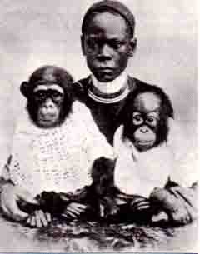
Responses
Theologians rejected Darwin’s ideas
Anthropological ethnographic information challenged the notion of primitive
Boas claimed the ideas were racist and pseudo scientific (see Eriksen, p14)

Slide 14
What is clear: most people moved from g/h →farming
Foraging
10,000 yrs ago
?
Agriculture
So why?

Slide 15
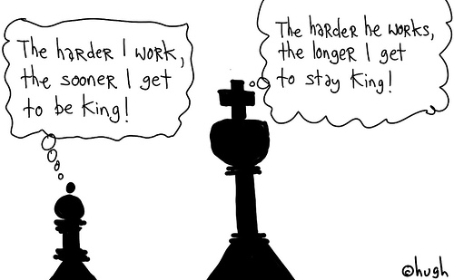
The transition to farming
Why?

Slide 16
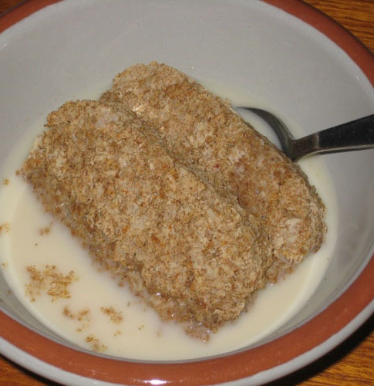
Some ideas
Climate changed
Binford, (‘70s) Population density, move out of forests
Diamond (1997) geographical ‘luck’
Wadley, (1992) Addiction to opiates in cereals
Dunn, (2011) adding to Binford cites milk as significant

Slide 17
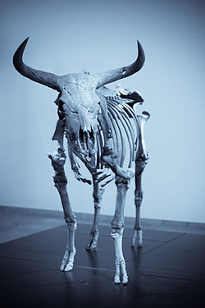
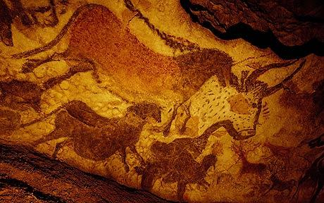
Auroch (ancient ‘giant’ cow)

Slide 18
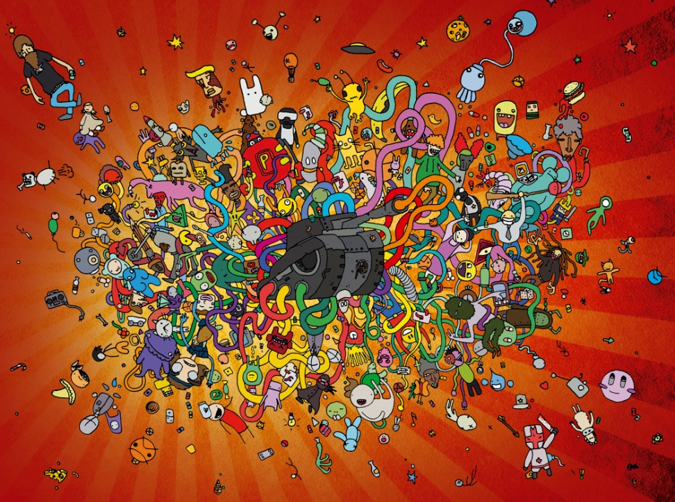
Consequences
Settlements
Security?
Notion of ownership (things to have)
Ability to exchange (economics)
Back breaking work
Poor diet – less variety
Social hierarchies

Slide 19
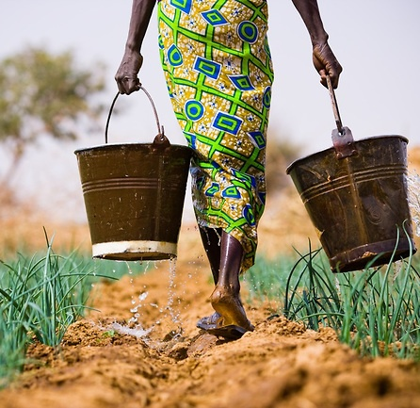
To sum up
There are a variety of different subsistence methods used by humans
Most human groups moved to farming about 10,000 years ago
This has had significant consequences

Slide 20
Refs
Binford L, R. 1978. Nunamiut ethnoarchaeology. New York: Academic press
Dunn, R. 2011. The wild lives of our bodies: predators, parasites and partners that shape who we are today
Engels, F. 1878 Anti- Duhring. Progress publishers
Eriksen, T. H. 1995. Small places, large issues an introduction to social and cultural anthropology. London: Pluto press
Morgan, L. H. 1877. Ancient Society. London: Macmillan
Wadley. G. 1992. A pharmacological model of the Neolithic transition [online]
Wadley, G. and Martin, A. 1993. The origins of agriculture: a biological perspective and a new hypothesis. Australian Biologist (6) pp 96- 105

