Slide 1
Results Section – Quantitative Research

Slide 2
Results Section – Quantitative Research…
Descriptive statistics
Essential to the clear presentation of your findings
Do NOT present raw data here (this goes into your appendices)
Present the mean scores for each condition in visual form (main effects table and interaction table in the case of an anova):
Tables of means and standard deviations
Bar charts??
Do not go overboard with graphs and tables - choose the most appropriate method of describing your findings.
LABEL YOUR TABLES appropriately – Table 1: The mean physical attractiveness ratings given by participants when sober and drunk, and in dim and bright lighting – before your table.
Present your tables in APA format.
Comment on what these indicate about the findings of your experiment

Slide 3
Results Section Quantitative Research – Continued…
Inferential statistics (follow guidance for each test)
Describe the type of analysis used and why.
Do not include SPSS printouts (in appendix)
Give the observed value
Level of significance
Degrees of freedom or sample size as appropriate.
Estimate of Effect Size.
Give a brief written summary of your findings.

Slide 4
Results
Descriptive statistics
  Essential to the clear presentation of your findings
    Do NOT present raw data here (in appendix)
  Present the mean scores for each condition in visual form:
    Table of mean and standard deviation
    LABEL YOUR TABLES/Charts appropriately – Table 1: The mean physical attractiveness ratings given by participants when sober and drunk,
    Comment on what these indicate about the findings of your experiment

Slide 5
Quantitative Results - cont’d
Inferential statistics (follow guidance for each test)
  Describe the type of analysis used and why.
    Do not include SPSS printouts (in appendix)
    Give the observed value
    Level of significance
    Degrees of freedom or sample size as appropriate.
    Give a brief written summary of your findings.

Slide 6
Example of a 2x2 Anova Write up.
A two way 2 (alcohol: 0 pints or 6 pints) × 2 (lighting: dim vs. bright) repeated measures ANOVA was conducted on the attractiveness ratings. This revealed a significant main effect of alcohol, F(1, 25) = 287.78, p < .001, ηp2 = .958. indicating that attractiveness ratings were significantly higher when participants were drunk. There was also a significant main effect of lighting, F(1, 25) = 14.04, p = .01, ηp2 = .733. indicating that attractiveness ratings were significantly higher in dim conditions. The alcohol × lighting interaction was also significant, F(1, 25) = 47.29, p < .001, ηp2 = .867. indicating that difference in attractiveness ratings due to lighting was present in the sober participants but not the drunk ones.
Following this – on a New Page you would start a separate discussion.

Slide 7
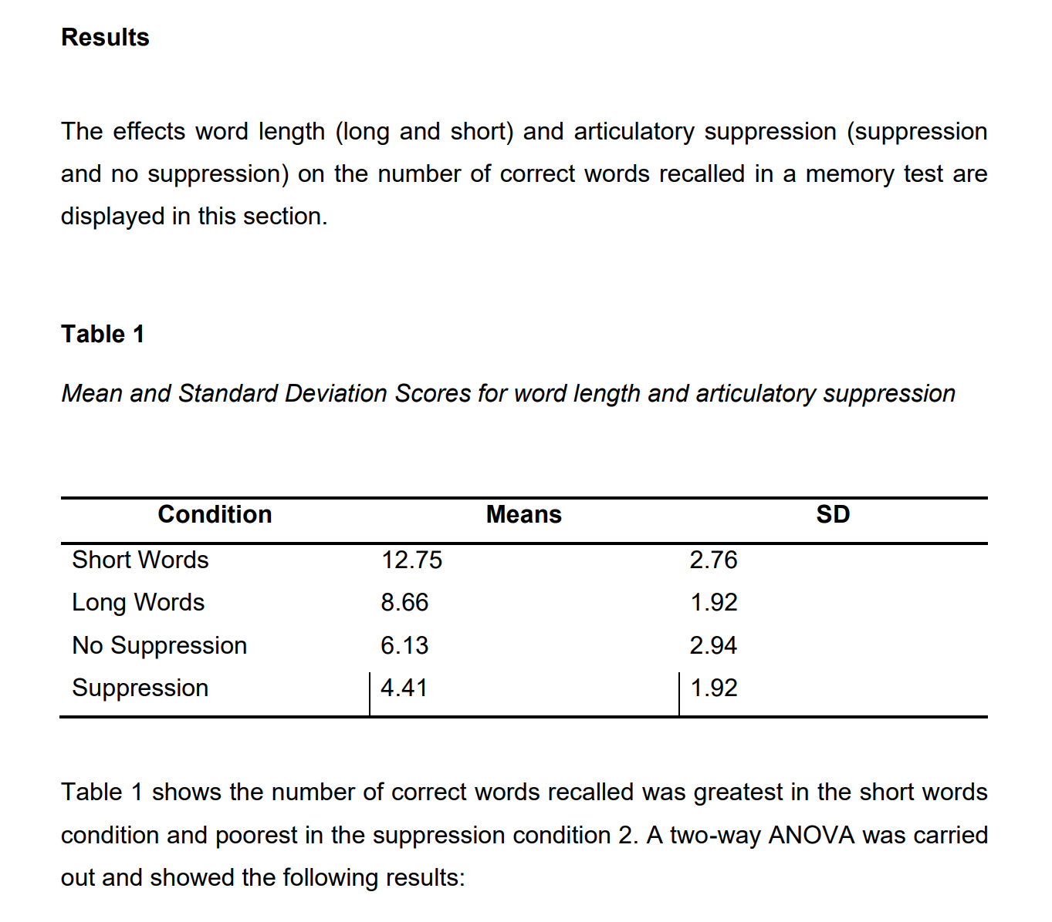
Results section example – 2x2 Anova.

Slide 8
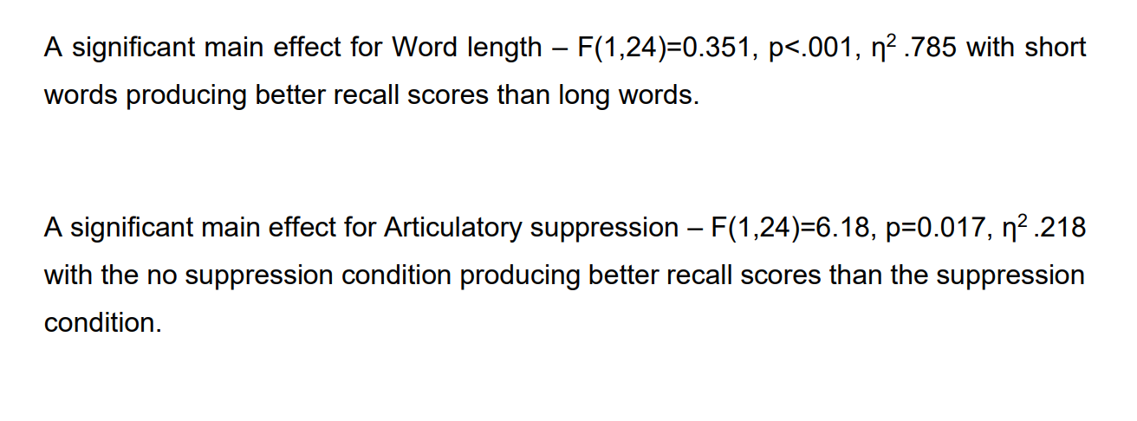
Result section example – 2x2 Anova.

Slide 9
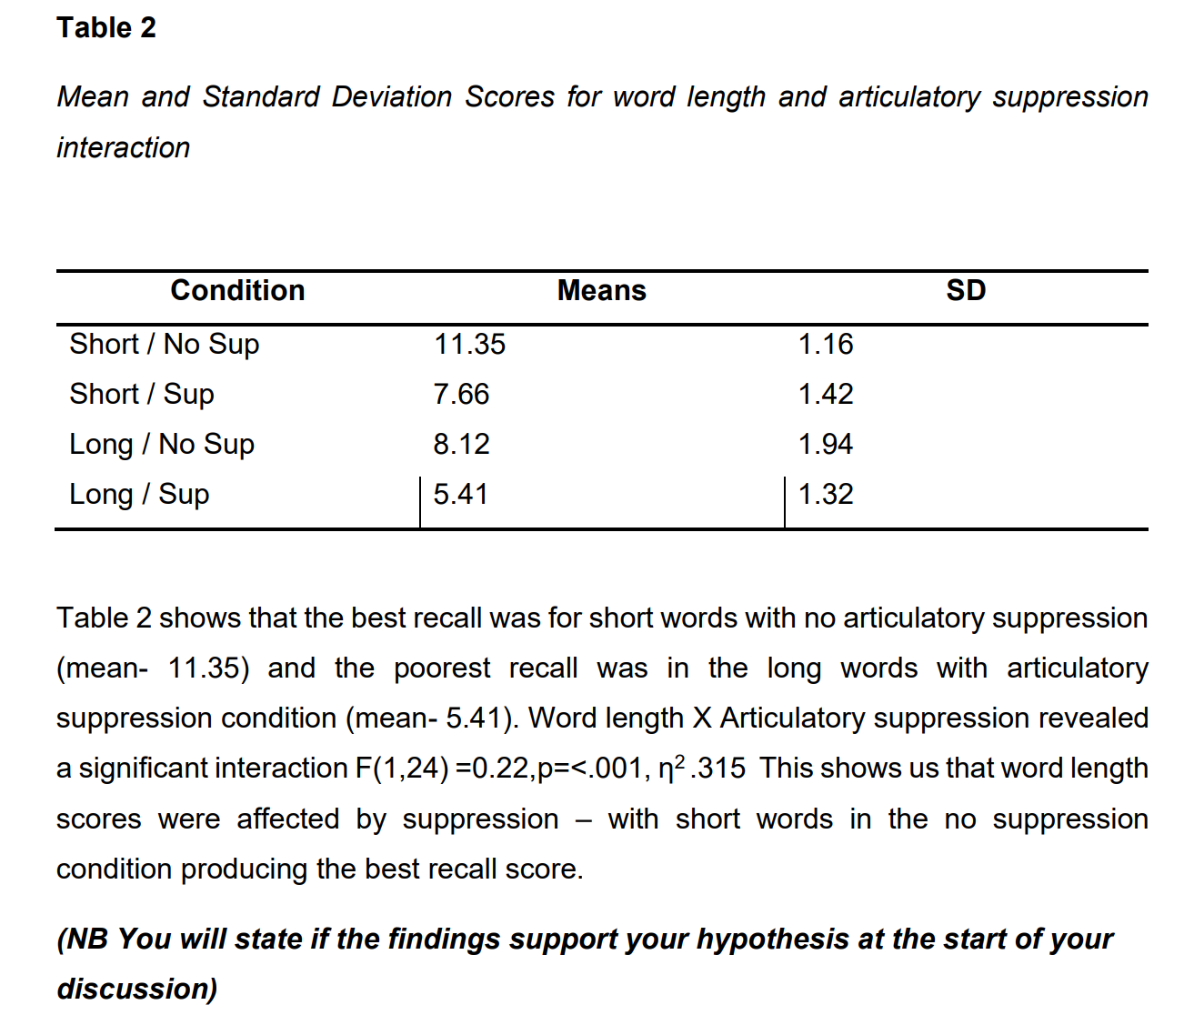
Results section example – 2x2 Anova

Slide 10
Quantitative Results Section – Points to remember.
Do not copy and paste from SPSS – SPSS outputs in the Appendices but you need to create your own table.
No tables for the actual statistics (e.g. P value) you state them – as noted in previous slides.
Remember for a 2x2 Analysis – you include a table of means for the main effect scores and the interactive scores (descriptive statistics) – remember again this is NOT the P values.
No need for graphs, unless you are doing a different analysis (e.g. percentages). You can use Excel to draw the graphs.
Make sure you draw your tables in APA format (as in previous slides) – Label them full (e.g. Table 1……) and also discuss them later.
Your linking back to hypothesis and previous research is in your DISCUSSION CHAPTER (CHAPTER 4).
Remember sometimes less is more.

