Slide 1
Datblygu Ymchwil –
Damcaniaeth ac Ymarfer
Developing Research –
Theory and Practice

Slide 2
“Research is formalized curiosity. It is poking and prying with a purpose.”
Zora Neale Hurston

Slide 3
JOIN IN THE DEBATE!
#UWTSD
#Athrofa
#DevelopingResearch

Slide 4
“In much of society, research means to investigate something you do not know or understand. ”
-Neil Armstrong

Slide 5
“An expert is one who knows more and more about less and less until he knows absolutely everything about nothing.”
― Nicholas Murray Butler

Slide 6

TWEET US!
#DevelopingResearch

Slide 7
“The library is not, as some would have it, a place for the retiring of disposition or faint of heart. It is not an ivory tower or a quiet room in a sanitarium facing away from the afternoon sun. It is, rather, a command center, a power base. A board room, a war room. An Oval Office for all who preside over their own destinies. One does not retreat from the world here; one prepares to join it at an advantage.”
― Eric Burns,

Slide 8
“The way to do research is to attack the facts at the point of greatest astonishment.”
― Celia Green

Slide 9
"The outcome of any serious research can only be to make two questions grow where only one grew before."
---Thorstein Veblen

Slide 10
TWEET US!
#DevelopingResearch

Slide 11
"There is nothing so practical as a good theory.“
--- Ludwig Boltzman

Slide 12


Slide 13
"It is a capital mistake to theorize before one has data."
--- Arthur Conan Doyle (via Sherlock Holmes)

Slide 14
"Basically, I'm not interested in doing research and I never have been. I'm interested in understanding, which is quite a different thing."
David Blackwell

Slide 15
TWEET US!
#DevelopingResearch

Slide 16
If we knew what we were doing it wouldn't be research.
Albert Einstein

Slide 17
Scientific research consists in seeing what everyone else has seen, but thinking what no one else has thought.

Slide 18
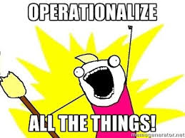

Slide 19
“The secret of getting ahead is getting started.”
– Mark Twain

Slide 20

#DatblyguYmchwil

Slide 21
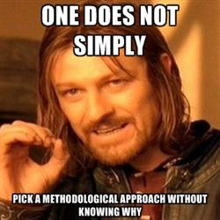

Slide 22
“In much of society, research means to investigate something you do not know or understand.”
Neil Armstrong

Slide 23
#DatblyguYmchwil

Slide 24
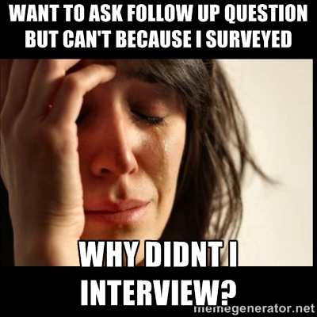

Slide 25
Today a reader, tomorrow a leader.
Margaret Fuller

Slide 26
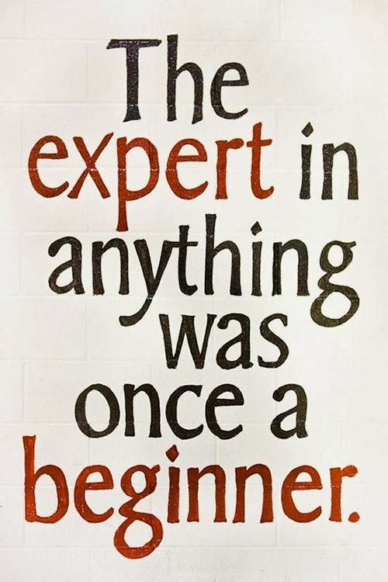

Slide 27


Slide 28
JOIN IN THE DEBATE!
#UWTSD
#Athrofa
#DevelopingResearch

Slide 29


