Slide 1
Porth Agored
Graduate Certificate
Consolidation
Workshop 4

Slide 2
Workshop 4 Programme
Task 1 part b of Portfolio – Developmental review
Marking Criteria
Hints and tips for a successful submission
Confidentiality and Plagiarism
Submission Process
Outstanding issues and concerns
Common mistakes/hints and tips
Individual time with trainer to look over your portfolio

Slide 3
Expectations/Ground rules for virtual workshops
Confidentiality
Respect
One person speaking at one time, please use the emoji for putting your hand up if you would like to make a comment
Use the discussion box during the presentation to type in any question you have
Participation – please ensure you engage and focus

Slide 4

Personal Development Planning
PDP in a process that:
Deepens your understanding of
yourself
Makes you more aware of what
motivates you
Helps you formulate what you really want from your life and career
Helps you to face up to your limitations and address these realistically
Helps you see yourself as other
people see you
Assists you to plan over the longer term towards goals that are important to you

Slide 5
What Does PDP Involve
Reflection - Focus will change over time, but will include issues such as who you are, what kind of practitioner you want to be, what alternatives there are and what have you learned
Increasing Self-Awareness - Including individual strength, interests, inspirations, preferences, qualities and own limitations.
Being Informed - Finding out about opportunities and choices that are open to you, and that broaden your perspective
Taking Personal Responsibility - Taking responsibility for your own education, training, learning and choices
Developing a Strategy - To get you where you want to be. Helps you to plan, set targets, take action, develop skills, and review your position

Slide 6
Professional Development Review
Task 1 part b askes you to continue to use a model of reflection Use a model of reflection to Critically Reflect on your development since completing Task 1 part a.
Including reference to the training, learning, research and use of supervision.
Consider in discussion with your mentor/supervisor/line manager the extent to which the learning needs you identified in Task 1, part a have been achieved
Identify future learning needs to support your development in the transition to becoming an experienced practitioner
You must include a reflection on feedback that you have received from individuals in need of care and support and/or their carers and how this feedback has informed your future professional development.

Slide 7


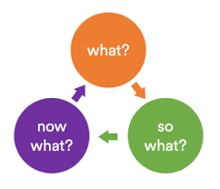
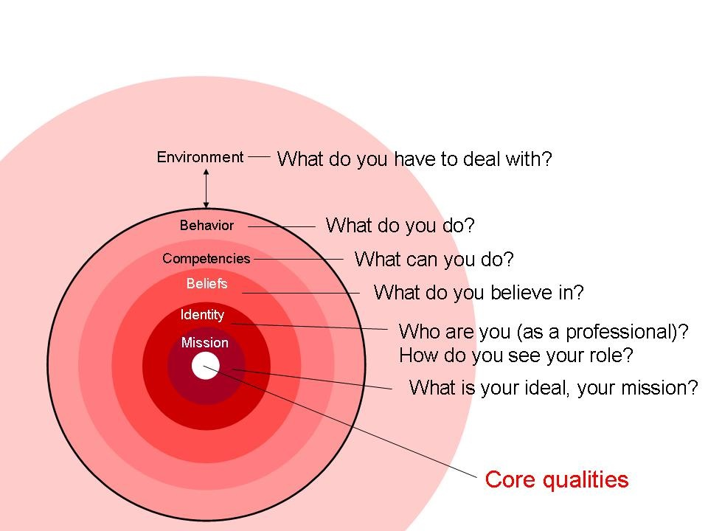
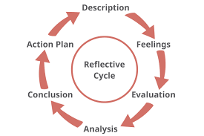
Task 1Part b
Professional Development Review
Exercise 1
Reflect on your learning and development since completing Task 1 part a (over the last year); including reference to the training, learning, research and use of supervision.
To what extent have the learning needs you identified under the SCW 3 learning outcomes at the beginning of this process been achieved?
Think about what has worked well or not worked so well for you in terms of your learning.
Use a reflective model (see
workshop 1).

Slide 8
The Importance of Continuous Professional Development & Learning
Social work demands a high level of interpersonal skill and clarity of communication to make your voice heard, to listen to others and to secure the best possible outcomes for individuals.
In order to address inequalities and practise effectively in complex situations, you will need to see every working day and indeed, every social work encounter as an opportunity to reflect and learn, not only from your own, but from the experiences of others. Open mindedness, honesty, self-awareness and humility are the keystones of learning and therefore of effective social work practice.

Slide 9

“A recognised factor of a professional workforce is the proactive use of continued professional development, so that staff can expand their knowledge and skills for effective and continually improving practice. Therefore it is a central aspect in improving social work practice over time, something that all social care professionals and the individuals who put their faith in that care and support aspire to.”
Sarah Roschira - Older Peoples’ Commissioner for Wales – 2014

Slide 10
Group exercise
What new learning needs can you identify for your future professional development? For instance, are there any learning outcomes not achieved that you identified task 1 part a or new areas of learning you would like to take forward?
Notes:
.

Slide 11
Why is the feedback we receive from individuals we work with so important
To demonstrate our commitment to valuing equally everyone's expertise
To understand the view point of the people we work with and listen to their views in line with the Social Service and Well-Being (Wales) Act, 2014
To work within our own Code of Professional Practice (Social Care Wales, 2017)
To involve people we work with in our own professional development and learning
To enhance the experience of the people we work with.

Slide 12
What do the people we work with say?
What social workers are saying
As a professional,
I value feedback from individuals I work with, I feel it is vital in informing my practice to be able to reflect and develop my skills.
As an individual
who uses service I have not been asked for feedback from any social worker in 20 years! I think the opportunity to do this would have empowered me and helped me to feel better listened to and understood which I would value.
Notes:
.

Slide 13
Exercise 3
Reflect on feedback you have received from individuals/families or carers you have worked with and consider how this feedback has informed your future professional development.

Slide 14
Completion of the Portfolio
Marking Criteria
The marking criteria gives the minimum standards that needs to be met to achieve a pass as well as a further explanation as to how to achieve higher marks
It is important you refer to this to make sure you meet the criteria
Take some time to look through the marking criteria for each section
You must meet every element of the marking criteria and answer all elements of the question to pass.

Slide 15
Marking Scheme
Task 1 - Developmental review (part a and b) = 15% of mark
Task 2 - Observation of social work practice = 20% of mark
Task 3 - Safeguarding case study = 50% of mark
Task– Safeguarding in an area that is not your main area of work = 15% of mark
You are required to achieve a pass in all 4 tasks in order to pass the portfolio.
Notes:
.

Slide 16

Learning Outcomes
Remember the 3 main themes/learning outcomes should be evidenced throughout the portfolio (see handbook appendix 4)
Analysis in assessment
Working collaboratively
Professional judgement in complex situations

Slide 17
Completion of the Portfolio
Exercise 4
Where you are now in relation to your completion of the assignments/portfolio?
Identify any areas that you need any further clarification on
Consider each section:
Task 1 - Professional development review
Task 2 - Observation of Practice
Task 3 - Safeguarding
Task 4 - Safeguarding in an area which is not your main area of work

Slide 18

Checklist - Common Mistakes
Failing to answer the question fully/not answering every element of the question
Poor referencing or large section not referenced
Acronyms not put in full in the first instance
Year not given with Acts/references
Acts and other work quoted but not referenced (be careful of plagiarism)
Being overly detailed in reflective sections.

Slide 19

Task 1 - Must integrate a referenced a model/s of reflection throughout in both parts a and b and take into account training, learning, research and use of supervision
Part a
Must identify future learning needs under each of the SCW 3 learning outcomes this is the larger part of the task
First reflect on past learning and development (about a quarter of the total amount written).
The consider your future learning need and how you intend to meet these
Analysis in assessment (quarter of written amount)
Collaborative working (quarter)
Professional judgement in complex situations (quarter).
Part b
Reflect on feedback from individuals and how this feedback has informed your future professional development.
Consider in discussion with a mentor/supervisor/line manager the extent to which learning needs has been achieved.
Identify any additional learning needs to support your development in the transition to becoming an experienced practitioner
Parts a and b need to provide academic references/evidence.

Slide 20
Checklist
Task 2 - Observation of Practice
Ensure the introduction clearly sets the scene e.g. give age, ethnicity, gender, language needs etc.
Reflect clearly on communication methods, ethics, values and use of a person centred approach
Reference to the Code of Professional Practice (there is no requirement to give each point e.g. 1.2, 1.3 just reference to the document (Social Care Wales, 2017)
Include reflection on Welsh context and highlight the “Active Offer” and make reference to “More than Just Words” (Welsh Government, 2012).
Watch the videos “More than just words”, this will inform the learner’s reflection.

Slide 21
Checklist
Task 3
The introductions should clearly set the scene e.g. give age, ethnicity, gender, language spoken etc and highlight relevant legislation to be discussed
Clearly refer to and critically reflect on the correct legislation in relation to safeguarding (including: Wales with the United Kingdom, the European Union (EU) and outside the EU)
Establish the role of the learner in the safeguarding issue
Reflect on the 3 SCW learning outcomes (see appendix 4)
It is important to be reflective and not overly detailed
Include reflection on “theories” this suggests more than one, make sure theories are referenced correctly
Discuss safeguarding boards and the dimension of working in Wales.

Slide 22
Checklist
Task 4
Ensure the work is based on an area that is not the learner’s main area of work, e.g. if task 3 is based on a child's safeguarding case task 4 must discuss adult safeguarding and vice versa
Clearly highlight the differences between safeguarding of adults and children
All sections require academic referencing; this should include, where relevant, recent academic research.

Slide 23

Importance of Confidentiality and Avoiding Plagiarism
Confidentiality
It is important that no individual(s) can be identified, either directly or indirectly, from the information in the portfolio.
You must take personal responsibility for adhering to confidentiality requirements and not rely on others to highlight breaches.
Plagiarisms
Please be aware you should;
Acknowledge with appropriate referencing any work that is not your own.
You should not:
Self plagiarism from previous work you have submitted, e.g., in your social work degree;
Use another learner’s portfolio for guidance or copy any part of another learner’s portfolio
The golden rule is “if in doubt provide references”.

Slide 24
Submission Process
Trinity University submission is via Moodle
Submit your portfolio through your Moodle account before the submission deadline of 12 noon as 1 complete word document using the portfolio template provided on Moodle
Signatures do not need to be included in your submission to Moodle (these will be included in your submission to your local authority).
Please ensure your portfolio is complete and that you receive a receipt from Trinity. Do not submit in parts only a one whole document
Local Authority submission is via email to your designated training coordinator/manager
Submit a PDF of the entire completed portfolio before the submission deadline to your training coordinator.
This must include either scanned copies of all original signatures or an electronic signature and a confirmation email from the line manager and should be submitted as one document (please copy and paste into the scanned document).

Slide 25

Finishing
Have you booked your study days? If not get them booked in.
The procedure regarding extenuating circumstances and suspension of studies is in the programme handbook and on Moodle
Please get in touch with the training department if you are having any problems
Please fill in and return the evaluation questionaries' you will receive on completion of the programme
Don’t leave it till the last minute!
Rest of the day
Individual time with trainers to
discuss your work
Time to do work on portfolios.

