Slide 1

Changemakers: creativity & Value
Unit 4 Overview

Slide 2
Unit 4 – What’s The Verdict?
Section 1 – It’s All In The Numbers
Section 2 – There’s a Theme Here
Section 3 – Succeed or Fail
Section 4 – Sharing Success

Slide 3

Different Forms of Statistical Analysis
Statistics, or more simply put stats, are ways we can try to reveal trends and patterns in numbers. While it may not be immediately obvious using a numerical approach, in the evaluation of any subject it can give insight in even the wordiest of subjects

Slide 4

Basic Analysis
A great way to describe data using mathematics that you collect is to create an average. An average is the middle point of collection of numbers.
Another approach to descriptive stats is to count the number of times an event occurs, or a particular answer is given. In maths, this is called the frequency.

Slide 5

Correlation
When we use inferential statistics, we are usually looking to see if there is a causal link between one thing happening and another. We can do this in several ways. The aim is to see if there is positive, negative or zero correlation.

Slide 6

Presenting Data
Creating charts is a fantastic way of understanding the data we collect. The software most people are familiar with is called Excel. Excel can take the tables of numbers you collect on your research and present them as bar charts, line charts and scatter charts. These can be copied into your research in the usual way.

Slide 7
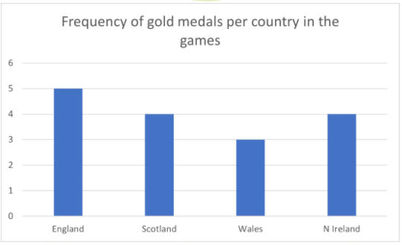
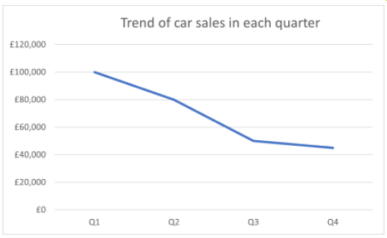
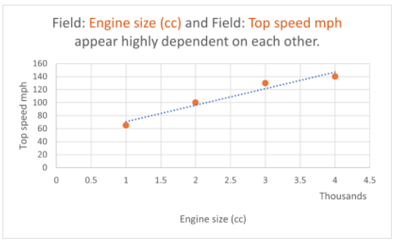

Quantitative Data - Charts

Slide 8


Using your data to tell a story
Considering the Reader
The Visual Hierarchy

Slide 9
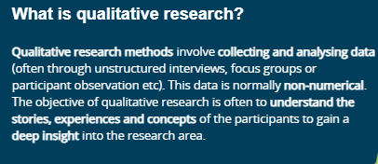

Organising qualitative data

Slide 10
The four stages of qualitative research
Data Collection
Reading and Re-Reading The Data
Interpreting Findings
Write Your Report

Slide 11


Learning from your project
The project that you are working on is the expression of what you will have learned in your time on the course, and it is your opportunity to demonstrate not just how you have improved, but how you have grown.
We learn all the time. Following on from the last session, you now understand that learning from past experiences is the fastest way of doing this. In short, we learn from our mistakes. However, as a species we are programmed to reframe and remember our mistakes in a favourable light, often misremembering events in order to make ourselves feel better.

Slide 12
Will you Innovate or Improve?
Part of the university experience is to deliberately place yourself in areas that are outside your Circle of Competence. In previous sessions, we have talked about this deliberate challenge to encourage creativity and new learning.
When making your project, you will of course be in a challenging zone, but you must take a moment to make sure that this challenge does not manifest into you appearing incompetent.
Your project must be coherent too.

Slide 13
Showcase your project
Throughout this module, you have learnt about several skills and ways to present your views and ideas. You have also created and developed an idea, either individually or as part of a team. Now it’s time to consider how you can showcase your learning and your work over this module.

Slide 14
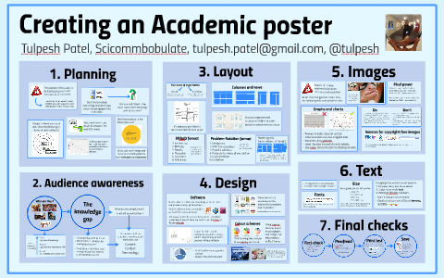
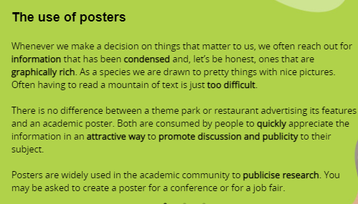
Posters

Slide 15
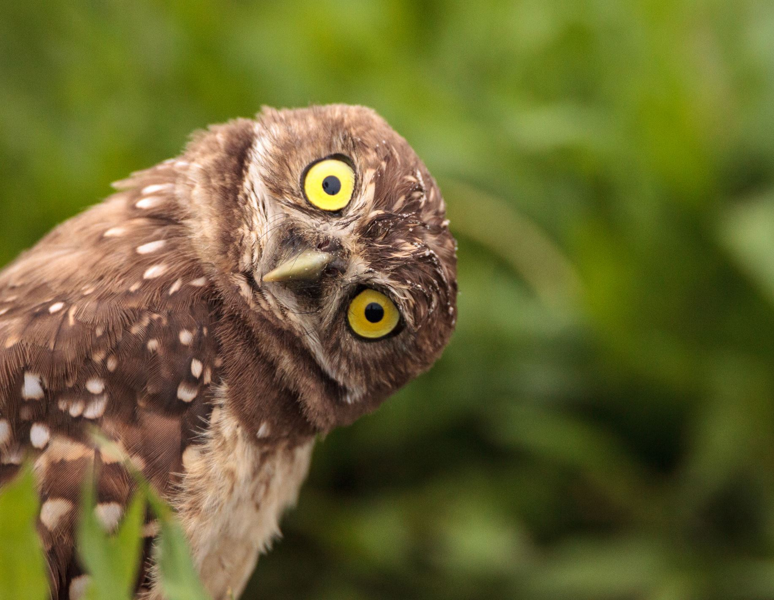
Any
Questions?

