Slide 1
Project Cost Management and Budgeting
Marie Pitson

Slide 2
Previously we looked at…….
accounting terminology and the financial statements, and discussed how the information contained within them aids management
Introduced the role of accounting in decision making and cost accounting
accounting for labour costs
Marginal and absorption costing
Monitoring project expenditure

Slide 3
Today we will look at…..
Break even analysis
Make or buy decisions
Stages in budget preparation
Limiting factors

Slide 4
Why would we monitor project expenditure?
Project managers monitor project expenditures to verify that they’re in accordance with the project plan and, if they’re not, to address any deviations.

Slide 5
Monitoring Project Expenditure

Slide 6
Break-Even Analysis

Slide 7
Introduction
An important part of running a company is the determination of how the company should be financed and how the prices of the products the company sells should be set
In order to do this properly a sound financial analysis is necessary

Slide 8

Variable Costs
These are roughly proportional to a company’s sales i.e. the cost per unit remains roughly constant
E.g. If a car manufacturer makes more cars it will use more sheet metal

Slide 9

Fixed Costs
Remain roughly the same regardless of the level of sales output
E.g. The cost of renting a factory to produce cars will not vary in line with the no of cars produced

Slide 10
Contribution
When the manufacturer sells a car it receives the selling price, which covers the variable costs of the car
As the selling price is greater than the variable costs there will also be money available to pay off the fixed costs incurred

Slide 11
Break-Even
Break-even is the point at which neither a profit nor a loss is made
The break-even point is the output level (units manufactured or services provided) at which the income from sales is just enough to cover all the costs

Slide 12
Break-Even
Break-even is the point at which the profit or (loss) is zero
The output level can be measured in a way that is appropriate for the particular business or organisation. It is commonly measured in units of output

Slide 13
Break-Even
The formula for break-even in units of output is:
Breakeven point = Total fixed costs/contribution per unit

Slide 14
Break-Even
In order to use break-even analysis, we need to know:-
Selling price (per unit)
Costs of the product (Variable and Overhead Costs)
  Limitations e.g. maximum production capacity

Slide 15
Interpretation of Break-Even
Break-even analysis, can be used by all types of businesses and organisations
For example, a shop will wish to know the sales it has to make each week to meet costs
Once the break-even has been reached, the additional contribution forms the profit

Slide 16
Limitations of Break-Even
Most businesses sell more than one product
Sales are unlikely to be the same as output e.g. stock, waste
Products are not sold at the same price at different levels of output e.g. discounts

Slide 17
Limitations of Break-Even
Variable costs do not always stay the same e.g. as output rises a business may benefit from lower costs due to buying power
It is a planning aid rather than a decision making tool

Slide 18
Margin of Safety
The margin of safety is the amount by which sales exceed the break-even point
Margin of safety can be expressed as:-
A number of units
A sales revenue amount
A percentage, using the following formula

Slide 19
Margin of Safety
Margin of safety = budgeted sales – breakeven

Slide 20

Margin of Safety
This calculation is especially important in times of recession as it expresses to management the amount of the ‘cushion’ where current production/sales gives beyond the break-even point

Slide 21
Margin of Safety
Where there is a comparison to be made between two or more products, each with different margins of safety, the product with the highest margin of safety is looked on favourably
However, margin of safety is only a factor in decision-making

Slide 22
Break-Even: Target Profit
A further analysis of break-even is to calculate the output that needs to be sold in order to give a certain amount of profit – the target profit
This is calculated as follows:

Slide 23
Break-Even: Target Profit
Fixed Costs (£) + Target Profit (£)
Contribution per unit (£)
= Number of units of output

Slide 24
Contribution to Sales Ratio
In break-even analysis, if fixed costs are known, we can use this ratio to find the sales value at which the business breaks-even
Or the sales value to give a target amount of profit

Slide 25
Contribution to Sales Ratio
The ratio, or percentage can be calculated on the basis of a single unit of production or for the whole business

Slide 26
Contribution to Sales Ratio (or P/V ratio)
This ratio expresses the amount of contribution in relation to the amount of the selling price:
Contribution (£)
Selling Price (£)
= Contribution to sales ratio

Slide 27
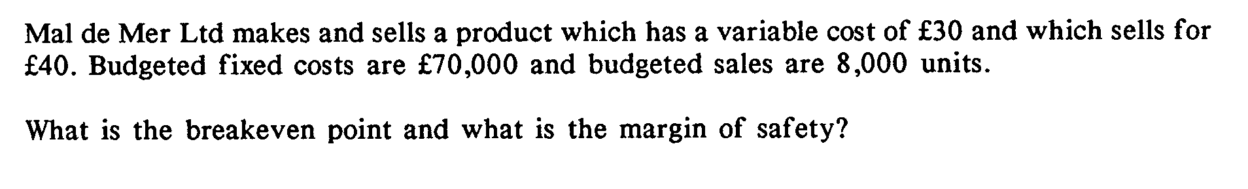
Example:

Slide 28
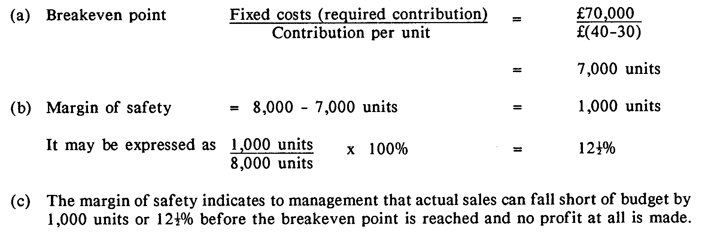
Solution:

Slide 29
Given the following information for product Z:
Selling price per unit £20
Variable cost per unit £12
Fixed costs £100,000
Required:
Calculate the break-even point in terms of number of units.
Calculate the break-even point sales revenue.
Calculate the sales volume needed to achieve a profit of £20,000.
If budgeted sales are 16,000 units, what is the margin of safety, in units and as a percentage?
Calculate the contribution/sales ratio and use that to find the break-even revenue.

Slide 31
Profit Planning and the Break Even Point

Slide 32
Profit Planning and Break Even Charts

Slide 33
Sales
Total Cost

Slide 34
The Concept of Relevance
To be relevant, i.e. to affect a decision, a cost must be:
Future
A Cash Flow
Incremental
Sunk costs (previously spent or committed) are removed from the process

Slide 35
Make or Buy Decisions
Do we buy in or manufacture a component?
E.g: We are currently manufacturing a component. At present 20,000 are needed and the annual costs are reported to be: £000’s
Direct Materials 200
Direct Wages 50
Supervision 8
Floor Space Occupancy 7
The component could be purchased for £12.75 each. Do we continue to manufacture?

Slide 36
Considerations

Slide 37
At 20,000 Units Volume

Slide 38
At 40,000 Units p.a.

Slide 39
This is a purely financial decision. Other factors must be taken into account:
  Reliability of outside product
  Ability of supplier to deliver to time and specification
  Potential loss if not delivered (particularly in the JIT environment)
  Other risks

Slide 40
Managing by the Numbers:
Will allow a clear indication of where profit comes from, and allows decisions on an obvious, rational, basis
May well result in a leaner, but more profitable, organisation
Will make any successful organisation the darling of the banks/investors
Can be fraught with problems in the long term

Slide 41
Where the problems arise...
Increased volatility of employment
Flight not fight (particularly under recession)
Market share increase may decrease profitability in the short term (see Japanese industrial policy for details)
Is money the only criterion for success (Yen Buddhism)?
The good of the shareholders is not consonant with the good of the other corporate stakeholders

Slide 42
An Example - Selling Price Setting (Use Marginal Costing)

Slide 43
Solution

Slide 44
But note ...
Unwise to handle large contracts at this price - it may displace more profitable business. Sale at lower price should not be permitted to displace sales giving a higher rate of contribution.
Price cutting can lead to a general reduction in prices either due to customers demanding comparable terms or due to competitors entering into a price war.

Slide 45
The Result?
Commonest problems of the end of a recession
  Companies stuck with low margin business cannot clear decks for profitable work
  Exposure on ongoing projects may be high
  Failure to predict end of recession leads to poor performance against new business
  Companies close because of recovery

Slide 46
Budgeting & variance analysis
identify the stages involved in your project.
attempt to assess a cost for each activity in each stage (materials, equipment)
set an estimated budget for each stage.
record actual costs in each stage.

Slide 47
Budgeting & variance analysis
compare actual and estimated costs to extract variances.
attempt to explain causes of variances.
derive a budgeted cost structure for a full production run.

Slide 48
Variance analysis
Deviations between actual money value of an item and the corresponding budget are known as variances. For effective action, we must identify:-
  who was responsible for variance occurring
  why it occurred - analysis by cause

Slide 49
Variances Cont.
Two main aspects in variance analysis:-
  Pricing aspect - selling price per unit in case of sales, cost price per unit in case of materials, labour, and other expenses.
  Physical aspect - quantity of products sold, or materials used, or the hours worked etc.

Slide 50
Budgets - Why?
Plan
Measure
Compare
Analyse by causes
Take action & revise.

Slide 51
Functional Budgets
A functional budget is a document that applies to a limited area of the company. It does not mean that the budget works, but that it applies to a function
(i) Sales budget (quantity, prices, values)
(ii) Production budget
  Production budget
  Plant utilisation
  Production cost
  Stock budget
(iii) Purchasing budget

Slide 52
Functional Budgets
(iv) Direct labour budget
(v) Admin expenses budget
(vi) Selling & Distribution expenses budget
(vii) Research & Development budget
(viii) Working Capital budget
(ix) Cash budget

Slide 53
Stages In Budget Preparation
  Determine budget period
  Identify limiting factors and principal budget factor.
  Prepare "functional" budgets
  Prepare a forecast P&L account and balance sheet at year end
  Calculate budgeted overhead rates.
  Obtain approval of budget committee.
  Obtain approval of MD/ board.

Slide 54
Limiting Factors
Any factor which restricts demand, production volume or any resource in such a way as to limit the activity of the company.
Management will seek to:
  (1) Overcome the limitation,
  or
  (2) Accept the limitation as outside the control of the organisation.

Slide 55
Principal Budget Factor
A limiting factor which cannot be overcome or avoided which will determine the form of the year's budget plan. The year's budgets are prepared around the principal budget factor.
The majority of companies have the SALES BUDGET as principal budget factor.

Slide 56
Preparing The Functional Budgets : Forecasting
Sales Budget
  Very difficult - depends on "uncontrollable" outside forces - unless have well filled order book several months ahead.
    (i) Statistical Analysis of Previous Years.
    (ii) Sales Staff Estimation.
    (iii) Internal/ External Market Research.
    (iv)Targeted Increase over Previous Year.
    (v) Desired Sales

Slide 57
Preparing The Functional Budgets
Production Budget
  Can production capacity support forecast sales and, if so, what production costs will we face?
    (i) Materials - volume and price?
    (ii) Productive workers - how many? What salary?
    (iii) Machines - how many? Operating cost?
    (iv) Facilities - operating cost?
    (v)Factory administration - which depts.? How much?

