Slide 1
The role of the adult in supporting children's wellbeing.

Slide 2
Vulnerability versus experiencers.
How do children develop an understanding of the world in which they live, and nurture a sense of agency and competence?
How can this be facilitated?
Life experiences impact on our feelings, thoughts and physical state

Slide 3
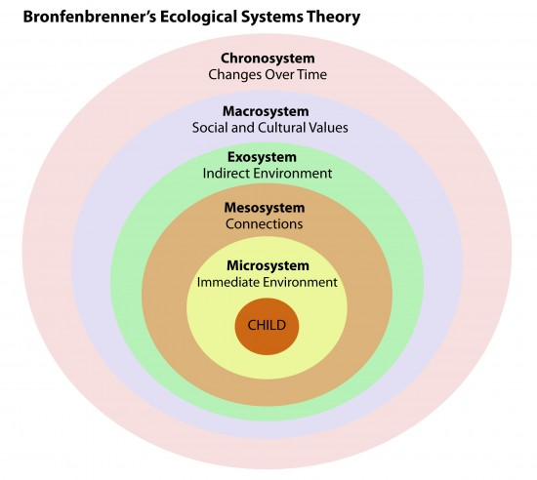
Remember our old friend?

Slide 4
Public Health Wales
Healthy and Confident Individuals...
I understand how my body works and how to keep it healthy.
I can form and maintain healthy relationships with others
I understand how my behaviour and choices can impact on my health and wellbeing both now and in the future
I can recognise and express my feelings.
I can recognise risk and think through the immediate and future consequences of my choices
I can recognise the individual, organisational, social and cultural values/norms which can influence my decisions
I can find and appraise information to help me make choices about my health and wellbeing
I can resolve conflict with others and recognise where the behaviour of others may be a sign of their unhappiness or distress
I have the confidence and skills to assert my view and make my own choices.
I have the skills to look after myself and those around me
I recognise how government and global decisions influence people’s health
I understand when and where I can access help

Slide 5
VYGOTSKY

Slide 6
Core skills of Early Years Practitioners.
Effective communication Listening and building empathy
Child and young person development
Knowledge
Safeguarding and promoting the welfare of the child or young person
Multi-agency and integrated working

Slide 7
Dr. A. Salusbury MacNalty (Chief Medical Officer Ministry of Health and Board of Education)…Hygiene in the school must be a training in habit, a discipline as well as a culture, concerned directly with the life of the children, his family and the community…..It is most important that the school premises should provide a civilising environment favourable to he foundation and practice of healthy habits – roomy classrooms with abundant sunlight and ventilations: well-arranged and properly equipped offices and lavatories with a supply of hot water; suitable uncrowded cloakrooms; facilities for drying clothes and boots and adequate playgrounds. Well-arranged dining-rooms, properly served school meals…with facilities for exercise and rest are powerful agents in health education.’
How can this become a reality in practice?

Slide 8
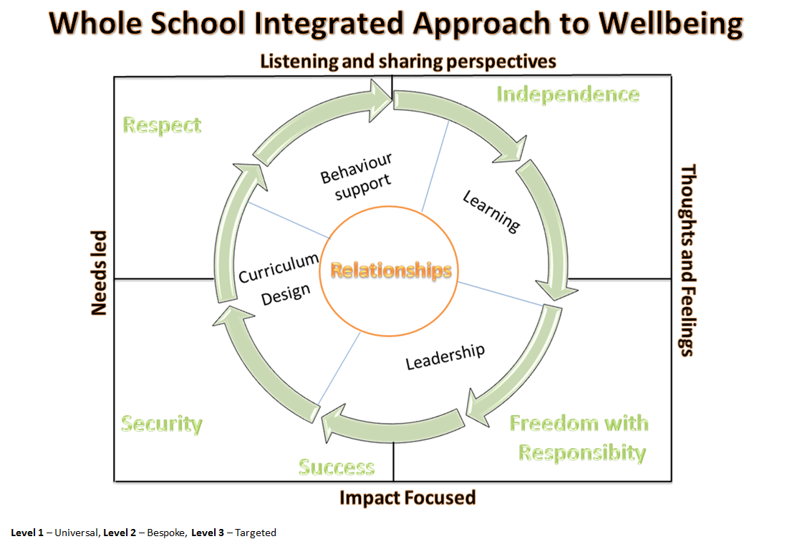

Slide 9
1. Physical confidence and competence has considerable lifelong benefits to health and well-being or We experience the world through our body
2. Life experiences impact on our feelings, thoughts and physical state
3. Our decision making and subsequent actions impact on the quality of our lives and others
4. Our physical, social and cultural environments are connected to our health and well-being
5. Relationships connect us with each other and the world

Slide 10
References
Public Health Wales. (2018) New curriculum places health and wellbeing at heart of learning http://www.wales.nhs.uk/sitesplus/888/news/48559
Welsh Government (2017)Health and Well-being AoLE: Submission to Curriculum & Assessment Group
https://beta.gov.wales/sites/default/files/publications/2018-07/health-and-well-being-aole-december-2017.pdf

