Slide 1
Leadership and Change
Day 5

Slide 2

Our Vision
critically examine the complex nature of challenges for the leadership role within times of organisational change;
• critically evaluate the influence of organisational culture in the context of change initiatives;
• identify and critically analyse a range of strategies for leading change in the context of challenges to the organisation from within.

Slide 3
Our Vision
critically examine the complex nature of challenges for the leadership role within times of organisational change;
• critically evaluate the influence of organisational culture in the context of change initiatives;
• identify and critically analyse a range of strategies for leading change in the context of challenges to the organisation from within.

Slide 4
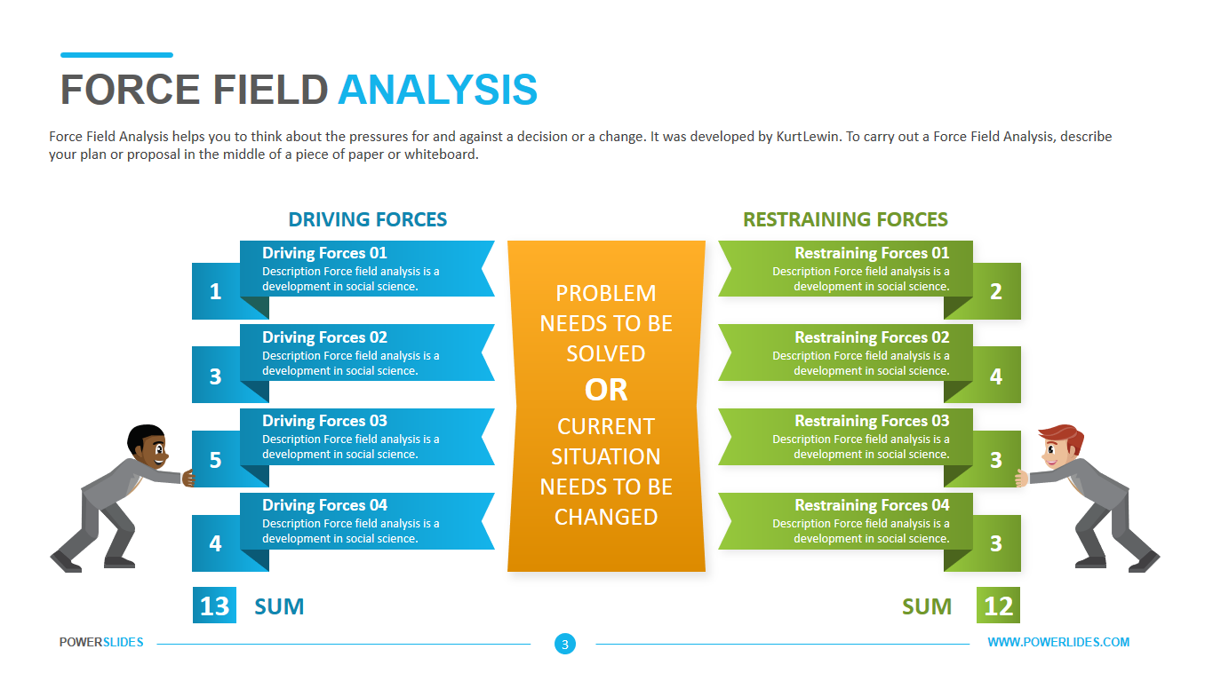

Recap on last session

Slide 5
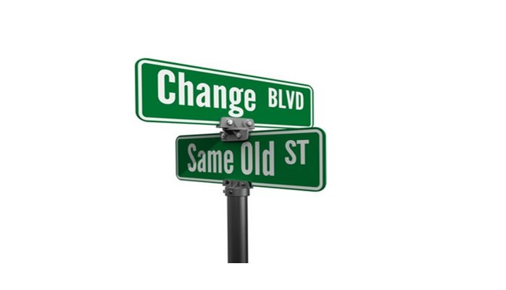
Barriers to change

Slide 6
Barriers to change
“Changing systems and processes, structure, even a new business strategy, isn’t terribly difficult. It’s the people aspect that’s tough.
We talk about encouraging people to take risks, but it is rarely safe for people to do so. We talk about empowering decision-making but maintain the prerogative to over-rule those decisions if we don’t like them.” Palmer, B (2016)

Slide 7
Readiness and resistance
“Tony Eccles (1994) identifies eight preconditions for successful change:
Is there pressure for this change?
Is there a clear and shared vision of the goal and the direction?
Do we have effective liaison and trust between those concerned?
Is there the will and power to act?

Slide 8
Readiness and resistance (continued)
5. Do we have enough capable people with sufficient resources?
6. Do we have suitable rewards and defined accountability for actions?
7. Have we identified actionable first steps?
8. Does the organization have a capacity to learn and to adapt?
Buchanan and Huczynski (2010: 570)

Slide 9

People don’t resist change – they resist being changed
Peter Senge
Notes:
You may agree or disagree, not sure?
As we move into a new module, we will be shifting our attention to leadership and change
Module is not about project management methodology – it’s about people because organisations don’t change, people do.
So how do you lead people through change is the central question of this module.

Slide 10
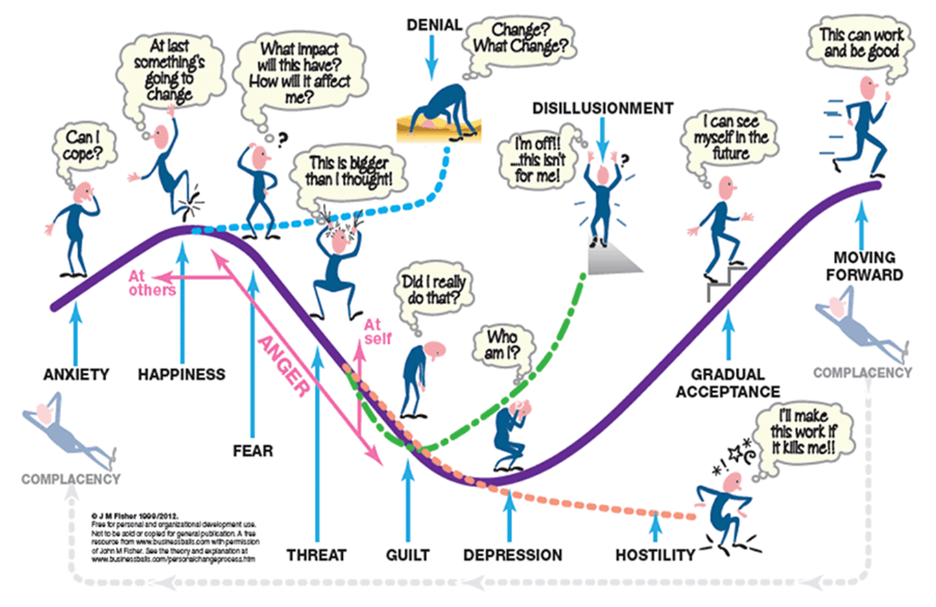
Individual responses to change
Fisher (2012)

Slide 11
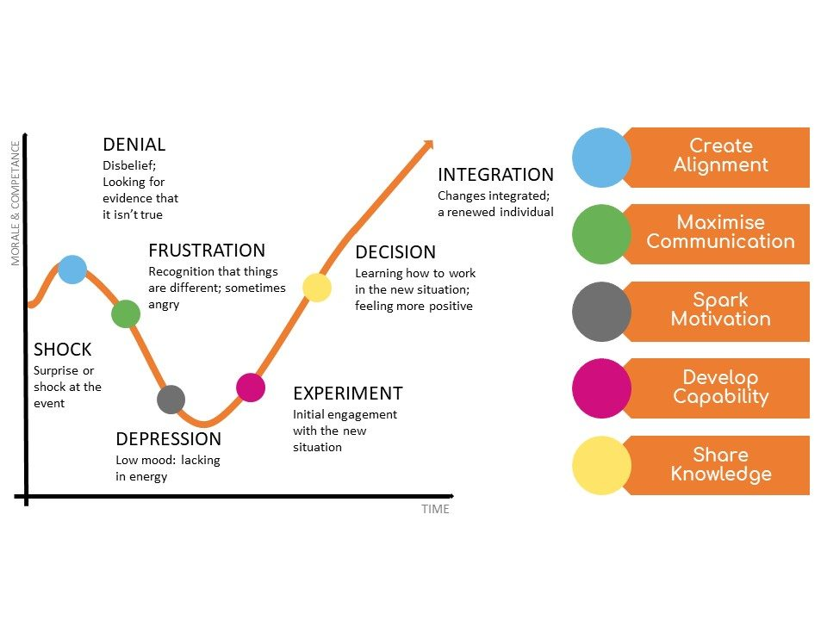
Kubler-Ross ® (1969)
Kubler-Ross Grief Cycle – 5 Stages

Slide 12
Understand the internal and external triggers
“…lists of triggers makes organizational change sound like a reactive process. Clearly this is not always the case. In many instances, organizations anticipate events and trends, and are proactive in implementing appropriate changes.”
Buchanan and Huczynski (2010: 564)

Slide 13
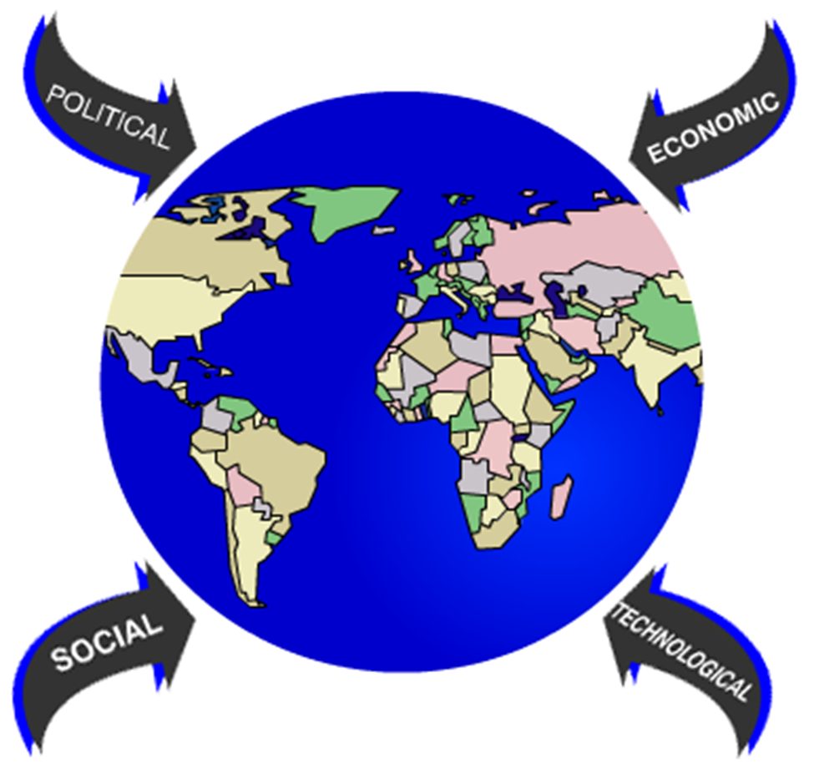


Internal and external drivers

Slide 14

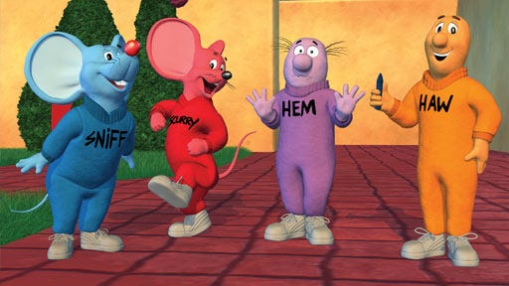
https://www.youtube.com/watch?v=jOUeHPS8A8g

Slide 15
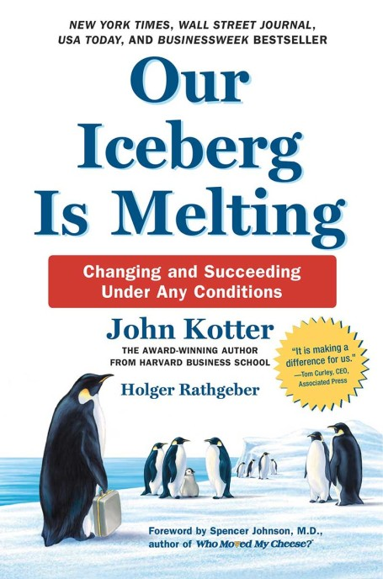

Kotter’s eight
step model

Slide 16
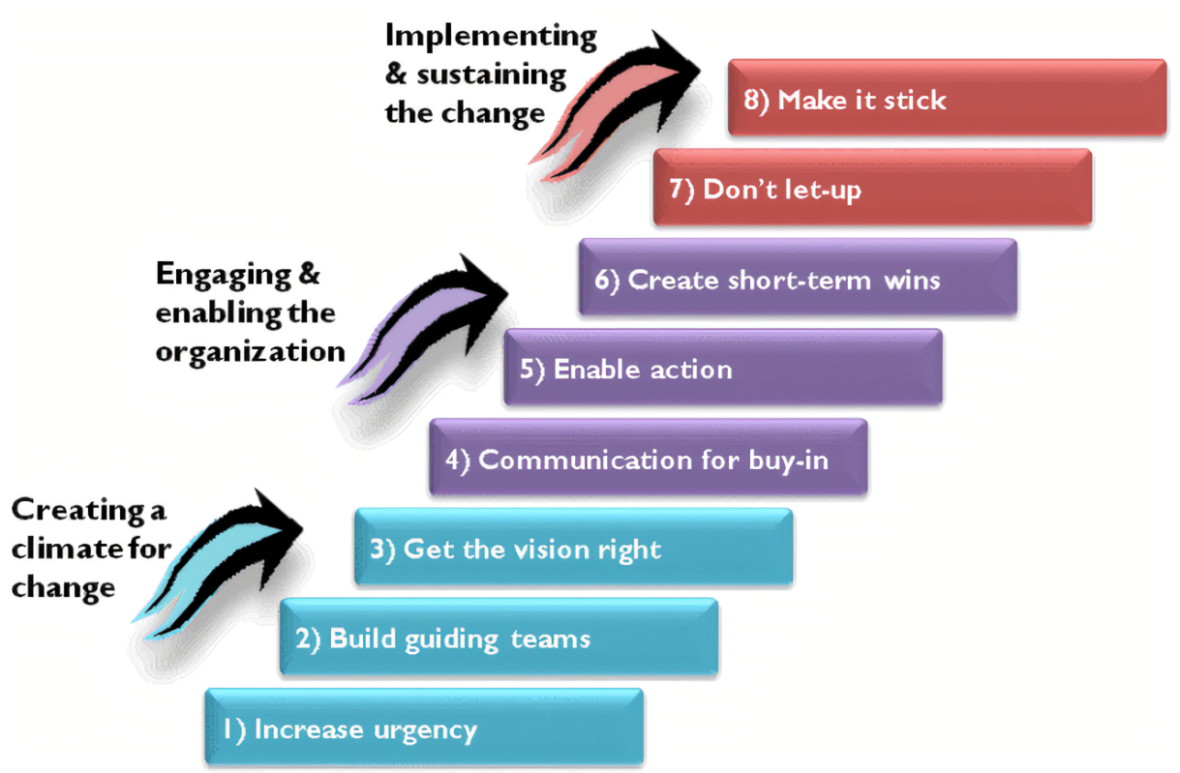

Slide 17
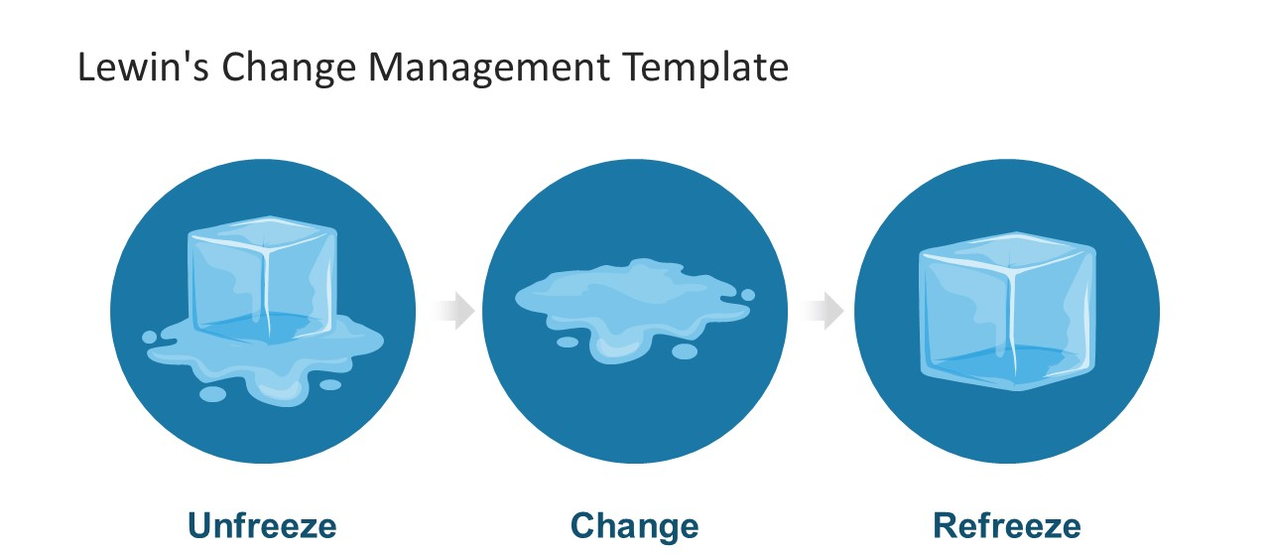
Identify and analyse Strategies
Lewin. K (1951)
Establish a sense of urgency
Create the guiding coalition
Develop a vision and strategy
Communicate the change vision
Empower broad-based action
Quick wins
Consolidate gains and make more change
Anchor new approaches within the culture
John Kotter

Slide 18
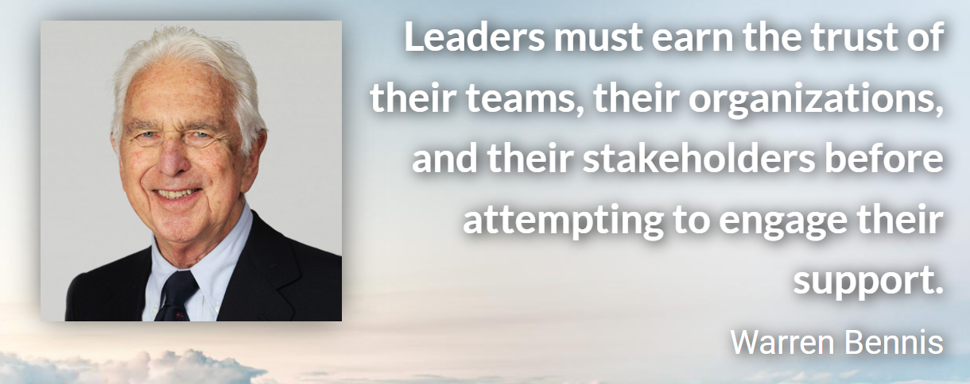
Stakeholder engagement

Slide 19

Stakeholders

Slide 20
Stakeholders
A stakeholder is an individual or a group affected by, or has an effect on, an organisation. So, the stakeholders in a business aren't just its owners, or its shareholders, or its employees. They're its customers, suppliers, local authority and national government.
They can be internal, external or sometimes both!

Slide 21
Importance of stakeholders
Once a business has identified its stakeholders, managers must ask themselves some key questions about each.
First, they need to determine:
Are they increasing or decreasing in importance and power?
What are their interests?

Slide 22
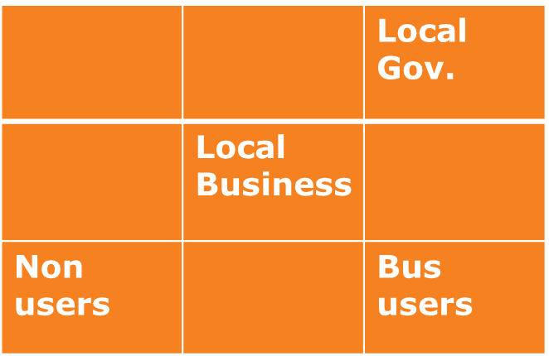
Mapping Stakeholders
Stakeholder interest and power can be mapped. The following example was produced by a private bus company.
Power
Low Some High
Low Some High
Interest

Slide 23

Mapping Stakeholders
Try this example from a college. The stakeholders have been identified but you need to agree where they should be plotted:
Central Government
Local residents
Funding body
Students and teachers
Local government
Power
Low Some High
Low Some High
Interest

Slide 24
Importance of stakeholders
Having established the importance/power and interests of the stakeholders, managers need to estimate the strength of the relationship, in terms of:
What impact do we have on them?
What impact can they have on us?

Slide 25
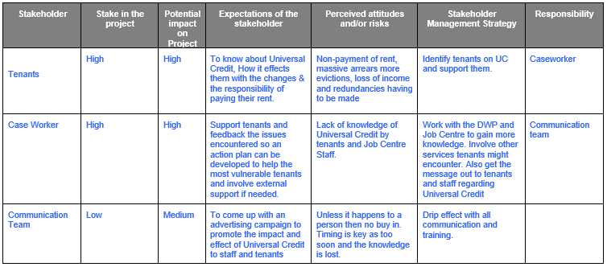
Stakeholder Management and Engagement

Slide 26
Guidelines
Identify and include all the stakeholders.
Involve those affected in putting the plans together.
Have SMART objectives.
Keep everyone regularly informed of progress using both formal and informal methods.
Keep the momentum going by rewarding “wins” along the way.

Slide 27


Slide 28
References
Buchanan, D.A. and Huczynski, A.A. (2010) Organizational Behaviour. 7th ed. Harlow: Financial Times Prentice Hall
Changing behaviours in public health. (2013) Available at:
http://www.local.gov.uk/documents/10180/11463/Changing+behaviours+in+public+health+-+to+nudge+or+to+shove/5ae3b9c8-e476-495b-89b4-401d70e1e2aa [Accessed 19th September 2016]
Chartered Management Institute (2017) Models – Stakeholder Analysis. CMI: Corby
Cranfield University School of Management (2009) Stakeholder Engagement: A Road Map to Meaningful Engagement. Doughty Centre: Bedfordshire
De Vita, E. and Vernon, M. (2007) ‘Get Engaged’, Management Today, April, pp. 38-43. Business Source Complete, EBSCOhost. [Accessed 18th August, 2016]
Mayson, H. (2014) ‘The Future of Employee engagement’, Institute of Leadership and Management. https://www.i-l-m.com/Insight/Inspire/2014/June/what-is-employee-engagement [Accessed on 18th August, 2016]
Merrell, P 2012, 'Effective Change Management: The Simple Truth', Management Services, 56, 2, pp. 20-23, Leadership & Management Source, EBSCOhost, viewed 21 September 2016.
Miller, R., Freeman, T., Davidson, D. and Glasby, J. (2015) An Adult social Care Compendium of Approaches and Tools for Organisational Change, Birmingham: University of Birmingham. Health Services Management Centre, Middlesex University
Nelson, D. a. Quick, J. 2008 Understanding Organizational Behavior, Mason, Ohio: South-Western Cengage Learning
Palmer, B. (2016) Why change programmes fail in their tracks. Available at: http://www.trainingzone.co.uk/community/blogs/blairepalmer/why-change-programmes-fail-in-their-tracks (accessed 1st September, 2016)
Senior, B. and Fleming, J. (2006) Organizational Change. 3rd ed. Harlow: Financial Times Prentice Hall
Thaler, R.H. and Sustein, C.R. (2008) Nudge: Improving Decisions about Health, Wealth, and Happiness. New Haven: Yale University Press

