Slide 1
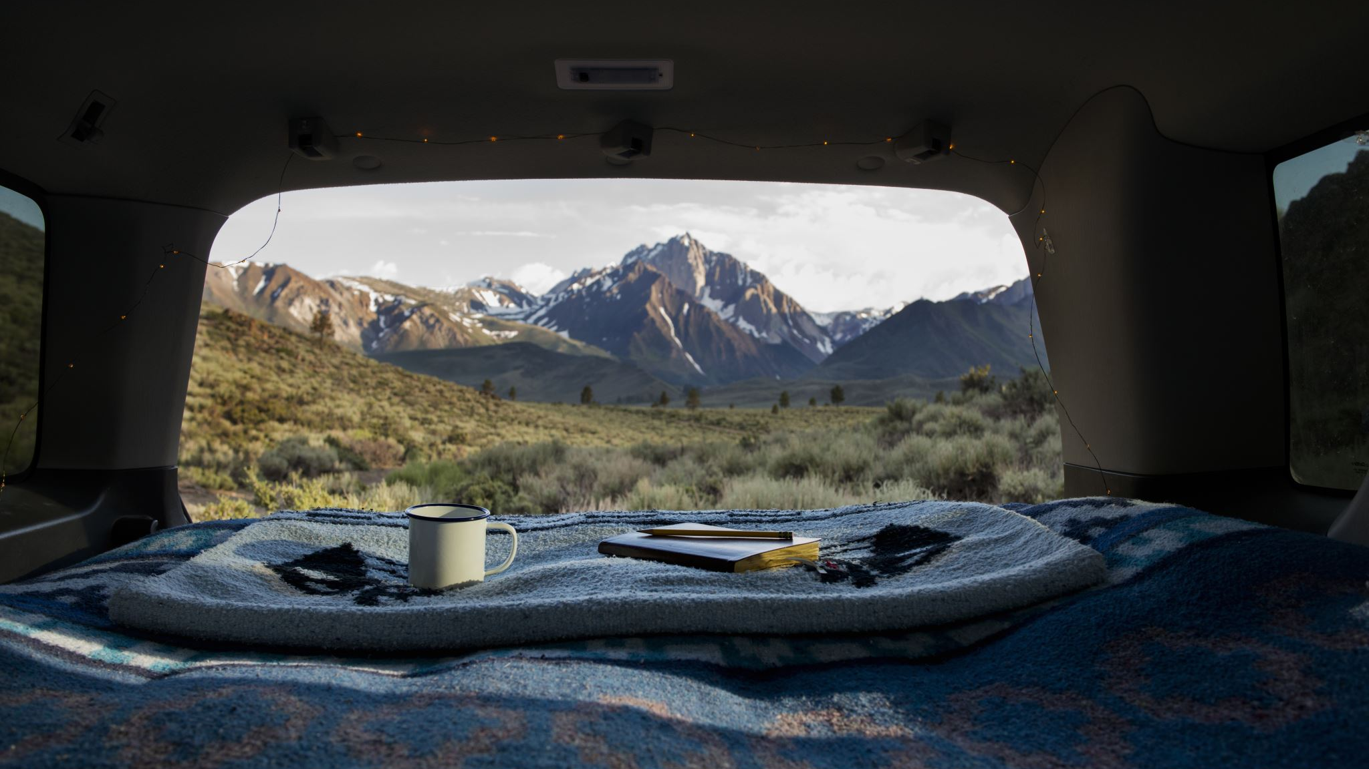


Curriculum Adventure- Assignment 2

Slide 2
Objectives
Discuss my proposed program for Key stage 3 pupils to prepare them for their residential visit.
Discuss the potential using the school grounds and nearby areas as a place to use as part of delivering this program.
Make links to the current Physical Education Curriculum and my unit of work.
addressing problems facing schools in relation to COVID 19 and also appropriate levels of challenge for secondary age pupils.

Slide 3
Modern foreign languages
Citizenship
Geography
Maths
Music
Religious education/ Sex Education
Key stage 3
Compulsory
English
Science
Computing
History
art and design
Design and technology
Physical Education

Slide 4
Physical Education
In physical education, learners engage in planning how to design and make progress in their performance, developing their ideas and strategies, and reflecting on how they might further improve their own and others' performance
Adventurous activities;Pupils should be given opportunities to: 2. plan, undertake and evaluate activities, using what they find out to plan how to improve their next attempts 5. listen carefully to the contribution of others, make individual and group decisions to identify problems and suggest alternative approaches.

Slide 5

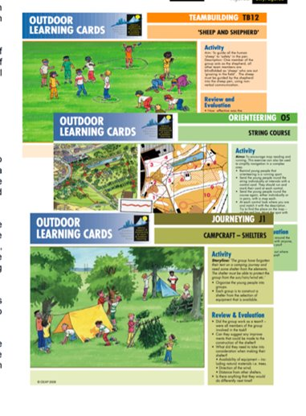
My proposed program
6 Weeks program that will prepare KS3 pupils for their residential.
"Outdoor learning cards will also support the broader curriculum, such as maths, English, geography, PSHE and ICT." (OUTDOOR EDUCATION ADVISERS’ PANEL)
outdoor learning isn’t a subject or topic; it’s a way of teaching. (Burt, 2016)
Gradual increase in challenging activities
Towards the end of the program, pupils will have the skills and experience needed to fully engage with the residential activities.

Slide 6
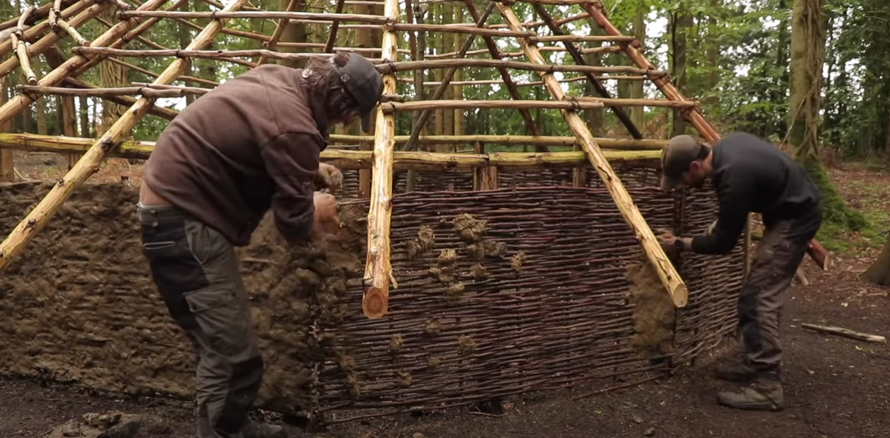
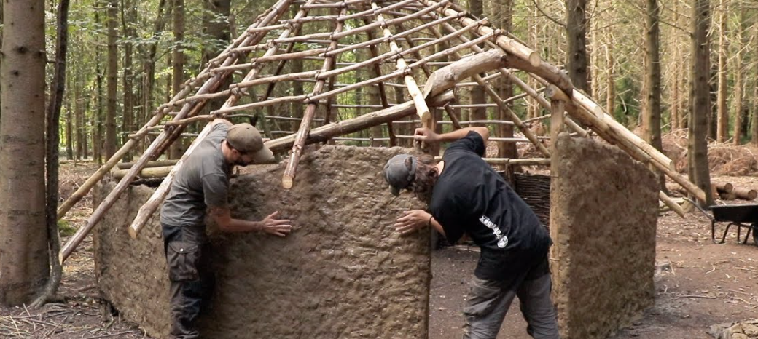
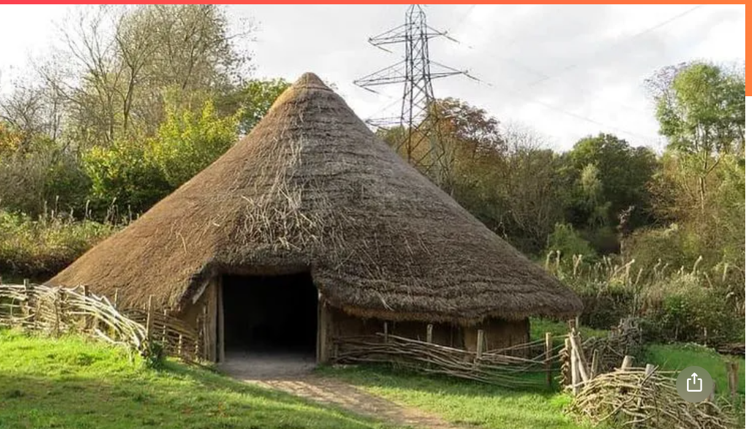
Roundhouse
(TA Outdoors, 2020)
‘Young people who experience learning outside the classroom as a regular part of their school life benefit from increased self-esteem and become more engaged in their education both inside and outside the classroom walls’ (Council for Learning Outside the Classroom).
Kellert (2012) suggests that starting early helps to develop a positive desire to be in nature.
kidadl.com

Slide 7
Staying local meant that we don't have to worry about the hassle and cost of organising transport. We don't need huge risk assessments and consent forms because we were on the school site and it encouraged lots of our staff to look around our site with a different frame of mind. ( Council for learning outside the classroom )
Outdoor and adventurous activities, initiative challenges and journeys promote a knowledge and understanding of the rich and varied environmental characteristics of Wales. (Welsh Government, 2015, P. 10
school grounds and local spaces can be used daily to enhance teaching and learning right across the curriculum (Burt, 2016)

Slide 8
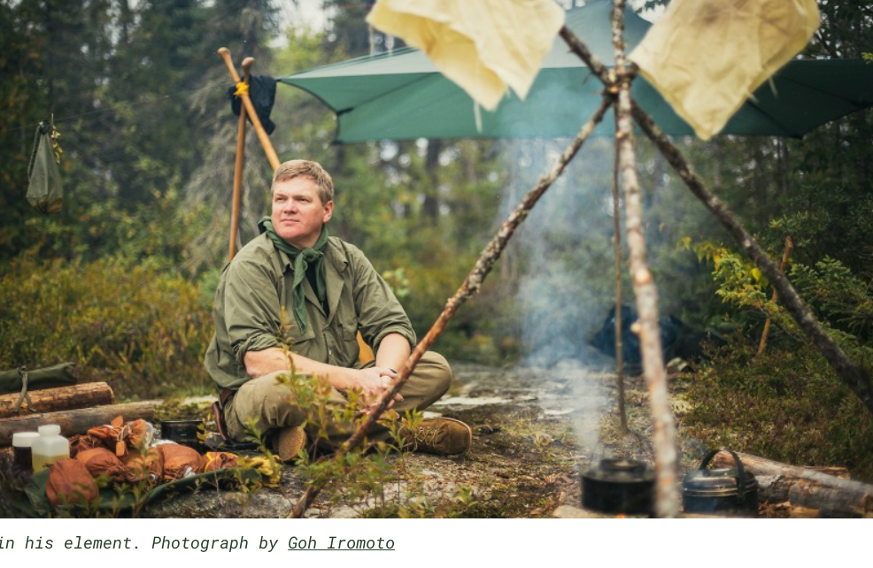
“child psychologists say that outdoor exploits aren’t only great for physical health but for mental health as well. The same psychologists also have concerns about ‘tiger parents’ who want to hothouse their kids in some sort of obsessive bid to produce pint-sized prodigies, who could end up stressed, frazzled and burned out by their late-teens and who could actually end up with mental health problems.”
Ray Mears (Woodlandclassroom, 2019)

Slide 9
References
Burton, J. (2016) 'Busting the myths on outdoor learning in schools', Natural England [blog] Available at: https://naturalengland.blog.gov.uk/2016/07/21/busting-the-myths-on-outdoor-learning-in-schools/ (Accessed: 9th January 2022).
Council for learning ourside the classroom. Case Study: Natural Connections Demonstration Project at Torpoint Community College (Accessed: 9th January 2022).
https://kidadl.com/articles/iron-age-houses-ks2-everything-you-need-to-know
Kellert, S. (2012). Birthright: People and Nature in the Modern World. New haven, CT: yale University Press.
MLA 8th Edition (Modern Language Assoc.)
Jo Barton, et al. Green Exercise : Linking Nature, Health and Well-Being. Routledge, 2016.
APA 7th Edition (American Psychological Assoc.)
Jo Barton, Rachel Bragg, Carly Wood, & Jules Pretty. (2016). Green Exercise : Linking Nature, Health and Well-being. Routledge.
Outdoor education advisors panel.
TA Outdoors, 2020
Woodlandclassroom (2019) Ray Mears Champions Forest School Available at: https://woodlandclassroom.com/ray-mears-champions-forest-school/ (Accessed: 9th January 2022).
Welsh Government (2015) Physical education: guidance for Key Stages 2 and 3. Available at: https://hwb.gov.wales/curriculum-for-wales-2008/key-stages-2-to-4/physical-education-guidance-for-key-stages-2-and-3/ (Accessed: 10th January 2022).

