Slide 1
Poverty
Discuss the concept of ‘poverty’ referring to theory policy and practice.
Lois Brunton – 1801507 module code – SJS1 4012
Notes:
Good afternoon, I'm lois Brunton and today I will discuss the concept of poverty referring to theory policy and practice

Slide 2
The aim of this presentation is..
To define poverty with links to social policy
To explain poverty using sociological theories such as..
To explain poverty using … as a theory
To talk about poverty policy in wales and how it is tackled
And to outline some real life examples of poverty
Notes:
To define poverty with links to social policy
To explain poverty using absolute and relative poverty as theories
To use sociological theories such as the undeserving poor and cultures of worklessness as theories
To talk about poverty policy in wales and how it is tackled
And to outline some real life examples of poverty

Slide 3
How can poverty be defined?
Poverty can be seen as a result of being unable to access basic needs (Joseph Rowntree Foundation, 2018)
Poverty in terms of social policy, is not just being unable to access basic needs.
The world Banks study, voices of the poor (1999) recognises there are a number of that factors which in turn, can contribute to causing poverty (Spicker, 2018)
Notes:
The joseph Rowntree foundation : poverty can be viewed in many ways, such as not being able to access basic needs (backed up by maslow, 1943)
Example in real life: (joseph Rowntree) not being able to afford paying your rent or being unable to heat your home.
Spicker and the World Banks Study: other factors contribute to poverty - low social class, lack of access to services, living in areas of deprivation.
THE WORLD BANK STUDY emphasises heavily on social relationships, such as social exclusion and then political issues such as limited communal organisations.
SPICKER 2018: these issues must be linked together when dealing with poverty, poverty is increasingly being thought as a MULTIDIMENSIONAL CONCEPT.
This means it is crucial to go beyond looking just at income when researching and tackling poverty, but also consider factors such as poor health and inadequate living standards – JUST AS LIKELY TO LEAD TO POVERTY.

Slide 4
Theories of poverty
Relative and absolute poverty
Absolute poverty – can be viewed in terms of income, and being unable to retain basic needs.
Relative poverty – occurs when a household income is enough to afford basic needs such as water and food, but not enough to afford anything more than the basics.
(Habitat for Humanity Great Britain, 2017)
Notes:
ABSOLUTE POVERTY: when household income is below a certain level, this makes it impossible to meet basic needs eg, food or shelter as stated by HABITAT FOR HUMANITY 2017.
EXAMPLE IN REAL LIFE: even with two full-time working parents on minimum wage, a family are still 12% below the minimum amount needed to access and provide basic needs. (CHILD POVERTY ACTION GROUP)
RELATIVE POVERTY: household income is 50% lower than an average household income. Can afford basic needs, but cannot afford above this level.
EXAMPLE IN REAL LIFE: a family that can afford food, water and shelter. but they may not live in a safe home, house may not be free from abuse or neglect. May be unable television and internet. (norm for many, luxury for some)
RELATIVE POVERTY CAN BE SEEN AS SCIAL EXCLUSION. In more developed countries such as the UK, this means being excluded from what most people in the UK would believe to be things that constitutes to normal life.
EXAMPLES OF THIS unable to pay for internet to access services, education, proper clothes for job interviews and employment.
(ALL RELATIVE POVERTY DESCRIPTIONS AND EXAMPLES FROM HABITAT FOR HUMANITY 2017)

Slide 5
A Sociological Theory of Poverty
The ‘undeserving poor’ and the idea of ‘cultures of worklessness’..
Belief that the welfare system is responsible for encouraging welfare dependency.
Further studies examine ‘cultures of worklessness’
(Joseph Rowntree foundation, 2015)
Notes:
JOSESPH ROWNTREE STUDIES REVEAL: Many sociologists believe poverty can be best understood by seeing it as a result of the unequal distribution of resources and opportunity across society rather than peoples individual failings.
In recent years it has been claimed the welfare system encourages welfare dependency.
Further studies have claimed that ‘cultures of worklessness’ are passed down generations.
MEANING it can become a viscous cycle of unemployment or welfare dependency if you are bought up in a welfare dependent household, it can become an instilled value, and you may then follow in this path and become a welfare dependent adult, you may install these ideas to your family alos

Slide 6
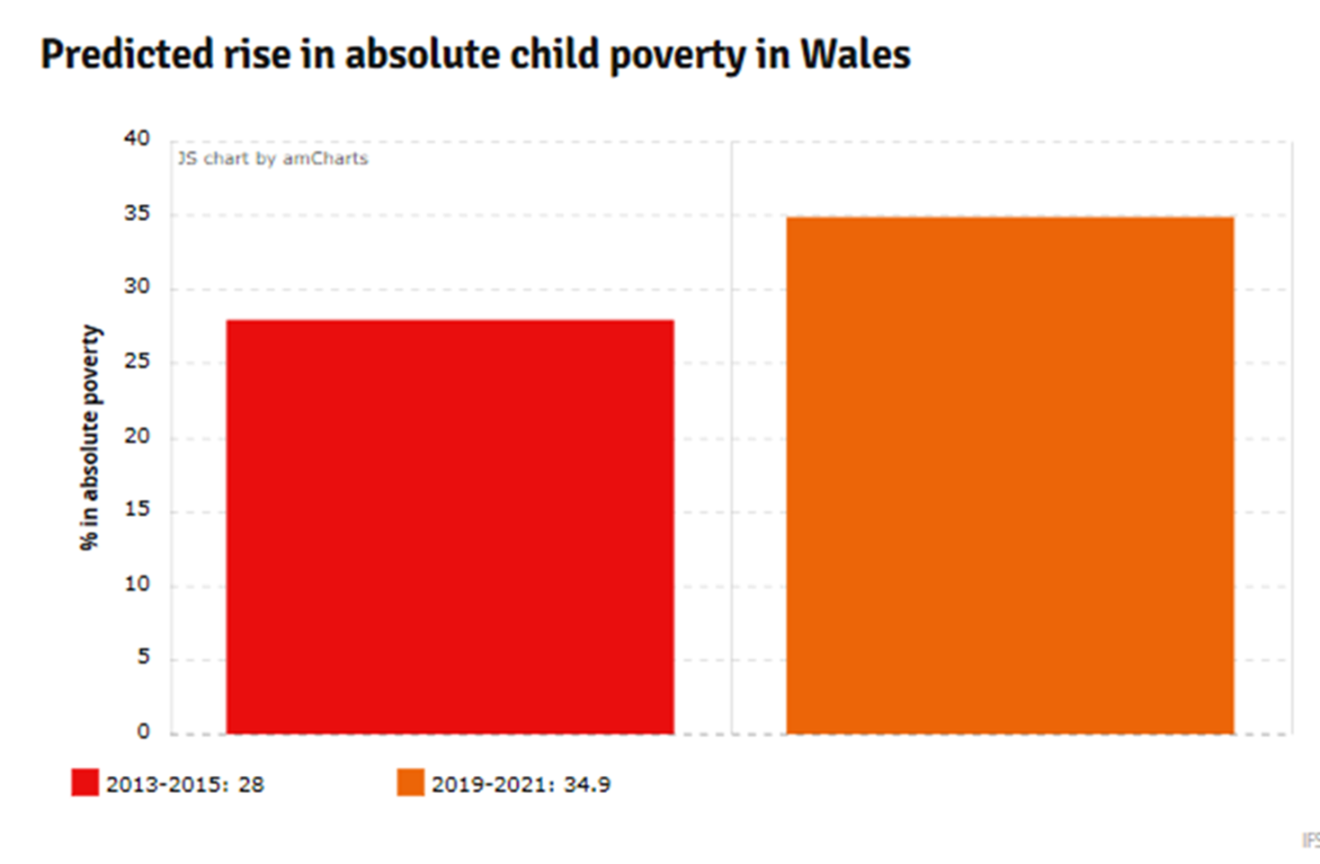
Poverty in Wales
Research is predicting a massive rise in absolute poverty is soon to occur in wales.
Research also predicts a rise in Child poverty
An expected 34.9% rise in child poverty in 2019-2021 period.
(David Williamson, 2017)
Notes:
DAVID WILLIAMSON POLITICAL EDITOR FOR WALES ONLINE: reported a massive rise in absolute poverty will soon Occur in wales, bigger than anywhere else in the UK.
expected 34.9% rise in child poverty in the 2019-2021 period.
JOSEPH ROWNTREE FOUNDATION supports this research and explain the freeze to working age benefits will result in approximately 7.5 million low-income households experiencing massive benefit entitlement cuts, in a real life will be a loss of around £500 a year for these families.
Welsh government have stated welfare changes are going to have a devastating effect on low income families in Wales, in particular those with children
This information is all from David Williamsons, Wales online report in 2017.
but what policies are in place in wales and th, and what is really being done to tackle poverty?

Slide 7
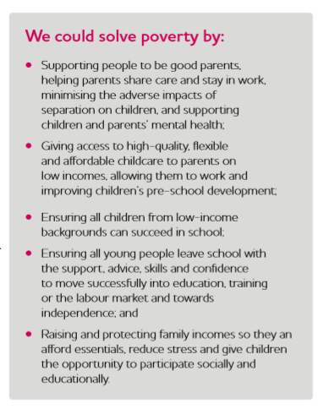
Joseph Rowntree foundations ideas
Ideas of prevention rather than cure
Tackling problems before they come problems
(Joseph Rowntree foundation, 2018)
Notes:
THE JOSPEH ROWNTREE FOUNDATION have their own ideas on tackling poverty.
They're approach – PREVENTION RATHER THAN CURE, better to put support in place to households before being able to fall in to poverty rather than helping them get out of poverty once they have already reached that level.
IDEAS:
1. making sure school leavers are leaving with the understanding and knowledge needed to access services, with the confidence to do so, along with the best qualifications possible
this could help prevent poverty because: they're in better position in accessing jobs, and helping themselves to maintain the qualifications needed for these jobs.
2. better providence of affordable and adequate child care, to decrease the pressure parents face in feeling the need to take long periods or permanent time out of work in order to look after their children – resulting in poverty because they have missed out on wages, and may be unable to find work due to job gaps on their cv.

Slide 8
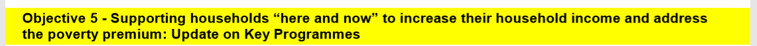
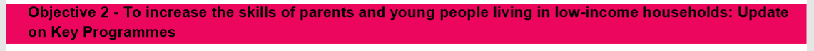
What are Wales doing to tackle poverty?
Wales, Child poverty strategy
Projects and policies running under this objective:
Water, credit unions, fuel poverty, Financial Inclusion Strategy and Delivery Plan, digital inclusion, Discretionary Assistance Fund, Reducing the cost of running new homes
Projects and policies running under this objective:
Apprenticeships, adult community learning, EU Funded Skills Programmes, skills gateway, skills policy
(Welsh Government, 2016)
Notes:
A poverty policy example: Welsh governments tackling child poverty strategy 2016
This policy has 5 objectives in tackling child poverty in wales.
For the benefit of this presentation I will be focussing on objective 5 and objective 2, giving an example of poverty prevention from each.

Slide 9
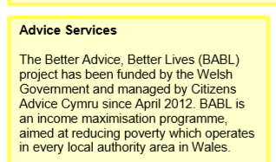
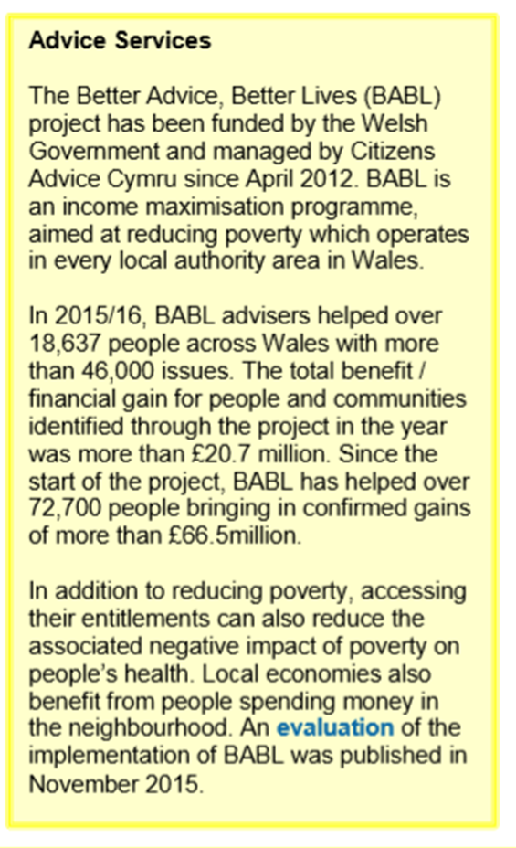
(Welsh Government, 2016)
Notes:
Welsh government under their 2016 child poverty strategy, are working with ADVICE SERVICES.
These services provide advice on ACCESSING BENEFITS AND BENEFIT ENTITLEMENTS. Also provide advice on employment and training services
The main aim: INCREASING HOUSEHOLD INCOME OF LOW INCOME FAMILIES AND ADVISING YOUNG PEOPLE IN MONEY MANAGEMENT SKILLS
The project helped over 18,000 people with over 46,000 issues.
This advice resulted in more than £20.7 million financial gain for these people and communities.
This project is helping to prevent many families from falling into poverty, simply by providing knowledge and understanding that otherwise they may not have been able to access.
In real life this project is helping improve household income of many families, but also improving the mental and physical health of many.
WELSH GOV, 2016

Slide 10
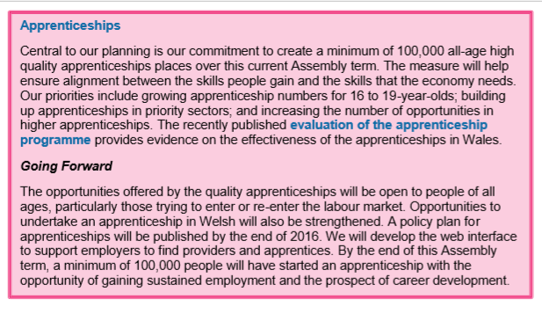
(Welsh Government, 2016)
Notes:
An aim of the welsh government 2016 child poverty strategy under objective 2, is to enhance and create a better network of apprenticeships across wales in order to tackle poverty
The welsh government aim to create a minimum of 100,000 high quality apprenticeships appropriate for all age groups.
The benefit of the providence of apprenticeships in the community is that is creates the opportunity for people to gain skills and qualifications needed for employment. With the right skills and training, people will have a better chance of not falling bellow the poverty line.
In conclusion, although there is a great deal of policy in place with the aim to tackle poverty, THE JOSEPH ROWNTREE FOUNDATION’S studys reveal there is still 18 million people living in poverty in the UK.
Also, PROFESSOR PHILLIP ALSTON, UNITED NATIONS SPECIAL RAPPOTUER ON EXTREME POVERTY ‘s 2018 visit to the UK and enquiry into poverty has highlighted that there may be a much greater deal of poverty occurrence in the UK than is being revealed by the powers in the country.
SPICKER’s belief is that poverty is a growing and extremely complicated problem problem, and a problem which will not go away or be solved on its own, new and equally as serious issues surrounding poverty are constantly arising.
NATIONAL ASSEMBLY WALES in 2015 expressed that Welsh Government must develop a better understanding of factors which contribute to poverty and who is in poverty, this way, poverty may become easier to tackle.

Slide 11
References
Child Poverty Action Group (N/D) ‘work and low pay’ (accessed on 17/12/2018) accessed at: http://cpag.org.uk/work-and-low-pay
David Williamson (2017) Warning that Wales could see the biggest rise in absolute poverty if benefits changes go ahead, Wales Online. (Accessed On 19/12/18) accessed at: https://www.walesonline.co.uk/news/politics/warning-wales-could-see-biggest-13845675
ERSC Poverty and Social Exclusion Project (n.d.) Definitions of Poverty webpage. Accessed at: http://www.poverty.ac.uk/definitionspoverty (Accessed on 10/12/2018)
Gov.UK (2010) ‘reforms will tackle poverty and get Britain working again’ (accessed on 17/12/2018) accessed at: https://www.gov.uk/government/news/reforms-will-tacklepoverty-and-get-britain-working-again
Habitats for Humanity Great Britain (2017) ‘Relative Vs Absolute Poverty’ (accessed on 17/12/2018) accessed at: https://www.habitatforhumanity.org.uk/blog/2018/09/relative-absolute-poverty/
Joseph Rowntree foundation (2018) ‘Poverty in Wales Breifing’ accssed at: https://moodle.uwtsd.ac.uk/pluginfile.php/218186/mod_resource/content/1/we_can_solve_poverty_in_the_uk_0.pdf accessed on 8/12/2018)

Slide 12
References
Joseph Rowntree foundation (2015) ‘sociological perspectives on poverty’ accessed on (17/12/2018) accessed at: https://www.jrf.org.uk/report/sociological-perspectives-poverty
Mike Hawking (2017) ‘Three ways the Apprenticeship Levy could help people in poverty’ Joseph Rowntree Foundation. Accessed on: 02/01/2019 accessed at: https://www.jrf.org.uk/blog/three-ways-apprenticeship-levy-could-help-people-poverty
Maslow, A and American Psychological Association (1943) A Theory of Human Motivation. Indianapolis: Bobbs-Merill
National Assembly Wales (2015) Inquiry into Poverty in Wales: Poverty and Inequality. June 2015. Online: http://www.assembly.wales/laid%20documents/cr-ld10252/cr-ld10252-e.pdf [Accessd: 22/11/2018]
Spiker, P. (2016) Poverty as a wicked problem. Poverty Brief. November 2016. No.35.
Spicker, P (2018), Poverty, An introduction to Social Policy, accessed at: http://spicker.uk/social-policy/poverty.htm, accessed 13/12/18.
Welsh Government (2016) Child Poverty Strategy: assessment of progress 2016: Annex 1 (accessed on:19/12/18) accessed at: https://gov.wales/docs/dsjlg/publications/cyp/161212-child-poverty-strategy-annex1-2016-en.pdf
World Bank (1999), ‘Voices of the Poor’. accessed at: http://siteresources.worldbank.org/INTVIETNAM/Resources/Voices-of-the-Poor.pdf accessed on: 13/12/18.

