Slide 1


Recycling Waste Materials
Business plan
STUDENT NUMBER :1604981
STUDENT NAME :RAMANDEEP KOUR

Slide 2
Title and Content Layout
Introduction
Key issues
Mission and vision
Key success
Background & funding
PEST analysis
SWOT analysis
Financial plan
References

Slide 3
Introduction
Green recycle consultancy is a startup organization in London, UK, and it will collect compost/recycle and market waste from municipality waste processing plants for utilize as a customer’s goods or products. The recycle good will meet two critical requirements;
It will provide municipalities a cost effective and feasible alternative to land filling the waste
It will aid to fulfill the raising demands for organic soil enhancers and fertilizers as well as the material that will be recycled by the green recycle consultancy is human waste sludge.

Slide 4
Key issues
The key issues associated with the Green recycle consultancy are following;
  Increase waste material
  Increase environmental issues

Slide 5
Mission and vision
Green recycle consultancy mission is threefold. The organization first mission is to make sure the financial well being of the organization. Second mission is to provide municipalities with an alternative and economical for disposal of individual waste sludge. The third mission is to offer a best quality of recycle material to the customers therefore that they may profit from compost’s several good properties as well as organic elements.
Vision of the Green recycle consultancy is illustrated in below;
Flush sales for the one year of functions and increasing each year thereafter
Establish six recycling wastage plant in London in one year
Achieve organization provides 5.3% on second years and 13% and third years

Slide 6
Key success
The key successes of Green recycle consultancy are:
Offers goods and products in reasonable price
Reduce perception issues
Establish positive trust and relationship with customers to help shield from upcoming competition
Expand business growth rapidly to control the market

Slide 7
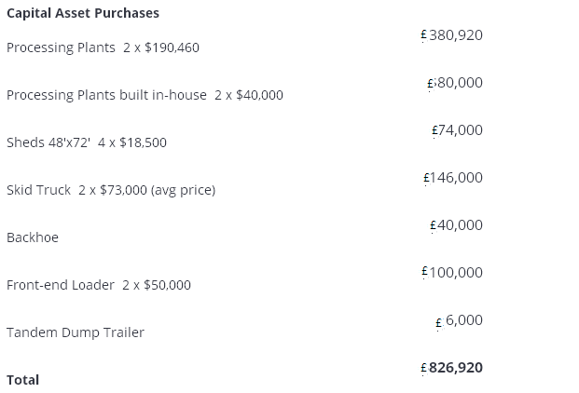
Background
The organization legal name is Green recycle consultancy which will be formed as a limited organization in London UK. The organization established by its president and founder Jack Franklin. Mr. Cameron Wallis will be an active participant in the organization in management decision.
Startup cost will be £1000000 and the fund will be initially used for the following;

Slide 8
PEST analysis
Political factors
Proactive governance and political stability
lowest corporate taxes in G20
Economical factors
Pound hit 30 year low after introducing Brexit
Social factors
Sex, age as well as incomes
Technological factors
Global entrepreneur program and department for international trade’s
UK government support to entrepreneurs and start ups organization
inflation issues
aging populations, religious and ethnic differences
high literacy rate in United kingdom
Social media marketing tools and internet
New invention and development
Offering high quality of products

Slide 9
SWOT
Strengths High skilled and knowledge labour Better management skills Uniqueness and cost effective strategies | Weakness Need to implement environment protection act It is an attractive to limited kind of person Lack of ability and reliability of plan, data and project
Opportunities Presently not many competitors Ease to create brand and market Sales products and services through social media Easy to add new features and expand | Threats Easy to copy Change is the policies and procedures in environmental acts Market demand and loss of resources

Slide 10
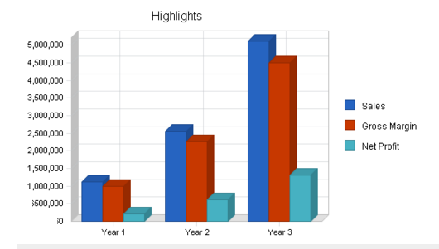
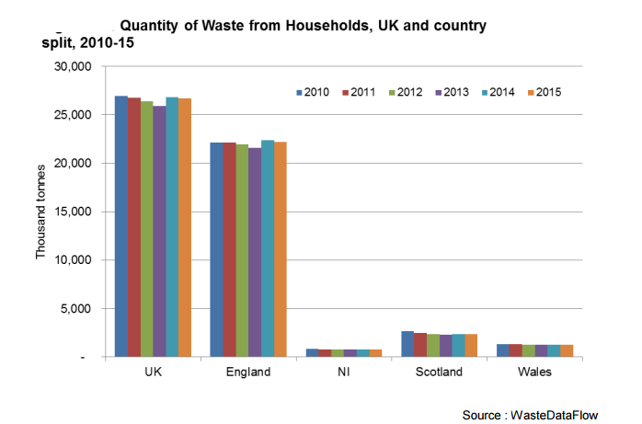
Financial plan

Slide 11
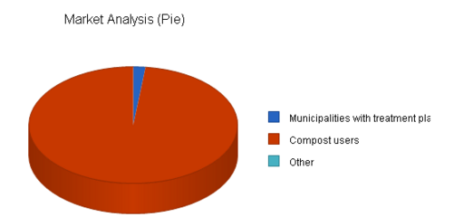
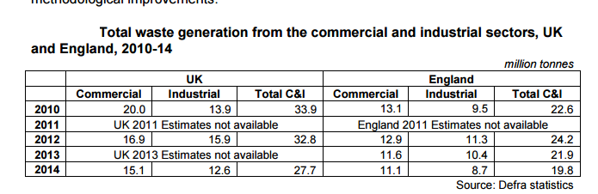
Marketing analysis

Slide 12
References
Tracy, B. (2014). Marketing. New York: AMACOM.
Etzel, M., Walker, B. and Stanton, W. (2007). Marketing. Boston: McGraw-Hill/Irwin.
Hiam, A. and Schewe, C. (2008). The portable MBA in marketing. New York: J. Wiley.
Tracy, B. (2014). Marketing. New York: AMACOM.
Etzel, M., Walker, B. and Stanton, W. (2007). Marketing. Boston: McGraw-Hill/Irwin.
Hiam, A. and Schewe, C. (2008). The portable MBA in marketing. New York: J. Wiley.
Hollensen, Svend: (2014) Global Marketing, 6th edition, Pearson; ISBN 978-0-273-77316-0
Aaker, David (2008): Strategic Market Management 2008
Kuester, Sabine (2012): MKT 301: Strategic Marketing & Marketing in Specific Industry Contexts, University of Mannheim
Philip Kotler & Keller (2005) Marketing Management, 12th edition

Slide 13
Thank you

