Slide 1
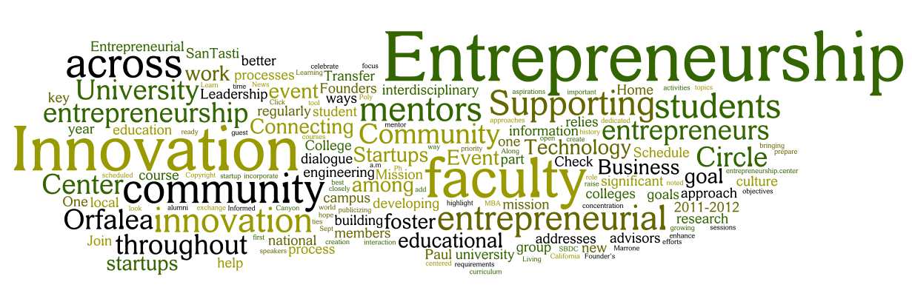
Welcome
CEO of Britannia Hotels
Alex Langsam
Motivation and Characteristics of an Entrepreneur
BA International Hotel Management
Entrepreneurship
M5XO1926
Lecturer: Dr David Jenkins
Student : Monuar Moni
1818185

Slide 2

Introduction
Entrepreneurship can be defined as activity of developing up a unique business and skills of taking up risk so that profit could be earned in near future.

Slide 3
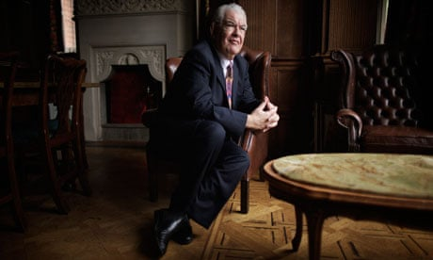
Brief overview of
Alex Langsam
Alex Langsam is a well-known entrepreneur in the UK, CEO of Britannia Hotels which is a hotel group and a part of the hospitality industry in the UK (Britanniahotels.com, 2020).
He has vast experience of working in real-world, which also gave him an added advantage to make a mark in the global trade industry of service.
At the initial stage of his career, Alex Langsam started learning skills of business management and his area of interest was the hospitality sector.
He invested time and monetary resources to purchase various hotel chains as a means of business expansion.
Alex made optimal utilisation of his skill to incorporate all hotels firms under Britannia Hotels.

Slide 4
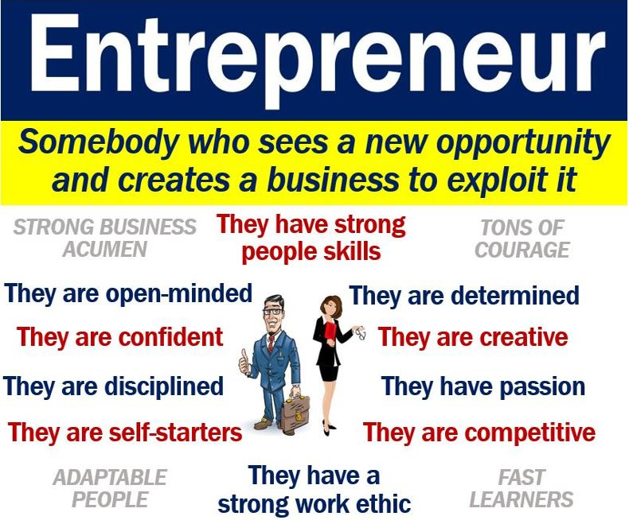


Slide 5
Vision
Langsam says:
"We do it because we enjoy the challenge,"
"Above all, it is fun; I don't do it for money."
"Our extraordinary buildings are enjoyed by ordinary people. That is a formula that has given us a thriving and sustainable business over the years."
"We have done more business in the last two years than ever before,"
"People are going for value for money.
We don't advertise; it is largely repeated business across the estate.
“We believe there is a growing demand for traditional seaside holidays."

Slide 6


Conclusion
Alex Langsam believes that he can influence the outside world through the means of his actions.
Moreover, he has the trait of transforming the available opportunities provided by the outside world for the benefit of his organization (Mariotti and Glackin, 2007).
Alex Langsam develops the levels of creativity in hotel chains to the maximum extent possible, using his incredible skill of sustainability, optimism and developing existing skills of creativity. As a successful entrepreneur, he always takes an optimistic outlook.

Slide 7
References
Britanniahotels.com, (2020), About us, Available at https://www.britanniahotels.com/about-us, [Accessed on 18.06.2020]
Wood, Z. (2017, November 26). Challenge Britannia: To perform some Disney-style magic at faded Pontins. the Guardian. https://www.theguardian.com/business/2011/feb/18/the-friday-interview-alex-langsam
Rich list: 'Asylum King' who houses migrants in budget hotels enters list of richest Britons. (n.d.). The Telegraph. https://www.telegraph.co.uk/news/2016/04/24/rich-list-asylum-king-who-houses-migrants-in-budget-hotels-enter/
Entrepreneur - definition and examples - Market business news. (2019, July 7). Market Business News. https://marketbusinessnews.com/financial-glossary/entrepreneur/
Britannia hotels. (2007, September 17). Wikipedia, the free encyclopedia. Retrieved June 19, 2020, from https://en.wikipedia.org/wiki/Britannia_Hotels
Mariotti, S. and Glackin, C. (2007). Entrepreneurship: Starting and operating a small business. Upper Saddle River, NJ: Pearson Prentice Hall.

Slide 8



