Slide 1

Managing People
LCBB5004
Assessment 1
Individual Presentation
Presented by: Mostapha Boulkheir (2114677)
Lecturer: Nishi Ramsurrun
University of Wales Trinity St David

Slide 2
TABLE OF CONTENTS
COVER PAGE
TABLE OF CONTENTS
INTRODUCTION IKEA
DIVERSITY IS STRENGTH IN IKEA
Flexible Work Arrangement in Ikea
Most common examples of flexible working in IKEA
Equality and Diversity in IKEA
promoting diversity in Ikea
Flexibility Work in IKEA, Advantages and Disadvantages
Advantages/Benefit
Disadvantages
Recommendations
List of References

Slide 3
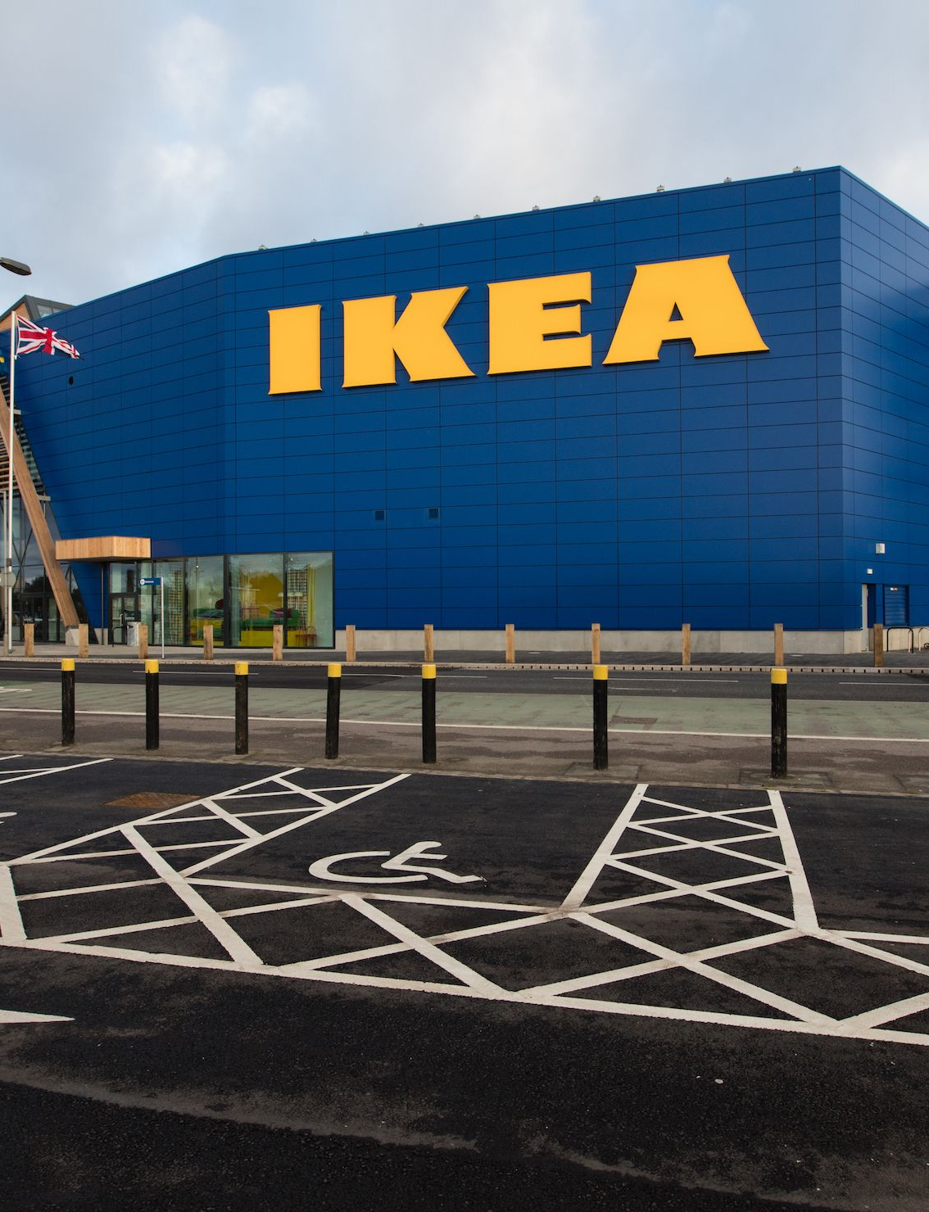
Introduction IKEA
IKEA was founded in 1943 by Ingvar Kamprad as it has grown over the years.
Today it is the largest in the furniture industry, recognized:
Scandinavian style
The affordable prices.
Ikea operates 433 stores in 52 countries. Ikea employs as many as 225,000 people worldwide.
(IKEAgroup, 2021)
Notes:
In IKEA, there is no single career path, there are a number of paths such as, Warehouse Work, Customer Service, Food Service, Business and IT. But these are some of the areas of the Ikea world.

Slide 4
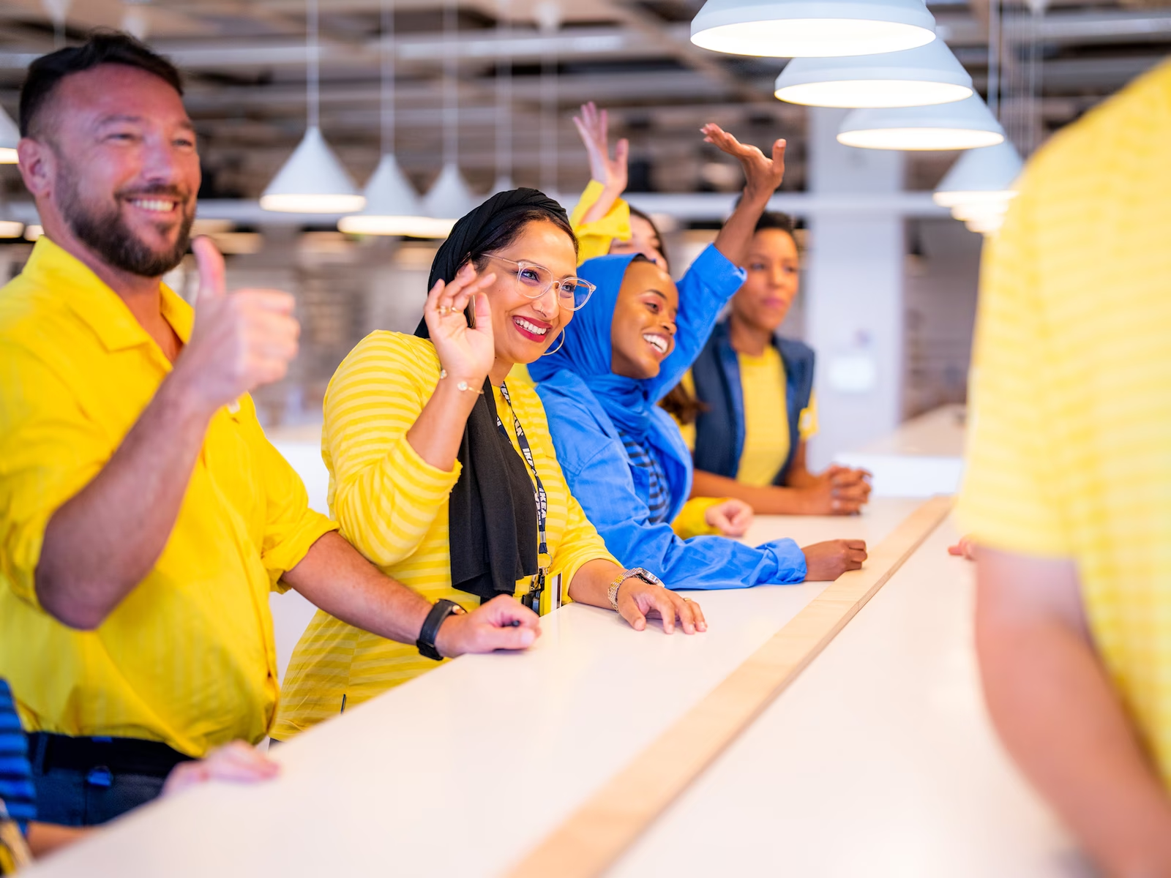
DIVERSITY IS STRENGTH IN IKEA
Everyone should be treated equally, with dignity and fairness. Everyone must have the same opportunities in the workplace. One example is gender equality (fair gender pay).
Research shows that diverse teams perform better. And having a diverse team within companies for example also leads to recruitment of talented people with different skills useful for the Ikea market.
Notes:
we give so much importance to each other's diversity. Because with that we can also diversify our market and our products.

Slide 5

Flexible Work Arrangement in Ikea
Flexible work is a term that describes different work patterns. It is usually the name given to any type of work pattern other than the existing one.
Employees may request changes in their work model for a variety of reasons.
Notes:
Employees may request changes in their work model for a variety of reasons, such as childcare arrangements, a better work-life balance, or more time to devote to their small business.

Slide 6
Most common examples of flexible working in IKEA
Part-time work: is a form of work where you work less than full-time hours, either by reducing your working hours during the day or by working fewer days.
Working from home: consists of performing your duties, at home, using appropriate digital tools.
Flexible schedule (flexitime): refers to any type of work organization in which working hours are not completely fixed and static.
(Wheatley, 2017)

Slide 7
Equality and Diversity in IKEA
Equality Act (2010)
Age
Gender
Disability
Religion or belief
Pregnancy and maternity
Ethnicity
Marriage and civil union
Every person is different. Sometimes, these differences can produce discrimination (direct or indirect) or discriminatory treatment. In Uk we have the Equality Act (2010), a law that protects these "characteristics."
Inequalities are often interconnected at the level of ethnicity, gender and class.
(Wheatley, 2017)
Notes:
A classic example is when a woman is not offered a promotion, which is offered to a man instead.
Interconnection we have an Example case of a black woman.
All these differences that exist between people can be summarized in the concept of DIVERSITY.

Slide 8
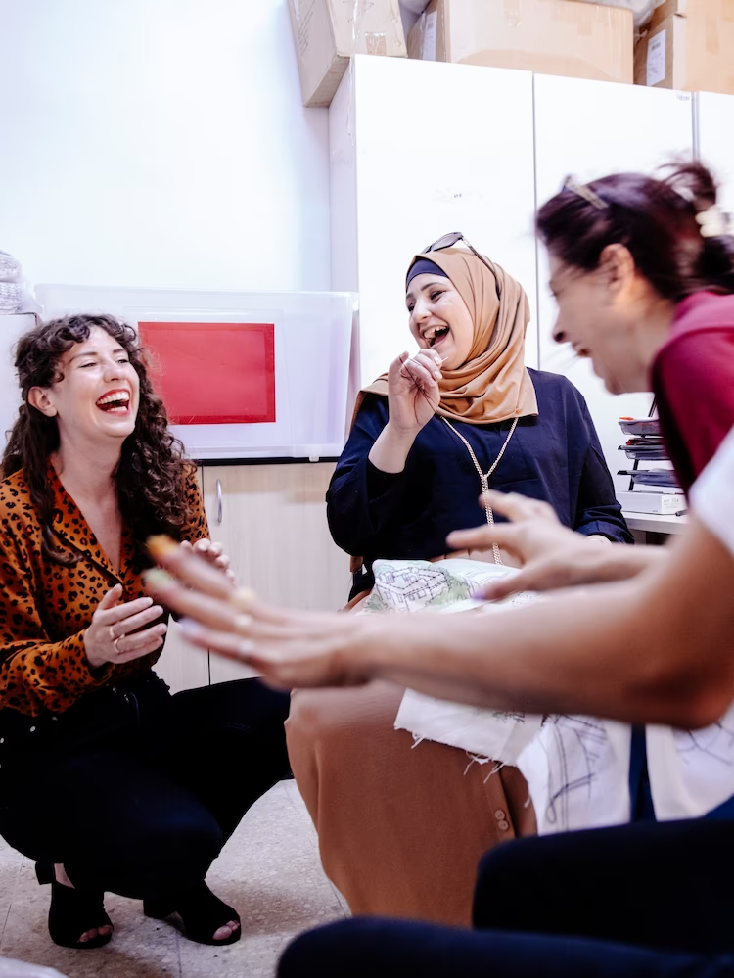
promoting diversity in Ikea
Diversity offers many advantages. But how do you promote it? (Holding, 2016)
In IKEA, we have thought of the following actions:
Celebrate diversity, without hiding it.
  Create a corporate culture in which diversity is seen as a source of energy
Create a recruitment process that promotes diversity
  Create recruitment process should be structured to attract and include diverse individuals.
Notes:
Note) Christmas dinner with children, celebrate all religious holidays.
Note) Create a network in diverse communities and post your job ads on various platforms. Ask standardized questions during interviews that focus on skills and not on age, gender issues, or other similar aspects.

Slide 9
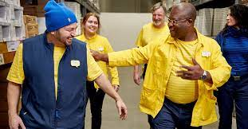
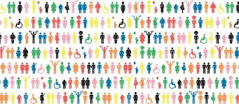
promoting diversity in Ikea
3. Provide training and further education opportunities for all.
4. Jobs suitable for elderly and disabled people
  Create as barrier-free a work environment as possible, giving everyone, without restrictions, the same opportunities within your company.
5. Promote work-time balance
  Offer flexible work time models so that different people have a chance to have a place at IKEA.
Notes:
3.Note) Offer people with different levels of education and background. Language courses to break down language barriers
4.Note) Notes Ramps, elevators.
Speaking of that, we are now going to talk about the advantages and disadvantages of flexibility at work for our employees.

Slide 10
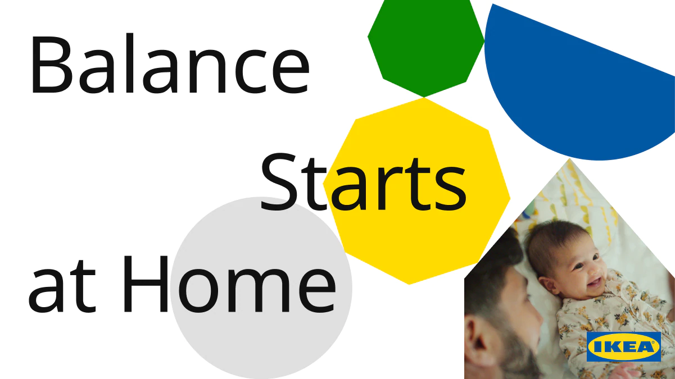
Flexibility Work in IKEA, Advantages and Disadvantages
With flexible working we at IKEA try to make our employees' lives as balanced as possible. There are many advantages that help the relationship the economic part and the quality of life. But there are also some disadvantages. (Wheatley, 2017)

Slide 11
Advantages/Benefit
more flexible schedules in general, and time savings.
financial savings from all travel expenses.
sense of gratification due to trust with one's workplace;
greater decision-making autonomy and more control over one's daily work routine;
last but not least, it should be emphasized that for those who have important professional ambitions, flexible work can be a chance to experience different experiences at the same time.

Slide 12
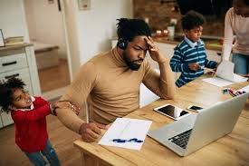
Disadvantages
Non-clarity on starting and ending work hours;
For some employees, working from home may be more difficult to find the necessary concentration;
One may be induced to work even when sick;
In general, in the absence of self-discipline and organization, you may not be efficient to do your work;
Notes:
1)Note There is a risk of being seen as "always on call," even late at night or on weekends;
note 2) example: noisy environment, not having the right environment(desk)

Slide 13
Recommendations
Try to give all the right tools for employees who work from home.
Set shifts based on worker availability. You can do this by putting digital communication systems in place, which for example can be an App where you can enter your availability.
Try to guide all staff according to a standard culture. Follow processes, even if you work remotely, very frequently.

Slide 14

thank you for listening
ANY QUESTIONS?

Slide 15
List of References
Holding, I. I. (2016). Inter IKEA conduct. London, England : Inter IKEA Group.
Hurst, A. (2020, 09 30). Want to build skills and inclusivity? Try peer learning. Retrieved from WORKFORCE AND EMPLOYMENT: https://www.weforum.org/agenda/2020/09/peer-learning-secret-to-building-skills-inclusive-businesses/
IKEAgroup. (2021, 10 14). IKEA grows again. Retrieved from https://about.ikea.com: https://about.ikea.com/en/newsroom/2021/10/14/ikea-facts-and-figures-fy21#:~:text=Big%20thanks%20to%20all%20the,accomplished%20together%20in%20tough%20times.
Wheatley, D. (2017). Employee satisfaction and use of flexible working arrangements. London, England: SAGE Publications Ltd.

