Slide 1
BALM – Level 5
Developing Workplace Critical Thinking
(BMSW 5101)
Reflective Writing

Slide 2

In this session we will…..
Discuss what reflective writing involves.
Develop a piece of reflective writing

Slide 3
Reflective writing

Slide 4
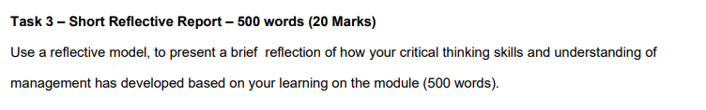
Task 3 – Reflective report
Your final task for this module is:
Notes:
Read through the task with the students and remind them all to access the full assignment brief to ensure they all understand all aspects of task 3. Explain that you will be introducing the several reflective cycles including the Gibbs Reflective Cycle today and you will be highlighting the how this can inform the Personal Development Plan (PDP).

Slide 5
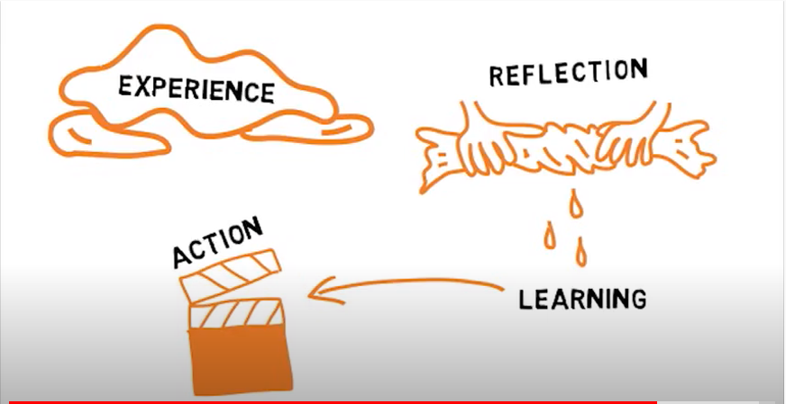
What is reflective writing?
Let us watch this video together.
Notes:
Image has hyperlink to video https://www.youtube.com/watch?v=QoI67VeE3ds

Slide 6

Importance of reflective writing
Experience
skill
Constantly updated
Professional
knowledge
Ability to reflect

Slide 7
Models of reflection
Bassot (2020) describes three models of reflection that can be used.
ERA Model
Driscoll’s ‘What?’ Model
Kolb’s Experiential Learning Cycle
Notes:
Explain that these three models will be explored in turn and then the Gibbs Reflective cycle will be introduced.

Slide 8
ERA Model
Jasper (2013) developed this reflective model.
ERA stands for :
Experience
Action
Reflection
Notes:
Experience – This can be anything that has happened recently that you feel has some significance. It could also be somethings from the past that has come to your attention more recently.
Reflection – this takes place afterwards and the reflective processes are how we learn from the experience. Reflection can also involve thinking about how we might respond in the future, and as we progress it can also happen during an experience.
Action – this follows the learning and is concerned with the action we than take after the experience, as our new perspectives then feed into the next experience.
Bassot (2020, p30)

Slide 9
Driscoll (2007) outlines three steps to this model.
Driscoll’s ‘What?’ Model
What?
So what?
Now what?
Notes:
What? Step 1 encourages you to write a description of an event that has happened in your professional practice.
So what? Step 2 involves carrying out an analysis of the event by reflecting on selected aspects of it.
Now what? Step 3 asks you to devise a number of proposed actions following the experience and in the light of what you have learned.
The ERA and Driscoll models are simple and easy to use but can lack depth for more complex experiences.

Slide 10
Kolb’s (1984) Experiential Learning Cycles gives insight into how we all learn from experience. There are four stages.
Concrete Experience
Active Experimentation
Reflective Observation
Kolb’s Experiential Learning Cycle
Abstract Conceptualisation
Notes:
Concrete experience – doing/having an experience.
Reflective observation – reviewing/reflecting on the experience
Abstract conceptualisation – concluding/learning from the experience
Active experimentation – planning/trying out what you have learned.
Kolb argues that this cycle often starts with a concrete experience that is reviewed through reflective observation. This is followed by abstract conceptualisation, where new thoughts and ideas emerge, which are then tried out in active experimentation, ready for the next relevant experience. All of this may happen in a matter of moments, or over days, weeks or months, depending on the experience.

Slide 11
The Gibbs Reflective Cycle
Graham Gibbs (1988) adapted the experiential learning cycle to acknowledge the importance of feelings and emotions in learning.
Let look at this cycle together.

Slide 12
The Gibb’s reflective cycle
Description
What Happened?
If it arose again, what would you do?
Feelings
Action Plan
What were you thinking and feeling at the time?
What else could you have done?
Conclusion
Evaluation
Analysis
What was good and bad about the experience?
What sense can you make out of the situation?
Notes:
Gibbs 1988, p9 – “It is from the feelings and thoughts emerging from this reflection that generalisations or concepts can be generated. And it is generalisations or concepts that allow new situations to be tackled effectively.”
He also emphasises the importance of being able to generalise, to transfer knowledge and insights gained from one situation to another. As a result, this framework is frequently used in developing practitioner courses in healthcare and business.

Slide 13

Summary
Can you identify the steps of reflection?

Slide 14
References
Bassot, B. (2020) The Reflective Journal, London: Red Globe Press
Driscoll, J (2007) Practising Clinical Supervision: A reflective approach for healthcare professionals, Edinburgh: Balliere Tindall, Elsevier
Gibbs, G. (1998) Learning By Doing : A guide to teaching and learning methods, Oxford: Further Education Unit, Oxford Polytechnic
Kolb, D (1984) Experiential Learning: Experience as the source of Learning and development, Englewood Cliffs, NJ: Prentice Hall.

