Slide 1

BMSP6002 Digital Business
Assignment 1
Dr Roisin Mullins
Student: Jonathan Preston

Slide 2
PEER-TO-PEER ACCOMMODATION NETWORKS
This presentation will explore some of the themes raised in Sara Dolnicars book Peer-to -Peer accommodation Networks and in particular, Airbnb.
Three chapters have been chosen to provide a summary of the themes identified, including a critique of their relevance to the digital marketplace and what aspects Airbnb encompass the functions of a shared economy
Pushing the boundaries
Sara Dolnicar

Slide 3
How Airbnb Captures and Disseminates Value
Environmental Sustainability
Supporting Events
What does Airbnb do that creates value for its stakeholders?
What does Airbnb do to contribute to contribute and engage with communities and events?
What impact does Airbnb have on the environment and is it a sustainable model?
Notes:
An assumption that property owners have vacant rooms that may otherwise not be in use.
Airbnb provides a platform along with photographs and descriptions connecting guests with hosts
Airbnb has listings that are suitable for hosting meetings and events across the globe. What type events can it accommodate and how does it contribute?
Airbnb claim to be environmentally responsible by enabling the sharing of resources.
Is Airbnb a sustainable business model?

Slide 4
How Airbnb Captures and Disseminates Value
Finding suitable accommodation
Gaining access
Mitigating risk
Augmenting experience
Value communication and transfer
Partners
Service recovery staff
Knowledge resources
Database of reviews tied to profiles
Trust-based relationships
Tailored marketplace
Key resources
Value creation – key activities
Understanding and tracking host and guest behaviour
Optimizing searches to match guests and hosts
Notes:
Stakeholders play a significant role in creating value for guests and hosts along with third parties. Airbnb must ensure that all stakeholders benefit from continued engagement with their online marketplace. To accommodate this Airbnb, interact with their stakeholders in a variety of ways. (Dolnicar, 2018)
In recent years this has become to be known as collaborative consumption. By developing international networks Airbnb have effectively challenged the traditional accommodation provision marketplace by applying a strategy that focuses directly on sharing available accommodation with actively seeking customers.

Slide 5
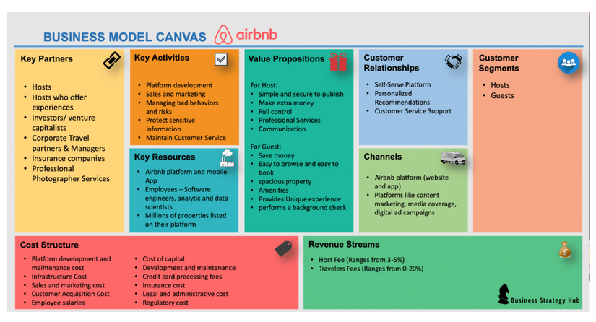

Slide 6
Supporting Events
Generating tourism activity
Raising awareness of a destination
Enhancing the image of a destination
Shifting demand to off-season
Providing accommodation for events
Infrastructure

Slide 7




Environmental Sustainability
Water
Land
Air
Climate change
Notes:
As a concept the sharing economy is based on the practice of a collaborative consumption and access to markets to promote a more sustainable society. (Heinrichs, 2013). Airbnb claim their business model reduces waste and better utilises resources making it environmentally responsible
Accommodation providers are the biggest users of water internationally
The direct average water use per guest night amounts to 350 litres
Pools, spas, and food preparation – require an additional 6205 litres per guest night.
A four-star hotel in Spain uses 361 litres
Accommodation infrastructure contributes considerably to land use
Hotels have the smallest land use per bed
The tourism accommodation sector is responsible for about 20% of global carbon emissions
Gössling, 2002

Slide 8

Communications Perspective
Business model operating within a Sharing Economy
Web based platform to provide a service
Service to both the Guest and Host
Makes use of under-utilised goods and services
Notes:
As a business model operating within a Sharing Economy, Airbnb uses a web based platform to provide a service to both the customer and the service provider which optimizes the choice of available accommodation to guests and bookings for providers that may otherwise have not been booked. It is an established trading model which makes use of underutilised goods and services and gives priority to accessibility rather than to ownership (Fang et al., 2016).

Slide 9
Business Process Perspective
Guests are charged for the accommodation at the time of booking
Airbnb have that revenue as an asset
based on trust
robust cancellation policies in place
Notes:
Guests are charged for the accommodation at the time of booking. This enables Airbnb to benefit from receiving payment before providing the service. In cases where customers book well in advance of their stay Airbnb have that revenue as an asset (possibly earning interest) On large scale this type of booking trend would present a lucrative opportunity for Airbnb to manage its cash flow. Such a model has been found to be based on trust, where the trust lies within the experience and trust in the hosts as opposed to trust in the actual transaction itself (Liang, Choi, & Marion Joppe, 2018). Airbnb operates a Digital Intermediary Model which generates revenue by facilitating the transactions between the guests who book and the hosts or accommodation providers. For this service Airbnb charge a commission which is a set percentage of the transaction value which is typically around 3% of the booking cost for hosts and up to 15% for guests. This can vary depending on the country in which the booking is made. Italy is an example where fees may be higher or cases where hosts have robust cancellation policies in place (Airbnb, 2021).

Slide 10
Service Perspective
Increase in technologies
Reach of the internet
Competitive turbulence
Declining costs
Notes:
Due to the increase in technologies available to consumers the digital reach of the internet has given access to the masses of inexpensive computer power. This set the path for new and innovative business models, creating a competitive turbulence where resources are plenty and marginal costs are declining, disrupting the digital arena where scarcity is no longer a valid assumption (Geissinger, Laurell, & Sandström, 2020).

Slide 11
Online Perspective
Opportunities to increase trade
Increase social interaction
Increase accessibility to resources
On-line platform that support the sharing economy
Notes:
The digital sharing economy provides opportunities to increase trade, social interaction and accessibility to resources that may not otherwise be achieved. Sometimes referred to as the collaboration economy it involves the sharing of items and services between people (Dillahunt and Malone, 2015). On-line platforms and apps like Airbnb, support the sharing economy. A marketplace where individuals can buy and share products or services (Dillahunt and Malone, 2015).

Slide 12
Collaboration Perspective
Collaborative consumption
Offering goods or services on a temporary Basis
Stranger Sharing
Notes:
It has been acknowledged that collaborative consumption is often recognised as offering goods or services on a temporary Basis. Such activity was once only adopted by those in familiar social networks but has evolved into another dimension where the term ‘Stranger Sharing’, the practice of allowing your property, areas of your home or other facilities to be used by people outside of your social networks presents a higher degree of risk (Rowe, 2017).

Slide 13
Community Perspective
The online Airbnb community can share experiences and exchange intelligence through collaboration to help mitigate risk.
Notes:
The online Airbnb community can share experiences and exchange intelligence through collaboration to help mitigate risk.

Slide 14

Conclusions
Notes:
Airbnb currently provides an on-line service which shows some evidence of sustainability. The current information on the industries carbon footprint remain open for debate and future changes in regulations for hosts may prove challenging. Hoverer, until such a time the Peer to Peer economic digital future of Airbnb looks set to continue to offer its services through collaboration within the shared marketplace. As innovative technologies develop there will remain ambitious entrepreneurs who will seek to disrupt the current models and take over the market share, but for the time being, Airbnb remains an industry leader in the digital marketplace.

Slide 15


Slide 16
References
https://www.airbnb.co.uk/help/article/1857/what-are-airbnb-service-fees
Business Strategy Hub. (2021). Airbnb Business Model | How does Airbnb make money? Retrieved from Business Strategy Hub: https://bstrategyhub.com/airbnb-business-model-how-does-airbnb-make-money/
Dolnicar, S. (2018). PEER-TO-PEER ACCOMMODATION NETWORKS: Pushing the boundaries. Oxford: Goodfellow Publishers Limited.
Geissinger, A., Laurell, C., & Sandström, C. (2020). Digital Disruption beyond Uber and Airbnb—Tracking the long tail of the sharing economy. Technological Forecasting and Social Change.
Liang, L. J., Choi, H. C., & Marion Joppe. (2018). Exploring the relationship between satisfaction, trust and switching intention, repurchase intention in the context of Airbnb. International Journal of Hospitality Management, 41-48.
Rowe, P. C. (2017). Beyond Uber and Airbnb: The Social Economy of Collaborative Consumption. Social Media and Society.
Gössling, S. (2002) Global environmental consequences of tourism, Global Environmental Change, 12 (4), 283–302.

