Slide 1


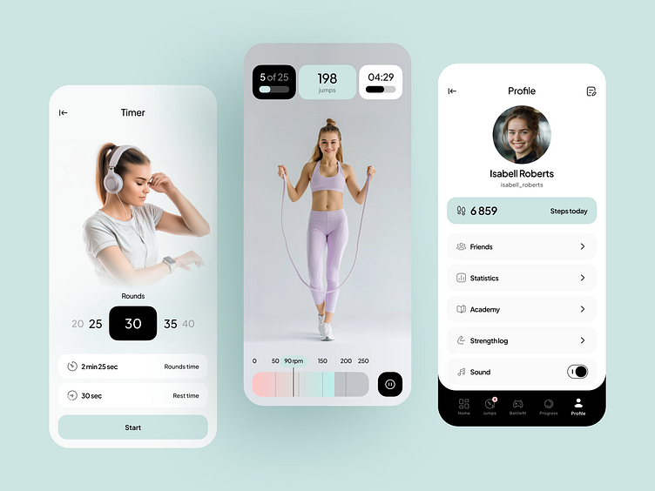
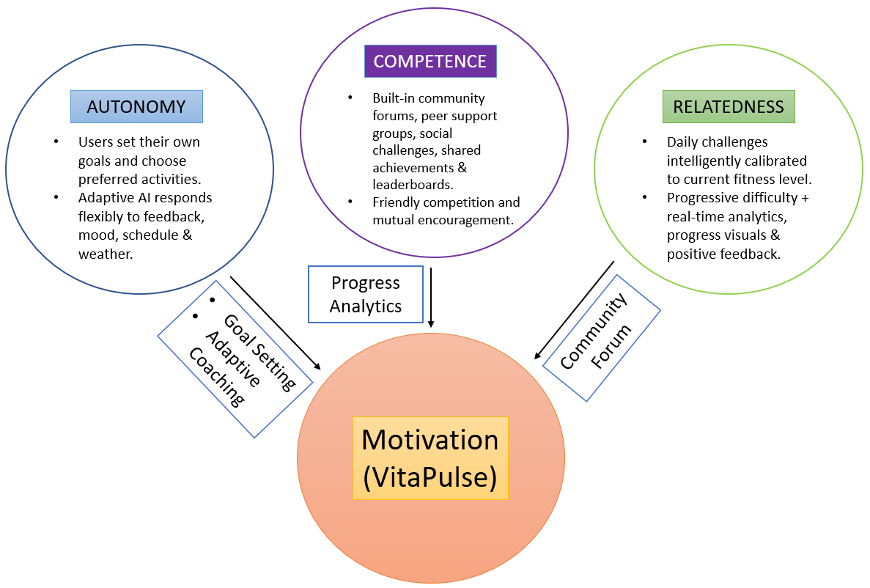






VitaPulse: Promoting Active Lifestyles through Personalised Digital Health Intervention
Module: Population Health and Digital Health Promotion Student Name: Prashant Gajera
Module code: LCHS7009 Student ID: 2428140
Background
Behavioural Change Theory
Expected Outcomes
Sedentary lifestyles are known for representing a major public health epidemic. WHO (2024) reported in 2024 that 31% of adults and 80% of adolescents do not meet the recommended levels of physical activity.
It is also essential to note that the global target set to reduce levels of physical inactivity in adults and adolescents is a 10% relative reduction by 2025 from the 2010 baseline. Physical inactivity is known for significantly contributing to obesity, along with various diseases such as cardiovascular disease and depression (WHO, 2024).
The rising cost of medical care threatens a vital aspect of the effective delivery of medical care, along with individual suffering and community burden, which makes effective interventions urgent (Chang et al., 2022). Traditional approaches are known for only including community walking programs, along with public awareness campaigns. Various digital solutions, such as Fitbit is known to have demonstrated success through implementing tracking and gamification (Hydari, Adjerid and Striegel, 2022). However, such techs are often known for lacking deep personalisation, alongside long-term adherence.
The proposed innovation, VitaPulse, will be an innovative smartphone application that will be harnessing artificial intelligence for delivering tailored physical activity recommendations. The app will also be integrating adaptive coaching, along with gamification elements and community forums for encouraging sustained behaviour change and long-term motivation.
VitaPulse will be applying the Self-Determination Theory, which represents a broad framework, for the study of human motivation and personality. It also fosters intrinsic motivation, along with sustained behaviour change (CSDT, 2025; Wu, Wang and Hsieh, 2022). It is known for identifying three basic psychological needs, which VitaPulse will be incorporating effectively:
Autonomy
Users will be able to set their own goals, along with select preferred activities.
The AI will be adaptive in nature, which will then respond flexibly to the feedback, mood, and schedule of the user, along with the weather, which will lead to the reinforcement of a strong sense of personal ownership and freedom (Padman and Ladhania, 2025).
This will also make users feel that they are in control of their own health journey compared to following rigid prescriptions.
Competence
There will be daily challenges in the app, which will be intelligently calibrated to the present fitness level of the user. It will also progressively increase its difficulty as the user keeps on achieving milestones.
The app will also include real-time analytics, along with progress visuals and positive feedback, all of which will help in building confidence and a sense of mastery (Khan et al. 2025).
Relatedness
Built-in community forums, peer support groups, social challenges, shared achievements, and leaderboards create meaningful social connections and a sense of belonging. Users will be able to experience a legit sense of belonging as friendly competition and mutual encouragement will strengthen interpersonal bonds.
With the systemic satisfaction of the three psychological needs, VitaPulse will be able to help users shift from relying on extrinsic motivators such as badges or streaks to intrinsic motivation.
Such a transition will be crucial due to autonomously motivated individuals have more possibilities of maintaining consistent physical activity over time. This will also lead to the improvement of health outcomes, along with reducing sedentary behaviour significantly.
With the application of SDT through VitaPulse, it is expected to generate several meaningful, alongside measurable, positive outcomes in the case of comparing sedentary lifestyles:
Enhanced Long-term Adherence
There will be several autonomy-supportive features present in the app, including user-driven goal setting and adaptive AI recommendations, which will be responding to the user’s personal feedback, mood, along with their schedule and weather.
This will help in sustaining intrinsic motivation. It is expected that users will potentially maintain consistent daily physical activity beyond their initial novelty phase.
This will lead to long-lasting behaviour change compared to temporary changes (Schwartz et al., 2019).
Improved User Engagement
It is also expected that user engagement will be improved. The app will also feature several competence-oriented features, such as providing tailored feedback and also progressive challenges, along with performance analytics.
These features will be designed to improve the overall confidence of users and also reinforce their capabilities.
Users’ levels of activity throughout their daily lives will also be increased, which is also evident in the case study by Cai, Zhao and Sun (2021).
Stronger Social Connections
There will also be relatedness-focused components in the app, including community forums, peer support groups, several social challenges, along with shared achievements and leaderboards.
This will help in developing a legit sense of belonging, along with mutual encouragement (Zamiri and Esmaeili, 2024).
Such features are expected to reduce overall dropout rates, along with also extending daily usage time of the app and developing supportive networks that will be contributing to the reinforcement of healthy behaviours through emotional support (Kim and Cho, 2025).
Reduction in Sedentary Behaviour
Such SDT-aligned mechanisms are expected to significantly improve daily activity levels. Users might be able to improve their average daily steps, along with also achieve closer alignment with the guidelines of WHO regarding 150 minutes of moderate activity per week (WHO, 2023).
It is also expected that, over time, this will be able to contribute to reducing the risk of several chronic diseases, which will ultimately improve individual, along with population-level public health metrics.
Potential Barriers and Limitations
However, there are expected barriers and limitations, such as overdependence on smartphone ownership, alongside digital literacy. This is essential as it could limit overall reach in underserved communities.
On the other hand, over-relying on extrinsic rewards could also lead to hindering the full transition to intrinsic motivation if not managed carefully.
With its thoughtful design, alongside its complementary digital literacy initiatives, VitaPulse will be able to acquire a strong potential for delivering measurable, scalable improvements in population-level physical activity.
Health Promotion Values and Principles
VitaPulse is grounded in core health promotion principles: empowerment, participation, equity, holistic approach, and sustainability.
VitaPulse will be grounded in core health promotion principles:
Empowerment: There will be AI-generated personalised activity plans in the app, which will help in enabling users to set realistic goals, particularly based on their lifestyle, along with capacity and preferences. This will provide users with control over their health journey (Jain, 2025).
Participation: Interactive features such as community forums, challenges, and gamification encourage active user involvement and social support. There will be various interactive features, including community forums, along with challenges and gamification. These will help in encouraging active user involvement, alongside social support (Allam et al., 2015).
Equity: VitaPulse will be a smartphone-based platform, and it will be offering wider accessibility. There will also be the presence of built-in digital literacy modules, which will help in reaching underserved populations (Alon, Perret and Torous, 2023).
Holistic: The app will also be addressing physical activity along with the user’s psychological well-being through motivational feedback and social connectedness via peer groups.
Sustainability: Lastly, it will be providing adaptive recommendations, along with continuous engagement strategies that will be promoting lifelong healthy habits, which will help in maintaining sustainability.
Thus, the proposed innovation, VitaPulse, will be able to create an inclusive, alongside user-centric digital intervention that will be aligned with modern health promotion values.
Conclusion and Implications
It can be stated that the proposed app, VitaPulse, showcases the transformative capability of AI-driven, personalised digital interventions in the case of combating the global sedentary lifestyle epidemic. The app is able to provide an effective, engaging, along with user-centric pathway for sustaining physical activity and healthier lives with integrating Self-Determination Theory with features such as gamification, community support and also adaptive coaching.
Policy Implications
Governments, alongside healthcare providers, are required to actively integrate personalised digital tools such as VitaPulse into their national prevention strategies. Apps such as VitaPulse are able to reduce the challenge of chronic diseases, along with lowering overall healthcare expenses with the addition of promoting population-wide behaviour change.
Educational Implications
Digital health literacy training is required to be incorporated in the curricula of schools, community programs, along with public health initiatives. This will help in filling the digital gap, aligning with maximising accessibility.
Research Implications
Continuous research is also important as it can evaluate the long-term effectiveness of several AI-driven interventions. Several studies on hybrid models are also required that will be combining digital technology with traditional community-based approaches, which will help in addressing digital inequality.
References
Allam, A., Kostova, Z., Nakamoto, K. and Schulz, P.J. (2015). The Effect of Social Support Features and Gamification on a Web-Based Intervention for Rheumatoid Arthritis Patients: Randomized Controlled Trial. Journal of Medical Internet Research, [online] 17(1), p.e14. doi:https://doi.org/10.2196/jmir.3510.
Alon, N., Perret, S. and Torous, J. (2023). Working towards a ready to implement digital literacy program. mHealth, [online] 9(0). doi:https://doi.org/10.21037/mhealth-23-13.
Cai, J., Zhao, Y. and Sun, J. (2021). Factors Influencing Fitness App Users’ Behavior in China. International Journal of Human–Computer Interaction, 38(1), pp.1–11. doi:https://doi.org/10.1080/10447318.2021.1921483.
Chang, E., Ali, R., Seibert, J. and Berkman, N.D. (2022). Interventions to Improve Outcomes for High-Need, High-Cost Patients: A Systematic Review and Meta-Analysis. Journal of General Internal Medicine. doi:https://doi.org/10.1007/s11606-022-07809-6.
CSDT (2025). Self-Determination Theory. [online] Selfdeterminationtheory.org. Available at: https://selfdeterminationtheory.org/theory/ [Accessed 24 Mar. 2026].
Hydari, M.Z., Adjerid, I. and Striegel, A.D. (2022). Health Wearables, Gamification, and Healthful Activity. Management Science, 69(7). doi:https://doi.org/10.1287/mnsc.2022.4581.
Jain, A. (2025). Personalized Health Monitoring App Using AI and Predictive Analytics | TechAhead. [online] TechAhead. Available at: https://www.techaheadcorp.com/blog/personalized-health-monitoring-app-using-ai-and-predictive-analytics/ [Accessed 24 Mar. 2026].
Khan, N., Deshpande, N., Singh, P. and Kadam, P., 2025. A review of AI-based health prediction using apple watch and fitbit data. Discover Applied Sciences, 7(10), p.1217.
Kim, M. and Cho, I., 2025. Navigating user discontent in wearable tech: an in-depth study of Fitbit reviews. Technology Analysis & Strategic Management, 37(12), pp.3392-3406.
Padman, R. and Ladhania, R., 2025. Artificial Intelligence and gamification for health. In Artificial Intelligence for Ecology, Health, and Education (pp. 92-111). Edward Elgar Publishing.
Schwartz, J., Rhodes, R., Bredin, S., Oh, P. and Warburton, D. (2019). Effectiveness of approaches to increase physical activity behavior to prevent chronic disease in adults: A brief commentary. Journal of Clinical Medicine, [online] 8(3), p.295. doi:https://doi.org/10.3390/jcm8030295.
WHO (2023). Physical Activity. [online] World Health Organization. Available at: https://www.who.int/initiatives/behealthy/physical-activity [Accessed 24 Mar. 2026].
WHO (2024). Physical activity. [online] World Health Organization. Available at: https://www.who.int/news-room/fact-sheets/detail/physical-activity [Accessed 24 Mar. 2026].
Wu, S.Y., Wang, W.T. and Hsieh, Y.H., 2022. Exploring knowledge sharing behavior in healthcare organizations: an integrated perspective of the empowerment theory and self-determination theory. Kybernetes, 51(8), pp.2529-2553.
Zamiri, M. and Esmaeili, A. (2024). Strategies, methods, and supports for developing skills within learning communities: A systematic review of the literature. Administrative Sciences, 14(9), pp.1–33.

