Slide 1
Assessment for Learning
Thomas Braddock
P138630

Slide 2
Introduction
This presentation is made to outline the benefits that certain AFL methods have on children
It will also recommend some methods that I believe should be implemented in my comprehensive school

Slide 3
Aims
Clear understanding of each strategy
Pro’s of each strategy
How it will benefit school

Slide 4
What is assessment for learning?
Support child’s learning
Takes place at any time
Engages children with learning
Promotes a good teacher-learner relationship

Slide 5
Reasons for assessment for learning
AFL develops lifelong learners
Spendlove (2009)
Teachers benefit just as much

Slide 6
Formative or Summative?
Formative
Summative
Non-evaluation
Feedback
Allows differences between learners
Evaluation style
Grades given
Easy to compare students

Slide 7
Formative
“Formative assessments allows teachers to fit their teaching to fit a range of learning styles” (Adey, Fairbrother, Wiliam, johnson, and Jones, 1999)
“Formative assessment is not more work, it’s better work” (Heritage, 2010)

Slide 8
Questioning
Quick, efficient and easy
Active learners
Use more open questions
Research shows that far too many teachers are using closed questions (Morgan and Saxton, 2002)

Slide 9
Theorists
Vygotsky – Scaffolding
    Learning in a Zone of proximal development is a joint activity that the educator just keep a close eye on.
Bruner (1960) – Active Learners

Slide 10
Proposed AFL methods
Providing feedback sessions
Peer Marking
Self Assessment

Slide 11
Feedback
Pupils can set goals
Teachers can tailor sessions to accommodate pupil strengths and weaknesses
“Feedback is very powerful for students” Brookhart (2017)

Slide 12
Self Assessment
Critical thinking
Donaldson – Lifelong learners
Children control their own learning
Notes:
.

Slide 13
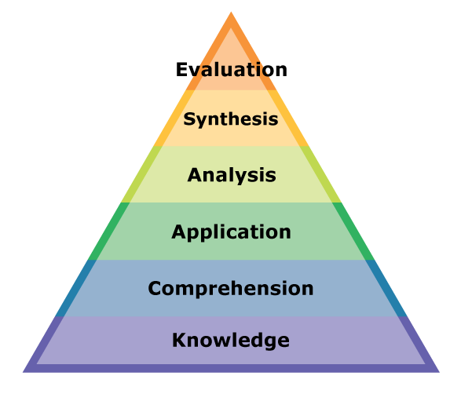
(Kincheloe and Weil, 2004)

Slide 14
Peer Marking
Pupils mark each others work
Allows them to be critical
Develops a deeper understanding

Slide 15
Conclusion
The methods are easy to implement
Do not cost any money
Go hand in hand with the current education policies
Develops the learner and teacher

Slide 16
References
Adey, P, Fairbrother, R, Wiliam, D, Johnson, B, Jones, C. (1999) Learning Styles and Strategies. A review of Research.. London: Kings College London School of Education.
Brookhart, S. (2017). How to Give Effective Feedback to Your Students. ASCD.
Heritage, M. (2010). Formative assessment. Thousand Oaks, Ca.: Corwin.
Kincheloe, J. and Weil, D. (2004). Critical thinking and learning. Westport, Conn.: Greenwood Press.
Morgan, N. and Saxton, J. (2002). Asking Better Questions, 2nd Edition. Markham: Pembroke Publishers.
Spendlove, D. (2009). Putting assessment for learning into practice. London: Continuum International Pub. Group.

