Slide 1
Social Media – The impact…
BMPE6006 Week 9

Slide 2
Social media and mental health
https://www.youtube.com/watch?v=Czg_9C7gw0o
Is leaving social media the answer?!
Quit social media...(watch this later)!​
https://www.youtube.com/watch?v=3E7hkPZ-HTk​

Slide 3


Thoughts?
Highlight reel – reality
Social currency – confidence / self esteem / identity
F.O.M.O – have to stay? Teenagers
Online harassment – etiquette / beliefs / divided society

Slide 4
Readings:
The Emotional Impact of Social Media in Higher Education (Iwamoto & Chun, 2020) – Comparison
Combating Fear of Missing Out (FoMO) on Social Media: The FoMO-R Method (Alutaybi et al., 2020)– FOMO
Dark consequences of social media-induced fear of missing out (FoMO): Social media stalking, comparisons, and fatigue (Tandon et al., 2021)
FOMO / Comparison / SM Stalking / Fatigue.

Slide 5
The Emotional Impact of Social Media in Higher Education (Iwamoto & Chun, 2020) – Comparison
TASK…Questions to answer / for discussion:
What was their rationale for selecting students as a population group?
What did they do (method)?
What significant correlations did the researchers find?
Which social media platforms were found to have relationships with depression, anxiety and stress?
What were the limitations of the study?
What did they suggest as future research directions?

Slide 6
Combating Fear of Missing Out (FoMO) on Social Media: The FoMO-R Method (Alutaybi et al., 2020)– FOMO
TASK…Questions to answer / for discussion:
What is FoMO and how is this linked to social media?
What type of previous research has been conducted on FoMO?
Why did the researchers use the TTM as a starting point for their FoMO-R approach?
What did they propose as a method for managing FoMO?
Did this work?
What are the limitations that they identified with their study?

Slide 7
Dark consequences of social media-induced fear of missing out (FoMO): Social media stalking, comparisons, and fatigue (Tandon et al., 2021)
FOMO / Comparison / SM Stalking / SM Fatigue.
TASK…Questions to answer / for discussion:
How do the researchers define the following? FOMO / Social Media Stalking / Online Social Comparison / Social Media Envy.
What is proposed (from previous research) regarding FoMO and Social Media Fatigue
  What did the researchers from the current study find?
What is proposed (from previous research) regarding the links between Online Social Comparison and Social Media Stalking?
  What did the researchers from the current study find?
What is proposed (from previous research) regarding the links between Social Media Stalking and Social Media Fatigue?
  What did the researchers from the current study find?
What is proposed (from previous research) regarding the links between Online Social Comparison and Social Media Fatigue?
  What did the researchers from the current study find?
What are the four practical implications that are suggested as a result of the studies findings?

Slide 8
Social media and body image - Adolescents
An extensive body of correlational research has demonstrated cross-sectional relationships between the consumption of traditional media (fashion magazines or television) and various indices of body dissatisfaction or disordered eating (Grabe et al., 2008)
A smaller body of research has likewise demonstrated a relationship between Internet usage and body dissatisfaction (Tiggermann and Miller, 2010).
Adolescent girls - social networking – prevalence of this.
Construct personal profiles, to share photos and information, to choose when and how they wish to engage, and to interact with “friends” in their networks.

Slide 9
A systematic review concluded that facebook use is associated with body image concerns and disordered eating in women and adolescent girls (Holland and Tiggermann, 2016).
However, the small amount of existing evidence is largely correlational in design and thus cannot determine the direction of causality between variables (Holland and Tiggermann, 2016).

Slide 10
sociocultural model
The sociocultural model would predict that engagement with Facebook leads to body image concerns, the converse causal direction is equally plausible (Thompson et al., 1999)
E.g. Women and girls who are most dissatisfied with or invested in their appearance may turn to the Internet and social networking in order to seek information or reassurance.
Only a longitudinal methodology can test a causal relationship.

Slide 11
What are the issues?
Managing the problem?
Access to social media?

Slide 12
Social media – Physical activity adolescents
Adolescents’ use of social media, which has increased considerably in the past decade, has both positive and negative influences on adolescents’ health and health behaviours.
As social media is the most prominent communication tool of choice for adolescents, it is important to understand the relationship between the frequency of social media use and health behaviours among this population.
Objective of study:
  to examine the associations between the frequency of social media use and physical activity and sleep adequacy among middle and high school students.
Medium intensity of social media use was associated with the highest levels of physical activity and lowest sleep adequacy among those with moderate health behaviours.
Optimal level of social media use that is beneficial to a variety of health behaviours would be most beneficial to adolescents who are in the middle of the health behaviour spectrum.

Slide 13

Social influence in social psychology
Human beings have a psychological need for experiencing relatedness (Deci & Ryan, 2000; Ryan & Deci, 2000), which refers to the needs of belonging and being connected with others.
When these needs are fulfilled in a given context, the experienced relatedness may increase intrinsic motivations toward activities related to that context (Ryan & Deci, 2000; Zhang, 2008).
In other words, for example in the information technology context, experiencing relatedness through the use of a system potentially makes the user more willing to engage with the system and continue using it (Zhang, 2008).

Slide 14

Group formation
One method for creating such senses of relatedness is by organizing into groups.
Groups form around mutual goals and through different stages of group formation usually develop to share mutual norms which are an important antecedent for group cohesion (Tuckman, 1965).
The process of group cohesion is revealed in the tendency of a group of people to stay together and pursue some instrumental objectives, and thus, reciprocally benefit from the social community (Carron & Brawley, 2000).

Slide 15
Becoming a member of a social community may thus lead to individuals being affected by the social influence from others.
Depending on whether the individual wishes to become part of the social community, he or she may accept the social influence, for example, the diffusion of the behavioural norms of the community that are communicated through the process of signalling the norms (Ajzen, 1988, 1991; Fishbein, 1979).
Depending on whether the individual accepts the norms, the social community provides feedback to the individual on his or her behaviour (Hernandez, Montaner, Sese, & Urquizu, 2011; Lin, 2008).

Slide 16

In case the individual has accepted the social influence and has received positive feedback from the relevant community, this may further lead to satisfaction for the individual who is conforming and complying with the norms (Kelman, 1958; Lin, 2008; Lindenberg, 2001).
Theories on group formation (Tuckman, 1965), relatedness regarding emergence of intrinsic motivations (Ryan & Deci, 2000) and social influence (Cialdini, Green, & Rusch, 1992; Kelman, 1958) suggest that social influence also includes the affective experience derived from gaining recognition from accepting and conforming with the social influence.
The fulfilment of needs of relatedness essential to intrinsic motivation requires a supportive environment.

Slide 17
Combating Fear of Missing Out (FoMO) on Social Media: The FoMO-R Method (Alutaybi et al., 2020)– FOMO
TASK…Questions to answer / for discussion:
What is FoMO and how is this linked to social media?
What type of previous research has been conducted on FoMO?
Why did the researchers use the TTM as a starting point for their FoMO-R approach?
What did they propose as a method for managing FoMO?
Did this work?
What are the limitations that they identified with their study?

Slide 18
Dark consequences of social media-induced fear of missing out (FoMO): Social media stalking, comparisons, and fatigue (Tandon et al., 2021)
FOMO / Comparison / SM Stalking / SM Fatigue.
TASK…Questions to answer / for discussion:
How do the researchers define the following? FOMO / Social Media Stalking / Online Social Comparison / Social Media Envy.
What is proposed (from previous research) regarding FoMO and Social Media Fatigue
  What did the researchers from the current study find?
What is proposed (from previous research) regarding the links between Online Social Comparison and Social Media Stalking?
  What did the researchers from the current study find?
What is proposed (from previous research) regarding the links between Social Media Stalking and Social Media Fatigue?
  What did the researchers from the current study find?
What is proposed (from previous research) regarding the links between Online Social Comparison and Social Media Fatigue?
  What did the researchers from the current study find?
What are the four practical implications that are suggested as a result of the studies findings?

Slide 19
Enhances existing behaviour?
Does social media have any impact on exercise behaviour?

Slide 20
Social media and exercise behaviour…Exercising for likes.
Social and gameful (mobile) applications in order to motivate
In order to investigate this phenomenon, measured how social influence predicts attitudes, use and further exercise in the context of gamification of exercise.
Results show that people indeed do ‘‘work out for likes’’, or in other words, social influence, positive recognition and reciprocity have a positive impact on how much people are willing to exercise as well as their attitudes and willingness to use gamification services.
Found that the more friends a user has in the service, the larger the effects are.
Important to consider how subjective norms, how getting recognized, receiving reciprocal benefits and network effects contribute to use continuance

Slide 21
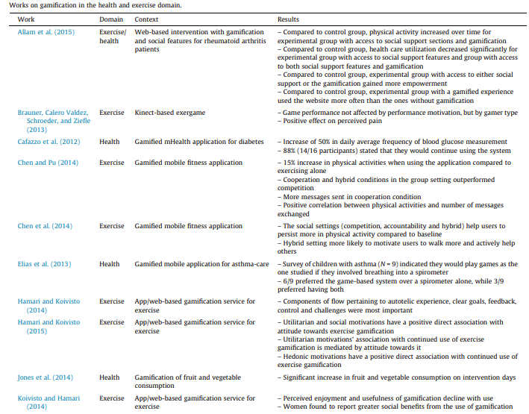

Slide 22
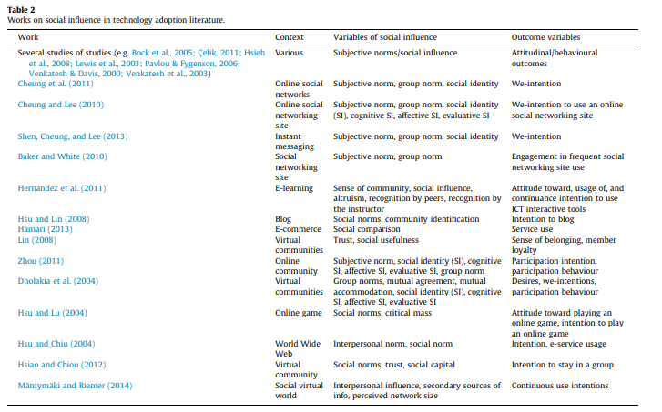

Slide 23
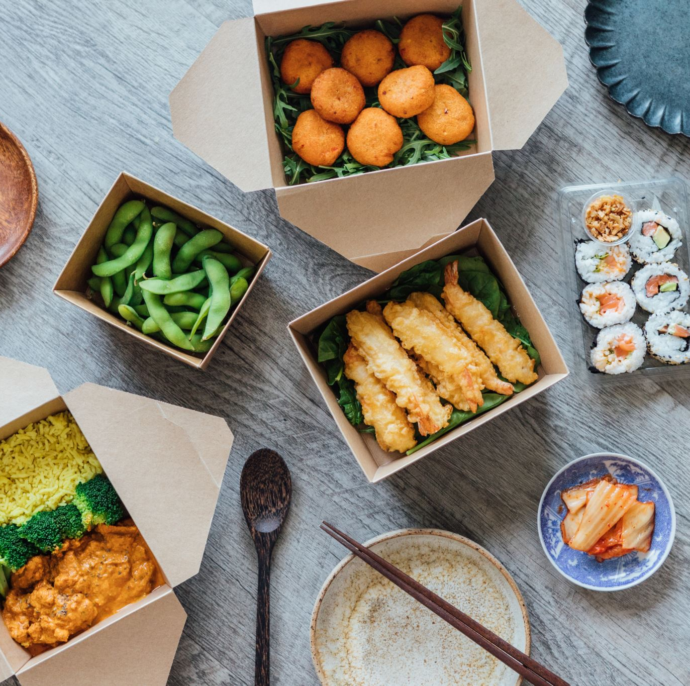
Social media and our relationship with food…
Using social media for good?

Slide 24
Social Media and the Dietetics Practitioner: Opportunities, Challenges, and Best Practices
Social media tools, including blogs, social networks, and media-sharing sites, help nutrition and dietetics practitioners reach broader audiences and connect directly with the public.
In many ways, social media has transformed the practice of dietetics and has opened up new avenues for communicating food and nutrition information.
Social media has been an effective tool for virtual nutrition counseling, patient education, peer-to-peer support, and public health campaigns.
Increasingly, nutrition and dietetics practitioners are using social media to network and collaborate with colleagues, conduct a job search, stay current with new research, champion a cause, promote products or services, and build a business.

Slide 25
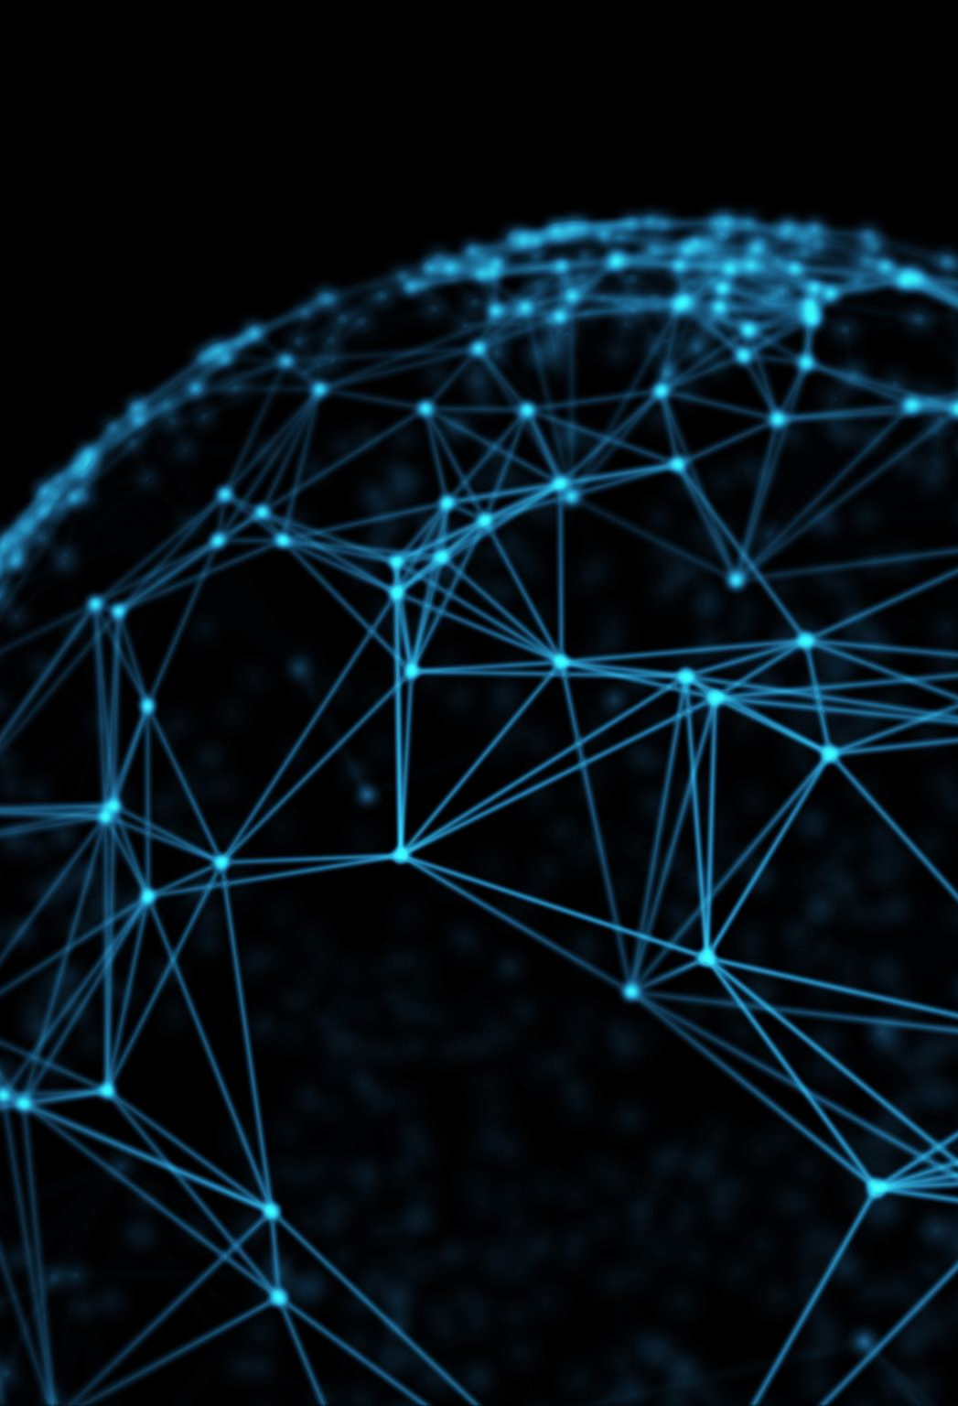
When using social media, nutrition and dietetics practitioners must remember that they are governed by the same Code of Ethics that guides all other aspects of practice
In today’s digital age, it is essential for nutrition and dietetics practitioners to recognize the professional opportunities and challenges of social media.
Failing to effectively and ethically use social media can reflect poorly on the individual practitioner and the profession.

Slide 26
Careers
Increasingly, nutrition and dietetics practitioners are using social media to network and collaborate with colleagues, conduct job searches, staying current with new research, promote products or service.
When using social media, nutrition and dietetics practitioners must remember that they are governed by the same Code of Ethics that guides all other aspects of practice
In today’s digital age, it is essential for nutrition and dietetics practitioners to recognize the professional opportunities and challenges of social media.
Failing to effectively and ethically use social media can reflect poorly on the individual practitioner and the profession.

Slide 27
Readings…
Moodle for additional readings…

