Slide 1
Property and Conveyancing:
Underpinning Land Law
Week 1 – Chapter 1

Slide 2

To understand:
common law and equity – a reminder
what is land?
estates and interests in land
formalities for the express creation of legal interests
formalities for the express creation of equitable interests, and
statutory requirements for a deed and the exceptions to the requirements for a deed.

Slide 3
Common Law and Equity
Medieval origins of Equity
Development of a more formal system
Fusion of Law and Equity
Equitable Maxims
Equitable Remedies

Slide 4
The Equitable Maxims
Equity acts ‘in personam’
Equity will not suffer a wrong to be without a remedy
Equity follows the law
He who seeks equity must come with ‘clean hands’
Delay defeats equity
He who seeks equity must do equity
Equity is equality
Equity sees as done what ought to be done
Equity looks to the substance and not to the form
Equity will not assist a volunteer
Equity will not act in vain

Slide 5
Equitable Remedies
specific performance – an order to the party to a contract to perform their obligations under the contract;
injunction – an order directing a person or persons to refrain from doing a particular act or thing (or, very occasionally, an order requiring them to do something);
rescission – the setting aside of a contract;
rectification – the correction of a contract where the writing does not properly represent what the parties to the contract had agreed;
account – the process whereby the sums due from one party to another resulting from transactions between them are investigated; and
the appointment of a receiver – the appointment of a person in order to preserve endangered property for the benefit of those who are entitled to it.

Slide 6
Equitable rights in Conveyancing
Examples:
Beneficial interests arising from co-ownership as tenants in common
Rights under restrictive covenants – take effect in equity
Equitable interest arising from an estate contract ( at the point of exchange of contracts but before completion)

Slide 7
Now a LAND LAW refresher!

Slide 8
History of Land Law
Doctrine of tenure : ultimate tenure lies with the Crown
tenure amounts to a method whereby land is held from an immediate lord and ultimately from the Crown.
Freeholder own the freehold but if dies intestate land reverts to the Crown
doctrine of tenure should be appreciated, although it is of little importance today.
doctrine of tenure defined the quality of the landholding because tenure determined the conditions on which the right to occupy the land was granted.
doctrine of estates marks out the extent and duration of the rights over the land in question and, therefore, defines the quantity of the landholding. there is always a temporal (time) element defining the duration of landholding.
Estates are classified into those of freehold and those of less than freehold.
Freehold estate is of indefinite duration. There is no knowing, at the time of the grant, precisely when the estate of freehold will end.
An estate of less than freehold is a lease and the characteristic of a lease is that it is of fixed maximum duration. Thus, an estate which lasts for a maximum of a year, or 10 years or, indeed, a thousand years or only one day, must be a lease.

Slide 9
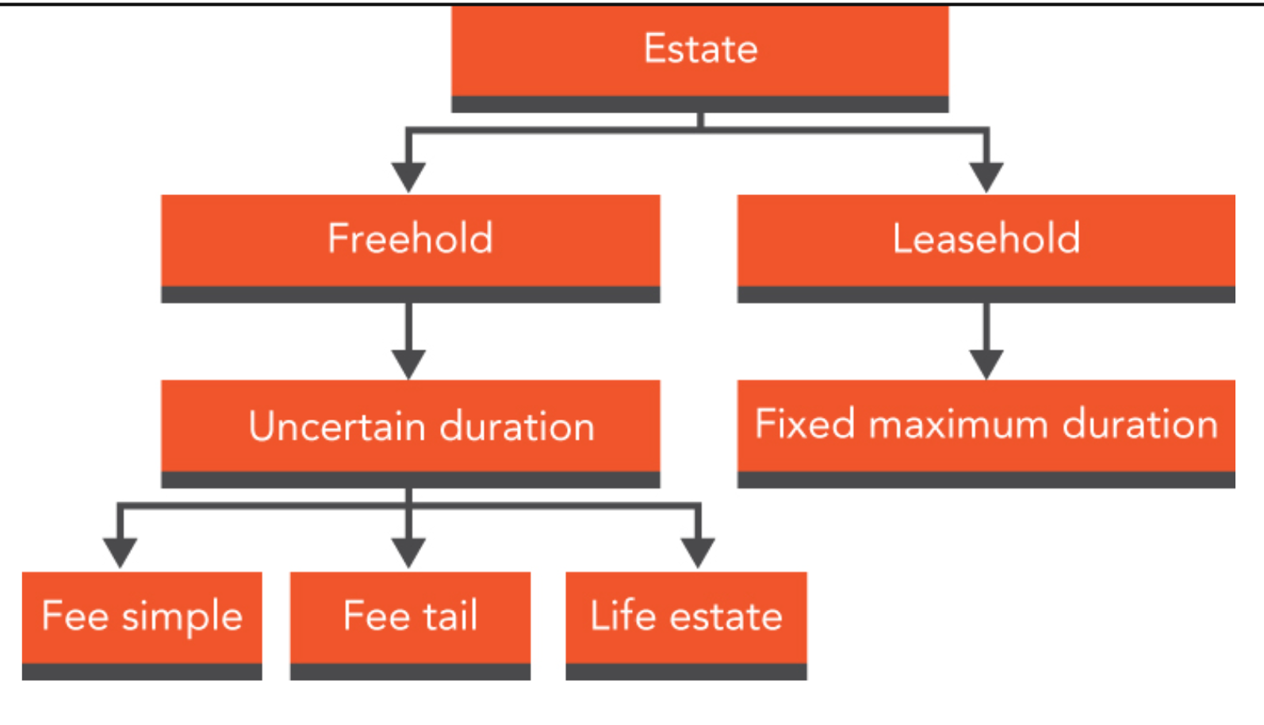
Estates at Common Law
The 3 freehold estates

Slide 10
Estates in possession, in remainder and in reversion
These estates and interests may be granted out of a fee simple e.g G owns the freehold (fee simple absolute) of land known as Bobbin Wood and grants the following to: “A for life, remainder to B for life, remainder to C in fee simple”
QUESTION: What interests are held?
ANSWER: A is entitled to immediate possession as there are no prior interests to their own.
B has a life interest in remainder – B is entitled to what “remains” after A’s interest has determined (i.e. ended), that is, after A’s death.
C has a fee simple in remainder. When A dies, B has a life interest in possession and C has a fee simple in remainder. Then, upon B’s death, C acquires the fee simple absolute in possession, which is equivalent to absolute ownership.
Although neither B nor C has a right to possession while A is alive, they do have an interest in the land which they are free to dispose of as they wish.

Slide 11
Words of Limitation
To create an estate less than a fee simple, a grantor must use words of limitation because, by s60(1) LPA 1925, a conveyance of freehold land to any person without words of limitation, or any equivalent expression, would result in the fee simple or the whole of the interest which the grantor had power to convey passing to the grantee.
If that is not the intention then that contrary intention must appear in the conveyance ( as long as the grantor doe have the fee simple to pass on obviously)
So, if the grantor has the fee simple, they pass that fee simple unless the contrary is stated.
Words of limitation to create a life estate would be “to X for life”.
NEXT: More terminology….

Slide 12
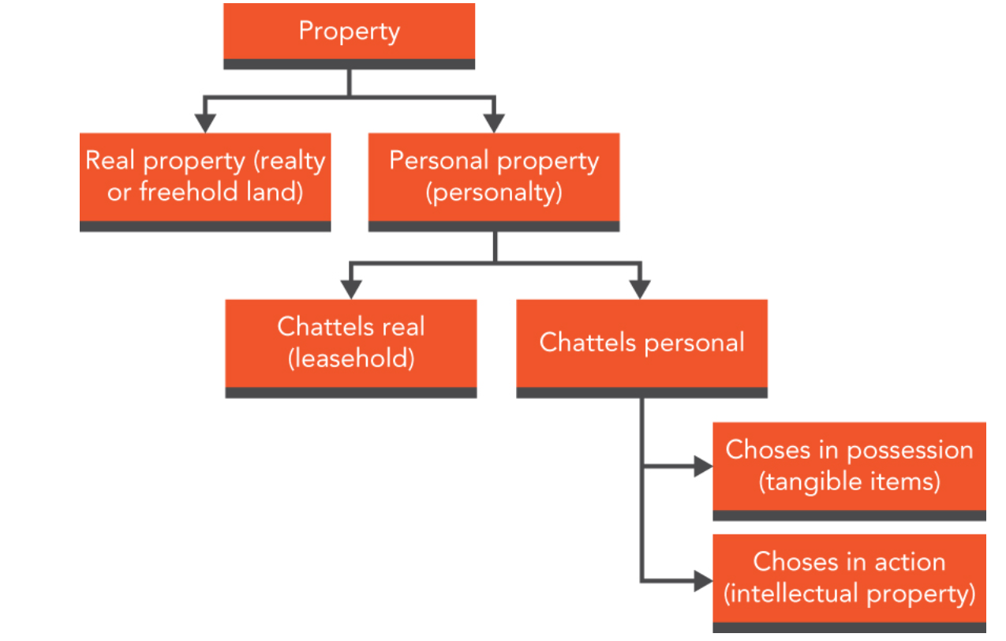
What is Land?
Realty and Personalty

Slide 13
Distinction between:
Realty vs Personalty
Distinction today ( post 1925 property legislation) is only of importance in specific circs e.g Probate.
Personal Rights and Proprietary Rights
Proprietary rights have the capacity to bind a buyer of the land. For example, easements and leases are proprietary rights in land and so can bind a buyer of the land that they are over.
However, an invitation to supper is a personal right only and, as such, an invitation would not bind a third-party buyer of the land. Personal rights can only bind the person who gave the right. With the exception of some licences, all the rights described in this course book are proprietary rights.

Slide 14
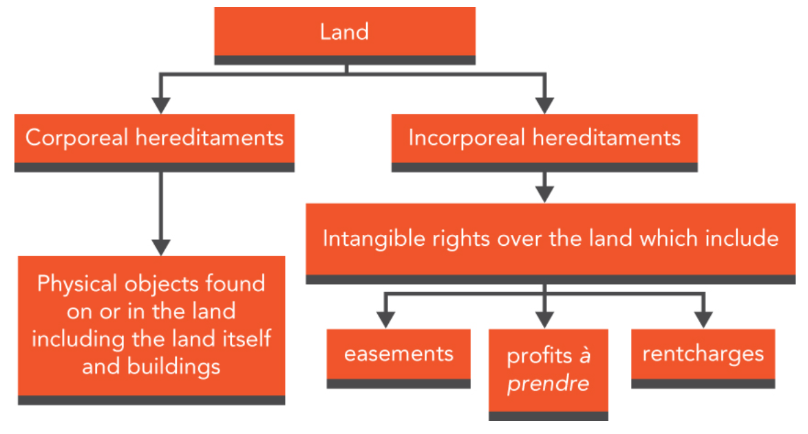
Definition of Land: s205(1)(ix) Law of Property Act 1925 (LPA 1925)
Land includes: land of any tenure, and mines and minerals, whether or not held apart from the surface, buildings or parts of buildings (whether the division is horizontal, vertical or made in any other way) and other corporeal hereditaments; also a manor, an advowson, and a rent and other incorporeal hereditaments.

Slide 15
“He who owns the land owns…. everything to the heavens and depths of the earth…..”
Limitations:
Crops are not land but naturally occurring plantlife could be.
Airspace: only to such a height as necessary for ordinary use and no action lies for nuisance by flights ( Civil Aviation Act 1982). Drones are also covered by specific legislation requiring a licence
So advertising sign that projected into neighbour’s airspace was trespass.
Mines and minerals: Landowner not entitled to minerals under land – ownership determined by statute (e.g Coal Act 1938, Petroleum Act 1998)
Treasure: treasure on land vest in the Crown
Objects ON the ground: finder entitled to possess the object as against the occupier unless i) object is attached to land or ii) occupier made clear their control of land and anything on it.
Objects BURIED in the ground: landowner has superior rights to things buried in the ground

Slide 16
“He who owns the land owns…. everything to the heavens and depths of the earth…..”
Limitations:
Wild animals: belong to no-one ( until it is killed then belongs to the landowner)
Water rights: landowner has no right to the water but may have right to fish in it.
Other rights: landowner may be subject to 3rd party rights over her land e.g easements and be liable to others who come on to their land.
Statutes can limit the rights of a landowner to do as he/she pleases.
Quicquid plantatur solo, solo cedit “ whatever is attached to the ground becomes a part of it”: eg an artificial heap of waste could become part of the land when grass and tress grew on it
Land includes buildings on the soil and every part of them so top floor of a high rise block of flats is “land”

Slide 17
Fixtures and fittings
Whatever is attached to the soil bcomes part of the land ( quicquid plantatur solo, solo cedit) but a distinction is made between fixtures and fittings
Fixtures = realty, part of the property and are included in a sale of the property subject to any contrary provision in a contract
Fittings = personalty, chattels – can be taken by the seller ad if buyer want them then the buyer needs to pay
If the Fittings and Contents form does not mention a particular object then a decision needs to be made whether the object is a fixture or a fitting – aided by two tests:
Degree of annexation test
Purpose of annexation test

Slide 18
Degree of annexation
The greater the degree of attachment of an object to land, the more likely it is to be a fixture. Holland v Hodgson [1872] Blackburn J (if the…) “article in question is no further attached to the land than by its own weight it is generally considered to be a chattel”. In Holland, spinning looms bolted to the floor of a factory were attached by some means other than their own weight and thus amounted to fixtures.
Conversely, Hulme v Brigham [1943], heavy printing presses resting on the floor of premises were chattels even though they could not be readily moved due to their excessive weight because there was no human attachment to the land. Likewise, Dean v Andrews [1985], a greenhouse standing on its own weight on dollies (a dolly is a platform on wheels for moving heavy objects) not attached to the ground was held not to be a fixture.
Note: degree of annexation test is not necessarily decisive. Even if the degree of annexation of an object to the property may be substantive, it could still be regarded as a fitting rather than as a fixture as a result of considering the purpose of annexation test.

Slide 19
Purpose of annexation –now the DOMINANT TEST
Climie v Wood (1868-69) that “sometimes things annexed to land remain chattels” but that “things may be made so completely a part of the land, as being essential to its convenient use, that even a tenant could not remove them”. This was approved.
London Borough of Tower Hamlets v London Borough of Bromley [2015] - Large bronze sculpture on a housing estate. Held: it was an entire object in itself, resting by its own weight on the ground and could be removed without damage and without diminishing its inherent beauty. It did not form part of the integral design of the housing estate and so was a chattel.
KEY CASE: Botham v TSB Bank plc [1996] looked at permanency, lasting improvement, utility and ease of removal when applying the law to a modern house. -carpet tiles glued to the floor = fixtures, the carpets in Botham were not fixed substantially to the floor, were fitted for their own enjoyment and did not become part of the building. Removal of them would not damage the fabric of the building and they were chattels.
Gas fire was attached by a pipe to the gas supply BUT electric fires plugged into the electricity supply were seen as chattels and, by analogy, gas fires would also be chattels. The kitchen units and sink were seen as fixtures because they were a permanent improvement to the property.
So, degree of annexation will prove nothing. However, the more damage that is likely to be caused on removal, the more likely the item is to be a fixture.

Slide 20
The right to remove fixtures
Unless a fee simple absolute owner excludes fixtures when they sell their land, they pass to the buyer
Fixtures which can be removed are known as removable tenant’s fixtures and they fall under three heads.
  Trade – attached by T for the purpose of their business can be removed by T
  Ornamental and Domestic: can only be removed if their removal does not cause substantial damage (stoves, grates, ranges, ovens)
  Agricultural: any engine, machinery, fencing or other fixture, fixed by the T and any building erected by them on agri land is removable by T during tenancy or within 2 months after.
As between mortgagor (borrower) and mortgagee (lender) fixtures pass with the land to the mortgagee, even though not mentioned in the deed. Third party fixtures can be removed by the third pary

Slide 21
Estates and Interests in Land… we consider:
The two legal estates in land – freehold and leasehold, s1 LPA 1925;
The five legal interests in land; and
The distinction between freehold and leasehold.
Rights in land are capable of being legal or equitable and there are significant differences between legal and equitable rights. This has particular implications when the land that a right is over has been sold.

Slide 22
Enforcing Legal and Equitable Rights
Legal rights in land bind in rem: they bind the world.
Not true of equitable rights. There is one category of person, affectionately known as “equity’s darling” (the bona fide purchaser), who will be able to take free of such rights. The following statement from Maitland’s Equity, defining equity’s darling, is therefore crucial
“Legal rights are good against all the world; equitable rights are good against all persons except a bona fide purchaser of a legal estate for value without notice, and those claiming under such a purchaser”.
The statement has, in a large number of cases, been superseded by statutory land registration. Nevertheless, the basic principle remains true.

Slide 23
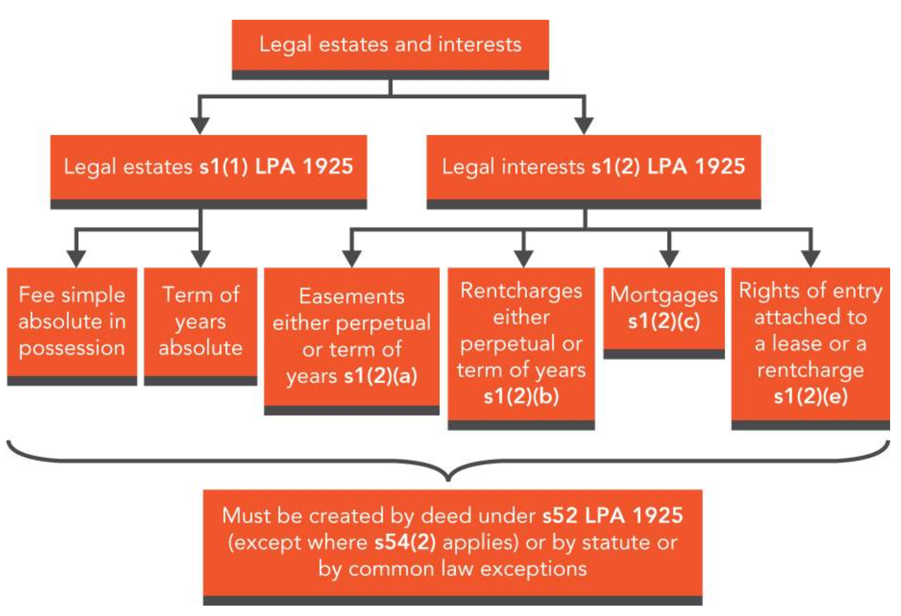

Slide 24
Legal Estates and Legal Interests
LEGAL ESTATES
  Fee simple absolute in possession ( Freehold)
    Right in perpetuity ( although owners of it can come and go)
    An immediate right
  Term of years absolute ( Leasehold)
    Fixed duration. Can also include periodic tenancies ( LPA s205 (1) (xxvii)

Slide 25
Commonhold
Commonhold was introduced by the Commonhold and Leasehold Reform Act 2002 (CLRA 2002) in order to meet the needs of owners of flats or apartments and other properties where the owners are interdependent, for example, retirement homes and business parks.
Commonhold is not a new estate in land but is one that is created out of an absolute freehold registered estate.
Where the commonhold system is to be used, the property is registered at the Land Registry as “commonhold land”. The owner of each individual unit is referred to as the unit-holder and is registered as its freehold owner (s12 CLRA 2002).

Slide 26
Legal Estates and Legal Interests
LEGAL INTEREST
  Easement ( easement, right or privilege) equal to fee simple absolute in possession or term of years absolute (s 1 (2) (a)
    i.e in perpetuity or for a fixed term of years
    E.g rights of way, rights of drainage
    Includes profits a prendre
  Charge by way of legal mortgage
  Rentcharge – right to a periodic payment of money attached to freehold land
  Rights of entry – attached to a lease, allowing L to forfeit the lease if T in arrears or in breach of other obligation
  Charges arising under statute ( of little significance)

Slide 27
All other estates, interests and charges are EQUITABLE
Any property rights referred to in S 1(1) or S 1 (2) LPA 1925 which are not created by deed are EQUITABLE.
All other estates, interests or charges in or over land are equitable interests S 1 (3).
Equitable interests can be held by person of any age
May be equitable if a flaw e.g fixed term lease not created by deed
Or benefit of a restrictive covenant
Or the right arising after exchange of contracts

Slide 28
Equitable Interests
No such thing as an equitable estate only equitable interest
Equitable interests do not bind the whole world
Equity’s darling – the bona fide purchaser for value of a legal estate without notice of the equitable interest – takes free of them.
Bona fide - in good faith
Purchaser for value – for consideration
Of a legal estate – (as opposed to an equitable interest)
Without notice – MOST IMPORTANT

Slide 29
Without notice
Actual notice: actual knowledge of the existence of an equitable interest. A suspicion of the existence of an equitable or beneficial interest is not actual notice, though it could be constructive notice.
Constructive notice : knowledge which you would have, had you made all the proper enquiries: Before purchasing property with an unregistered title (unregistered land is examined in a later chapter), a buyer should make three types of enquiry:
(a) check the seller’s title to land up to a good root of title – s44 LPA 1925, as amended by s23 LPA 1969;
(b) check any relevant registers showing rights adversely affecting the land (dealt with in a later chapter);
(c) inspect the land and enquire of those in occupation.
See Kingsnorth Trust Ltd v Tizard [1986]
Imputed notice: the actual or constructive notice of an agent acting for a buyer. Thus, the knowledge of a conveyancer employed to undertake the conveyance of a house – or, as in Kingsnorth v Tizard, a surveyor (Kingsnorth’s surveyor knew of the existence of Mrs Tizard and that the couple were recently separated) – is imputed to the buyer.
It should be remembered that much of the doctrine of notice has been overridden by statute. In the case of unregistered land, this is through the Land Charges Act 1972 and in the case of registered land it is through the Land Registration Act 2002.

Slide 30
Equitable Remedies
specific performance – an order to the party to a contract to perform their obligations under the contract;
injunction – an order directing a person or persons to refrain from doing a particular act or thing (or, very occasionally, an order requiring them to do something);
rescission – the setting aside of a contract;
rectification – the correction of a contract where the writing does not properly represent what the parties to the contract had agreed;
account – the process whereby the sums due from one party to another resulting from transactions between them are investigated; and
the appointment of a receiver – the appointment of a person in order to preserve endangered property for the benefit of those who are entitled to it.

Slide 31
Formalities

Slide 32
Formalities required for the express creation of legal interests
These formalities are to be found in the following statutes:
s2 Law of Property (Miscellaneous Provisions) Act 1989 (LP(MP)A 1989); relates to contracts
s52 Law of Property Act 1925 (LPA 1925); relates to the creation of legal estates ( e.g the actual transfer)
s1 LP(MP)A 1989; (what is a valid ‘deed’) and
the Land Registration Act 2002 (LRA 2002) – requirement to register and details of how

Slide 33
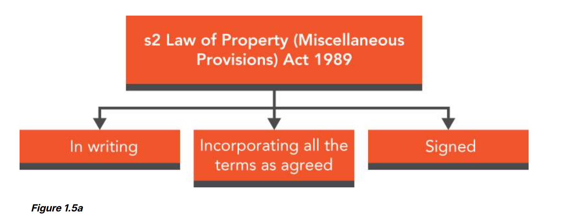
Contracts in relation to the creation or transfer of an interest in land are governed by s2 LP(MP)A 1989

Slide 34
S 52 LPA 1925
All conveyances of land or of any interest therein are void for the purpose of conveying or creating a legal estate unless made by deed.
Exception: a lease for 3 years or less taking effect immediately at a market rent can be created in writing or orally.
All others must be by DEED

Slide 35
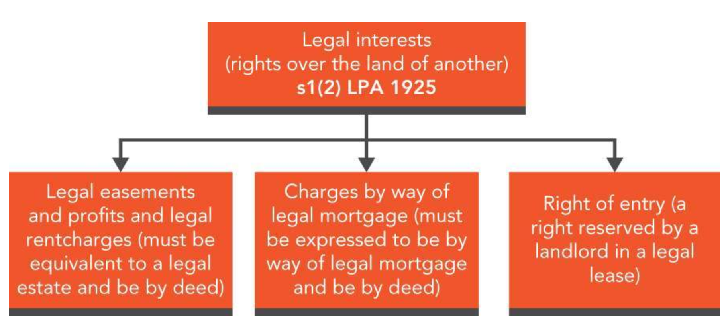
S 1 (2) LPA 1925 – states 5 legal interests ( we do not consider legal rentcharges or charges arising under statute)

Slide 36
Formalities for express creation of EQUITABLE INTERESTS
Equitable interest can be held by someone of any age
Can arise under a trust ( property being held on behalf of another)
Can arise when an interest is created but does not comply with correct formalities e.g 21 year lease not created by deed.
Can arise as an estate contract
Or the benefit of a restrictive covenant
S53(1) LPA 1925: above must be created in writing and signed by the person disposing of the equitable interest ( subject to some exceptions)
The exceptions: creation or operation of resulting, implied or constructive trusts.

Slide 37
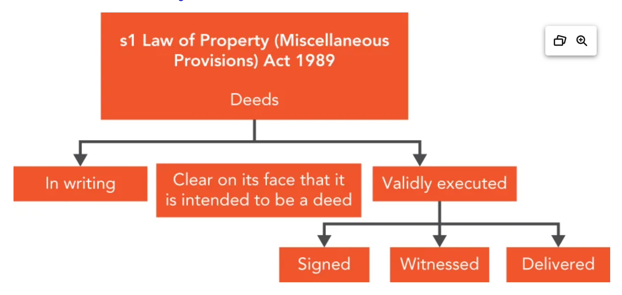
Requirements for a DEED
Examples: TR1, mortgage deed, conveyance, deed of easement
Requirements ( s 1 LP (MP)A 1989) i) in writing, ii) clear it is intended to be a deed, iii) delivered as a deed ( clear that person intends to be bound) and iv)validly executed

Slide 38
What is meant by ‘conveyance’?
S 205 LPA 1925: Conveyance” includes a mortgage, charge, lease, assent, vesting declaration, vesting instrument, disclaimer, release and every other assurance of property or of an interest therein by any instrument, except a will

Slide 39
Exceptions to requirement for a deed
(1) Assents, which must be in writing but need not be executed as a deed (s 36(4) AEA 1925).
(2) Leases taking effect in possession for a term not exceeding three years at the best rent which can be reasonably obtained without taking a fine (this means the market rent for the premises) (s54(2) LPA 1925).
(3) Disclaimers under Insolvency Act 1986 (s52(2)(b) LPA 1925). A liquidator has the power to “disclaim onerous property”. This essentially means to reject the asset on the basis that it will not be a benefit. A lease is often seen as onerous property (due to the rental costs) and is often disclaimed.
(4) Surrenders by operation of law, including surrenders which may, by law, be effected without writing (s52(2)(c) LPA 1925). A lease can be surrendered by deed or by operation of law. The latter occurs when the unequivocal conduct of landlord and tenant is inconsistent with the continuation of the tenancy. An example of this might be when the tenant hands back the keys to the premises and these are accepted by the landlord.
(5) Leases and tenancies not required to be made in writing (s52(2)(d) LPA 1925).

Slide 40

Any questions?

