Slide 1
Choral Directing in the 21st Century.
What does it take to be a UK choral director – understanding the education and pathways to choral directorship.

Slide 2
Introductions
My name is Laura Ward and I’m a choral director.
BA (hons) Music and Humanities
MA Music
Accountant
Voice Works student
Chorister, Choral Singer and sometime Soloist
Choral Director for 12 years
ABCD Intermediate (DipABRSM equivalent)
And now I know how little I knew before starting the MA in Vocal Pedagogy…

Slide 3
Why?
In 2017, Voices Now conducted a survey, The Big Choral Census, that estimated there were over 2 million amateur choral singers in the UK singing in around 40,000 choirs (BBC Radio 3 Choir and Organ Online, n.d.).
This includes community choirs, children’s choirs, choral societies, choirs for health, church choirs, choirs for well-being, LBGTQ+ choirs amongst others
Each choir will have at least one choral conductor, and many choral conductors will have more than one choir.
And that adds up to a lot of choral conductors responsible for an awful lot of choral singers.

Slide 4

Why?
The benefits of choral singing from a health and well-being perspective are being increasingly researched, documented and endorsed (Cooper, 2017; Livesey et al., 2012; Osman, Tischler and Schneider, 2016; Smith et al., 2020).
However, choral conducting is an unregulated activity in the UK and yet every week, hundreds of thousands of singers put themselves in the hands of a choral conductor.
And anyone can set themselves up as a choral director, regardless of education, knowledge or experience.

Slide 5
Why?
Australia has seen a boom in the number of community choirs in recent times and Cooper argues that this means the education and development of choral directors is now a matter of ‘public interest’ (2017, p. 358) as a way of protecting participants.
Given amateur participation levels in the UK, it may be reasonable to make the same comment about the choral conducting community here.
The choral directing community should look to educate their singers, not just musically but in the efficient and safe use of their voices (Durrant & Varvarigou, 2015).

Slide 6

Why?
So, the question arose; how many other choral directors in the UK are aware how little they may know?

Slide 7
Why?
Aims:
To establish the level of knowledge in the UK choral conducting community by
  Understanding the routes to choral directorship
  Their background, education levels and experience.
To determine the common areas of training and highlight those that are not.
To understand what areas of continuous professional development (CPD) are undertaken
To conclude whether there is an appetite for further training and CPD
To suggest the key areas for training and development

Slide 8
How?
Before determining how the data for this project would be collected, the questions of Inside Research and Ethics were considered.
Being an insider researcher has advantages:
  A ‘shared experience of the world’ (Smetherham, 1978, p.98);
  A common understanding of the subject and associated language (Darra, 2008; Brannick and Coughlan, 2007).
But it also has dangers:
  The perception of bias;
  The need to manage being the inquisitor (researcher) and being a member of the community.
    (Bulk & Collins, 2023; Humphrey, 2012).
How is this managed?
  By implementing controls to mitigate potential conflicts of interest without compromising the advantages (Humphrey, 2012).
  By choice of methods (Wilkinson & Kitzinger, 2013)

Slide 9
How?
Ethics
The project was conducted in accordance with the ethical guidance laid down by the University of Wales Trinity St David.
Consent was obtained from all the participants.
Participation was voluntary and all were free to withdraw from the project at any time.
The participants were given the option to omit any questions they preferred not to answer.

Slide 10

How?
Methodology decision factors:
New researcher
Little experience of qualitative methods
Like numbers a lot and comfortable with quantitative concepts
The need to triangulate my methods.
The answer?

Slide 11
How?
MIXED METHODS
would allow the flexibility to choose the best methods for the project (MacKenzie & Knipe, 2006)
Can mix quantitative methods with qualitative ones
Appealed to me as a new researcher with ‘an open mind as to how to tackle a particular problem’ (Mitchell, 2018, p.203)

Slide 12

How?
Methods chosen:
Questionnaire
  29 questions
  Predominately closed
  A few open questions for personal statements and unusual circumstances
  Clear and unambiguous
  Not overlapping
  Mainly quantitative allowing for statistical analysis using SPSS
  Where ranked responses were required, a simple frequency ranking method was used.
  Piloted with a small group of 10
  Feedback used to refine it to ensure it would provide reliable and valid responses (Xerri, 2017; Cohen, Manion & Morrison, 2018)
  Set up using Qualtrics and issued with an anonymous link.

Slide 13
How?
Methods chosen cont’d:
Semi-structured interviews
  Qualitative
  Used to enhance survey data and provide a personal perspective (Adamson et al,. 2004)
  Allow some flexibility to explore different aspects alongside set questions (Kallio et al., 2016)
  Volunteers requested at end of survey
  24 responded of which several were selected by random number and contacted.
  7 replied and were interviewed via Teams and recorded.
  Recordings were run through an AI transcription tools, then reviewed and amended for significant mis-transcribed words and phrases.
  Transcriptions then analysed using Reflexive Thematic Analysis to identify the themes (Byrne, 2022)
  A summary of keywords, codes and themes was created, modelled on a format by Naeem et al. (2023).

Slide 14
How?
Methods chosen cont’d:
Literature Review
  Systematic literature review including documentary analysis of grey literature.
  Grey literature used to add balance and further context (Paez, 2017).
  Grey literature sources were documents relating to choral conductor training from reputable educational establishments such as Royal Academy of Music and Association of British Choral Directors.

Slide 15

What?
Few primary sources on choral conductor education in the UK. The most significant are:
  Dr. Colin Durrant, choral conductor, choral conducting tutor and educator;
  Dr. Maria Varvarigou, choral singer and conductor, lecturer and researcher
  And in Norway with research interests in the UK
  Prof. Dag Jansson, choral conductor and educator
  Dr. Anne Haughland Balsnes, music educator
  Study of choral conducting training and practice is an immature academic field in the UK.

Slide 16
What?
First specialist choral conducting course was introduced in 1997 by the Royal Academy of Music (Royal Academy of Music Online, n.d)
At this point, choral conducting in the UK considered ‘pedagogically unsound’ (Durrant in Abrahams & Head (ed), 2017, p.230)

Slide 17
Why?
Study of this field stems extensively from the USA, where choral conducting has been offered as an academic subject at colleges and conservatoires for many years
Consequently, the field of study is better established.
Because of the established nature of choral conducting training in the US education system, it was considered too different from the UK to be used as a basis for comparison.

Slide 18
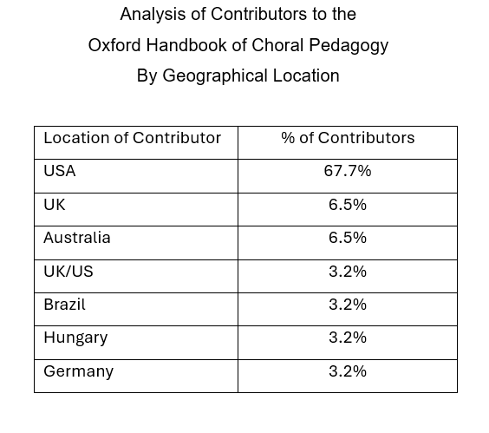
What?
An illustration (of sorts):

Slide 19
What?
Highlights (or should that be lowlights?) of research into UK Choral Conducting Teaching and Development.
‘Professional development in conducting is inconsistent across the UK, leading to a lack of confidence amongst teachers’ (Durrant and Varvarigou, 2008,p. 72).
The lack of formal training for choral directors had resulted in inconsistency in standards, skills and understanding of aspects such as gesture (Varvarigou & Durrant, 2015).
To be effective, a choral director needs more that good technique, they also need confidence in their interpersonal skills (Varvarigou & Durrant, 2015).
1994, Durrant found the UK choral conducting education system to be disorganised, unstructured and lacking in training at Higher Education level.
‘Professional development in conducting is inconsistent across the UK, leading to a lack of confidence in teachers’ (Durrant & Varvarigou, 2008, p.72)
Lack of training in non-technical aspects such as vocal anatomy and technique (Varvarigou, 2009).

Slide 20
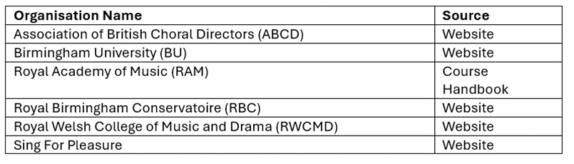
What?
What did the grey literature say?
The following grey literature sources were examined for this project:
The following were offered by all the above:
Conducting technique
Efficient and effective rehearsals
Score knowledge and preparation
Repertoire knowledge and choice
Musicianship

Slide 21
What?
The Higher Education institutions also provided coaching in the skills for professional and career development.
The independent organisations were mainly focusses on the technical aspects of choral conducting
In both cases, there was little mention of:
Interpersonal skills required for effective management
Vocal health and anatomy
Where people management elements were identified, they were vague:
‘create a rapport with the choir’ (ABCD Online, n.d.)
‘keep singers interested and musically satisfied’ (RBC Online, n.d.)

Slide 22
What?
Interviews
The themes arising from the analysis of the seven interview transcripts provided the structure for the presentation of the survey findings.

Slide 23
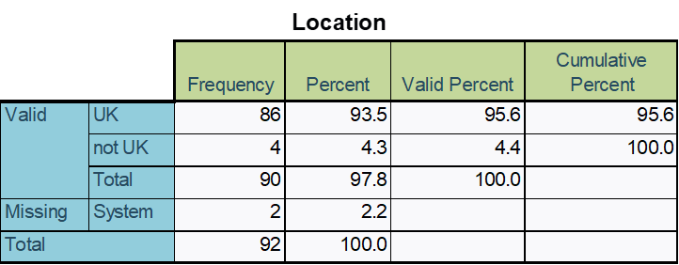
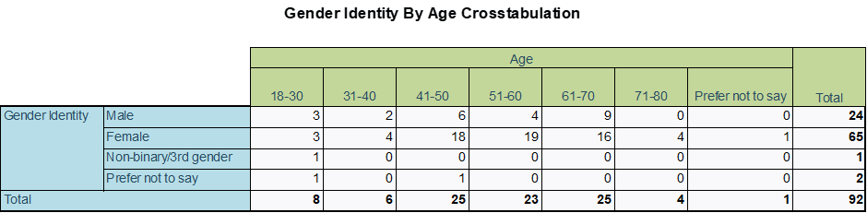
What?
People
The reasons for the concentration of respondents between the ages of 41 and 70 was not explored as part of this project but there may be link between the reasons for a similar profile in choral singers as expressed by Interviewee 3:
‘I think they tend to drop out of things as work and family take over... your competition isn't the other choirs and orchestras… they've got children, they can't get out of an evening… when the kids grow up, they come back to it…’
Alternatively, it could be a natural progression for the experienced choral singer to be curious about a change in role who decides to exploit the opportunity if it arises as it did for Interviewee 6:
‘I've been a choir singer for donkey's years… and one choir in particular, the director was very keen to encourage people to, to have a go. So, I had a little go once, and began to sort of sense that I had the bug for it a little... he gave me regular goes, and then he gave me a little bit of coaching.’

Slide 24
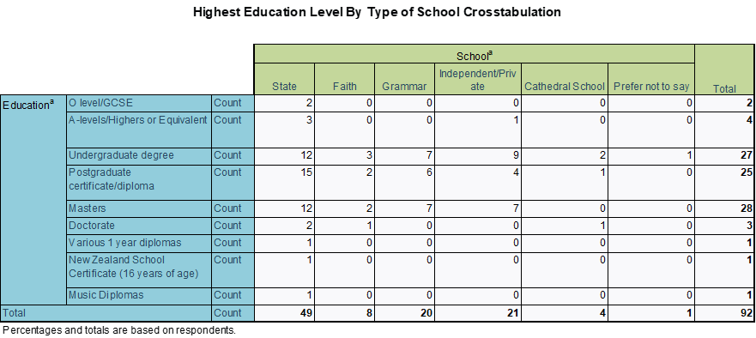
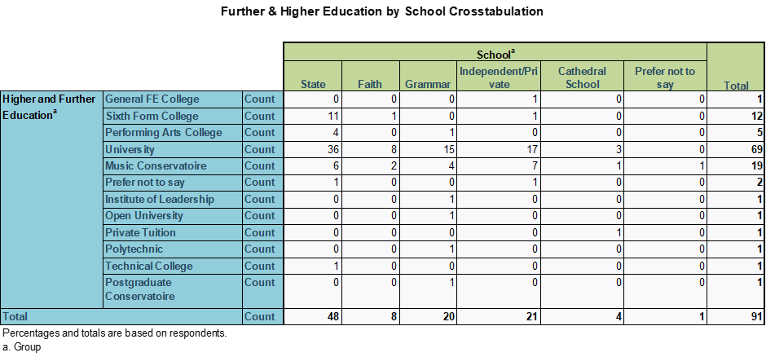
What?

Slide 25
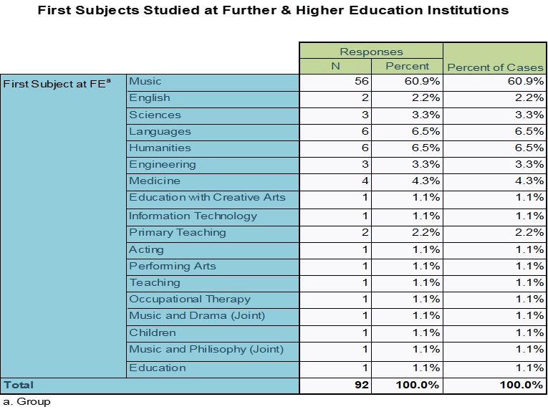
What?
If the sample is representative of the choral directing community in the UK as a whole, UK choral directors are appreciative of the benefits of higher education and are a well-educated community. Given the sample size is small when considering the most recent statistics on choir numbers, it may be difficult to confidently extrapolate this to the wider population.
However, it could prove to be indicative of a predisposition to continuing personal development (CPD) if opportunities of interest are available.

Slide 26
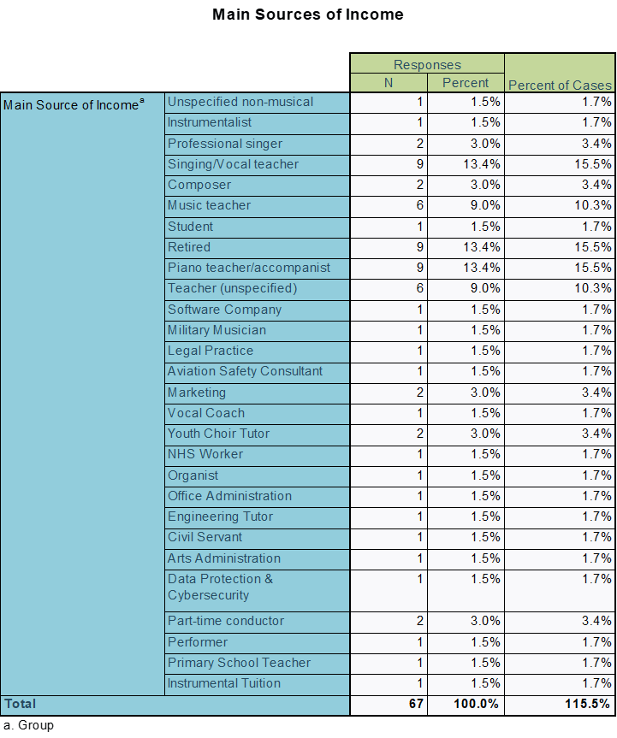
What?
For the majority of respondents, their main income is derived from other sources, including several music related activities such as instrumental teaching, instrumental and singing performing
These individuals could be described as ‘portfolio musicians’ as described by Interviewee 7 who considers himself to be a portfolio conductor:
  ‘they talk about being a portfolio musician these days, about having some teaching and some playing work and quartet work… I feel like I’m a portfolio choral conductor, because I have to be able to do lots of different styles and lots of different lots of different types....you have to be, yeah, multi skilled in different, different areas to make a success. You can't just do one thing.’

Slide 27
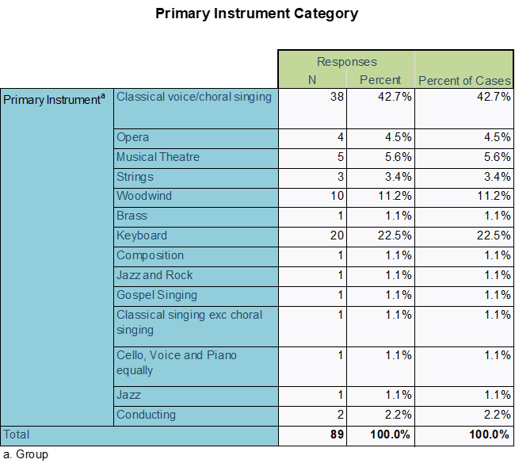
What?
The high incidence of singers leading choirs is perhaps to be expected and having keyboard skills was recognised as a desirable attribute for a choral conductor in both the survey, where it was identified as an additional key competence.
Interviewee 2 had this to say on the benefits of proficient keyboard skills:
‘I have got grade four piano and working on a grade five piece at the moment, but I don't have the confidence or the skills to be able to just to sit in front of children and just play with them… but to have the option to be able to select things if I wanted to, and not rely on a on a digital track, which is very inflexible.’

Slide 28
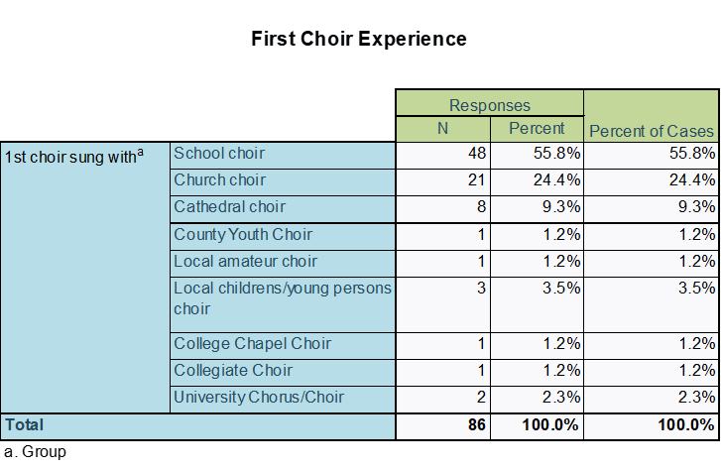
What?
Of the seven interviewees, five had been involved in choral singing as singers and two were primarily instrumentalists that had sung as part of their musical education. Interviewee 4 summed up the situation:
‘and um, so I'm, ultimately, I'm a pianist. That's my kind of background. Um, obviously you don't go through a musical education without being pulled into singing in choirs.’
In their 2021 paper looking at choral conducting education, Jansson and Balsnes also found this to be true of choral conductors in Norway, and that being a choral singer first was the most frequent route to becoming a choral director.

Slide 29
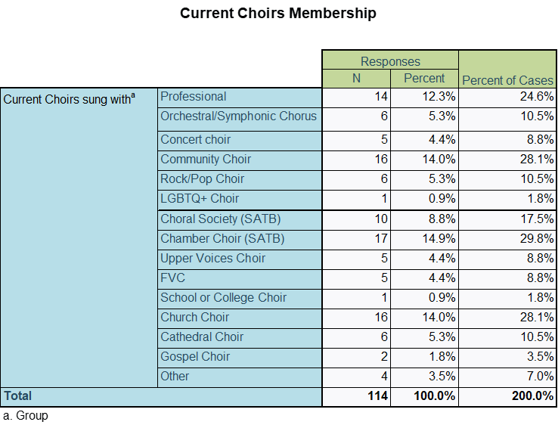
What?
One of the benefits of a choral director also being an active choral singer is that it potentially exposes the individual to a variety of conducting styles, repertoires and performance practices. I6 stated that it is important to:
‘not just to sing as much as you can, but of singing in different kinds of choirs…wonderfully invigorating and cross fertilizing and refreshing… You have to, you have to fertilize your own experience.’
One of the participants in Jansson and Balsnes 2021 study on choral conducting education concurs, explaining that:
‘You learn a huge amount, about vocal technique and choral leadership, how the choir works like a group, and the interaction between conductor and choir.’ (p.351)

Slide 30
What?
However, the motivations for being an active choral singer other than learning and development have not been considered and an opportunity was missed to delve into this further. One reason could be that with professional singers in the sample, choral singing is part of their career portfolio; another reason could be for own satisfaction and well-being, as Interviewee 2 stated:
‘I'm in the National Teachers choir, which teachers go for a weekend... on Sunday afternoon, they do a concert. It is just uplifting, and for teachers, it's just such a relief from being in the classroom.’

Slide 31
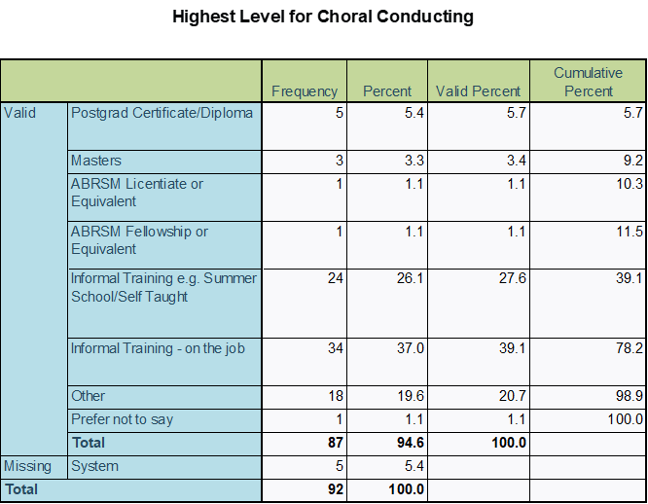
What?
Training
For those respondents who selected the Other category, several participants study choral conducting as part of a degree, either as second study or an elective module.
Overall, the uptake of training of one form or another was high with only 2 of the 87 respondents stating they were purely self-taught.

Slide 32
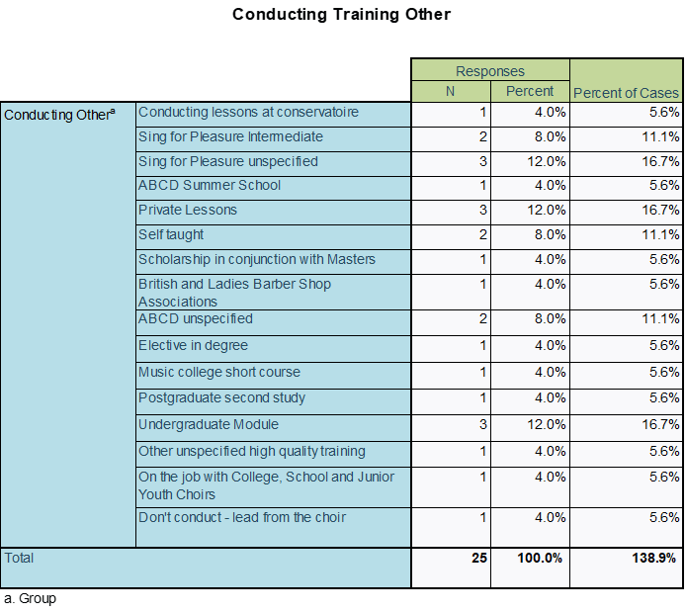
What?

Slide 33
What?
Choral Leadership Competencies
One of the aims of this project was to understand the areas of common knowledge within the British choral directing community and to determine if there are any gaps or areas of concern.
To achieve this, it was decided to ask respondents to rank a number of both technical conducting competencies and leadership/soft skills in terms of importance.
They were also asked nominate and rank their top three strengths and weaknesses.
This information was then ranked and simply weighted to determine the community’s overall view of areas of competence and common areas for possible improvement.

Slide 34
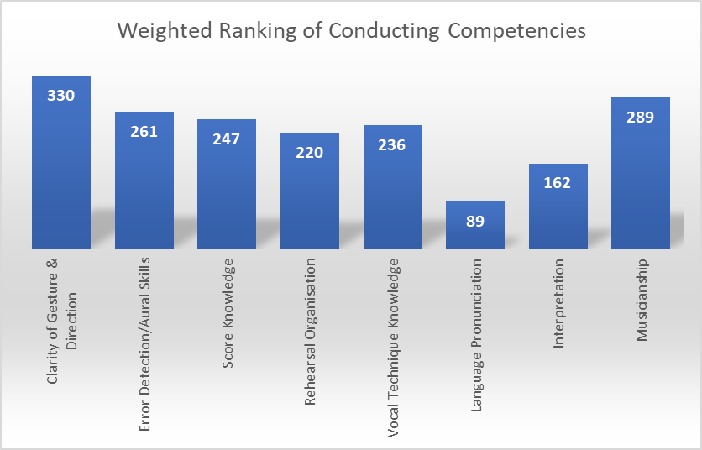
What?

Slide 35
What?
Importance of clarity of gesture
Interviewee 1 commented as a singer, saying:
  ‘if I was stood in front of them as a singer, I'd rather somebody had understanding and intention and a deep knowledge of what we were trying to achieve… if their beat shapes are a bit unorthodox… I can square that square, those circles, ‘
In addition, reflecting on the role of conductor, they commented that:
  ‘the gesture is only a minuscule part of the job. It is, what's the turn of phrase, a requirement, but not sufficient.’
Similarly, Interviewee 4 states that:
  ‘Yep, I didn't feel like I need conducting lessons. I did all that coming up through my piano and clarinet grades…we did in those days, have to learn conducting patterns... I don't do it very often. I do sometimes, but… it is a communication that you develop with your choir, and nobody can tell you how to do that.’

Slide 36
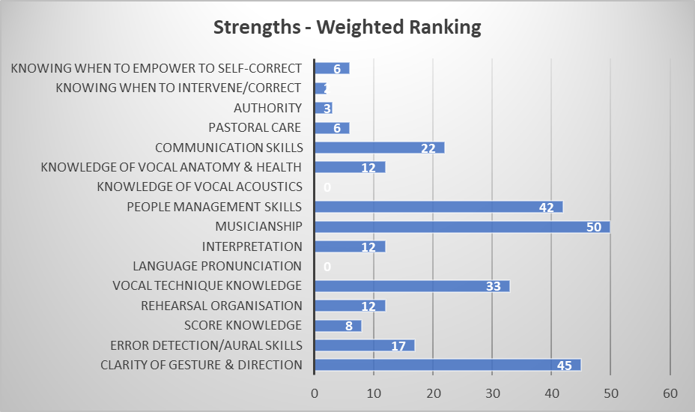
What?

Slide 37
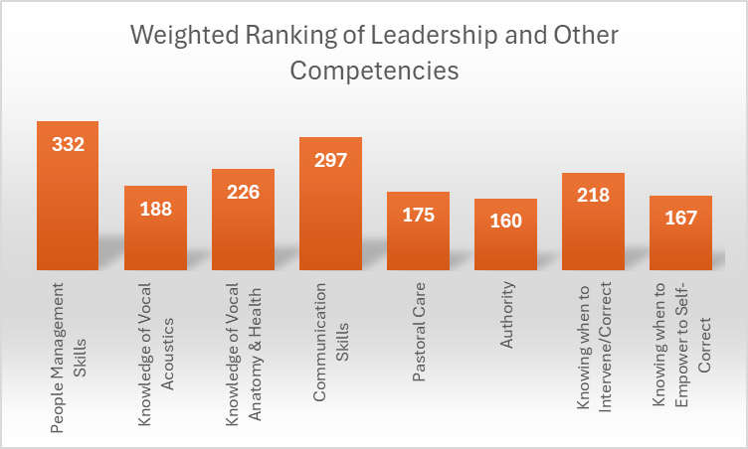
What?

Slide 38
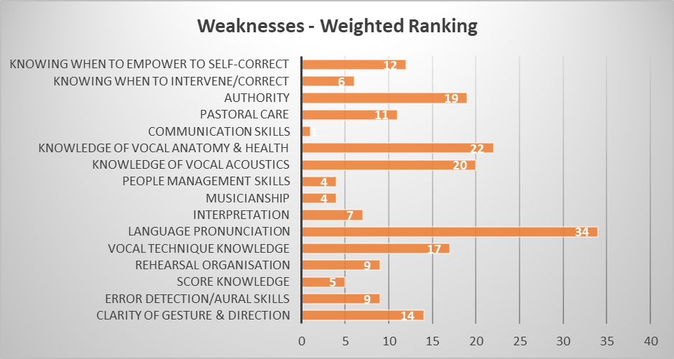
What?

Slide 39
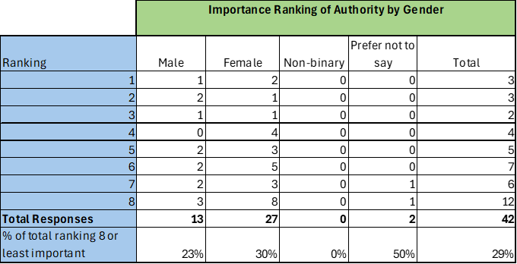
When examining the top three weaknesses by gender identity, 39% (11) of females ranked Authority within their top three weaknesses compared to 6.6% (1) of males.
What?

Slide 40
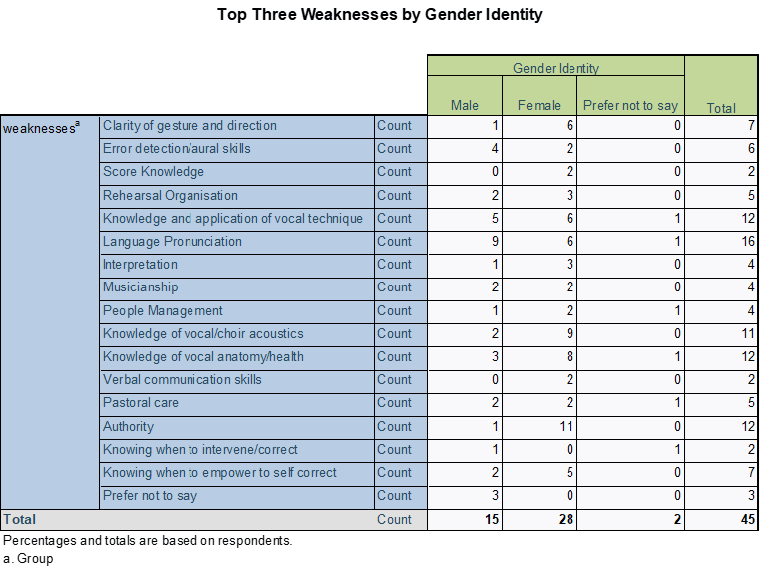
What?
Understanding the reasons for the ranking of importance or strengths and weaknesses was not an aim of this project. But the disparity between male and female identifying respondents on the issue of authority is striking and warrants further investigation into the reasons and whether it is something that could be addressed through training.
Additionally, Interviewees 2, 5, and 7admitted to experiencing feelings harbouring on imposter syndrome – the fear of losing credibility and being found out to be fraud despite their demonstratable expertise, training or achievements (Bothello & Roulet, 2019). In this case it was because (respectively) they were not a trained singer, had a non-musical HE education or when working with orchestras because they did not have orchestral conducting training. Again, whilst investigating the reasons for this is not an aim of this project, there may be a worthwhile investigation to be made.

Slide 41
People management
‘So probably the thing that has come to me, and it's still a journey, is the managing, the managing the people, and always been able to go right, let's go this way and be exciting and have people follow you because you were exciting. But to actually have deep, fruitful relationships with, with these people is something that's come later also,’ (Interviewee 1)
‘The people management type of thing kind of gets in the way of just the music sometimes. But I know it's important…always a small group who are just wasting time chatting and wanting to go to the toilet constantly and in and out.’ (Interviewee 2)
‘one of my choirs is committee led, and I think not feeling as in control is tricky, to manage the politics. I think that's a whole different ball game, because I can influence, I can heavily influence how things go, but sometimes the people politics, in the choir, can be tricky because I just don't have the same handle on it as I do my other choirs’. (Interviewee 4)
What?

Slide 42
When discussing the least favourite aspects of choral conducting, Interviewee 7 stated:
‘committees! But I guess it's that kind of trying to get that shared sense of direction. And obviously, and when I first started, I was talking about this, because I was quite blinkered about the music, music, and so have I had to kind of open myself a little bit up to, like, finances and venues and, you know, and thinking more strategically over, over a course of three or four years, rather than thinking, I want to do those pieces, I want to do the 100 piece orchestra, I want to have the best service in the world, you know,’
People management
‘It's the people management. It's the thinking ahead. It's the problem solving, troubleshooting, thinking on your feet, a lot of acting, pretending that you're happy when you're not, or, you know, all those things that you have to do as a teacher.’ (Interviewee 2)
‘yes, I mean, sometimes management, I'm not sort of really strict, as strict as I should be, and people talking rehearsals and answering back and stuff. I mean, I think over the years, I've, you know, got a fairly interactive style of running rehearsals, but then it can get that can get a bit sort of that everyone's talking at once, and I've got to stop it, please. That's one of the things I found more difficult.’ (Interviewee 3)
What?

Slide 43
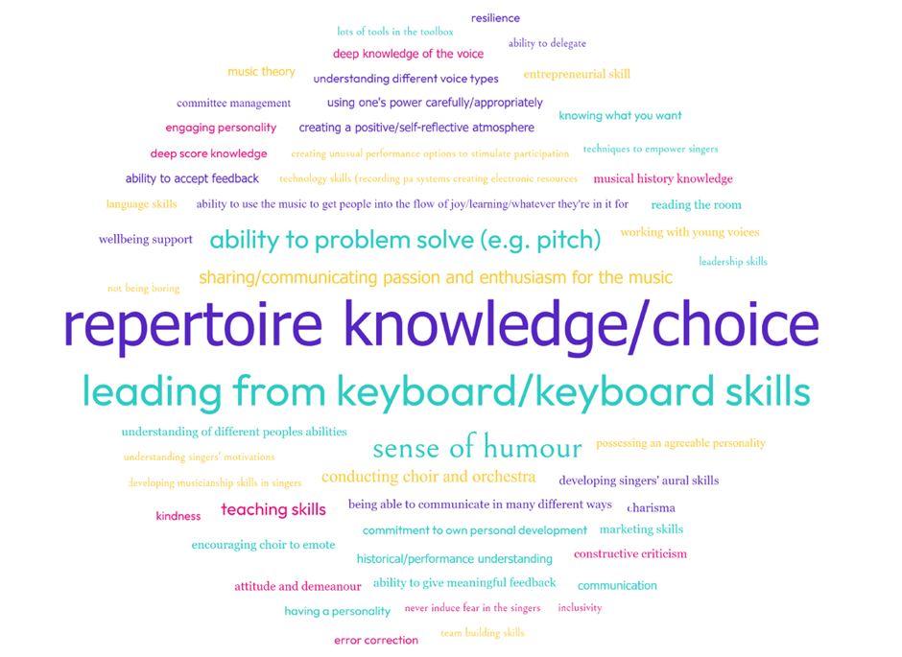
What?
The survey participants were asked to provide examples of other important competencies that were not included in the original list.

Slide 44
Commercial Skills
A recurring theme for the interviewees and one that cropped up in the Additional Competencies response, is the need for the modern choral director to have an almost entrepreneurial mindset and a set of commercial skills that can be used to support their choirs, especially if setting up their own.
‘in terms of administration, I've learned over the years about how to do it. That's something that I think could have been in my course. I think that sort of thing and that the people skills required... I know I've never had to write down a 12 part Victoria motet since I was at college doing it. So that was part of my test…, having to plan financially, having to think about a concert series and looking at music repertoire that was, that was perfect for that choir, that was, that was really, really interesting.’ Interviewee 7
What?
‘I think one of the things that's missing is kind of how to set up and market a choir, I think that is something that would be incredibly useful, because I think a lot of us it's a, it's become very competitive… And I think helping, helping people, helping choir leaders, I suppose, to identify what their strengths are and how to market their choirs on that, I think, is something that that might be useful…’ Interviewee 4

Slide 45
The benefits of a grasp of commercial matters were demonstrated by Interviewee 5 who had worked in commercial businesses before becoming a choral director. Having made the decision to set up their own singing studio, they realised they needed to boost their profile in their local area:
‘So, what I did was advertise a kind of singing workshop so that people could get to know me, and I could get to know some people, and that would be the start of my studio. But what happened was the singing workshop turned into a regular event and became a choir.’
What?
Attracting audiences needs thought, as Interviewee 6 advised:
‘I guess I'll just want to encourage people to, to think outside the box a bit… Don't just think always in terms of concerts on a Saturday night in the church at 7.30 you know… just think of some other fun stuff… Give the audience a good time. Rethink things, reinvent things, whatever the style of music want to do, have fun with it, and just do a bit differently to the way everyone else does it and the way you've always done it.’

Slide 46
Health and Well-being
A knowledge of vocal health and anatomy ranks third in importance for Leadership and Other Competencies.
However, for every benefit, there is the potential for hurt to someone’s mental and physical health and several of the interviewees raised the question of vocal health:
From Interviewee 4
‘I personally feel that I have a responsibility to my singers to make sure that they are not doing any damage to themselves. It's like safety first, isn't it?’
What?
‘Vocal health, vocal anatomy, we have had to look after people's voices, yeah, and get the best out of them.’ Interviewee 5
Interviewee 3 commented on their lack of knowledge: ‘I go to these warmups with the vague idea about getting the muscles going, but really, you know, other than just easing in gently is all I really know about…’
And regarding training previously undertaken
‘I thought, well, I don't, you know , I'm a musician. I don't know so much about singing. And I was hoping for more actual singing technique and how I can help my choir…’

Slide 47
What?
Choirs are communities and safe places:
‘it's a very much a community in a choir, that it's a very inclusive, welcoming choir. And I think everybody in the choir feels it's their choir, so it's our choir rather than my choir.’
Interviewee 5
‘it's about the community, about, about the about the collaboration, about the joy, and that's, that's what I love about amateur music making’ Interviewee 7
you create that environment for them... if you are creating a choir for well-being, I think that's quite important that people feel safe.’ Interviewee 4

Slide 48
What?
Choral Directors attitudes can affect their singers:
‘How do you handle those people who you, who can't match any pitches back to you in that two or three minutes? And one of the music directors says to me…why lie to them or just put them out the misery and tell them singing, it’s not their thing… and they should find something else to do… Where is everything that you should believe in, your compassion and your empathy,… it makes me want to weep, because that person will, will now never sing when their child gets married, that person will be silent in the church’. Interviewee 1
And choral directors can be impacted as well:
Rehearsing I think it is the creative process… I don't enjoy concerts when I'm conducting it. I've got to stay focused and make sure everything happens right. I enjoy the buzz afterwards when everyone says, Oh, that was great. Or conversely, I'll go right down if things weren't didn't go as well as I wanted to, but I just found this sort of stress, a lot of pressure around stupid things… I sort of get to the end of the concert, I feel bit sort of, you know, I've missed it’. Interviewee 3

Slide 49
What?
And choral directors can be impacted as well as Interviewee 4 explained
‘so I'm not like her, and it nearly destroyed me that first year, actually, or a couple of people in the choir, nearly destroyed me, because I relied quite heavily on the keyboard, and I didn't realize until I was talking to my singing teacher during lockdown that I'd kind of developed performance anxiety. I couldn't, I couldn't remember, the notes just went from my head during rehearsal, just couldn't do it, so I was relying more and more on my keyboard. And I think essentially, I'd been trying to be this other person for them, which was not me’.
Interviewee 4 also commented about the need for boundaries:
‘And I think this is the thing with choirs for wellbeing to separate… it's keeping everything warm and friendly, but still having boundaries in place,… to make sure that I'm doing my own things outside of choir, within my own friendship groups, and I'm looking after my own wellbeing. So that the choir doesn't become something that I need’.
Regarding training, Interviewee 1 had this to add:
‘So, so pathways to choral conducting ought to also include… bit somewhere around music therapy, isn't it?... whilst there certainly is the, the training out there to prepare in a structured way, decent professional choral conductors, there's certainly not the pathways out there to prepare the equally valid person who needs to be skilled in a whole load of other things to run the community choir really ‘

Slide 50
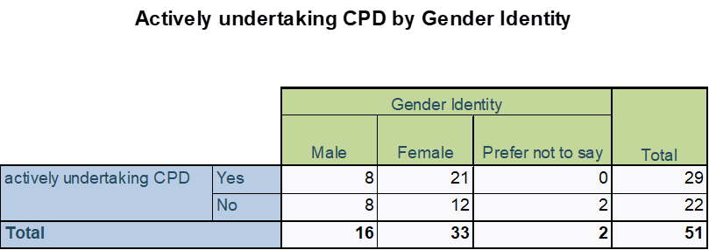
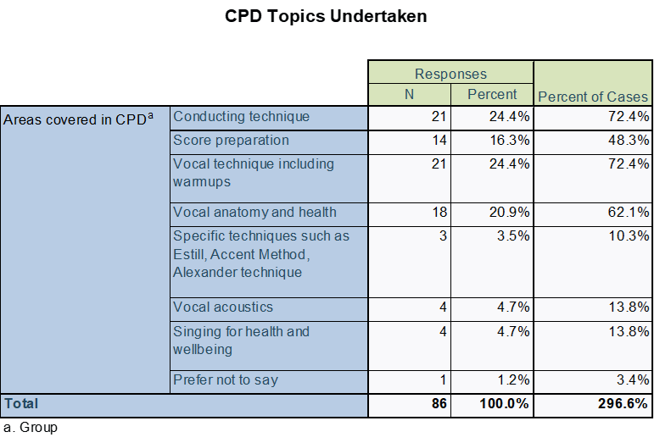
CPD!
What?
The bad news is by this stage of the survey, around 44% (41) of the initial respondents failed to complete any further questions.
The good news is whilst disappointing, this does provide an opportunity for reflection on the reasons for this such as survey fatigue and is a useful learning experience that can be used to inform future projects.

Slide 51
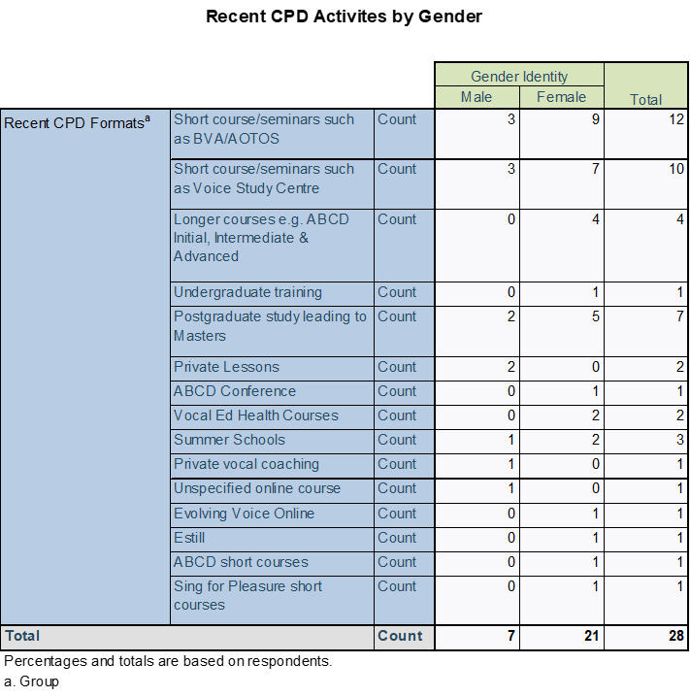
What?
Unfortunately, given the attrition rate in overall participation, the sample may now be too skewed to allow for valid conclusions to be drawn; but once again, further investigation with a narrower focus on some of the issues identified may provide a more balanced and justifiable conclusion.

Slide 52
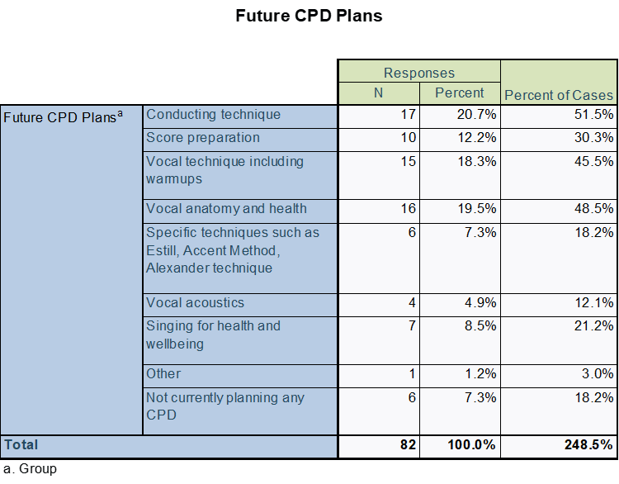
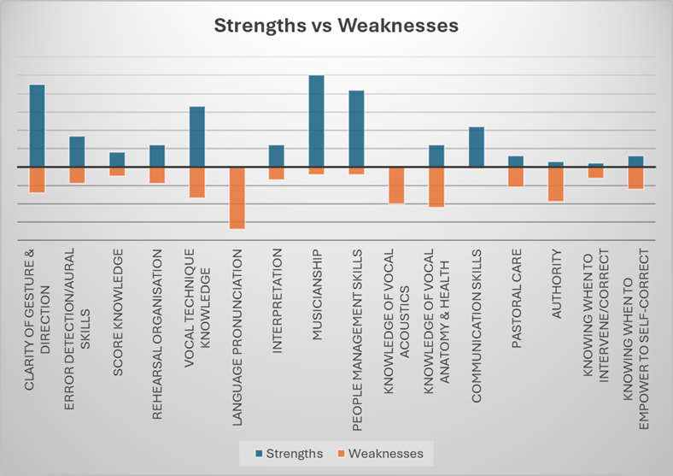
What?
And the plans for CPD?
Given the findings so far, it is unsurprising that vocal technique, anatomy and health are near the top of the list.
But are choral directors too concerned about conducting technique?
A reminder of the strengths and weaknesses previously identified

Slide 53
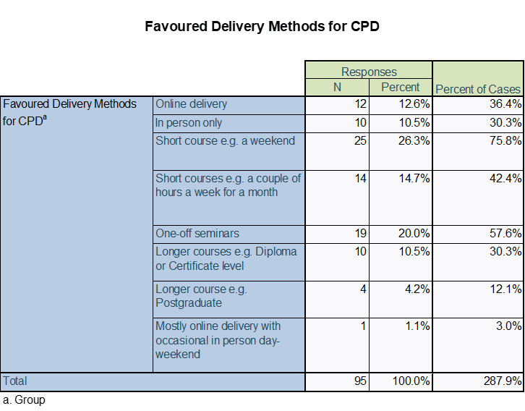
What?
How should CPD be delivered?
For the most part, short and sweet is the way forward.

Slide 54
Barriers to CPD
LOCATION LOCATION LOCATION
What?
As Interviewee 5 put it:
‘Being in Scotland, a lot of the ABCD courses are quite London centric, but there's more and more stuff going on up at the centre of the country.’

Slide 55
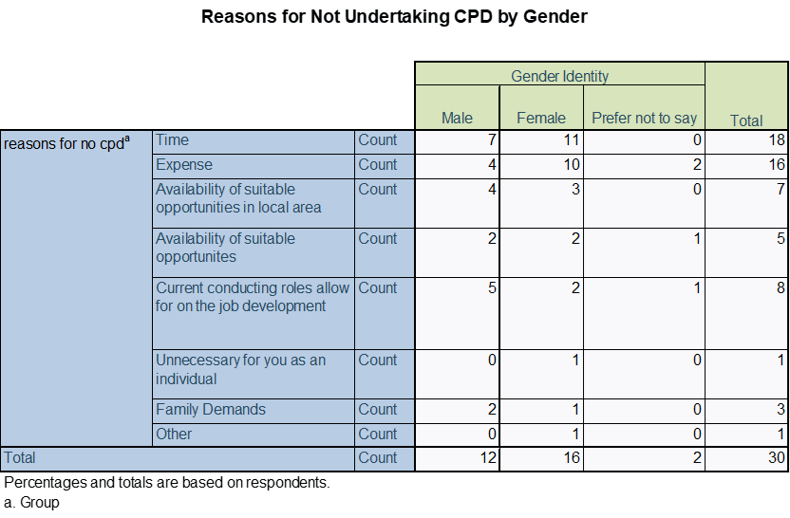
Barriers to CPD
What?
Unsurprisingly perhaps – time and expense.

Slide 56
What Next?
Conclusions
Based on the population sample UK Choral Directors are well educated and appreciative of the need for training
Vocal and mental health is an important issue for both the singers and the choral directors
The available training is too focussed on conducting technique and does not address the other needs of the amateur choir choral director.
It’s becoming harder to run choirs, there is a lot of competition and as such, training is needed on the commercial side.
The HE institutions are too focussed on professional conductors for professional choirs - not everyone will conduct The BBC Singers or The Sixteen (Interviewee 2)
Most professional choral directors will have amateur choirs in their portfolio and their needs need addressing.
Choral conducting needs to play a bigger part in HE music and teacher education.

Slide 57
What Next?
Recommendations
Organisations need to be more proactive in getting the word out – if people don’t know the training is there…
Organisations need to be less focussed on classic conducting technique and more focussed on health, anatomy, people skills and commercial skills
Choir committees should be more aware of all the aspects of a choral director’s role and assess these as part of the recruitment process
In the absence of statutory regulation, the main voice related organisations should come together (The British Choral Voice Board anyone?) and consider a system of voluntary accreditation that represents best practice. This would ideally include the HE institutions as well as the following ABCD, SfP, British Voice Association, Making Music, Natural Voice, Royal College of Speech and Language Therapists etc. Accreditation by this organisation should be a guarantee of an understanding of most aspects of choral conducting and be recognised by prospective singers as well as committees and trustees.
A strategy to educate or weed out those choral conductors that believe vocal warmups are for wimps and a waste of time (and yes, there are still some out there)
As the incidence of choral singing as therapy increases, organisations should be working more closely with the charities and institutions encouraging this such as the Alzheimer’s Society to ensure best practice is encouraged. And if this is happening already, they need to spread the word!

Slide 58
What Next?
Future Actions
Several themes for future studies came to mind:
Motivations for becoming a choral director
Educational levels of a larger and more representative sample of the UK choral conducting community and whether it supports a more formal requirement for CPD
Comparison of UK choral conducting education and training with that of other Northern European countries to identify the similarities and differences.
Gender identity and the exertion of authority, this could also be broadened to examine whether there is an ethnicity element to be considered.
The occurrence of imposter syndrome in the choral conducting community. Three out of seven (43%) of the interviewees admitted to feelings of inadequacy which they labelled imposter syndrome.
The impact of choral directorship on conductor’s mental health and possible preventative strategies.

Slide 59
What has this meant for me?
Reflections
Don’t use new methods in your final module!
Don’t use new software in your final module! In this case, Qualtrics and SPSS!
Attention to detail is vital. A mistake was made in the survey but only one person commented! Check, check and check again.
Don’t be greedy for data, limit your study to the amount of data you can feasibly, accurately and coherently analyse in the time you have.
Interviewing for a research project is harder than interviewing someone for a job!
Coding is difficult, it requires interpretation, decision making and consistency of application.
I’m a coward and frightened of rejection by my peers (imposter syndrome anyone?)
Once I got into the analysis, I loved it! It was like opening a new box of chocolates every day. But I don’t like writing it all up – I might get it wrong.

Slide 60
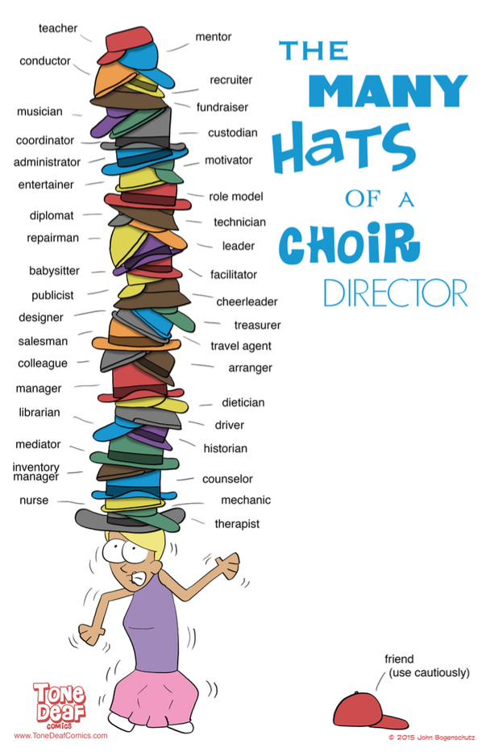
This is what it means to be a choral director in 21st Century
No choral directors were hurt in the making of this presentation.
With thanks to I7 for sharing this.

Slide 61
The End
With apologies to Borton (1970) and Rolfe (2002)

Slide 62
References
Adamson, J. et al. (2004) ‘Questerviews’: using questionnaires in qualitative interviews as a method of integrating qualitative and quantitative health services research’, Journal of health services research & policy, 9(3), pp. 139–145.
BBC Radio 3 – Choir and Organ Online (n.d.) Voices Now Big Choral Census, https://www.bbc.co.uk/programmes/p05g5y1j/p05g5xhk
(Accessed 15th June 2024)
Borton, T. (1970) Reach, Touch, and Teach: Student Concerns and Process Education. McGraw-Hill: New York.
Brannick, T. and Coghlan, D. (2007) ‘In Defense of Being “Native”: The Case for Insider Academic Research’, Organizational research methods, 10(1), pp. 59–74. Available at: https://doi.org/10.1177/1094428106289253.
(Accessed 19th September 2023)
Byrne, D. (2022) ‘A worked example of Braun and Clarke’s approach to reflexive thematic analysis’, Quality & quantity, 56(3), pp. 1391–1412.
Cohen, L., Manion, L. and Morrision, K. (2018) Research Methods in Education, 8th edn. Abingdon, Oxon and New York: Routledge.
Cooper, N. (2017) ‘Design-based research as an informal learning model for choral conductors’, London Review of Education, 15(3), p. 358–371.
Darra, S. (2008) ‘Emotion work and the ethics of novice insider research’, Journal of research in nursing, 13(3), pp. 251–261.

Slide 63
References
Durrant, C. (1994) ‘Towards a Model of Effective Communication: A Case for Structured Teaching of Conducting’, British journal of music education, 11(1), pp. 57–76.
Durrant, C. and Varvarigou, M. (2008) ‘Real time and virtual: tracking the professional development and reflections of choral conductors’ Reflecting Education, 4, pp.72-80
Durrant, C. & Varvarigou, M. (2015). ‘Perspectives on Choral Conducting’ in The Oxford Handbook of Singing ed. Welch, G., Howard, D.M. & Nix, J. Oxford: Oxford University Press.
Durrant, C. (2017). ‘The Framing of Choirs and Their Conductors: A UK Perspective’ in Abrahams, F and Head, P.D. (eds), The Oxford Handbook of Choral Pedagogy, Oxford: OUP.
Humphrey, C. (2013) ‘Dilemmas in doing insider research in professional education’, Qualitative Social Work, 12(5), pp.572–586.
Jansson, D. and Balsnes, A.H. (2021) ‘Choral conducting education: The lifelong entanglement of competence, identity and meaning’, Research studies in music education, 43(3), pp. 347–365.
Kallio, H. et al. (2016) ‘Systematic methodological review: developing a framework for a qualitative semi-structured interview guide’, Journal of advanced nursing, 72(12), pp. 2954–2965.
Livesey, L. et al. (2012) ‘Benefits of choral singing for social and mental wellbeing: qualitative findings from a cross-national survey of choir members’, Journal of public mental health, 11(1), pp. 10–26.

Slide 64
References
Mackenzie, N. and Knipe, S. (2006) ‘Research dilemmas : paradigms, methods and methodology’, Issues in educational research, 16(2), pp. 193–205.
Mitchell, A. (2018) ‘A Review of Mixed Methods, Pragmatism and Abduction Techniques’, Electronic journal of business research methods, 16(3), pp. 103–116.
Naeem, M. et al. (2023) ‘A Step-by-Step Process of Thematic Analysis to Develop a Conceptual Model in Qualitative Research’, International journal of qualitative methods, 22. Available at: https://doi.org/10.1177/16094069231205789.
(Accessed 16th August 2024)
Osman, S.E., Tischler, V. and Schneider, J. (2016) ‘“Singing for the Brain”: A qualitative study exploring the health and well-being benefits of singing for people with dementia and their carers’, Dementia (London, England), 15(6), pp. 1326–1339.
Paez, A. (2017) ‘Gray literature: An important resource in systematic reviews’, Journal of evidence-based medicine, 10(3), pp. 233–240.
Rolfe, G. (2002) Reflective practice: where now? Nurse Education in Practice, 2(1), pp.21–29.
Royal Academy of Music Online (n.d.) Professor Patrick Russill Biography.
Available at https://www.ram.ac.uk/people/patrick-russill
(Accessed: 5th February 2022)
Smetherham, D. (1978) ‘Insider Research’, British educational research journal, 4(2), pp. 97–102.

Slide 65
References
Smith, A.P. et al. (2020) ‘Choral singing with dementia: Examining the experience and impact of embodied and relational musical performance: Developing topics’, Alzheimer’s & dementia, 16(S7).
Varvarigou, M. (2009) Modelling effective choral conducting education through an exploration of example teaching and learning in England. Institute of Education, University of London. (Doctoral Thesis)
Wilkinson, S. and Kitzinger, C. (2013) ‘Representing Our Own Experience: Issues in “Insider” Research’, Psychology of Women Quarterly, 37(2), pp. 251–255. Available at: https://doi.org/10.1177/0361684313483111.
(Accessed: 19th September 2023)
Xerri, D. (2017) ‘Using Questionnaires in Teacher Research’, The Clearing house, 90(3), pp. 65–69.
Yvonne Bulk, L. and Collins, B. (2023) ‘Blurry Lines: Reflections on “Insider” Research’, Qualitative inquiry [Preprint].

