Slide 1
Student name: Edina Szasz
Student ID number: 2120996
Tutor: Muhammad Cassamo, Laurence Blake
Operating Hotel Facilities BMIH4006
Employee Engagement Presentation

Slide 2
Introduction
The presentation will focus on employee engagement in the hospitality industry.
In the following slides, employee engagement and the hospitality industry will be introduced.
The presentation will also include the effect of employee engagement on the hospitality industry while focusing on the benefits.

Slide 3

Hospitality industry
A specific category that comprises services in hotels, parks or events.
There are three categories existing in the hospitality industry: travel and tourism, lodging, and recreation.
Hospitality helps to create better relationships and better space to spend leisure time while meeting all the human needs and demands.
(Source: Google)

Slide 4

Employee engagement
The concept is mainly about human resources which describes the enthusiastic nature and dedication of the employees.
Employee engagement is known as the degree where employees use their cognitive, behavior and emotional energies that can help in achieving a positive outcome.
It is important for maintaining the overall culture, increasing employee retention rate and productivity.
(Source: Google)

Slide 5

Employee engagement in hospitality
Employee engagement is important in all industries but hospitality in particular.
The industry is customer driven which makes employees an important asset.
Engagement allows the hospitality industry to reach potential goals.
Employee engagement is also helpful in increasing the overall productivity and creating better communication for the ultimate success in employee engagement.
(Source: Google)

Slide 6
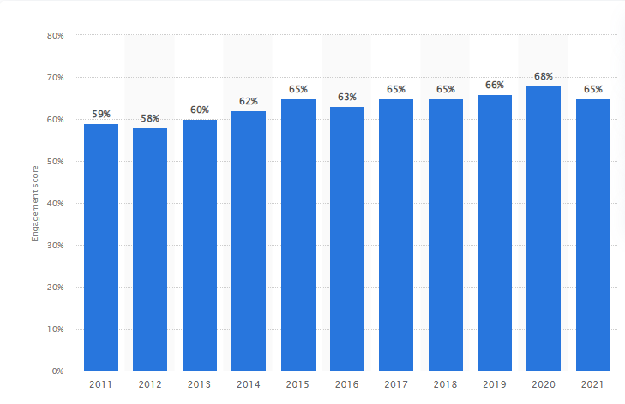
Employee engagement in hospitality: strategy
The hospitality industry engages their employees through psychological empowerment and motivation.
Empowering leadership also plays a huge role in empowering the employees for better engagement in the workplace.
Psychological empowerment helps the employees to achieve personal and workplace goals which ultimately lead to a high level of work engagement.
Figure 1: Employee engagement in hospitality
(Source: Google)

Slide 7
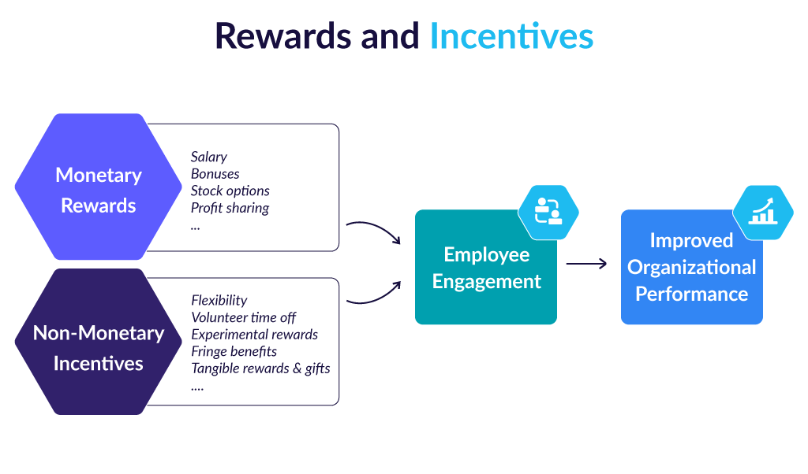
Drivers of employee engagement in hospitality
The employees are properly managed and engaged by the help of reward management which offers both monetary and nonmonetary rewards.
Location flexibility, events, greater network opportunities, tips and bonuses are offered to the employees for better engagement in the hospitality industry.
(Source: Google)

Slide 8
Drivers of employee engagement in hospitality
The human resources practices play a major role in providing safety and security in the industry.
They focus on providing psychological safety to the employees in meeting their psychological demands and needs that they expect from the employers.
The hospitality industry provides all kinds of safety and security to the employees through supervising and training them.

Slide 9
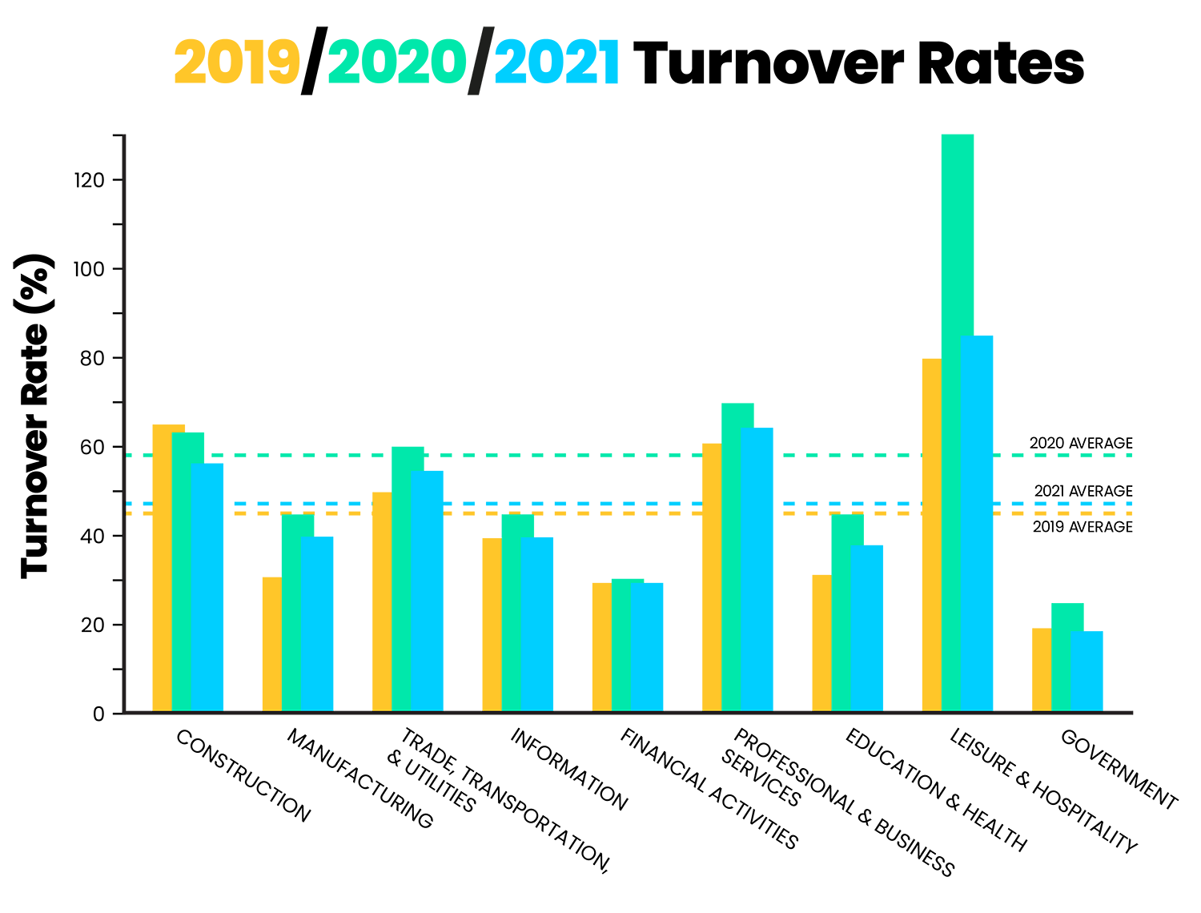
Employee turnover rate in the hospitality
In general, turnover specifically talks about the percentage of employees who are leaving a particular organization. High turnover often leads to high costs for satisfied employees.
The turn over rate in the hospitality industry is always high in rate.
Employee turnover rate is often caused by dissatisfaction, poor working conditions or even working schedules.
Figure 2: Employee Turnover in hospitality
(Source: Google)

Slide 10
Possible solutions to mitigate the employee engagement issues in hospitality
Hospitality industry obtain employee engagement by the help of strategies.
The strategies must consider all the psychological and relevant benefits that can help in understanding the necessity of employees.
The industry can have policies and codes which can be followed by all the sectors.

Slide 11
Conclusion
Employee engagement is considered as the parameter for overall performance of the industry.
This acts as a predictor for the performance of the hotel or restaurant sector.
It attracts candidates from different regions which can ultimately increase the employee retention.

Slide 12
References
de Souza Meira, J.V. and Hancer, M., 2021. Using the social exchange theory to explore the employee-organization relationship in the hospitality industry. International Journal of Contemporary Hospitality Management.
Gürlek, M. and Tuna, M., 2019. Corporate social responsibility and work engagement: Evidence from the hotel industry. Tourism Management Perspectives, 31, pp.195-208.
Holston-Okae, B.L. and Mushi, R.J., 2018. Employee turnover in the hospitality industry using Herzberg’s two-factor motivation-hygiene theory. International Journal of Academic Research in Business and Social Sciences, 8(1), pp.218-248.
Hu, X., Yan, H., Casey, T. and Wu, C.H., 2021. Creating a safe haven during the crisis: How organizations can achieve deep compliance with COVID-19 safety measures in the hospitality industry. International Journal of Hospitality Management, 92, p.102662.
Huertas-Valdivia, I., Llorens-Montes, F.J. and Ruiz-Moreno, A., 2018. Achieving engagement among hospitality employees: A serial mediation model. International Journal of Contemporary Hospitality Management.
Rhou, Y. and Singal, M., 2020. A review of the business case for CSR in the hospitality industry. International Journal of Hospitality Management, 84, p.102330.
Seng, N. and Arumugam, T., 2017. Financial reward and motivation toward employee job performance in the hospitality industry in Klang Valley. Electronic Journal of Business & Management, 2(1), pp.51-60.
Sun, L. and Bunchapattanasakda, C., 2019. Employee engagement: A literature review. International Journal of Human Resource Studies, 9(1), pp.63-80.
Tanwar, A., 2017. Impact of employee engagement on performance. International Journal of Advanced Engineering, Management and Science, 3(5), p.239845.
Thisera, T.J.R. and Sewwandi, E.P.I., 2018. Transformational leadership and employee engagement in hospitality sector in Sri Lanka. Global Journal of Management and Business Research.

