Slide 1
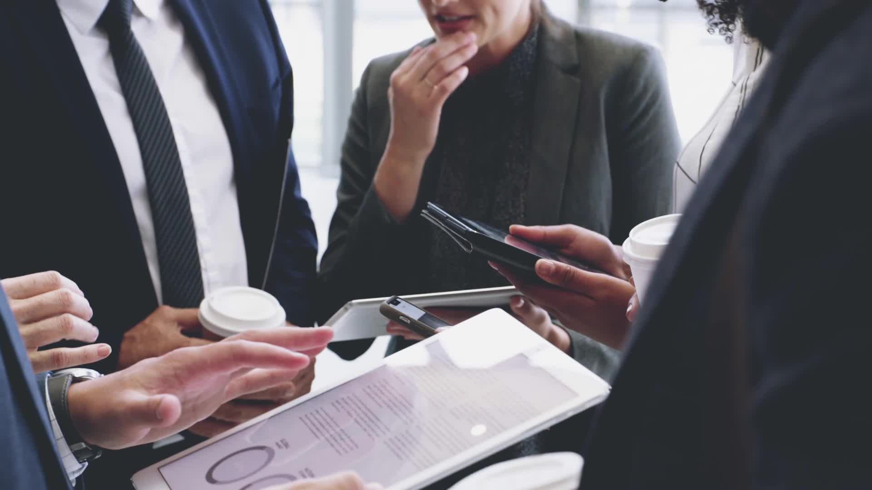
Strategies for effective communication in a business setting.
BY
Nargas Ahmadzai
2106756@student.uwtsd.ac.uk
Nikolay Kermedchiev
2112598@student.uwtsd.ac.uk
Nasar Ali
2112745@student.uwtsd.ac.uk
Dominic Jones
2028674@sdent.uwtsd.ac.uk
BMSW 4002
LECTURER DALE CLARKE

Slide 2

About this organization
External stakeholders
Channel of communication
Theories and models of communication
Types of barriers
BY NARGAS AHMADZAI
2106756@student.uwtsd.ac.uk

Slide 3
What is amazon known for
American online business
Jeff Bezos 1994
Based Washington
By
Nargas Ahmadzai
2106756@student.uwtsd.ac.uk

Slide 4
BENEFITS OF EFFECTIVE COMMUNICATION ON THE BUSINESS PROCESS
Upwards to a supervisor
Reduce conflict
Increase engagement
Improve productivity
Build a strong relationship
Job satisfaction
Diagonally to a different department
Literally to co-worker
communication
Downward to a subordinate
NARGAS AHMADZAI
2106756@student.uwtsd.ac.uk

Slide 5
Theories relating models of communication
A sender
A message
A receiver
By
Nikolay Kermedchiev
2112598@student.uwtsd.ac.uk

Slide 6
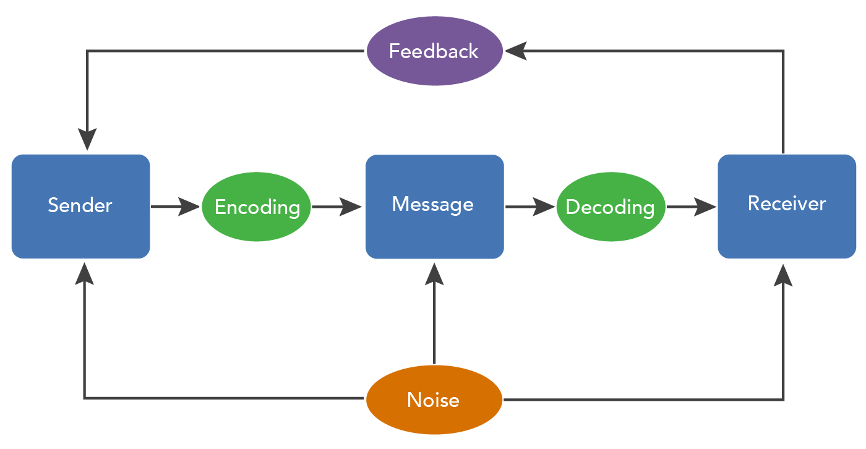
Models of communication
Linear
Interactional
Transactional
By
Nikolay Kermedchiev
2112598@student.uwtsd.ac.uk

Slide 7
According to B. Abrey Fisher, some important models of communication are:
Harrold D. Lasswell’s model (1948)
Claude Shannon and Warren Weaver’s model (1949)
Charles E. Osgood’s model (1954)
Wilbur Schramm’s model (1971)
George Gerbner’s model (1956)
Theodore M. Newcomb’s model (1953)
Bruce H. Westley’s and M.S. MacLean’s model (1957)
Nikolay Kermedchiev
2112598@student.uwtsd.ac.uk

Slide 8
Types of barriers with external stakeholders
Miscommunicate
Mis advertise
Unanswered calls or emails
Lack of communication
Nasar Ali
2112745@student.uwtsd.ac.uk

Slide 9

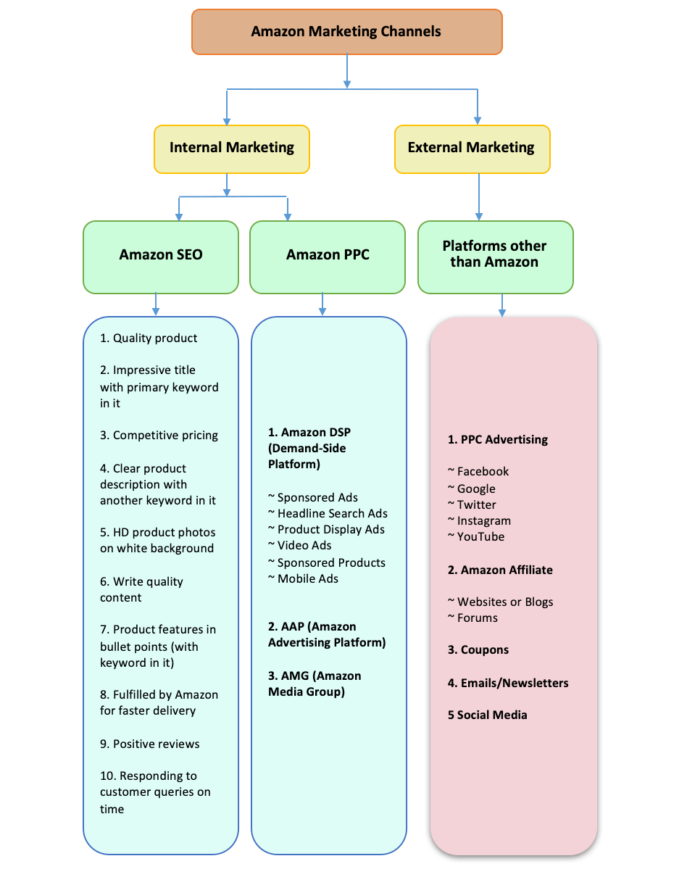

Channels of communication
Network marketing
Social and online advertising
Television advertising
Live chat
Emails
Phone calls
BY
DOMINIC JONES
2028674@STUDENT.UWTSD.AC.UK

Slide 10
How to improve communication
Build up trust
Improve communication methods
Customer reviews
Customer Questions and answers
Amazon seller communication guidelines
Respond immediately
BY
DOMINIC JONES
2028674@STUDENT.UWTSD.AS.UK

Slide 11
B. Aubrey Fisher, MacMillan, 1978 – Perspective on human communication
En.wikipedia.org. 1997. History of Amazon - Wikipedia. [online] Available at: <https://en.wikipedia.org/wiki/History_of_Amazon> [Accessed 25 March 2022].
N, A., 2022. Amazon Marketing Strategies 2022 Advertising, PPC, and SEO. [online] SellerApp. Available at: <https://www.sellerapp.com/blog/amazon-seller-strategies/> [Accessed 26 March 2022].
N, A., 2022. The Latest Ways to Effectively Communicate with Amazon Customers. [online] Seller. Available at: <https://www.sellerapp.com/blog/best-ways-to-contact-amazon-customers/> [Accessed 26 March 2022].
123helpme.com. 2012. [online] Available at: <https://www.123helpme.com/essay/Amazon-Creates-Value-for-Customers-163599> [Accessed 22 March 2022].
Amazon.com. 2020. Barnes & noble. [online] Available at: <https://www.amazon.com/Successful-Commerce-Stakeholders-Organizational-Strategies-ebook/dp/B07QDBK8P3> [Accessed 22 March 2022].
References
RingCentral. 2021. A guide to organizational communication | RingCentral. [online] Available at: <https://www.ringcentral.com/us/en/blog/a-guide-to-organizational-communication/> [Accessed 25 March 2022].
Wilbur Schramm and Donald F. Roberts, 1971 – The process and effects of mass communication

Slide 12
Teamwork Evaluation | Team responses.
Who was in your team? | Nargas Ahmadzai Nasara Ali Dominic jones
What were the key strengths of your team? | A good teamwork with nice and responsible persons
What were the challenges that you overcame as a team? | The communication with people we never met before and arranging a power point presentation, something really good for me
What would you do differently if you worked as a team again? | Meet , face to face and spending more time for details
How would you rate your team working? Out of 10? | 9

