Slide 1
Module Name : Electronics I
Module Code : ACDB5002
Lecture : 5
Topic : Voltage Regulators
Lecture By,
Mrs. Jenifer Prince Devaraj,
Lecturer - Embedded Electronics,
Faculty of Applied Computing,
UWTSD
Email:j.prince-devaraj@uwtsd.ac.uk

Slide 2
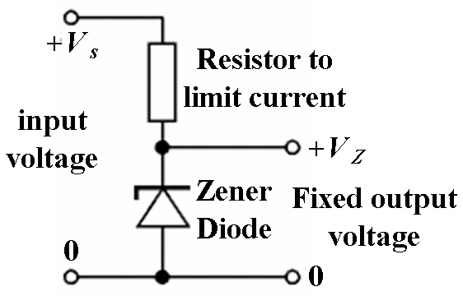

Voltage Regulators
Zener diode regulator
For low current power supplies - a simple voltage regulator can be made with a resistor and a zener diode connected in reverse.
Zener diodes are rated for their breakdown voltage V_{z} and maximum power P_{z}

Slide 3
Voltage Regulators
Two basic categories of voltage regulation are:
  line regulation(input varies)
  load regulation(load varies)
The purpose of line regulation is to maintain a nearly constant output voltage when the input voltage varies.
The purpose of load regulation is to maintain a nearly constant output voltage when the load varies

Slide 4
Line Regulation
Voltage Regulators
Line regulation can be defined as the percentage of change in the output voltage for a given change in the input voltage.
Δ means “a change in”

Slide 5
Load Regulation
Voltage Regulators
Load regulation can be defined as the percentage change in the difference of output voltage from no-load (NL) to full-load (FL) to the full-load.
Where:
V_{NL} = the no-load output voltage
V_{FL} = the full-load output voltage

Slide 6
Types of Regulator
Voltage Regulators
Fundamental classes of voltage regulators are linear regulators and switching regulators.
Two basic types of linear regulator are the
  Series regulator and
  Shunt regulator

Slide 7
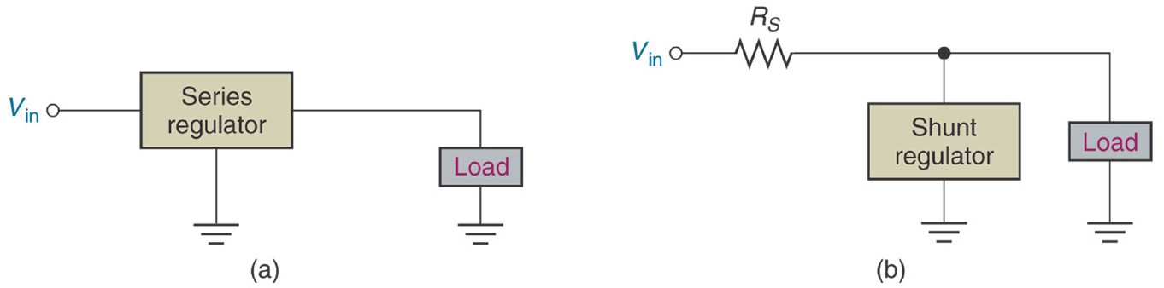
Types of Regulator
Voltage Regulators
The series regulator is connected in series with the load
The shunt regulator is connected in parallel with the load.

Slide 8
IC Voltage Regulators
Voltage Regulators
Regulation circuits in integrated circuit form are widely used.
Generally, three terminal devices that provide a positive or negative output.
A typical 7800 series voltage regulator is used for positive voltages.
The 7900 series are negative voltage regulators.

Slide 9
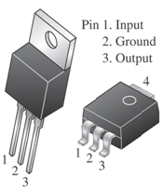
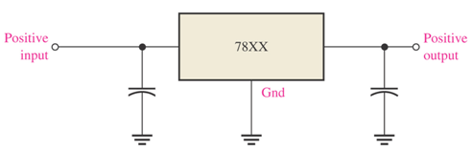
Fixed Voltage Regulator
Voltage Regulators
The fixed voltage regulator has an unregulated dc input voltage V_{i} applied to one input terminal, a regulated output dc voltage V_{o} from a second terminal, and the third terminal connected to ground.
Fixed-Positive Voltage Regulator
The series 78XX regulators are the three-terminal devices that provide a fixed positive output voltage.

Slide 10
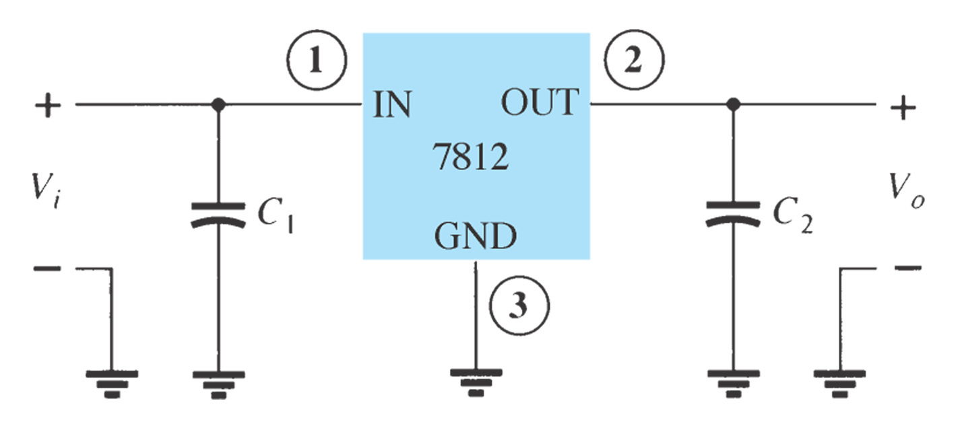
Fixed Voltage Regulator
Voltage Regulators
An unregulated input voltage V_{i} is filtered by a capacitor C₁ and connected to the IC’s IN terminal.
The IC’s OUT terminal provides a regulated +12 V, which is filtered by capacitor C₂.
The third IC terminal is connected to ground (GND)

Slide 11
Fixed Voltage Regulator
Voltage Regulators
Positive-Voltage Regulators in the 78XX Series
IC Part | Output Voltage (V) | Minimum V_{i} (V)
7805 | +5 | +7.3
7806 | +6 | +8.3
7808 | +8 | +10.5
7810 | +10 | +12.5
7812 | +12 | +14.5
7815 | +15 | +17.7
7818 | +18 | +21.0
7824 | +24 | +27.1

Slide 12
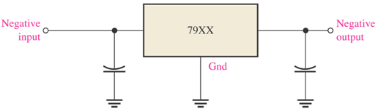
Fixed Voltage Regulator
Voltage Regulators
Fixed-Negative Voltage Regulator
The series 79XX regulators are the three-terminal IC regulators that provide a fixed negative output voltage.
This series has the same features and characteristics as the series 78XX regulators except the pin numbers are different.

Slide 13
Fixed Voltage Regulator
Voltage Regulators
Negative-Voltage Regulators in the 79XX Series
IC Part | Output Voltage (V) | Minimum V_{i} (V)
7905 | -5 | -7.3
7906 | -6 | -8.4
7908 | -8 | -10.5
7909 | -9 | -11.5
7912 | -12 | -14.6
7915 | -15 | -17.7
7918 | -18 | -20.8
7924 | -24 | -27.1

Slide 14
Thank You

