Slide 1

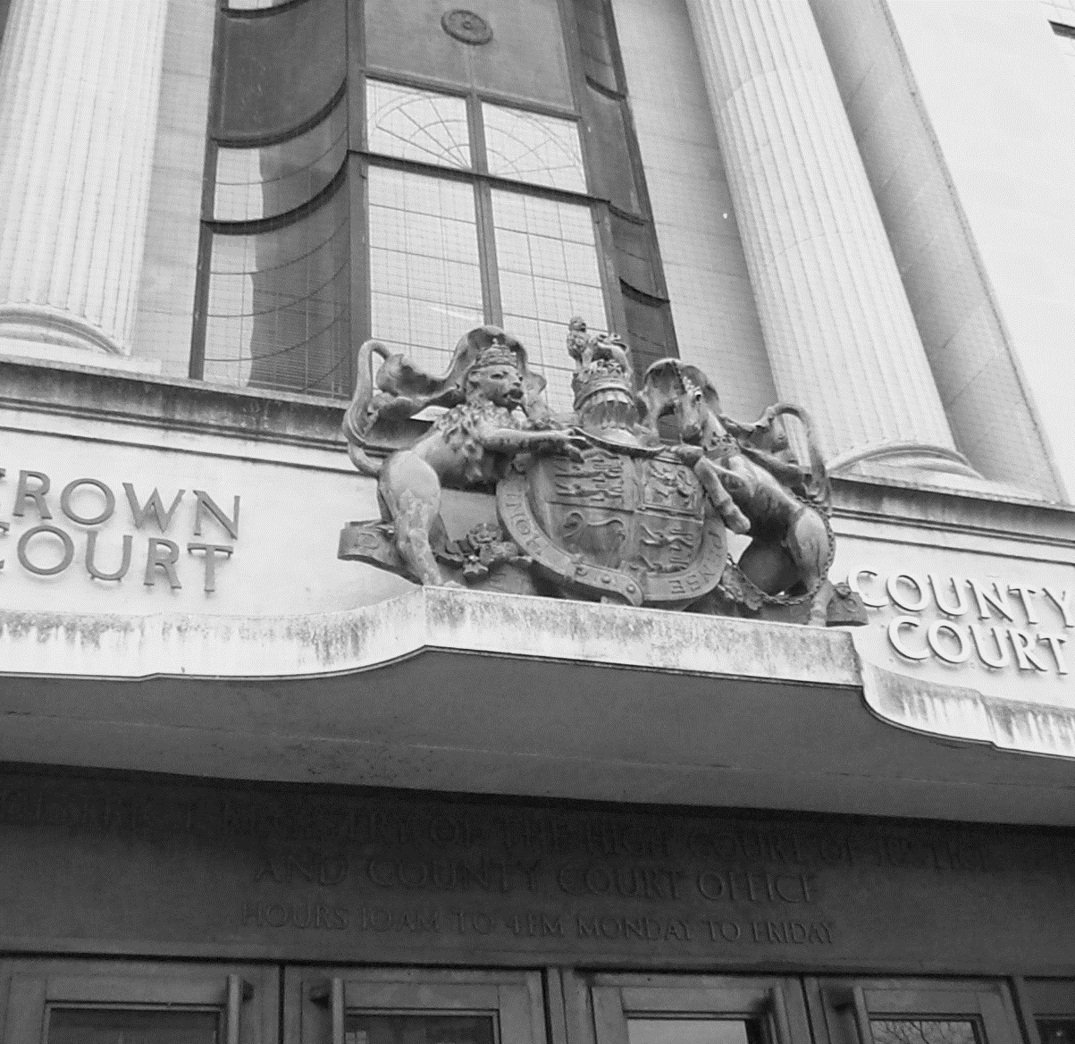
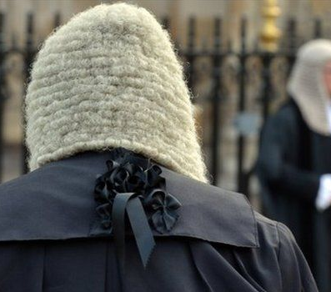
Court Awareness
and Giving Evidence
V6.0
Notes:
To provide students with an understanding of the structure and functions of the criminal courts and to explain how students will be required to give evidence and how it will be presented in court
Identify the different types of court and describe what happens at each court.
Discuss concerns in relation to giving evidence at court as a Police Officer.
Demonstrate taking the Oath / Affirmation and introducing yourself to the Court.
Explain different forms of evidence.
State the processes to follow when giving evidence in court, including researching findings

Slide 2
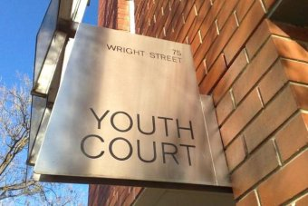
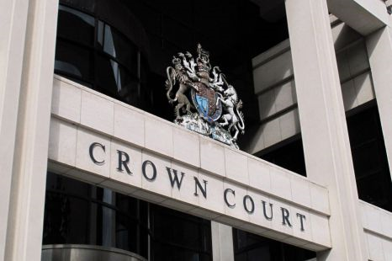
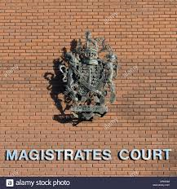
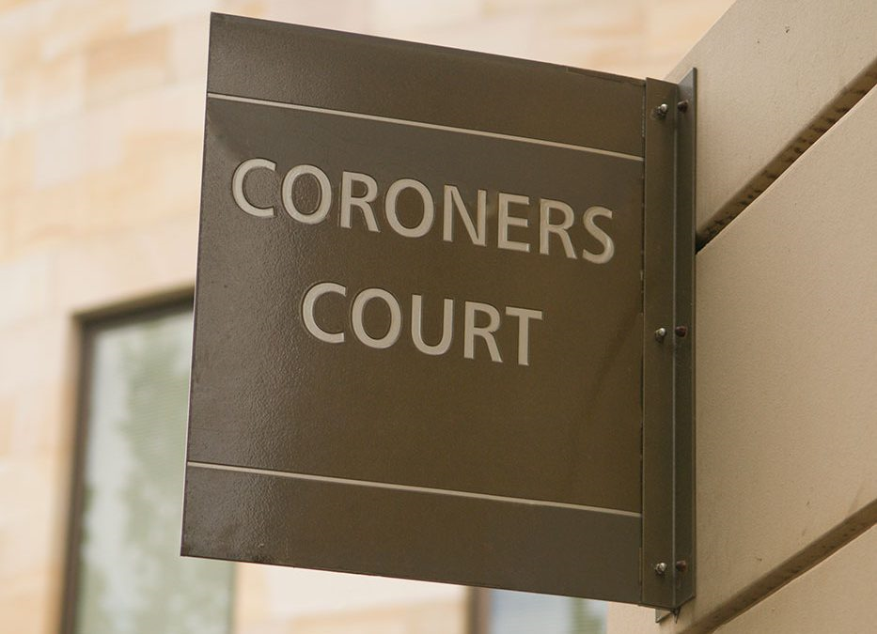



Types of Court
Notes:
QTS – Does anybody have any experience of going to court?
QTS – Has anybody ever given evidence at court?
Trainer to refresh knowledge of students on types of court (this was covered earlier on in the course in initial introduction to criminal justice)
Magistrates court is covered in the following slides.
Criminal courts : All criminal courts work on the assumption that you are innocent until proven guilty. This has to be proved beyond all reasonable doubt. Which is a very high burden of proof. All these courts can deal and refer cases a higher court on appeal and deal with human rights abuses if needed.
Youth Court- Usually same building as Mags court but sit on different days. No press allowed or if they are allowed in special cases then ID of youths cannot be disclosed (speak about some cases where youths u18 can end up in Mags or Crown Court - charged jointly with adult or Murder cases where must go to Crown - Jamie BULGER). NOT OPEN TO THE PUBLIC. J.P’s who preside over youth courts receive special training. They hear cases involving persons 10 - 17years If triable either way offence or believe more severe sentence needed - hear case, commit to CC for sentence.
Coroner’s Court
Most Coroners’ Court hearings are heard without a jury.
A jury in a Coroner’s court will comprise of between 7 - 11 people (unlike Crown Court which requires 12).
Any witnesses who can provide material evidence may be called to give oral evidence in the witness box at court.
Legal representations can be heard by both those acting for the crown and those who may dispute evidence; e.g. a company defending their record on factory safety following industrial accident.
In some cases the identity of the deceased will need to be established.
Such an example could be a vagrant who died, fell into a river was swept away and the body not discovered for several weeks.
All of the above points need to be covered to the best ability. It may be difficult to discover the exact site where the death took place. The death may well be of natural causes and vagrant fell into water of own volition.
The Coroner may need to direct an enquiry to establish all of above points.
Establishes the cause of death such as suicide, accidental death, unlawful death, death by misadventure, open verdict
Examples of Unlawful Death will include murder, manslaughter, assisted suicide and motor manslaughter.
Examples of Death by Misadventure would be when erotic sexual games go wrong, such as a ligature tied around the neck to enhance sexual pleasure which results in death.
A further example would be when someone takes a quantity of tablets as a cry for help rather than a genuine suicide attempt which subsequently results in death

Slide 3
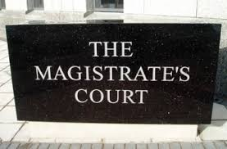
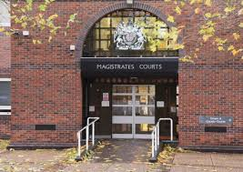
Magistrate’s Court
Found in towns & cities
Responsible for hearing cases that occur in their area – called the petty sessional area
They hear the vast majority of cases
More serious matters can only be tried at their Crown Court but will start their life in Magistrate’s Court
Notes:
Use the following slides to enforce the knowledge presented by the students
Magistrates court hear and deal with around 95% of all offences in England and Wales.
Restrictions on the sentences they can pass at Mags - 6 mths for one case or 12 mths total imprisonment up to £5000 fines (post 12 March 2015 – unlimited fines)
Listen to the evidence that is presented to them, decide who is telling the truth and adjudicate on guilt or innocence. They then decide on sentence, fine etc which they impose

Slide 4
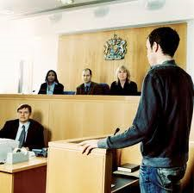
The Magistrate
Commonly known as JP’s (Your Worship)
Appointed by the Lord Chancellor
Ordinary members of the community
Appointed for life
Unpaid
Retire at 70
Not legally qualified
Advised by a Magistrate’s Clerk
Described as a ‘bench’ consisting of between 2 & 7 magistrates
Notes:
Approximately 30,000 in England and Wales.
JP – Justice of the Peace – 12th Century when Richard I appointed knights to keep the peace in ‘lawless areas’. Over time the role evolved to the one we have now where they hear evidence against offenders and decide on guilt.
Maximum sentence – 6 months and traditionally £5000 fine (but for offences committed on or after 12 March 2015 the fines in a magistrates’ court will be unlimited in most cases).
If they feel that in the circumstances the offender deserves a more serious punishment/penalty than they can impose the case can be referred to the crown court for sentencing.
Cases are usually heard by a panel of 3 lay magistrates, (Justices of the Peace), supported by a legally qualified Court Clerk, (the Clerk to the Justices). The magistrates are collectively called a Bench. Lay magistrates are appointed by the Crown, they come from all walks of life and are unpaid and usually unqualified – although they do receive training – must retire at 70.

Slide 5
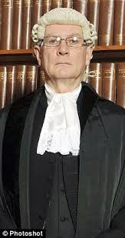
District Judge ‘Stipendiary’
Must be a barrister or solicitor of at least 7 years standing
Is appointed to the role as a paid official, the word ‘Stipend’ means payment
Will sit & hear cases alone & has the same power as a bench of Magistrates
Addressed as ‘Your Worship.’
Notes:
Approx. 130 stipendiary/district judges in England and Wales
Same sentencing powers
District Judges, (previously known as Stipendary Magistrates). These are qualified barristers or solicitors of at least 7 years experience and 2 years as a Deputy District Judge. District Judges will sit alone and will deal with more complex cases.
Magistrates hear the cases and decide upon points of law and fact in the cases. Magistrates courts hear the less serious cases (in the eyes of the law not the eyes of the victim).
Also called – Your worship

Slide 6
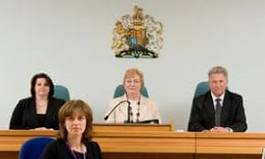
Magistrate’s Clerk
The clerk is a paid barrister or solicitor of at least 5 years standing
Will advise the court on matters of law & procedure. Will effectively run the court when a lay bench is sitting
Notes:
A paid court official
Does not hear or try cases and has no formal powers. Advises magistrates in open court on matters of law – cannot advise on the evidence, except on matters of admissibility.

Slide 7
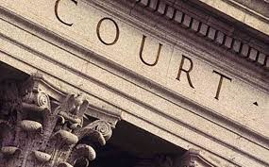

Inside a Magistrate’s Court
Notes:
https://youtu.be/QF46W6LvHY4
5 mins 46 seconds

Slide 8
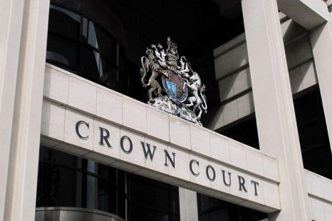
Inside a Crown Court
Notes:
Trainer to click on the image of ‘Crown Court’ which will link to a video of 4:51mins in relation to the crown court

Slide 9
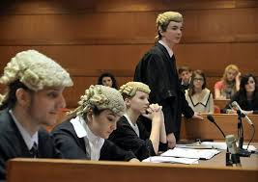
Crown Court
Crown Courts try the more serious cases
Will be heard before a judge & a jury
Judges appointed from within the legal profession
Crown Court judges referred to as ‘Your Honour’
High Court judges referred to as ‘My Lord/Lady’
Notes:
Crown Court- Deals with: - a)more serious cases, b) cases that are indictable only, c) persons committed for sentence from Mags. Court for sentencing, d) appeals from the lower courts, inc. Youth in relation to sentence and conviction.
Presided over by Circuit Judge or part time judge known as recorder. The Judge deals with the points of law whilst the jury of 12 decide on the facts of the case presented to them.
Crown Courts hear all indictable offences and some either-way offences. Cases will be heard by a judge and jury unless the defendant pleads guilty then only a judge will deal with sentencing
More serious indictable offences where punishments are more severe. Crown Court will sentence on cases that magistrates have remitted a case requiring tougher sentence and in some cases will hear appeals against a conviction made in the magistrates court.

Slide 10
The Jury
12 randomly chosen members of the public
They receive advice & direction from the judge on all legal matters
Serving Police Officers & staff are now eligible for jury service
Defendant & witnesses may object to any jury member during the ‘swearing in’ process
Notes:
Decide on guilt at trial in Crown Court
Listen to evidence from witness and accused (where relevant) and make that assessment on guilt or innocence.
Judge will advise on matters of law – not the facts of the case.
Police Officers sitting on a Jury
As you will be aware Police Officers are able to undertake Jury Service, when invited. There is, however, an expectation to declare that they are Police Officers when they attend a Court to participate upon Jury Service. This ensures that all parties are aware of their profession, when selecting jury members for a trial. Also, when a Police Officer is a Juror the case must not be discussed outside of the confines of the Jury or Court room, Police Officer Jurors should not engage or attempt to engage with the officer in case or undertake Police system checks for any reason. This not only comprises the integrity of the Police Officer which could result in prosecution, in addition it impacts the credibility of the whole Police Service and could potentially undermine the defendant’s conviction. Lord Justice Fulford Chair of the Criminal Procedures Rules Committee has requested that Police Officers are reminded of their responsibilities when completing Jury service. To remain professional and not take steps to influence any criminal proceedings.
**Group work following this slide and prior to PPT slide 11**

Slide 11
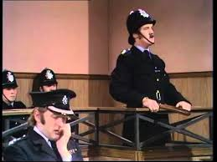
Giving Evidence as a Police Officer
Some nerves can be eradicated by effective planning. Get to the court in plenty of time, check parking arrangements & locate the court room where your case is being heard. If there early enough, familiarise yourself with the layout of the court room. Identify yourself to the CPS solicitor/barrister.
You will be called into the court room when you are required by the court usher
You are not allowed to be present in court prior to having given your evidence
Notes:
GIVING EVIDENCE GENERALLY
Evidence must determine the accused guilt “BEYOND ALL REASONABLE DOUBT” – high benchmark of proof and can be tracked back to -
Woolmington v DPP 1935 House of Lords Statement – “Throughout the web of the English Criminal Law one golden thread is always to be seen that it is the duty of the prosecution to prove the prisoner's guilt” “The possibility of guilt is not enough, suspicion is not enough, probability is not enough, likelihood is not enough. A criminal matter is not a question of balancing probabilities and deciding in favour of probability”

Slide 12
Giving Evidence as a Police Officer
The usher will call you into the court room & direct you to the witness box
You will either take the oath or affirmation. If you are taking the oath you will hold up the relevant Holy Book in your right hand as you read

Slide 13


The Oath
The oath which is taken whilst holding up a copy of the relevant Holy Book is:
“I swear by Almighty God that the evidence I shall give shall be the truth, the whole truth & nothing but the truth”
Muslim officers may take the oath using the Koran. Jewish officers the Old Testament and Hindu officers the Vedas

Slide 14
The Affirmation
Alternatively, the affirmation is:
“I do solemnly & sincerely & truly declare & affirm that the evidence I shall give shall be the truth, the whole truth & nothing but the truth”

Slide 15


Introducing Yourself to the Court
You will then introduce yourself. This must include Rank, collar number, full name & place of work
The CPS solicitor/barrister will then lead you through your statement
Notes:
Evidence in chief
Caution – recite it

Slide 16
Answering Questions
It may seem unnatural but all of your replies should be directed to the judge/magistrate. Answers should be directed to the jury when they are in court
Upon conclusion of the prosecution questioning it will be the defence barrister’s opportunity to cross examine your evidence
Notes:
Listen carefully to the questions
Keep you answers concise and to the point. Comment only on things you know to be factual and true. DO NOT give opinions, speculate or appear judgemental.
If you do not know the answer to a question- say so, don’t be afraid of stating you cant remember if that is the case
Your evidence will be challenged- don’t take it personally and remain calm and professional. Remember, the defence are there to try and get a not guilty verdict or a case dismissed outcome for the defendant. The defence may ask questions to you that will try and undermine your confidence e.g. they may say the caution incorrectly for you to agree with them, listen carefully, and refer all your answers to the Bench or to the Jury, not the defence lawyer.
The defence lawyer may pull faces of disbelief in relation to what you say. This again will try to undermine you and as such, by speaking directly to the Bench or Jury, you will not see this and will you to maintain your confidence.
Do not feel afraid to agree with defence or prosecution on certain points, and again, do not be afraid to disagree also.
If defence bring forward evidence that you were not aware of, when questioned on it, be honest and inform the court that you were not aware of it e.g. ‘Your Worships, I was not aware that this evidence existed’
Remember- it is not your job to convict- you simply present evidence to enable the court to decide guilt

Slide 17
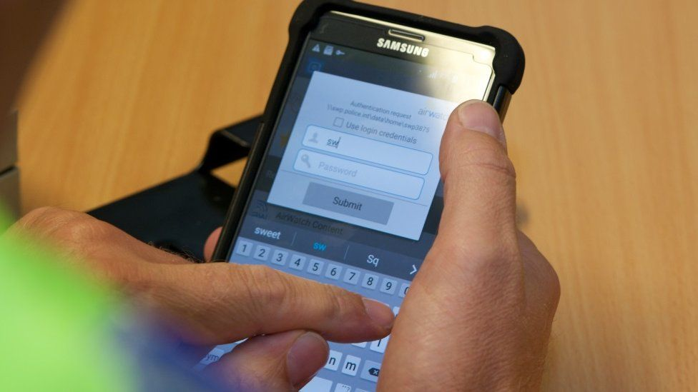
E-PNB Entries
If you wish to refer to your EPNB (or printout) you must ask permission of the court. Be prepared to be asked when the notes were made & if you made them together with other officers
It is essential EPNB entries are thorough & accurate
All entries are disclosable & will be checked against statement content & verbal evidence
Inadequate entries can cause officers difficulties in recalling vital information & enable defence solicitors & barristers to discredit officers evidence
Notes:
If you wish to refer to your EPNB (or printout), you must ask permission of the court. Be prepared to be asked when the notes were made and if you made them together with other officers.

Slide 18

Remember ….
Be confident
Be smart
Be objective
Admit mistakes
Be straightforward
Use your notes to refresh your memory

Slide 19
Forms of Evidence
Oral evidence
Hearsay Evidence
Real Evidence
Evidence of opinion
Documentary evidence
Circumstantial evidence
Notes:
Oral Evidence
Generally, spoken evidence given by a witness in court, usually on oath. Under the Criminal Justice Act 2003 oral evidence includes evidence that, by reason of any disability, disorder, or other impairment, a person called as a witness gives in writing or by signs or by way of any device.
Hearsay Evidence
Evidence of what a witness heard another person say
Considered inadmissible because it cannot be tested under cross examination as the person who allegedly said it isn’t in court.
Exceptions are:
Confessions made by the accused in front of ANY person, provided not obtained under OPPRESSION or some kind of INDUCMENT, or made by a person with low IQ or mental health concerns.
Dying declarations are admissible when made by a person with mortal injuries who knows he/she is about to die.
Real Evidence
Physical evidence (also called real evidence or material evidence) is any material object that plays some role in the matter that gave rise to the litigation, introduced as evidence in a judicial proceeding (such as a trial) to prove a fact in issue based on the object's physical characteristics
Evidence of Opinion
Opinion evidence refers to evidence of what the witness thinks, believes, or infers in regard to facts, as distinguished from personal knowledge of the facts themselves. In common law jurisdictions the general rule is that a witness is supposed to testify as to what was observed and not to give an opinion on what was observed.
Documentary Evidence
Documentary evidence is any evidence that is, or can be, introduced at a trial in the form of documents, as distinguished from oral testimony
Circumstantial Evidence
Not direct evidence of what is seen, heard etc about the offence.
It implies that something occurred but cannot directly prove it, a sequence of facts and circumstances that suggest the person is guilty or not.
Circumstantial evidence, in law, evidence not drawn from direct observation of a fact in issue. If a witness testifies that he saw a defendant fire a bullet into the body of a person who then died, this is direct testimony of material facts in murder, and the only question is whether the witness is telling the truth. If, however, the witness is able to testify only that he heard the shot and that he arrived on the scene seconds later to see the accused standing over the corpse with a smoking pistol in his hand, the evidence is circumstantial; the accused may have been shooting at the escaping killer or merely have been a bystander who picked up the weapon after the killer had dropped it.
***Please note that if there are any exhibits in relation to the case then the OIC must ensure that these are taken to court ***

Slide 20

Honesty and Integrity
Any person lawfully sworn as a witness or interpreter in a judicial proceeding wilfully makes a statement which he knows to be false, or does not believe to be true
Section 1 Perjury Act 1911
Notes:
Maximum : 7 years imprisonment

Slide 21
False Statement in Criminal Proceedings
Any person wilfully makes a written statement tendered in evidence in criminal proceedings which he knows to be false or does not believe to be true
Section 89 Criminal Justice Act 1967
Notes:
Maximum: 2 years imprisonment

Slide 22
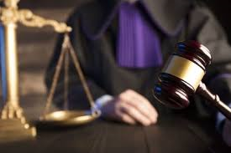
Justice Outcomes
There are two types:
1. Formal Justice System
2. Out-of-Court Disposals
Notes:
Justice Outcomes is the term given to cover the range of disciplinary options that are available to the Criminal Justice System (CJS).
The Formal Justice System
An accused person is charged, attends the relevant court and is either acquitted or sentenced accordingly. There is a range of sentencing options available to the various courts including orders, attendance requirements, fines, discharges and custodial sentences
Out-of-Court Disposals
These are a range of disposals designed to provide an alternative outcome to the formal justice system which are available to help the police (and certain accredited individuals) deal with offenders and secure an effective justice outcome.
It is necessary to record out-of-court disposal outcomes on local force systems and/or PNC. This ensures compliance with the National Crime Recording Standards (NCRS), requiring any crime to be recorded regardless of the method of disposal. It is also important to ensure the rationale for choosing the disposal is recorded so that data is available and retained.

Slide 23

Formal Justice System
Community Orders: Adults
Youth Rehabilitation Order (YRO)
Fines
Forfeiture of Property
Proceeds of Crime Act 2002
Discharges
Custodial or Suspended Sentences
Notes:
QTS:- How can you find out the results of your court case? (research the courts findings?)
A:- Several ways you can do this:
Can stay till the end of the court hearing, Once given your evidence can sit in for the rest of the hearing.
Public Record online
Results will be uploaded to Niche & PNC
Community Orders: Adults - where a person aged 18 or over is convicted of an offence, the court that convicts them may make an order (referred to as a “community order”) imposing requirements on them – examples could include unpaid work, curfews, drug rehabilitation, mental health treatment etc.
Youth Rehabilitation Order (YRO) - in addition to the ‘menu’ of options available for adults, young people can also be required to participate in the activities by way of disposal such as local authority residence, education, intensive fostering etc.
Fines - For any offence other than one for which the sentence is fixed by law, the court may impose fines. The level of the fine set should reflect the seriousness of the offence and the financial circumstances of the offender.
Forfeiture of Property - under the power given by Section 143 of the Powers of Criminal Courts (Sentencing) Act 2000, courts can order a convicted person to forfeit property used for the purposes of crime.
Proceeds of Crime Act 2002 - The Proceeds of Crime Act 2002 (POCA) exists to allow proceeds of crime to be taken from offenders and there are investigatory powers which can be exercised by constables (and in some cases by others). Consequently, when investigating crime consideration needs to be given as to whether the evidence suggests someone has profited from their crime.
Custodial & Suspended Sentences
Custodial sentences. - Prison is only used for the most serious offences and offenders. As well as guideline decisions on the length of sentence laid down by the Court of Appeal, all offences where prison is the punishment have a maximum term laid down by Parliament.
Suspended prison sentences - A 'suspended' prison sentence is carried out in the community. The person has to meet certain conditions - eg: having to stay away from a certain place or person
Sentencing guidelines
Help judges and magistrates decide the appropriate sentence for a criminal offence.
Criminal offences in England and Wales are very broadly defined and can have different levels of seriousness. Guidelines help to ensure that courts across England and Wales are consistent in their approach to sentencing.
Sentencing guidelines are available for most of the significant offences sentenced in the magistrates’ court and for a wide range of offences in the Crown Court. There is also guidance on general sentencing issues and principles. These guidelines are not specific to individual offences.
Where no guideline exists, judges refer to court of appeal judgments to examine how sentences have been reached for similar cases in the past. Each new guideline is consulted on as part of its development and you can get involved by responding to consultations
What guidelines do
Guidelines provide guidance on factors the court should take into account that may affect the sentence given. They set out different levels of sentence based on the harm caused to the victim and how blameworthy the offender is. Offences happen in many different ways with many different results. For example, assault offences can range from an argument where someone pushes someone else causing no injury, up to a carefully-planned gang attack that causes life-changing injuries. It is therefore necessary to have a range of sentences that appropriately reflect the seriousness of each individual offence.

Slide 24

Out of Court Disposals
Neighbourhood Justice
Restorative Justice
Community Resolutions
Cannabis Warnings
Penalty Notice for Disorder (PND)
Youth or Adult Caution
Youth or Adult Conditional Caution
Notes:
Neighbourhood Justice
Out-of-court disposals are grouped together as ‘neighbourhood justice’ - this enables the police to quickly and proportionately deal with low-level, often first-time offending which could more appropriately be resolved without a prosecution at court.
The police have a duty to consider whether Neighbourhood Justice would better serve the public interest when deciding whether to prosecute an offender. Any decision made must be appropriate and proportional to the offence and the offender.
Restorative Justice
Restorative justice is a means of resolving conflicts without resorting to the criminal courts, and focuses on the victim’s needs rather than on convicting the offender. The intention is to give victims more of a voice and to involve the offender in making amends directly to the victim.
Restorative justice is a technique which can be used out of court and in conjunction with an Out-of-Court Disposal. It is the process of bringing together those harmed by crime or conflict with those responsible for the harm, to find a positive way forward. It gives victims the chance to:
Tell offenders the real impact of their crime
Get answers to their questions
Get an apology.
In the majority of cases, the offences addressed are of a non-criminal nature and relate mainly to ASB and neighbour disputes. The resolution of the situation often involves an apology, unpaid work, repairing public damage, some restrictions and/or financial compensation.
Community Resolutions
Can include elements of restorative justice, and are used for adults or youths as a non-statutory disposal. They are a proportionate way of dealing with offenders for lower-level crime, such as low-level criminal damage, low-value theft, minor assaults (without injury) and anti-social behaviour.
The Legal Aid, Sentencing and Punishment of Offenders Act 2012 (LASPO) neighbourhood justice outcomes framework presents an overview of neighbourhood justice outcomes.
Cannabis Warnings - The ACPO Guidance on Cannabis Possession for Personal Use (revised Intervention Framework 28 January 2009) outlines the procedures when the police find a person in possession of a small amount of cannabis. A Cannabis Warning applies to adults possessing cannabis for personal use only. The warning cannot be given to a person under 18 years of age. It is an informal, verbal warning given by a police officer to an offender, either on the street or in a police station.
Penalty Notices for Disorder: Under the Criminal Justice and Police Act 2001, the PND scheme provides the police and certain accredited individuals with a swift, out-of-court disposal to deal with low level, anti-social and nuisance suspected offending for adult offenders.
Youth Cautions are a formal warning used when it is not in the public interest to prosecute an offender aged 10 to 17.
Adult Simple Caution are available for any offence, but are primarily intended for low level and mainly first time offending when specified public interest and eligibility criteria are met. Only in exceptional circumstances should it be used to deal with more serious offences.
Youth Conditional Caution (YCC) they are a caution with conditions attached. The conditions that can be attached must be rehabilitative, reparative or punitive.
Adult Conditional Cautions provide an opportunity to:
respond proportionally to low level offending
allow offenders to make swift reparation to victims and communities
divert offenders into rehabilitative services at an early opportunity, reducing the risk of re-offending
punish an offender by means of a financial penalty.

Slide 25


