Slide 1
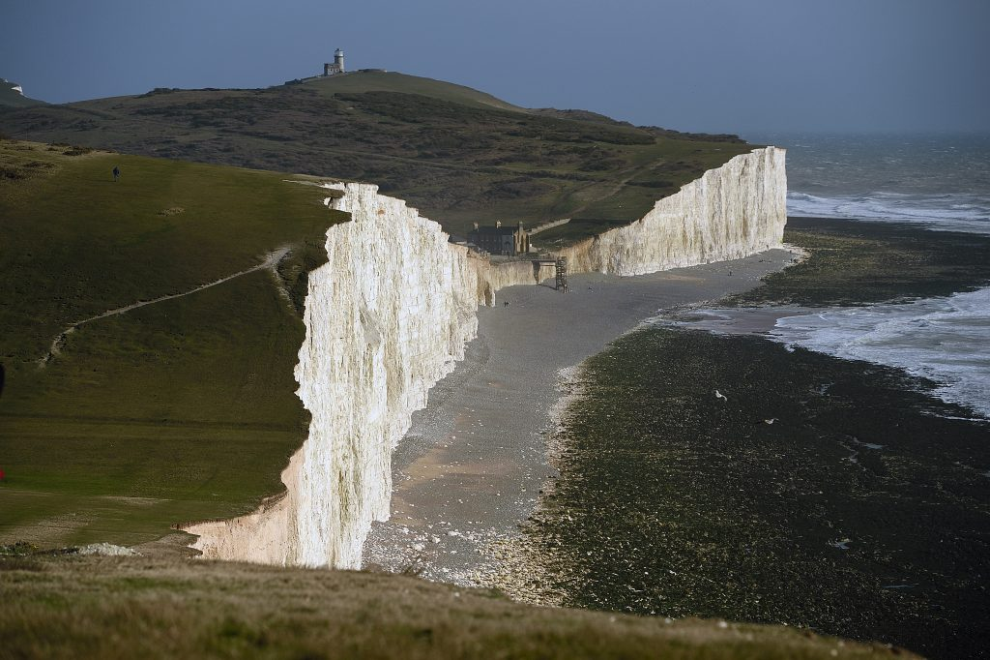


Mapping and monitoring of marine and coastal environments
ACNA5001
Alissa Flatley

Slide 2
OUTLINE
mAPPING
How we MAP COASTLINES?
Mapping and classifications
2) mONITORING
GIS approaches to coastal monitoring

Slide 3
OUTLINE
mAPPING
How we MAP COASTLINES?
Mapping and classifications
2) mONITORING
GIS approaches to coastal monitoring
1hr

Slide 4
OUTLINE
mAPPING
How we map COASTLINES?
Mapping and classifications
2) mONITORING
GIS approaches to coastal monitoring
1hr

Slide 5
Why map coastlines?

Slide 6
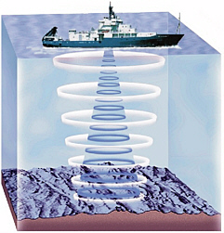
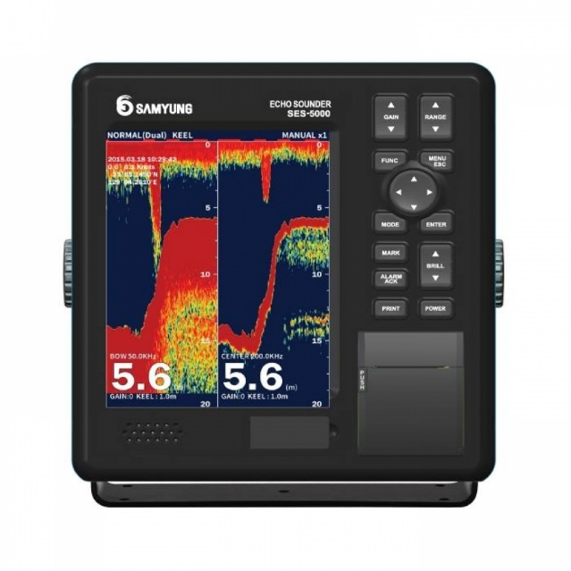
ECHOSOUNDER
Echosounders are a type of sonar commonly used for a variety of tasks, including navigation, measuring bottom depth, and detecting schools of fish and plankton. Single beam echosounders emit a pulse of sound in a narrow cone (2°-12°).
Only 15% of ocean measured by sonar…

Slide 7
ECHOSOUNDER
Echosounders are a type of sonar commonly used for a variety of tasks, including navigation, measuring bottom depth, and detecting schools of fish and plankton. Single beam echosounders emit a pulse of sound in a narrow cone (2°-12°).
Only 15% of ocean measured by sonar…
The users of the sonar system, i.e., sailors, fishermen, and marine researchers have adopted the following terms: - a sonar system that transmits vertically is called an “echo-sounder” - a sonar system that transmits horizontally is called a “sonar”

Slide 8
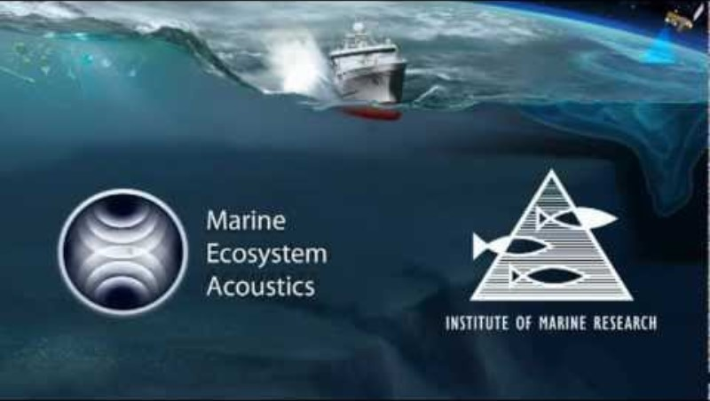
ECHOSOUNDER

Slide 9
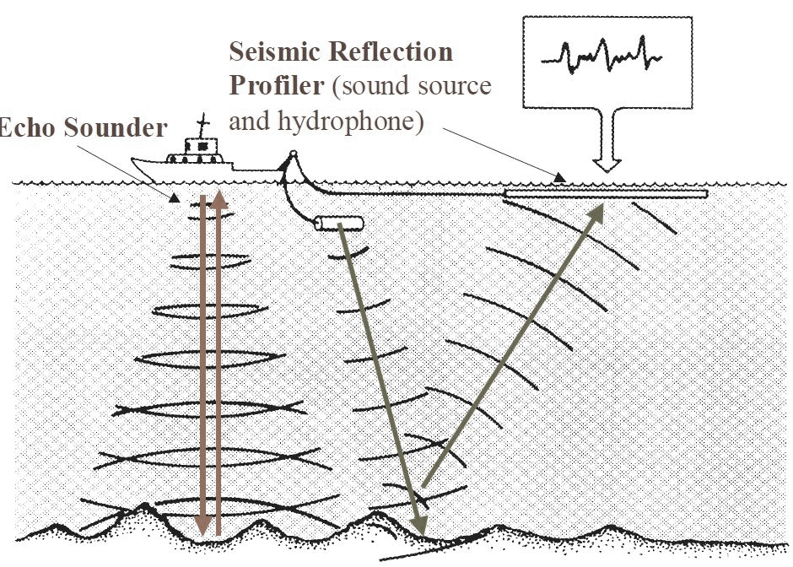
REFLECTION SEISMIC
The general principle involves sending artificially generated acoustic waves down the water column and into the seafloor, where the different structures and objects within the Earth's crust reflect this energy back according to their acoustic impedance.
These reflected energy waves are recorded by hydrophones, and the data are processed to produce a visual representation of the seabed sub-surface.
Sidescan Sonar - an overview | ScienceDirect Topics
Notes:
Seismic reflection is a method of exploration geophysics that provides information about the sub-surface structure of the seafloor.

Slide 10
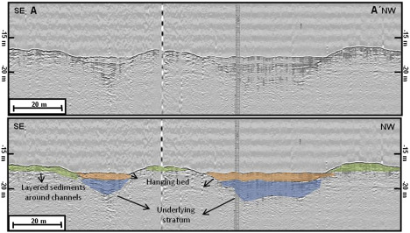
REFLECTION SEISMIC
Reflection-seismic profile acquired with a boomer system showing two sub-surface channels filled with tsunami-laid deposits (blue) and covered by post-tsunami background sediment (orange).
Results from investigations in the Andaman Sea offshore of Khao Lak four years after the 2004 Indian Ocean Tsunami.
Sidescan Sonar - an overview | ScienceDirect Topics

Slide 11
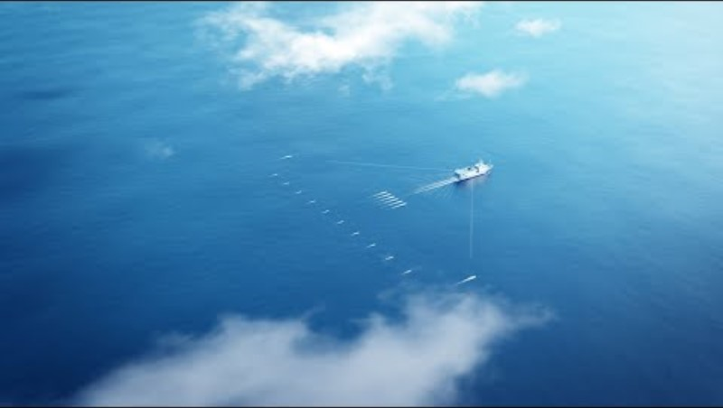
REFLECTION SEISMIC
Sidescan Sonar - an overview | ScienceDirect Topics

Slide 12
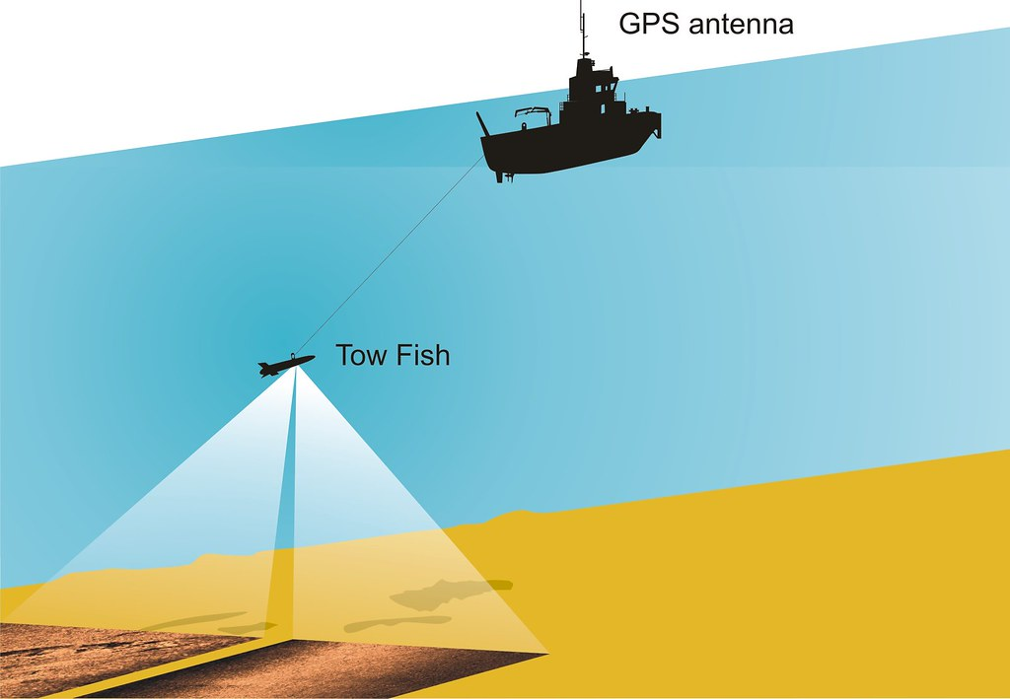
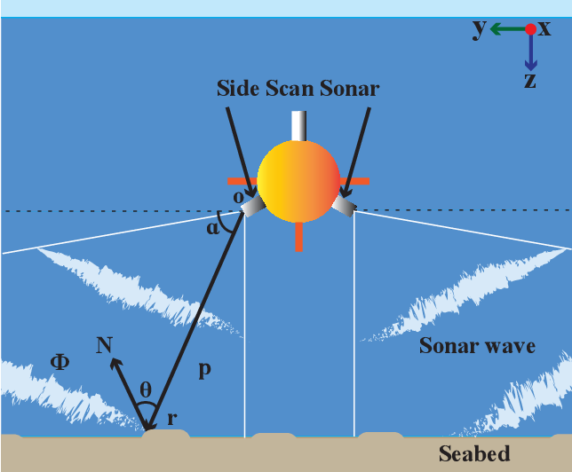
SIDESCAN SONAR
… like echo sounder, but images a 60 km swath of seafloor
Side-scan sonar is a category of active sonar system for detecting and imaging objects on the seafloor. The multiple physical sensors of the sonar — called a transducer array — send and receive the acoustic pulses that help map the seafloor or detect other objects. This array can be mounted on the ship’s hull or placed on another platform like a towfish.
Sidescan Sonar - an overview | ScienceDirect Topics

Slide 13
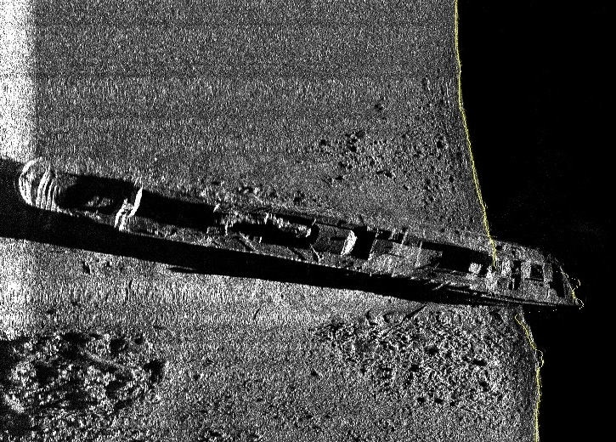
SIDESCAN SONAR
Side-scan sonar is an effective tool for identifying seabed objects or items of debris as it creates an image of the sea floor using sound energy and strength of signal return to cover large areas quickly and cost effectively.
Side-Scan Sonar – Aspect Land & Hydrographic Surveys (aspectsurveys.com)
Sidescan Sonar - an overview | ScienceDirect Topics

Slide 14
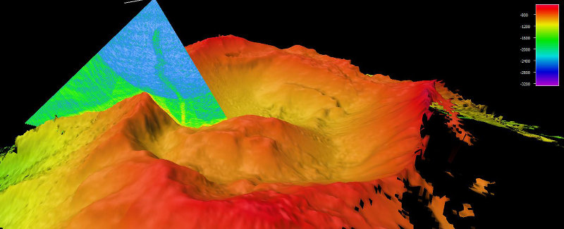
MULTIBEAM SONAR
Unlike single-beam sonar, which uses just one transducer to map the seafloor, a multibeam sonar sends out multiple, simultaneous sonar beams (or sound waves) at once in a fan-shaped pattern. This covers the space both directly under the ship and out to each side. Multibeam collects two types of data: seafloor depth and backscatter.
Echosounders – Discovery of Sound in the Sea (dosits.org)
Exploration Tools: Multibeam Sonar: NOAA Office of Ocean Exploration and Research

Slide 15
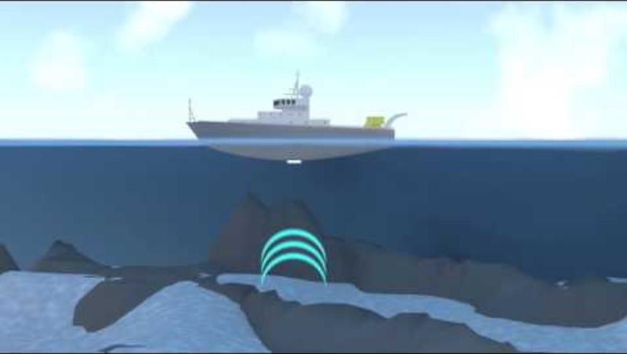
MULTIBEAM SONAR

Slide 16
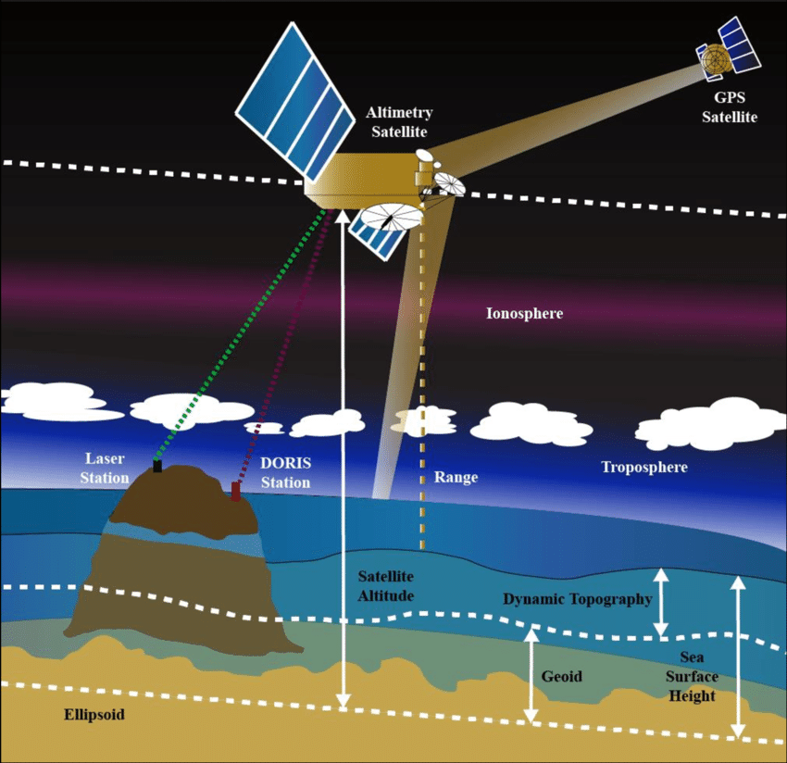
SATELLITE ALTIMETRY
Satellite radar altimeters measure the ocean surface height (sea level) by measuring the time it takes a radar pulse to make a round-trip from the satellite to the sea surface and back.
Notes:
Those were the sea floor – this is the sea surface!

Slide 17
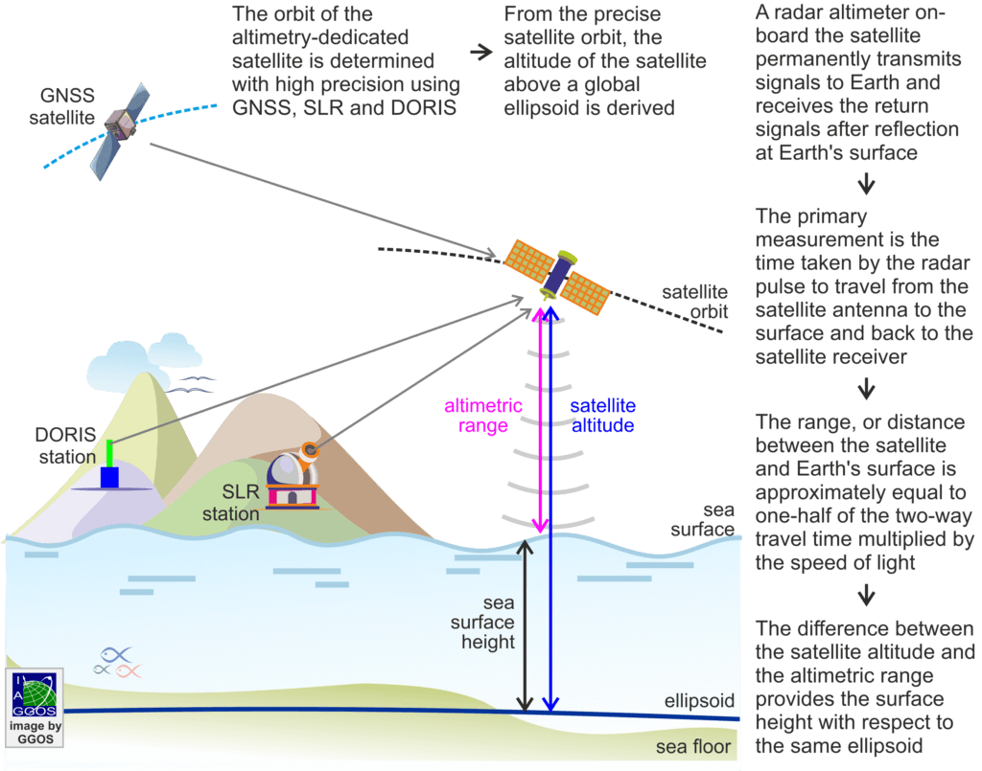
SATELLITE ALTIMETRY
Notes:
GNSS: global navigation satellite system
SLR: Satellite Laser Ranging
DORIS: The Doppler Orbitography and Radio-positioning Integrated by Satellite instrument

Slide 18
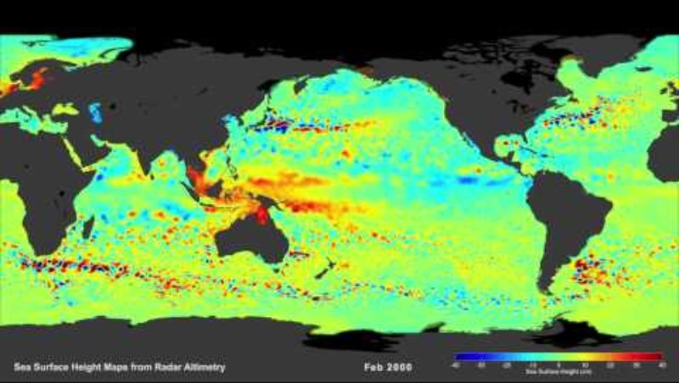
SATELLITE ALTIMETRY
Swirling currents called eddies pepper the global ocean. Like small pock-marks in sea surface height, these eddies are found in every major ocean basin.
Near the Equator, the eddies give way to fast moving features called Kelvin Waves. When they build up in the Pacific, these waves can usher in a phenomenon known as El Nino, which happens when warm water and high sea levels move into the Eastern Pacific along the Equator.
NASA/JPL

Slide 19
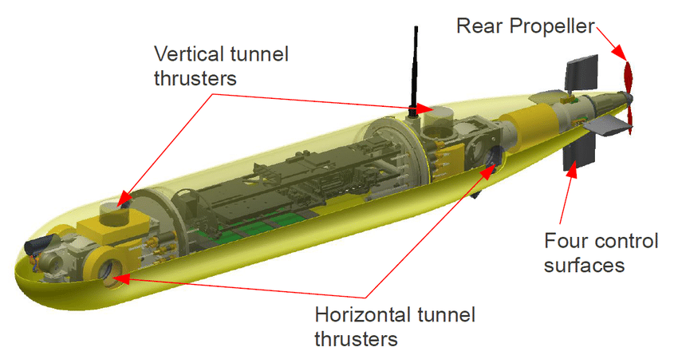
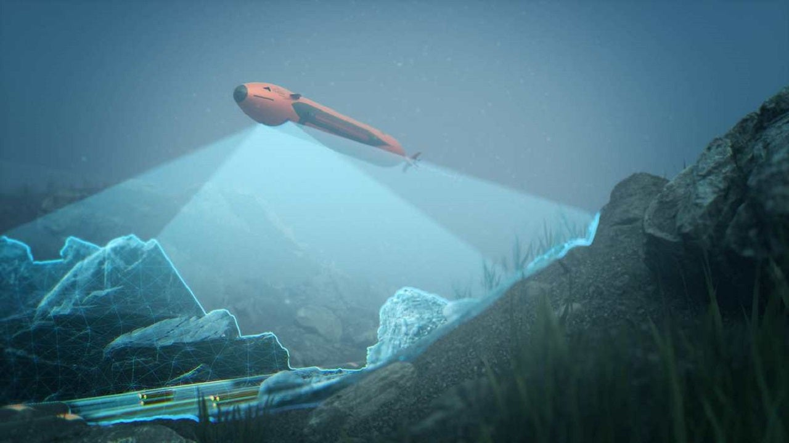
ROV and AUVs
An AUV conducts its survey mission without operator intervention. When a mission is complete, the AUV will return to a pre-programmed location where the data can be downloaded and processed.
A remotely operated vehicle (ROV) is an unoccupied underwater robot that is connected to a ship by a series of cables.
Notes:
Boaty mc boat face
AUV: autonomous underwater vehicle

Slide 20
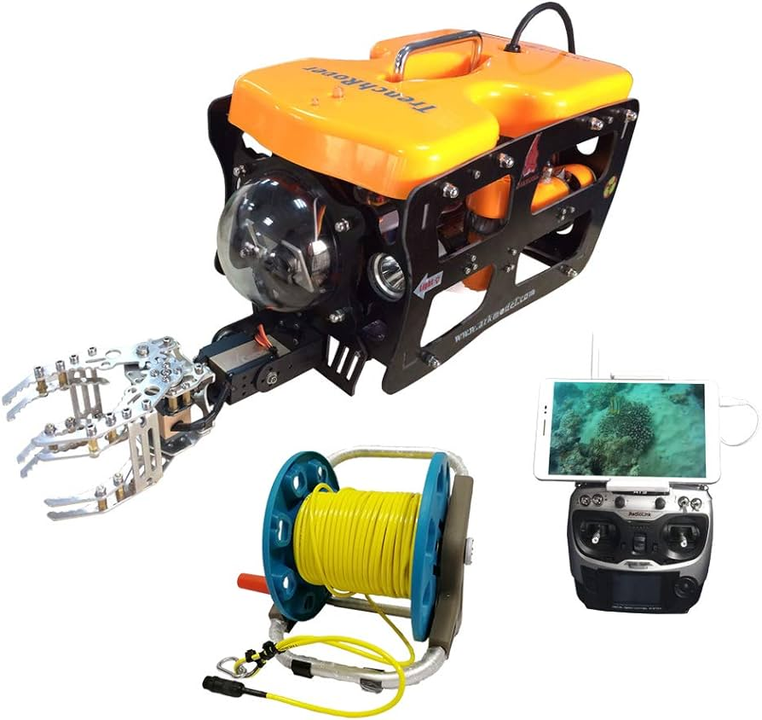
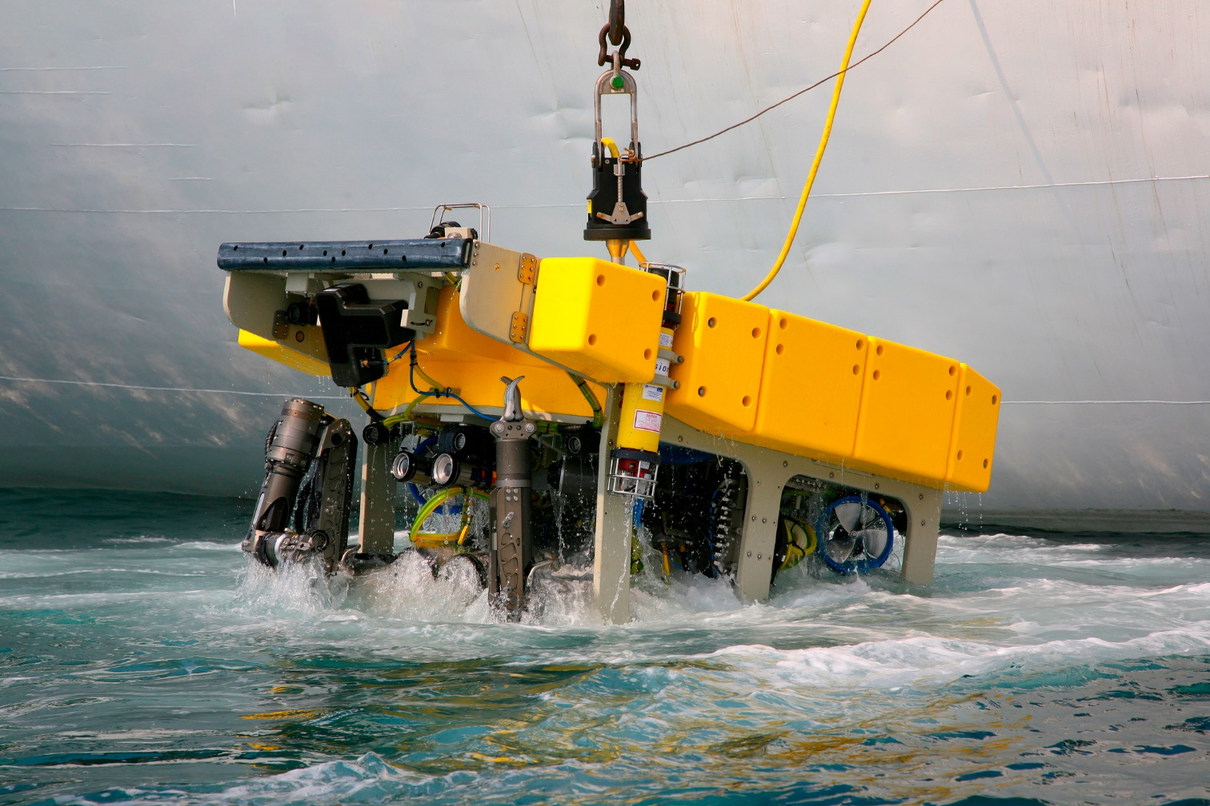
ROV and AUVs
An AUV conducts its survey mission without operator intervention. When a mission is complete, the AUV will return to a pre-programmed location where the data can be downloaded and processed.
https://youtu.be/_lKEfGwlLrY
A remotely operated vehicle (ROV) is an unoccupied underwater robot that is connected to a ship by a series of cables.

Slide 21
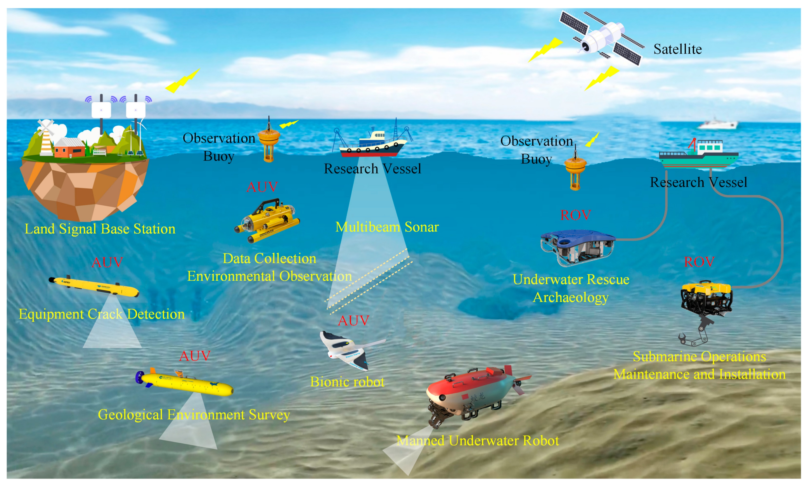
HOW WE MAP THE MARINE ENVIRONMENT

Slide 22
WHAT ABOUT THE COAST?
Topographic beach profiles
Dune toe surveys
Cliff edge surveys
Laser scans
Bathymetry
Wave and tidal data
Coastal defence inspections
Aerial photography
Light Detection and Ranging LiDAR

Slide 23


TAKE A BREAK

Slide 24
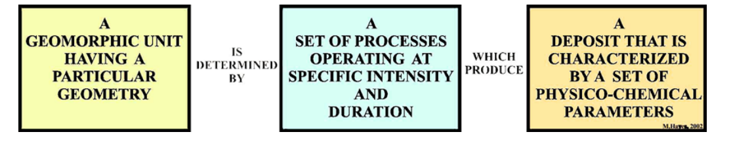
Coastal classification systems
(1) (PDF) Field Seminar Guidebook - Environments of Sand Deposition within a Wave-Dominated Delta and Estuary, Nayarit, Mexico (researchgate.net)

Slide 25
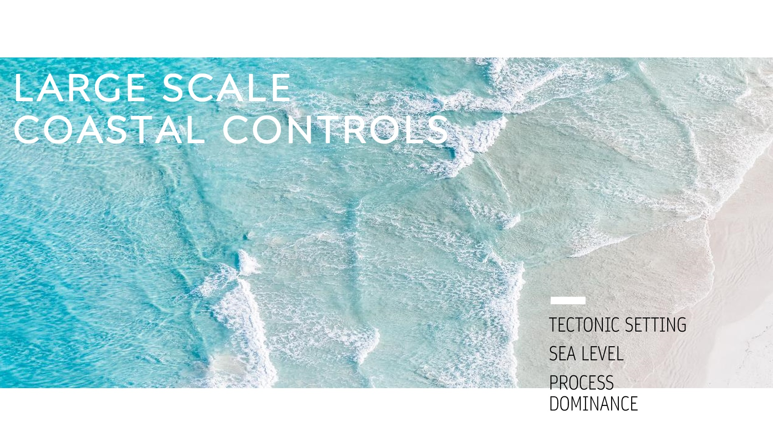
Coastal classification systems

Slide 26
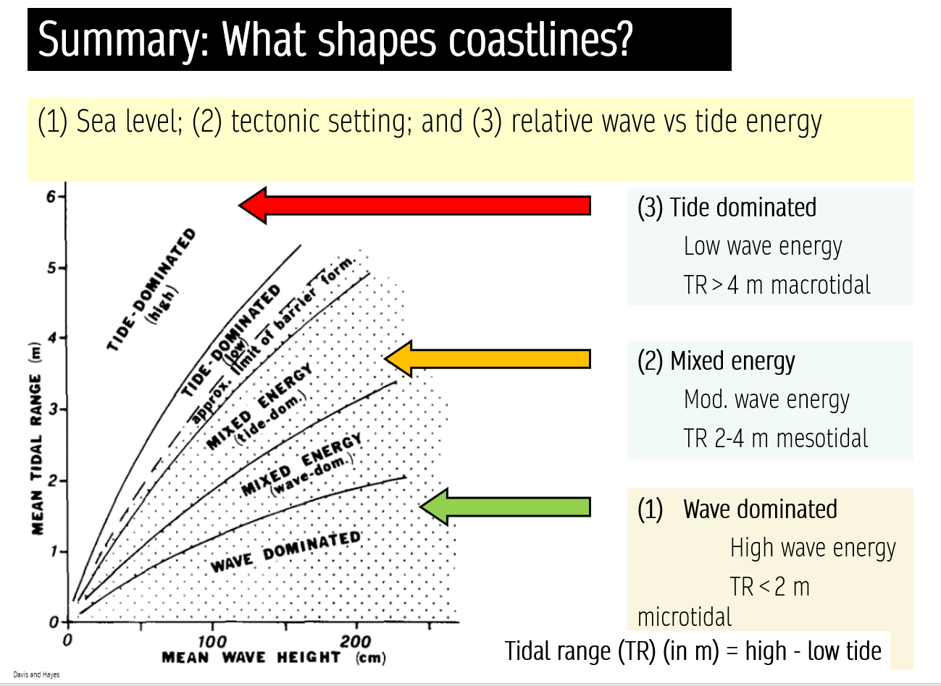
Coastal classification systems

Slide 27
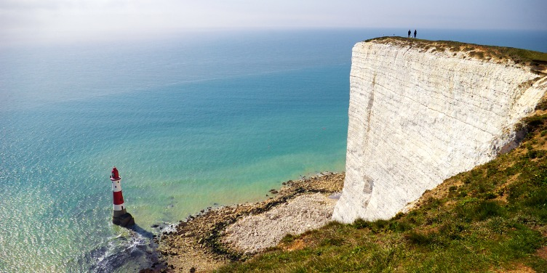
COASTAL CLASSIFICATION SYSTEMS
Most have grouped coastal areas into classes that have similar features because of having developed in similar geological and environmental settings.
Notes:
By its very nature, the coast is an incredibly complex and diverse environment, one that may defy organization into neat compartments.
Nevertheless, the quest for understanding how shorelines formed and how human activities affect these processes has demanded that classification schemes be devised.

Slide 28
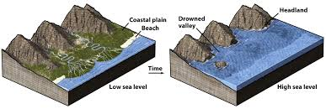
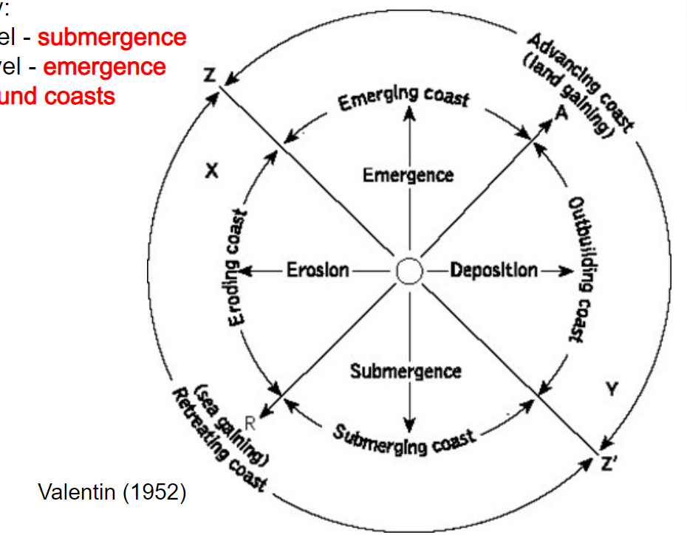
EARLY CLASSIFICATION
Many early geologists took a genetic approach to classification and distinguished whether the coast had been primarily affected by rising sea level (submergence), falling sea level (emergence), or both (compound coasts) (Dana 1849; Davis 1896a; Gulliver 1899; Johnson 1919; Suess 1888; Valentin, 1952).

Slide 29
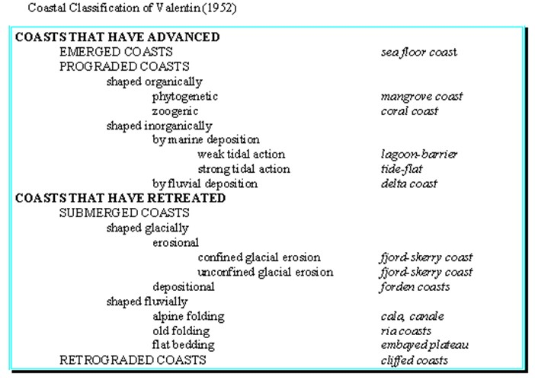
EARLY CLASSIFICATION
Many early geologists took a genetic approach to classification and distinguished whether the coast had been primarily affected by rising sea level (submergence), falling sea level (emergence), or both (compound coasts) (Dana 1849; Davis 1896a; Gulliver 1899; Johnson 1919; Suess 1888; Valentin, 1952).

Slide 30
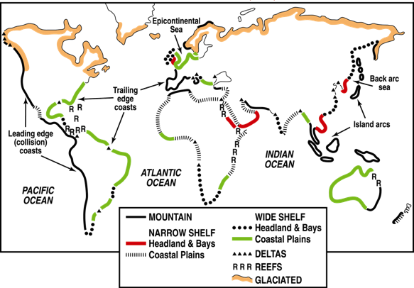
Inman and Nordstrom (1971)
Considered continental margins and devised a classification based on tectonic framework.

Slide 31
Shepherd (1973)
Primary Coasts
• Land Erosion Coasts
• Subaerial Deposition Coasts
• Volcanic Coasts
• Shaped by Diastrophic Movements
• Ice Coasts
Secondary Coasts
• Marine Deposition Coasts
• Coasts built by organisms
Possibly the most widely used coastal classification scheme is the one introduced by Shepard in 1937 and modified in later years (1973).
It divides the world’s coasts into primary coasts formed mostly by non-marine agents and secondary coasts - shaped primarily by marine processes. Further subdivisions occur according to which specific agent, terrestrial or marine, had the greatest influence on coastal development.

Slide 32
Shepherd (1973)
The advantage of Shepard’s classification is that it is more detailed than others, allowing most of the world’s coasts to be incorporated.
Although gradational shore types exist, which are difficult to classify, most coasts show only one dominant influence as the cause of their major characteristics.

Slide 33

Readings for you!
Whitfield and Elliot (2011)
Ecosystem and Biotic Classifications of Estuaries and Coasts (uwtsd.ac.uk)
Thom et al (2018)
National sediment compartment framework for Australian coastal management (uwtsd.ac.uk)

Slide 34
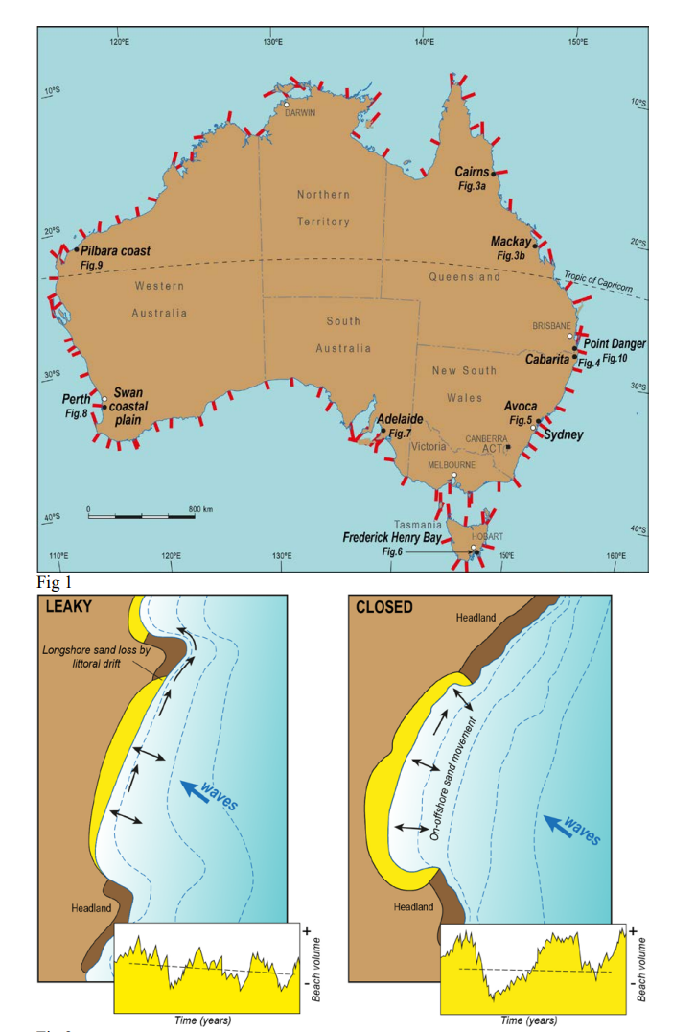
Readings for you!
Whitfield and Elliot (2011)
Ecosystem and Biotic Classifications of Estuaries and Coasts (uwtsd.ac.uk)
Thom et al (2018)
National sediment compartment framework for Australian coastal management (uwtsd.ac.uk)

Slide 35
Readings for you!
Whitfield and Elliot (2011)
Ecosystem and Biotic Classifications of Estuaries and Coasts (uwtsd.ac.uk)
Thom et al (2018)
National sediment compartment framework for Australian coastal management (uwtsd.ac.uk)

Slide 36
Readings for you!
Cotton (1954)
Deductive Morphology and Genetic Classification of Coasts (uwtsd.ac.uk)
Finkl (2004)
Coastal Classification: Systematic Approaches to Consider in the Development of a Comprehensive Scheme (uwtsd.ac.uk)

Slide 37

Readings for you!
Cotton (1954)
Deductive Morphology and Genetic Classification of Coasts (uwtsd.ac.uk)
Finkl (2004)
Coastal Classification: Systematic Approaches to Consider in the Development of a Comprehensive Scheme (uwtsd.ac.uk)

Slide 38

GIS and Monitoring coastlines

Slide 39
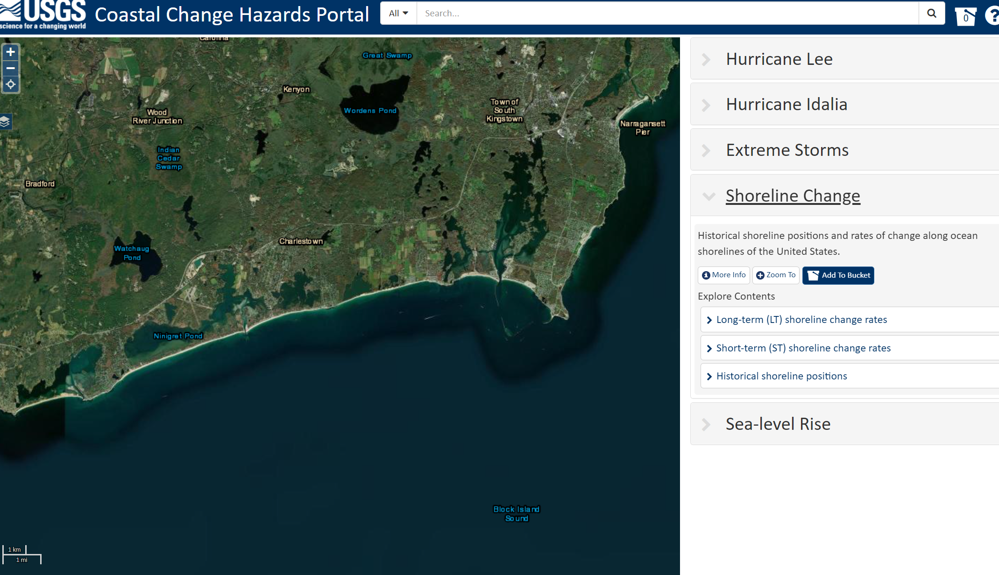
ACTIVITY
GIS APPROACHES TO MONITORING
USGS Coastal Change Hazards Portal
Click on the USGS Coastal Change Hazards Portal and Navigate to Shoreline Change.

Slide 40
ACTIVITY
GIS APPROACHES TO MONITORING
USGS Coastal Change Hazards Portal
Click on the USGS Coastal Change Hazards Portal and Navigate to Shoreline Change.
Explore the three key layers:
LT Shoreline Change
ST Shoreline Change
Historical Shoreline Positions

Slide 41
ACTIVITY
GIS APPROACHES TO MONITORING
USGS Coastal Change Hazards Portal
Next, explore the SEALEVEL rise section
.

Slide 42
ACTIVITY
GIS APPROACHES TO MONITORING
National Coastal Monitoring - Welcome
Let's explore some content for Wales
Wales Coastal Monitoring Centre | WCMC
What is being monitored? How?
.

Slide 43
ADDITIONAL READING
GIS APPROACHES TO MONITORING
Development and application of a coastal change likelihood assessment for the northeast region, Maine to Virginia (usgs.gov).

