Slide 1


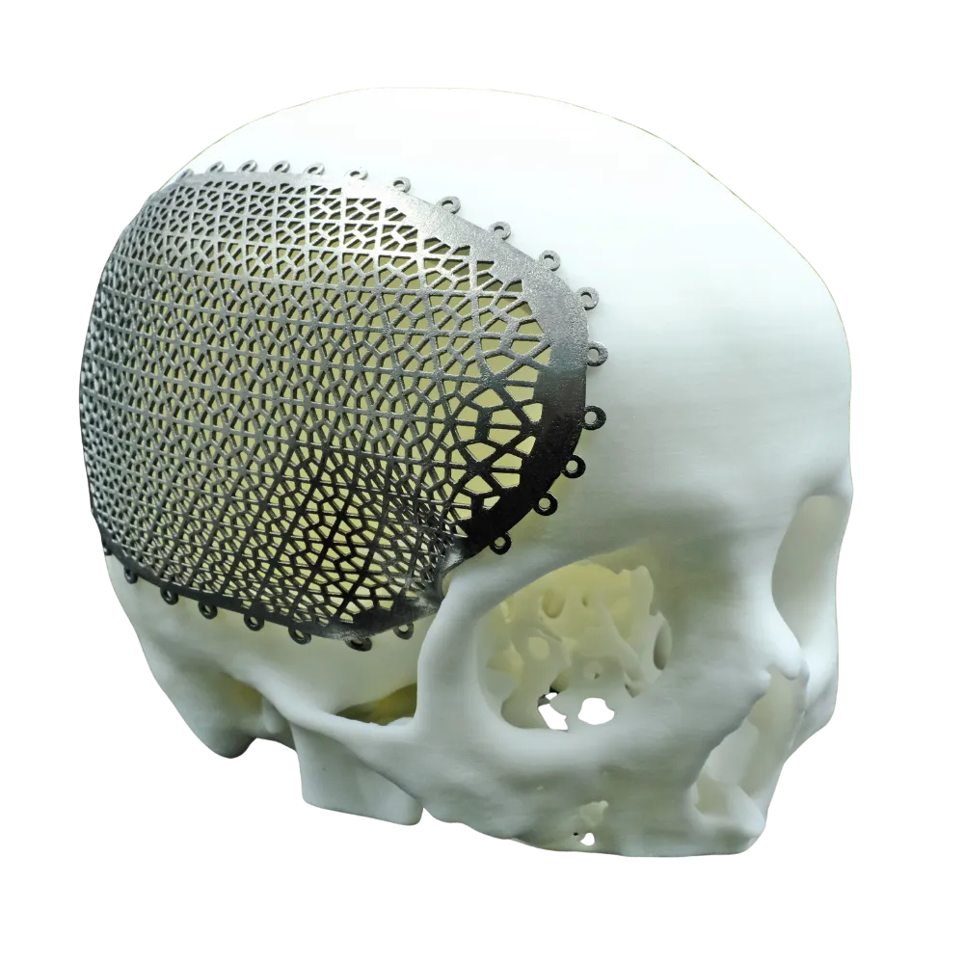
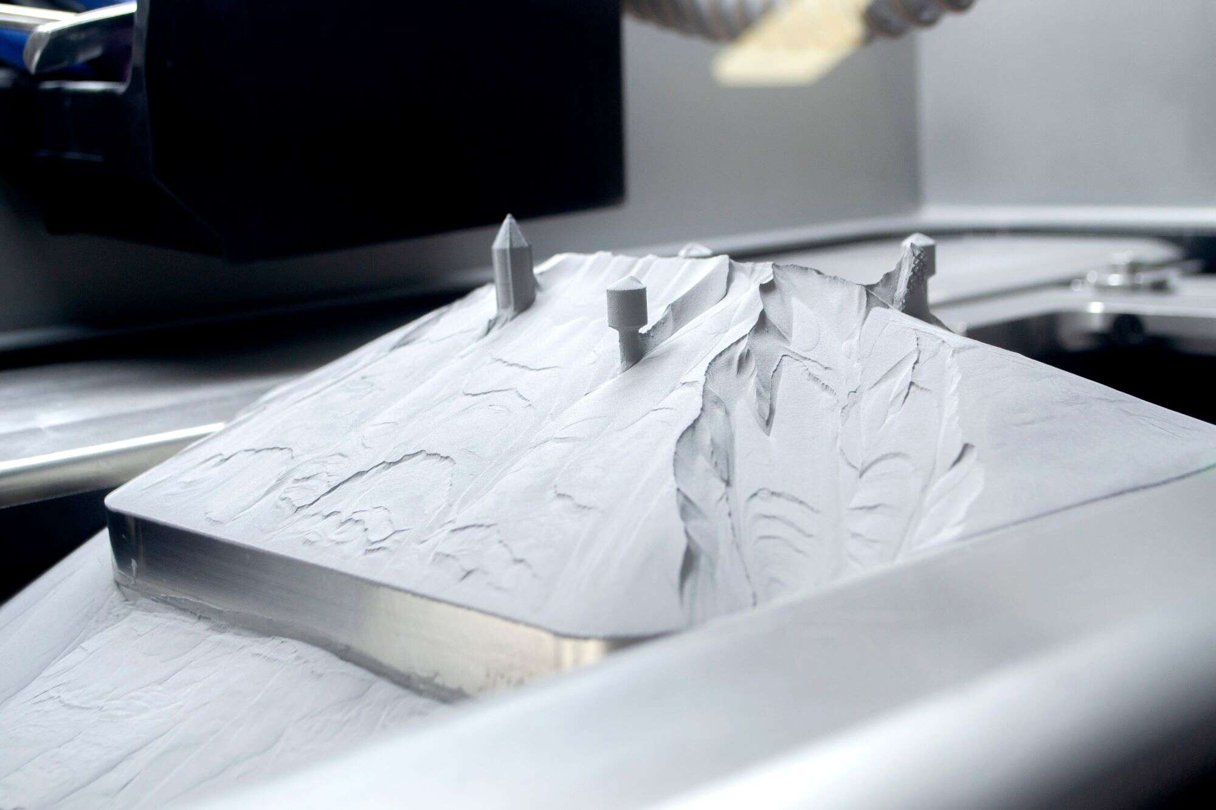
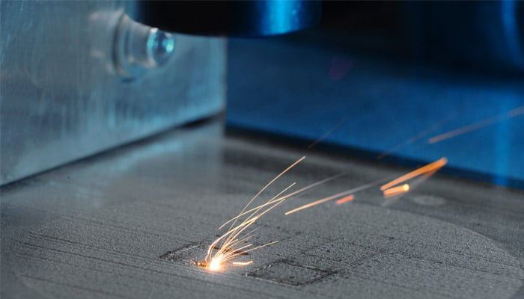
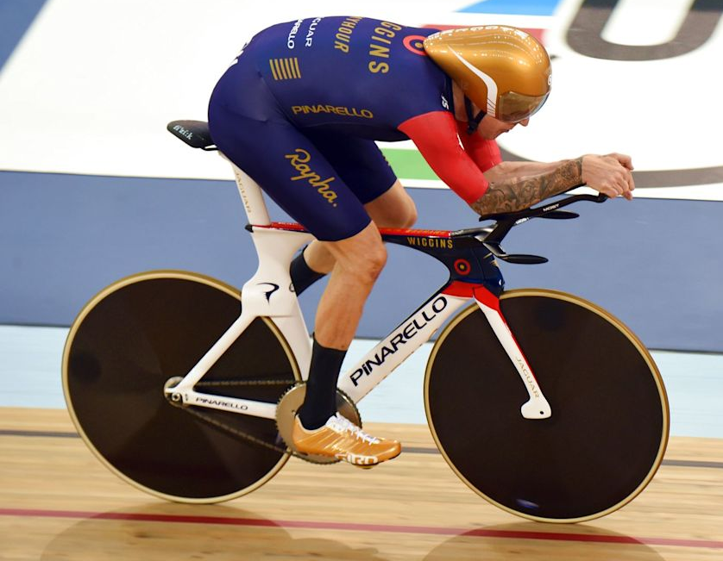
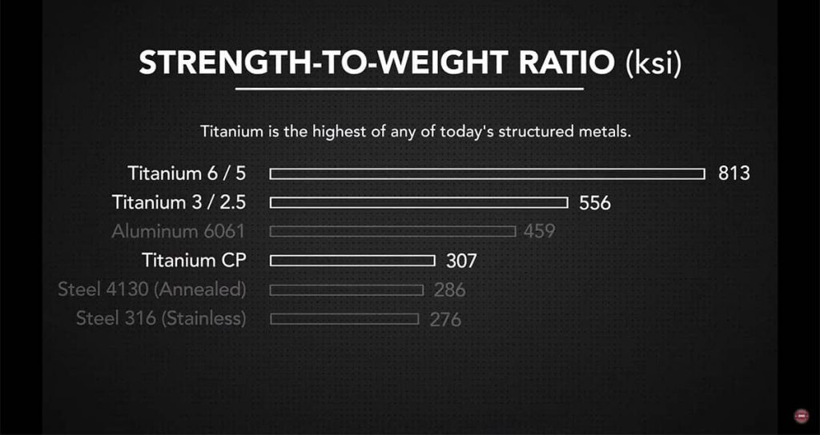
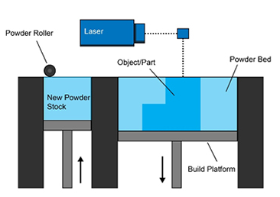
Use in the medical industry
Laser powder bed fusion of titanium has been widely adopted in biomedical engineering for use in implants. Titanium’s resistance to corrosion makes it the most used metal for medical implants as it doesn’t react to the fluids within the body. The LPBF process is favoured by biomedical engineers for implants due to the uniqueness of each required model, not only will they be modelling many different bones joints and braces, but each one will be required to be different due to the wide variety of shapes and sizes of people. Before additive manufacture titanium models biomed engineers would have to CNC block titanium or cast into moulds, these often resulted in stock implants that would limit the patient's mobility.
Additive Manufacture : Titanium Laser Powder Bed fusion
Tobias Smith
Andrew Harrison
Wales Institute for Science & Art
BEng Motorcycle Engineering
Introduction
First patented in 1996, Metallic Laser Powder Bed Fusion (LPBF) is a Computer Aided Manufacturing (CAM) process in which a high-power laser is guided over a bed of powdered metal following a CAD software model, the laser melts the powder layer over layer producing a 3d printed metallic structure. Metallic LPBF was a natural continuation of the work coming out of the university of Texas in the 1980s, selective laser sintering (SLS) using polymer powder to produce 3d structures.
Printed titanium lattice to replace part of a skull
Titanium
By the mid 90’s, the LPBF process was adapted to allow for high performance materials a significant one being Titanium. Titanium is a premium material. It boasts the highest strength to density ratio of any metallic element on the periodic table. Additionally, it is naturally resistant to corrosion rivalling stainless steel in its resistance to the elements therefore it is considered the most biocompatible and medically inert material. Historically the draw back of titanium was its difficulty in manufacture as it cannot easily be cast making complex structures very difficult to produce, however by implementing the LPBF process highly complex structures would be achievable. (What are the pros and cons of titanium? 2022)
Use in competitive sport
MYTHOS is a company that supplies custom premium titanium LPBF printed parts for professional cyclists. Their first parts were used by Sir Bradley Wiggins in his 1-hour record in 2015, he shattered the standing world record. Since then, the company has supplied these parts to highly successful bike teams, MYTHOS components have been ridden to 22 world championships and 7 Olympic medals. Use and therefore trust by these professional cyclists, for LPBF parts to give them a competitive edge shows the benefit that titanium LPBF can have on over traditional manufacturing methods. The material of choice within competitive cycling has long been carbon fibre, however the restrictions carbon faces is the manufacturing process moulds must used to produce a carbon part. MYTHOS specialises in parts which have complex lattice forms to save weight and increases stiffness to ensure the athletes power is efficiently transferred into motion, carbon moulds cannot achieve these complex lattice forms
(Luke, 2024)
2015, Sir Bradley Wiggins smashes 1 hour record, on a bike with titanium LPBF 3d printed parts from MYTHOS
Process
The LPBF printer spreads a thin (typically 0.1mm) layer of the titanium powder over the base platform, then a high-power laser fuses the cross-section shape of the model into the powder to create the first layer. A new layer of powder is then spread over the previous layer with a roller, the process is repeated until the whole model is fused, the excess powder stays in place later removed in the finishing process. (Powder Bed Fusion: Additive Manufacturing Research Group: Loughborough University 2026)
References
(2022) What are the pros and cons of titanium?, OneMonroe. Available at: https://monroeengineering.com/blog/pros-and-cons-of-titanium/ (Accessed: 14 April 2026).
Powder Bed Fusion: Additive Manufacturing Research Group: Loughborough University Powder Bed Fusion | Additive Manufacturing Research Group | Loughborough University. Available at: https://www.lboro.ac.uk/research/amrg/about/the7categoriesofadditivemanufacturing/powderbedfusion/ (Accessed: 14 April 2026).
Luke, C. (2024) What is titanium?, SawbladeUniversity.com. Available at: https://sawbladeuniversity.com/what-is-titanium/ (Accessed: 14 April 2026).
Wales Institute for Science & Art

