Slide 1
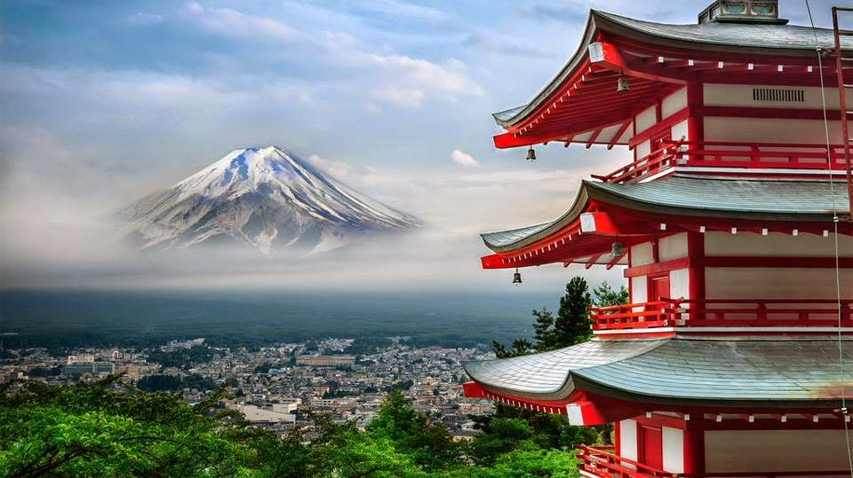


Marketing essential m4x01916

Slide 2
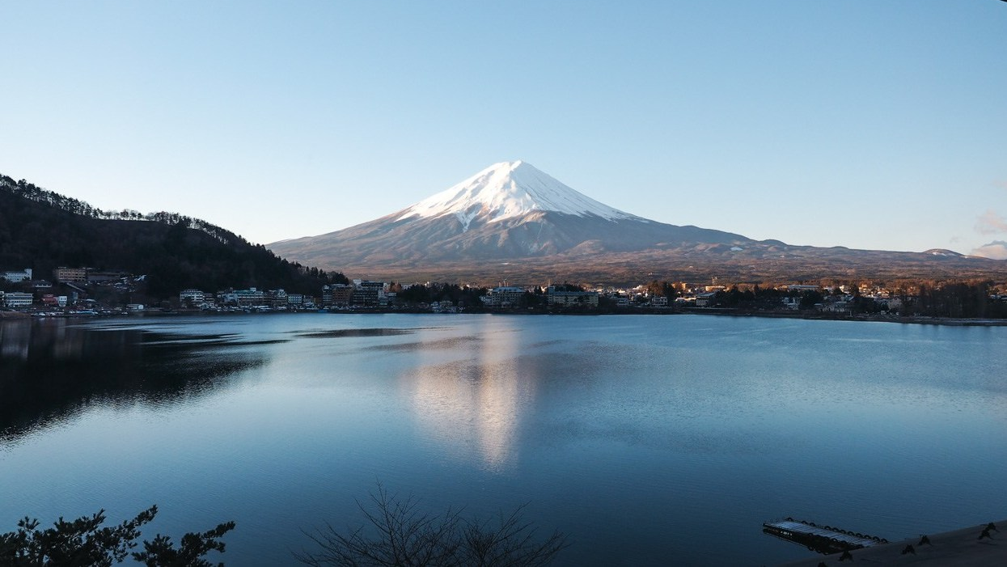
Aurel badica 1815467
EMANUELA STAN 1815346
STEFAN ILIE 1815223
Lecturer dr. Olu adegbite

Slide 3
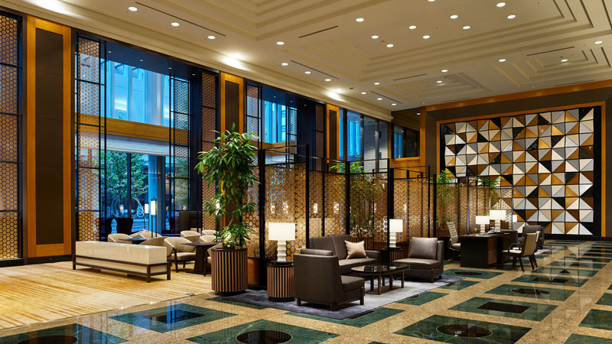
Hi Everyone!
Thank you for being here today.
I am Emanuela and I am proud to be part of the best Team ever.
My team and I are here today to present you our chosen product for our Group Team Presentation.
Before I go any forward let me introduce my great team Aurel and Stefan.

Slide 4
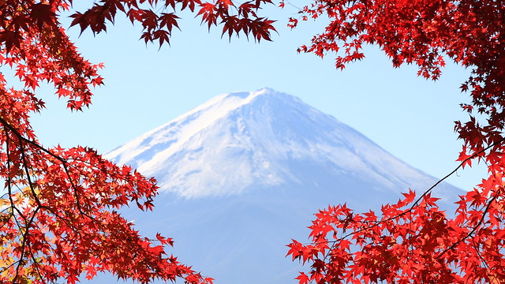
Mount fuji hotel

Slide 5
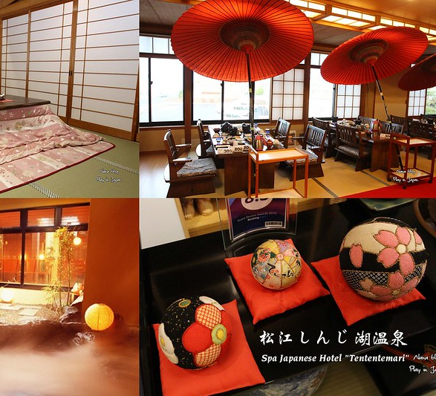
Marketing Audit of
Mount Fuji Hotel
Strategic Plan Marketing
External Marketing Environment
Internal Marketing Environment
Marketing Strategy Review
C C
C
C C

Slide 6
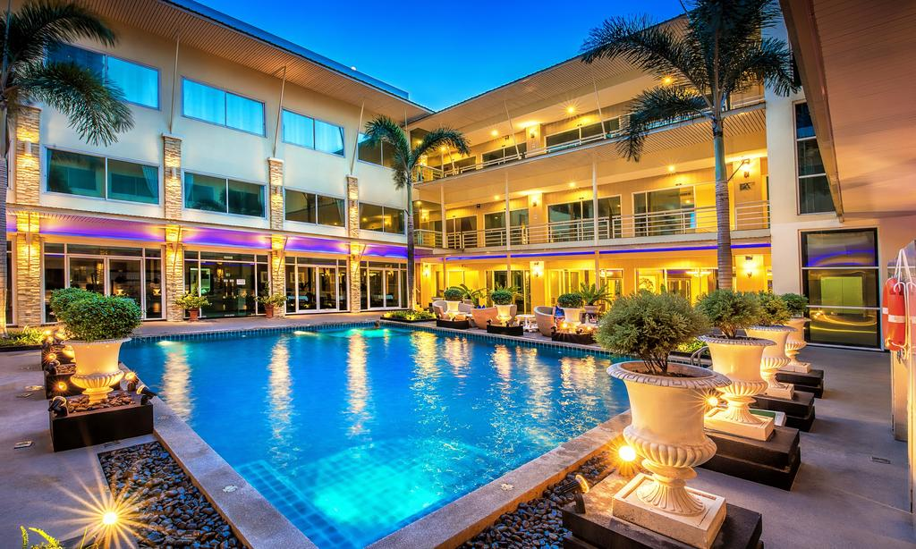

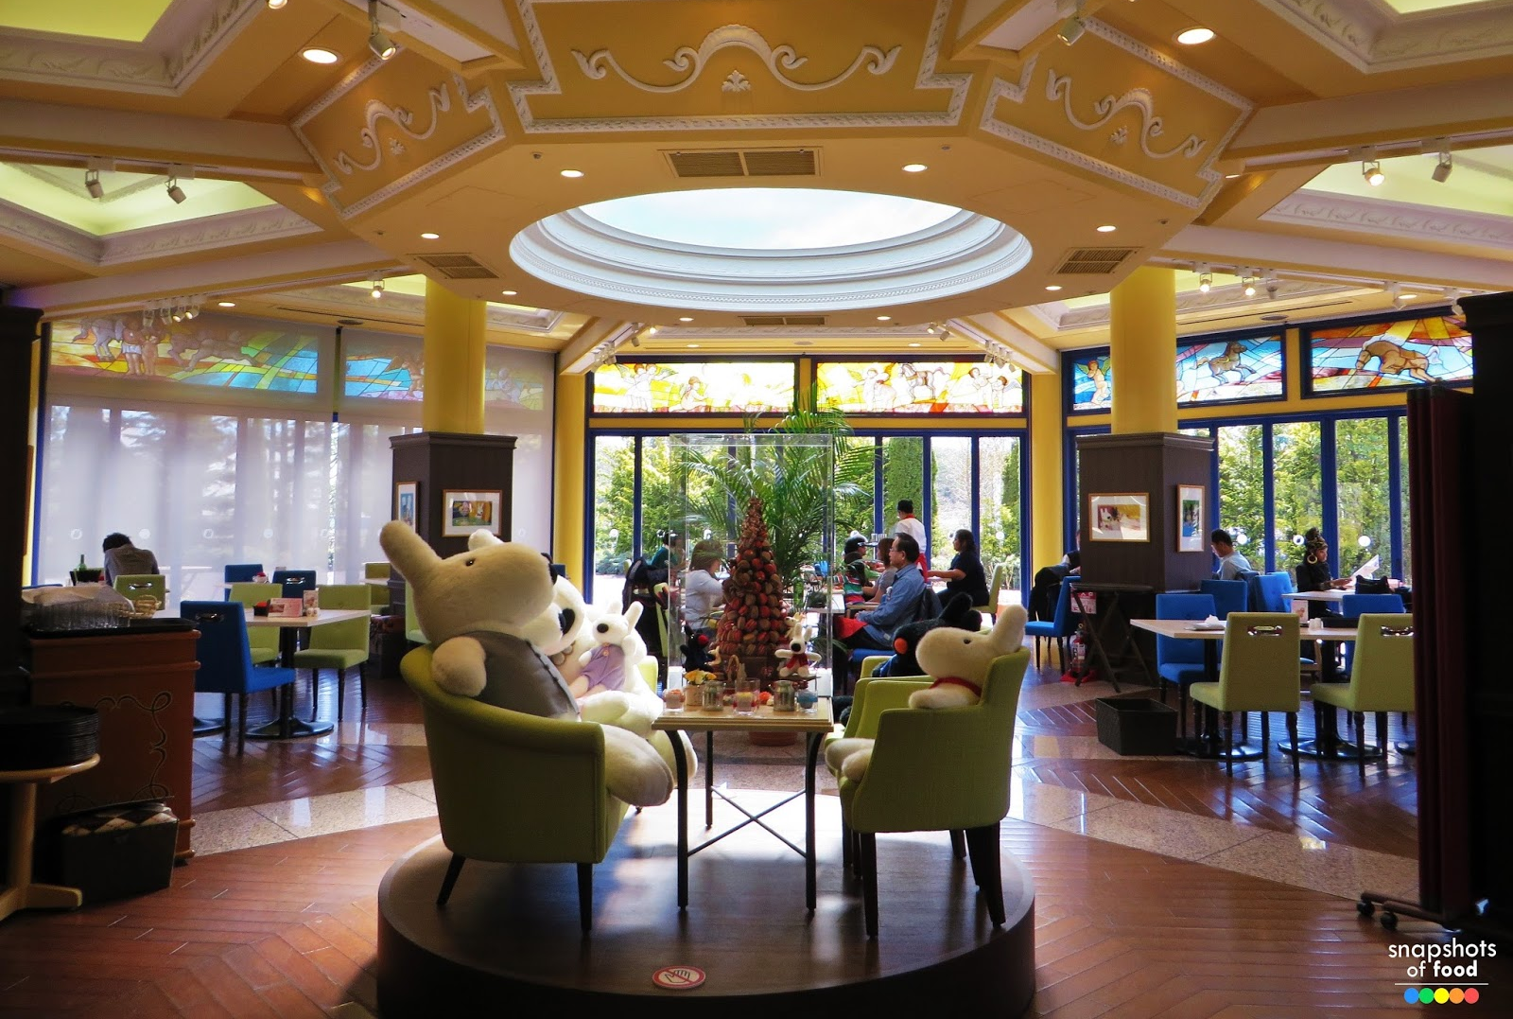
Introduction
We are planning to open a hotel at Japan, one of the fastest growing economic market in the globe. The name of our hotel business is “Mount Fuji Hotel” which is a family owned business. The Hotel business often face the recession of any country. The increase amount of customer is the base of opening a hotel in Japan city. The location will be in the middle of Japan.

Slide 7
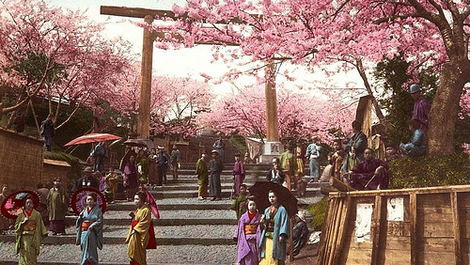
Strategic Marketing Plan
“Mount Fuji Hotel”
Environment
What is happening?
How does it affect us?
Customer Needs
What are they?
How can we satisfy them?
Market Segments
What are they?
Which do we target?
Competitive Positioning
  Who are they?
  How do we compare?
This Photo by Unknown author is licensed under CC BY-SA-NC.

Slide 8
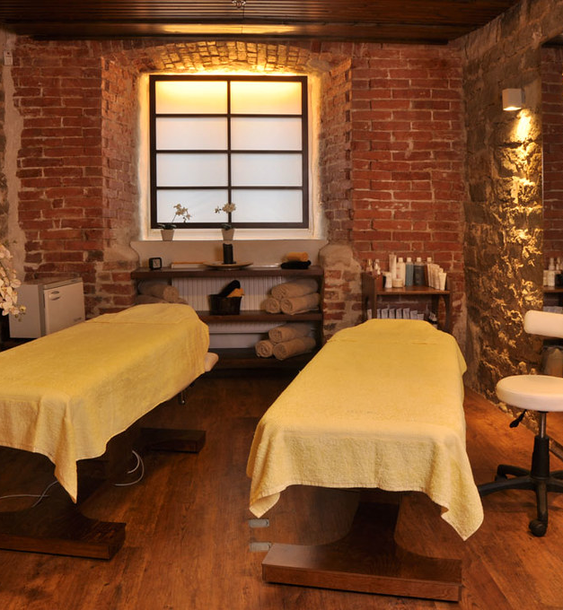
Environment
The environment of Japan is quite economically stable.
Political times changes in every 4 year.
The Hotel industry of Japan has increased amount of customer which is concerning. Japan is so concerned about the risking issue which comes under the health and safety legislation issue.
Technological factors do not have an powerful impact on the hotel industry.

Slide 9

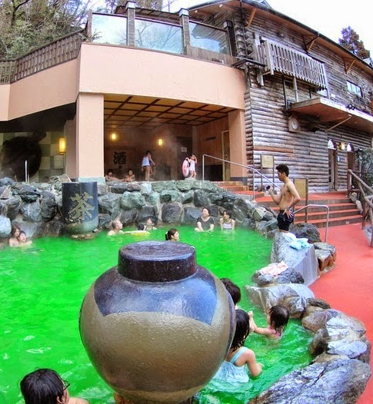
Customer Needs
The customer needs In Japan from a hotel Business are:
Weekend Spa Treatments
Backyard Barbeque
Hotels Own Golf Field
Medium Price Suits

Slide 10

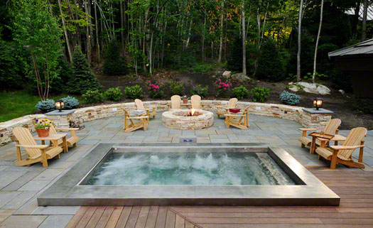
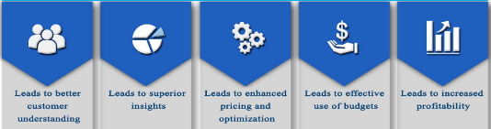
Market Segments
Demographic Businessman Families Tourists Market

Slide 11
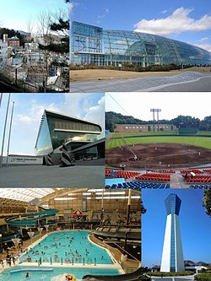
Competitive Positioning
High Service
Mount Fuji Hotel
Homewood Suites by Hilton Downtown
Hotel Ballard
Marriott Waterfront
Low Price
High Price
The Edgewater a Noble House Hotel
Kimpton Palladian Hotel
Low Service

Slide 12

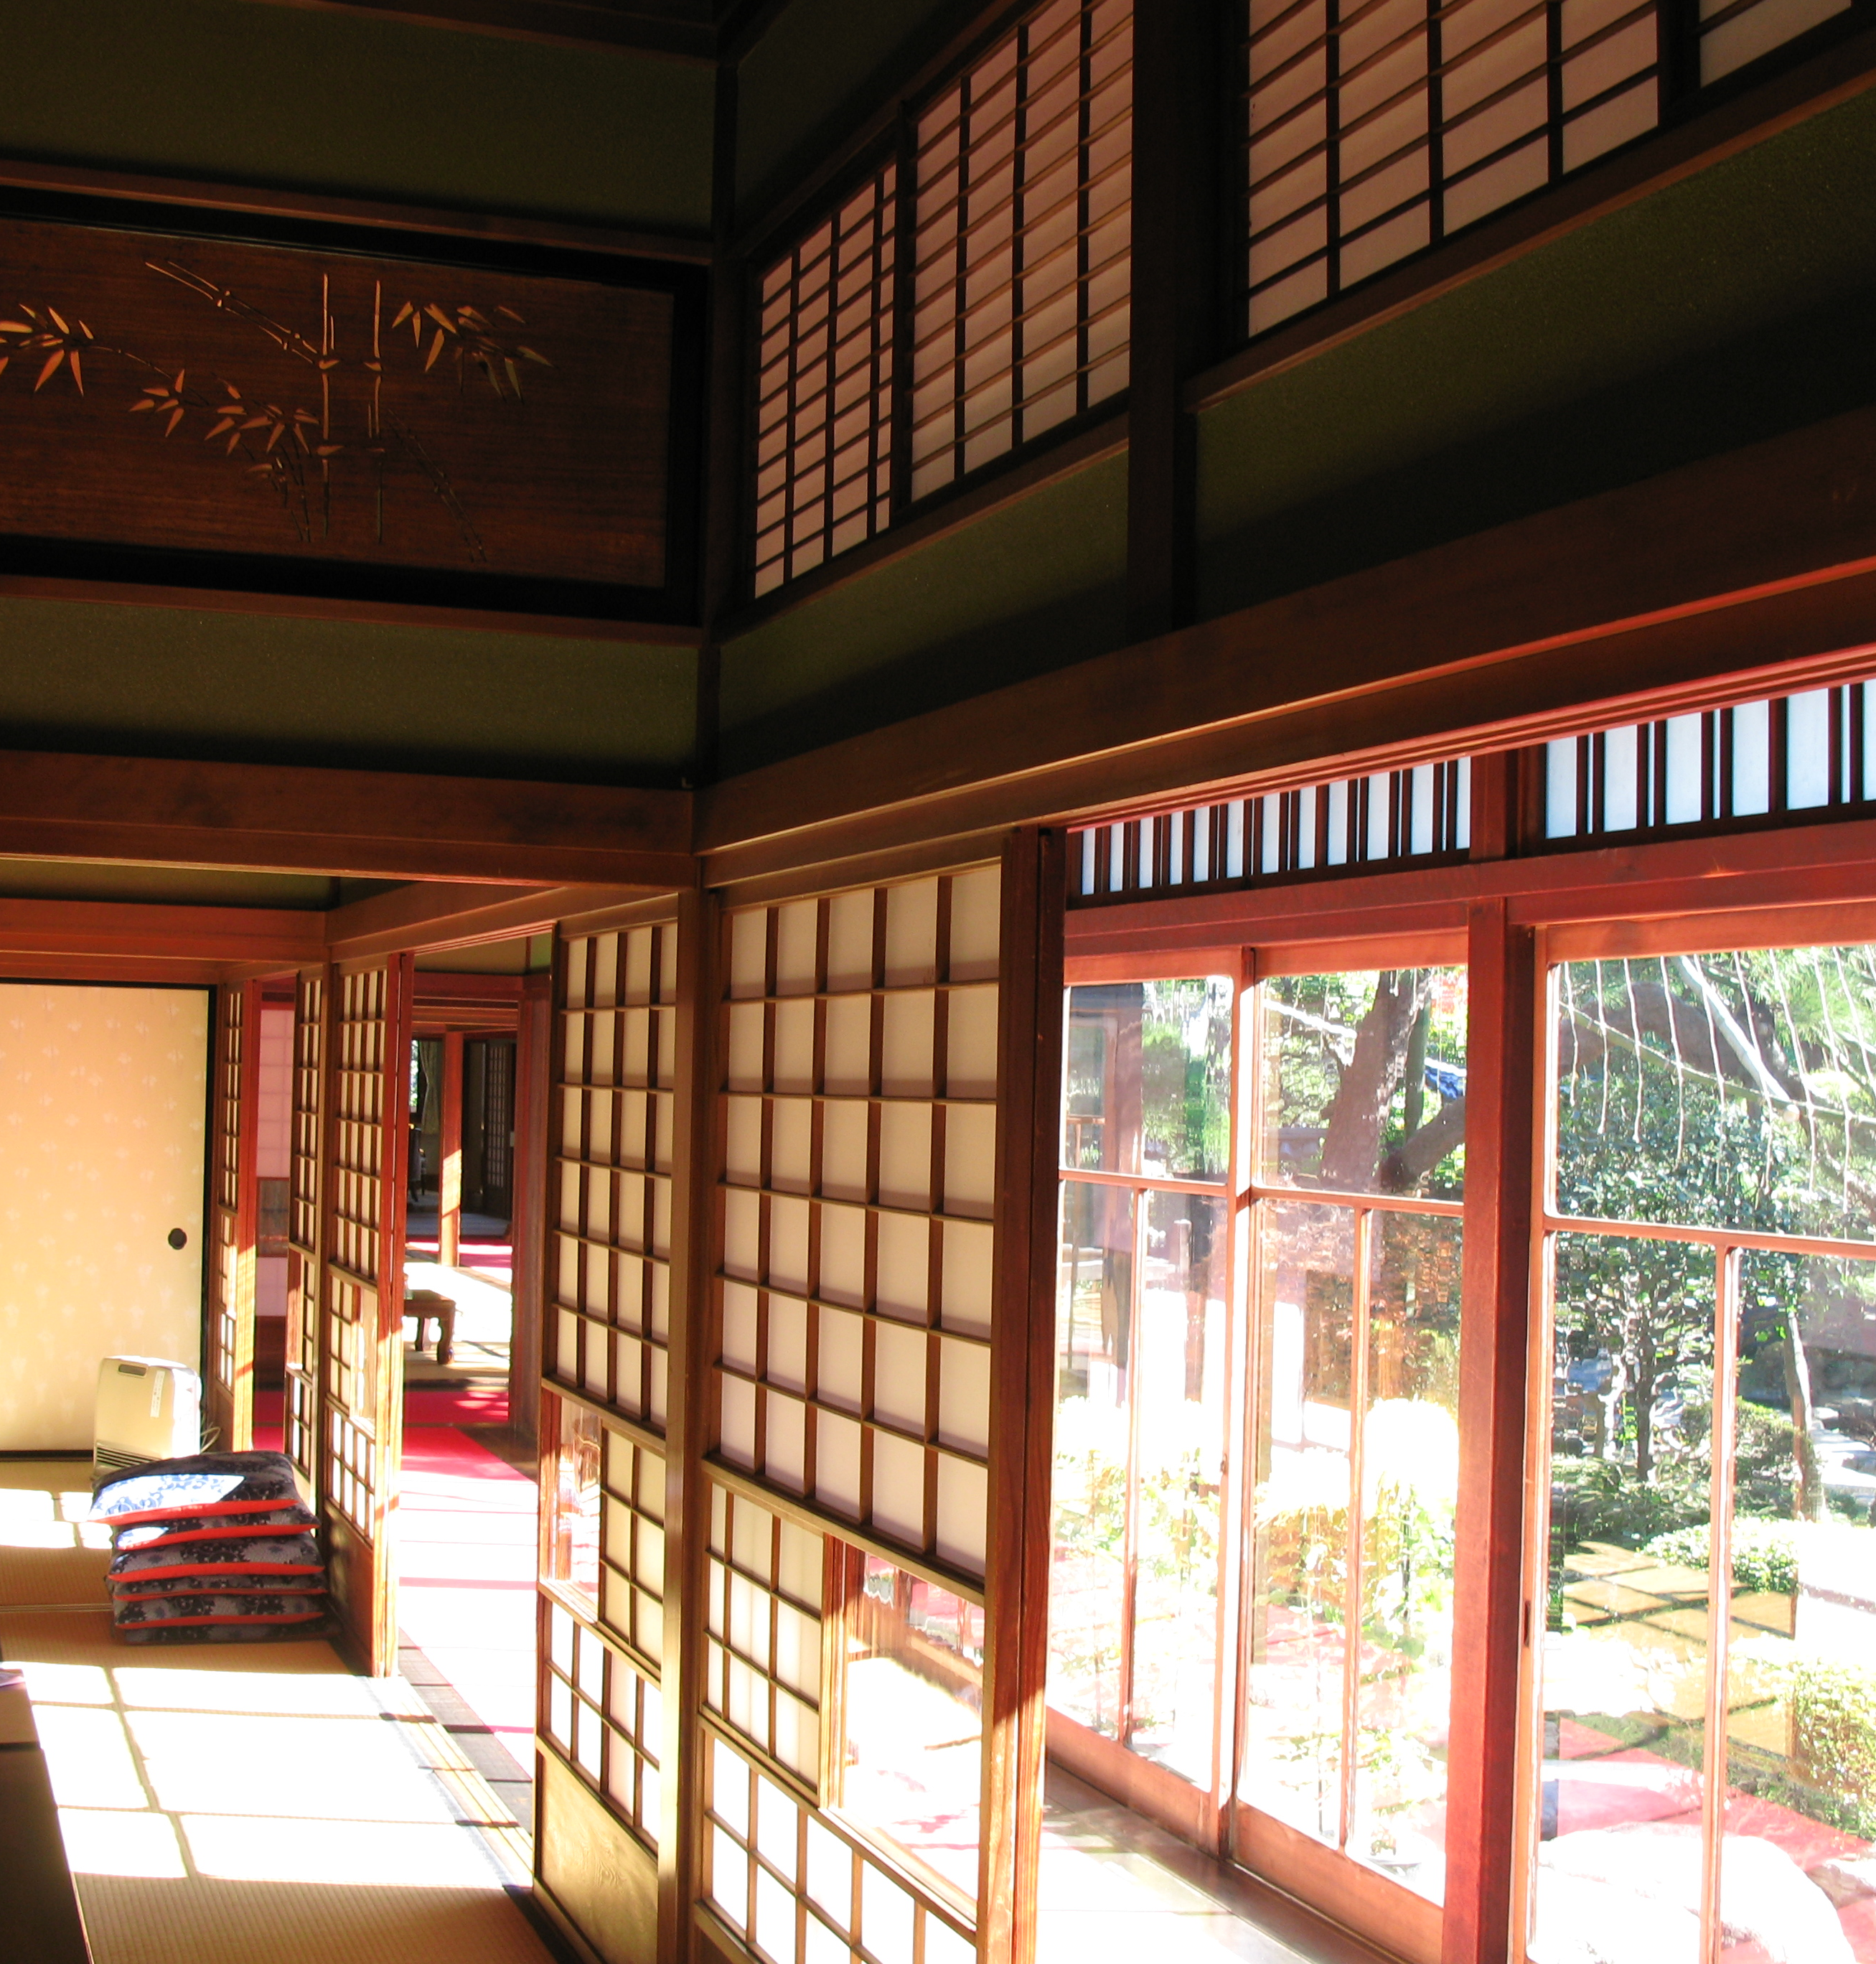
Strategic Marketing
Plan
“Mount Fuji Hotel”
Marketing Strategies
Product
Pricing
Promotion
Placing (distribution)

Slide 13
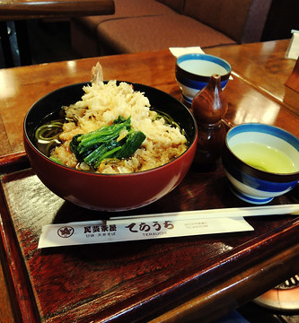
Product
Bistro and Restaurant
Pool
60 standard rooms,
20 'princely' suites and 20 family suites
Meeting room
Bar

Slide 14
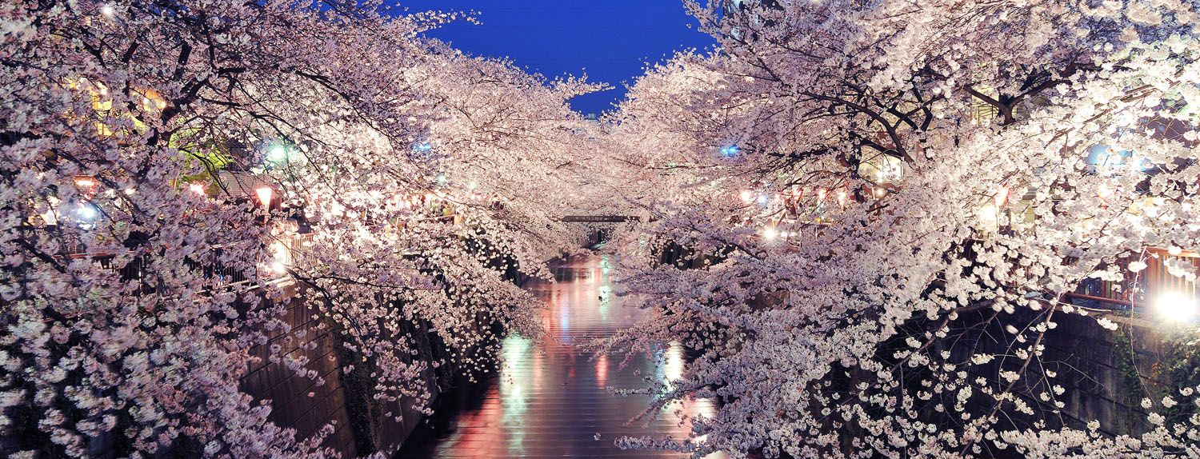
Pricing
included a price reduction
10% of purchaser buy on cost
(Proved ‘moderately successful’)

Slide 15
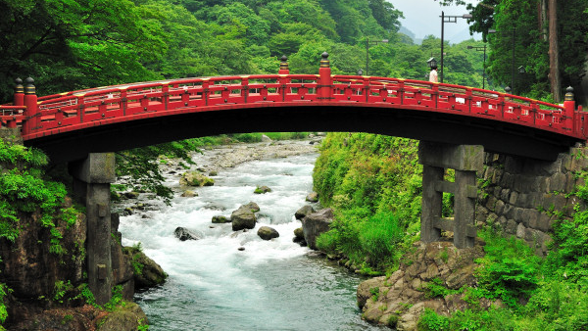
Promotion
Surrounding attractions in combination with customized trips on FUJI mountain reputation is a great marketing tools for tourists that enjoy playing golf. Several forms of promotions are made through online platforms and public relations.

Slide 16
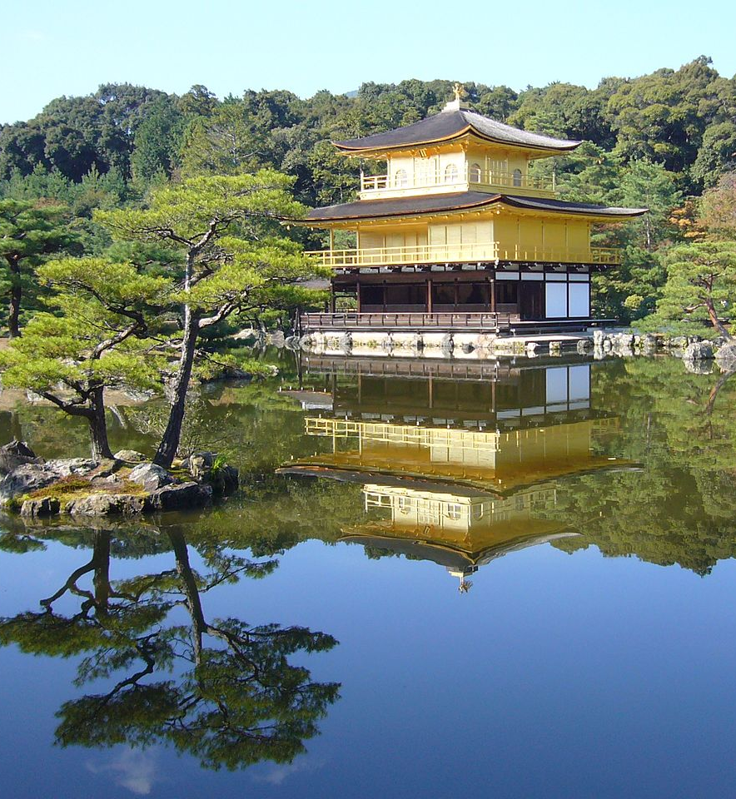
Process
Just night administration and institutionalized occasions do not offer adaptability for the representatives section nor assortment for the tourist segment.

Slide 17
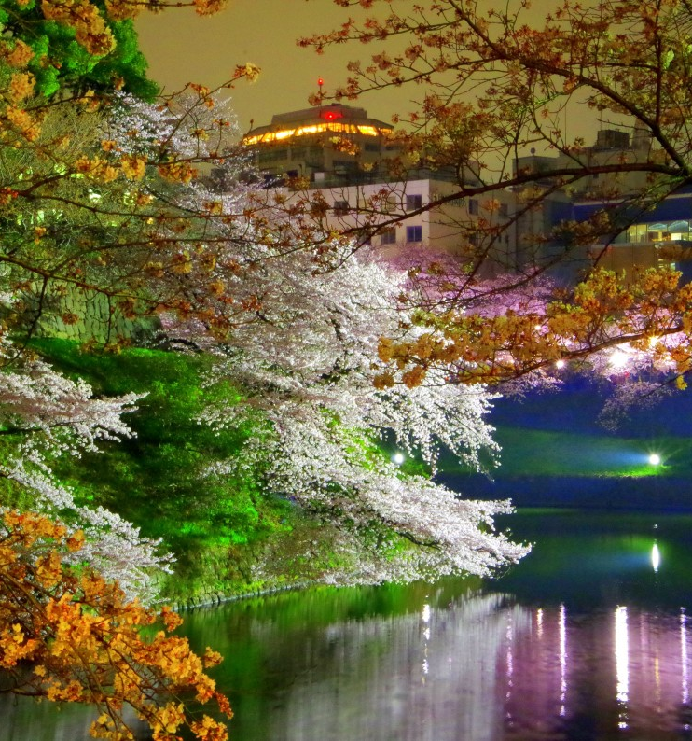
Placing
The location of the hotel strategically and may be effective as a selling tool. It facilitates International tourist activity and International business. For Japan tourists and businessmen the hotel is located near Pacific coast of central Honshu,(another plus).

Slide 18
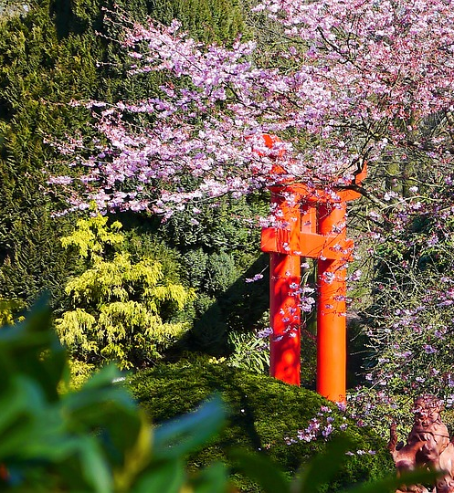
People and Physical Evidence
Permanent Staff and
Temporary Staff so that they create customer relationships.
Customary and worldwide menu which is valued by the nearby market, yet faulty for the International market. As patterns in the business demonstrate a tendency towards fusion cuisine this present element may influence the hotel.

Slide 19
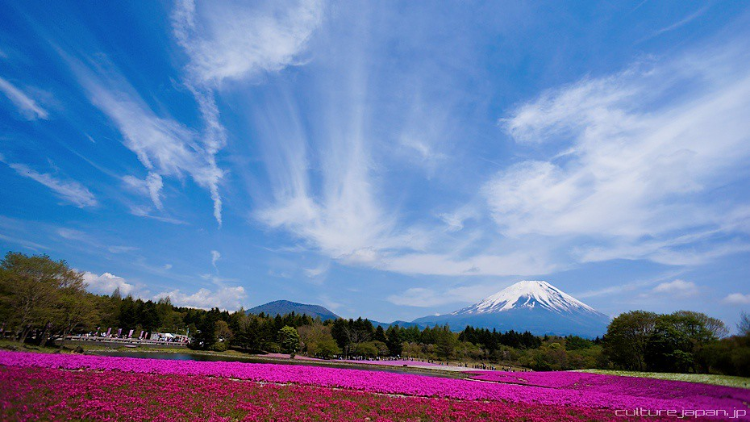
SWOT ANALYSIS
STRENGHTS: Continuous improvement and innovation Good employee retention Long history in hotel management expertise WEAKNESSES: High operating costs OPPORTUNITIES : Growing demands in some emerging economies Heightened awareness and interest in "green" tourism THREATS :Increased competition from existing competitors and new entries

Slide 20
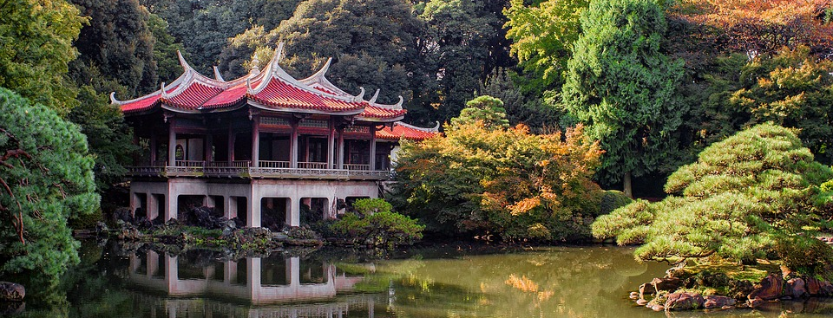

BCG Matrix
Star conference room, swimming pool, 40 bedrooms and conference rooms | Question Mark 20 family bedrooms,
Cash Cow Bar, bistro and a restaurant | Dog NO PRODUCT

Slide 21
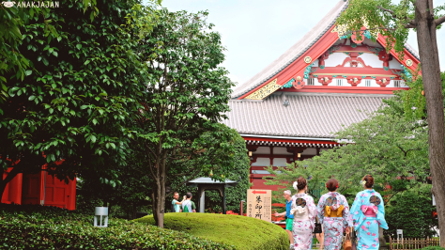
External Marketing Environment
“Mount Fuji Hotel”

Slide 22
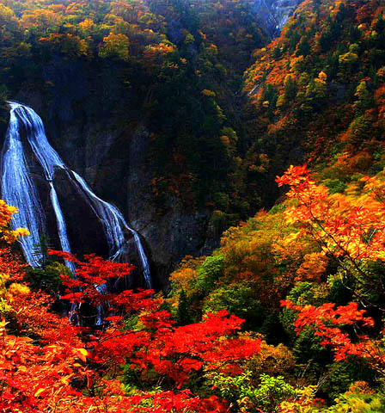
Who are your Customers?
Businessman
Families
Tourists Market
Who are your Competitors?
The Edgewater a Noble House Hotel
Marriott Waterfront
Homewood Suites by Hilton Downtown
Kimpson Palladian Hotel
Hotel Ballard
Who are your Collaborators?
Motif Seattle
Panama Hotel and Tea house
Hotel Sorrento

Slide 23
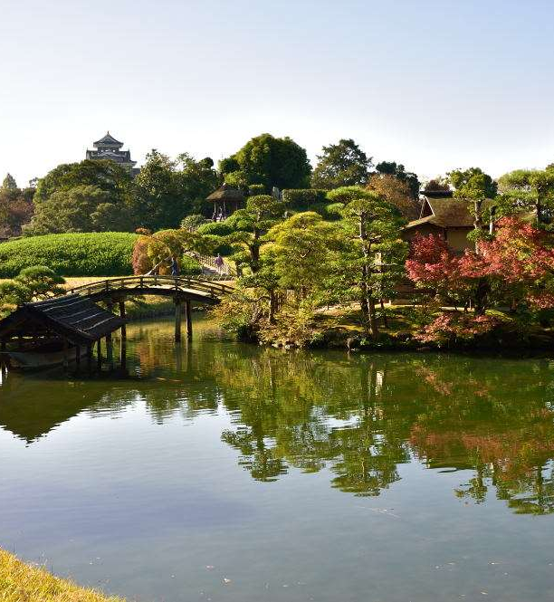
Internal Marketing Environment
“Mount Fuji Hotel”
Allocated Resources
People
Money
Tools
Time

Slide 24
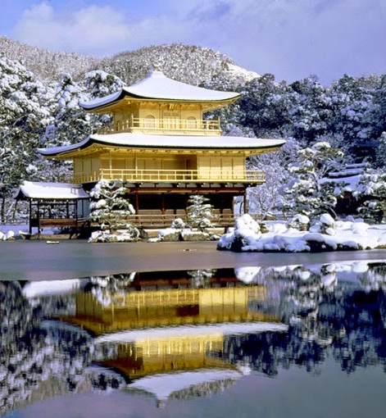
Marketing Strategy Review
“Mount Fuji Hotel”
Strategy:
Objectives
Marketing Mix

Slide 25
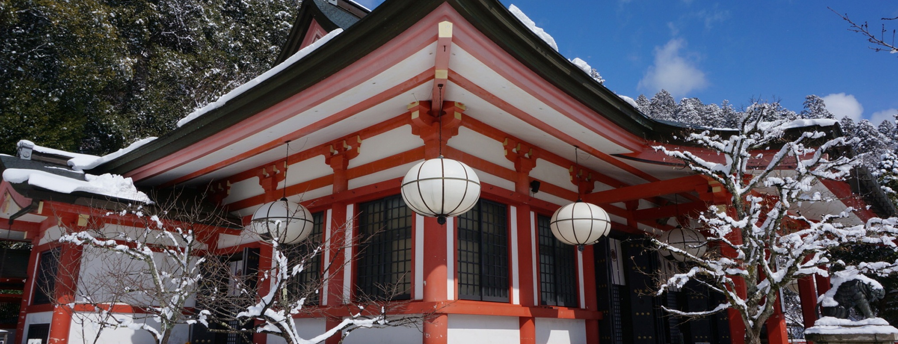
Objectives
Marketing objective
Increment organization deals by 25% by 2021
Accomplish a market share of 30% for Products inside 3 years of dispatch
Increment the level of clients who rate services as "magnificent" from 80% to 85% inside year and a halfIncrease company sales by 25% by 2021

Slide 26
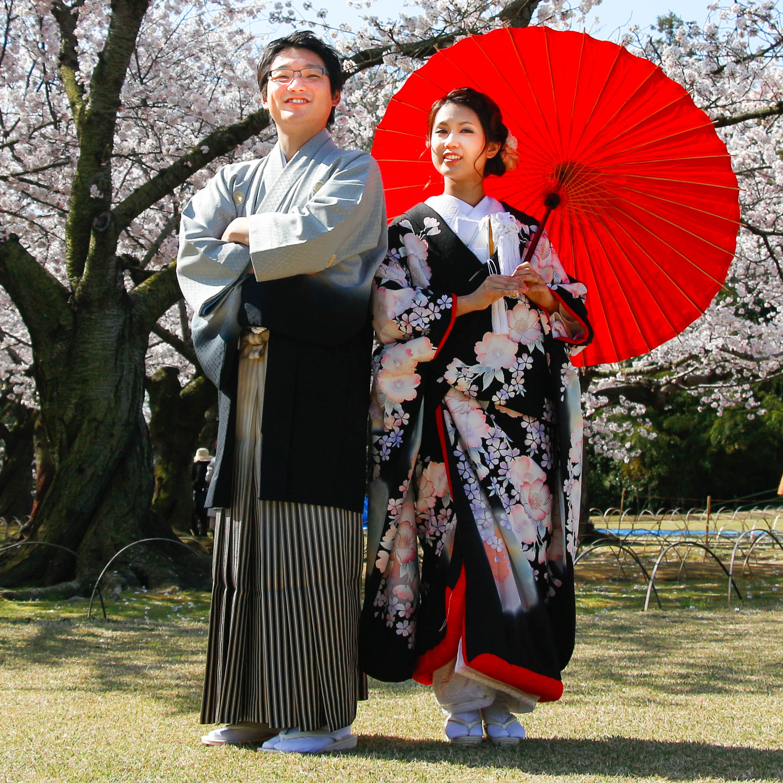
Objectives
Financial objective
Generate revenue of $100,000 in sales the first Year
Making the product price more competitive through lowering the cost in marketplace.
Using historical data and Future marketing campaigns
Profit projection and monitoring of all the target market.

Slide 27
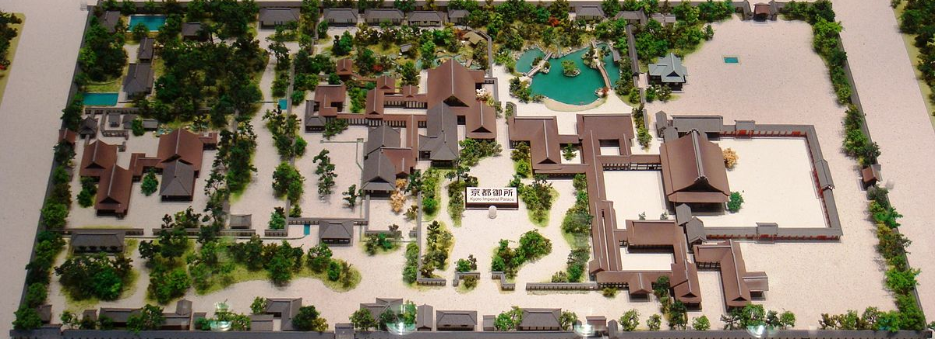
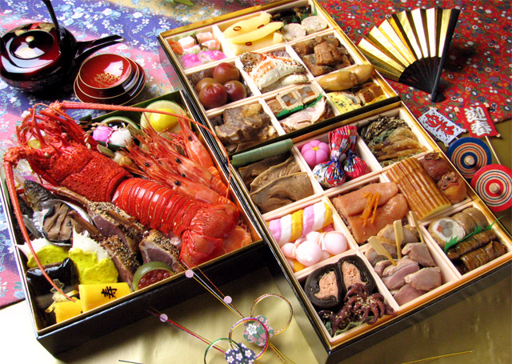
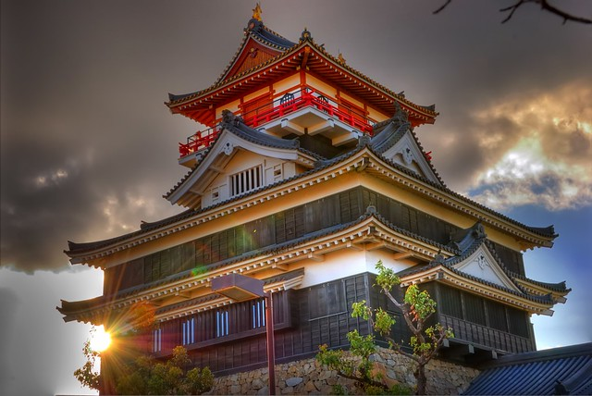
Conclusion
In conclusion, taking in consideration the favorable and stable economy of Japan, but bearing in mind also the precarious health and safety legislation under it`s tutelage, an investment towards opening a hotel in Japan can prove financially sustainable and even profitable under the right management.

Slide 28
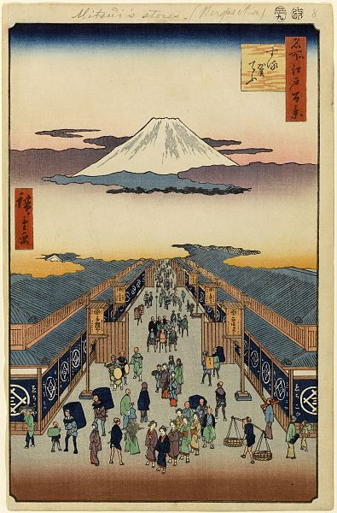
References
Dickson, P. R. & Ginter, J. L (1987), Market Segmentation, Product Differentiation, and Marketing Strategy. Journal of Marketing, Vol. 51 No. 2, pp. 1-10.
Kotler, P., Armstrong, G., Harris, L., & Piercy, N. (2017), Principles of Marketing, (7 th ed.) European Edition, Pearson.
Lee, K., & Carter, S., (2012), Global Marketing Management, (3 rd ed.), Oxford University Press.
McDonald, M & Wilson, H. (2011), Marketing Plans, How to Prepare Them, How to Use Them (7 th ed.), Essex: Wiley.
West, D., Fords, J. & Ibrahim, E. (2015), Strategic Marketing, How to Create Competitive Advantage (3 rd ed.) Italy: Oxford University Press.

