Slide 1
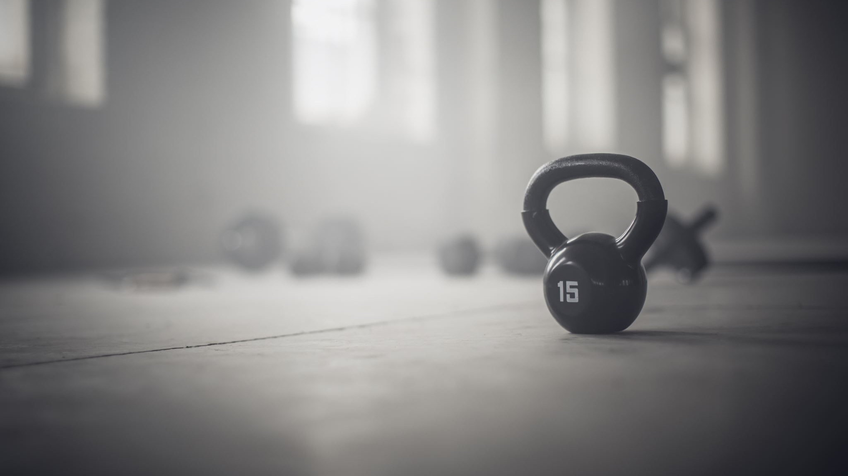
Is fitness important for 7–11-year-olds?
Small task write 3 bullet points on what fitness means to you?

Slide 2
what are the physical health benefits for our children? health board gives 1.5k in grants this would help massively with equipment
Short-Term Benefits
More energy & fitness
Stronger muscles & bones
Better mood & confidence
Improved focus in school
Better sleep
Long-Term Benefits
Healthier weight ️
Reduces risk of Type 2 Diabetes
Stronger heart health ️
Lowers risk of cardiovascular disease
Lifelong healthy habits
Reduced risk of chronic illness
Based on the National Health Service guidelines

Slide 3
Can fitness help lower youth crime rate in your area?
Youth crime in Swansea varies in 2022-2023 youth offences rose 7 percent serious-offences proceeding up to 11 percent. According to youth Swansea.
Sports programmes reduces youth crime in the UK up to 66% and reoffending rates decreased (Collage Of Policing)
Sports interventions can lead to reduced aggressive behaviour
Builds discipline, teamwork, confidence, and emotional control
Provides positive role models through coaches and youth leaders
Improves mental and isolation
Encourages positive goals and achievements instead of risky behaviour

Slide 4
Ysgol Bae Baglan community school facility
The benefits are
Studies show a direct link between fitness and a higher score on maths and englush tests
Healthier and active children have better school attendance
Fitness Improves memory and the ability to stay on task (youth sport trust)
So, I am not asking for money to support the programme just the facility for free or a lower rate due to this being a non-profitable program look at the benefits we can do for you and the local youth.

Slide 5
What would the sessions look like
Sessions will be an hour long
It would consist of biomatrix type workouts. With interval running and strength and conditioning
Part 1 could be completed in pairs or individually, for example 30 burpees, 3 lap run, 20 push ups.
Part 2 would be weight-based training, for example farmers carry, thrusters, shoulder press, goblin squats and bicep curls.
Part 3 is the final stage where we would do a group activity, such as tug of war, stuck in the mud to keep the kids engaged in a fun activity.

Slide 6
Target audience
Local football teams
Local rugby teams
People who just want to came and social with other kids
School sport teams who want extra fitness sessions
At that age kids can't access gym equipment till there 16 so by doing this gives them a headstart on how it works making it more of a chance of them being more active when they are older
I would promote this being going to local sports teams asking them to put it on their page same with schools put it on facebook so parents would see it.

Slide 7
More grants
Grant | What It Funds | Typical Amount
Be Active Wales Fund | Sports equipment, coaching, venue hire, youth fitness projects | £300–£50,000
Swansea COAST Winter Wellbeing Grant | Free or low-cost holiday fitness and wellbeing activities for children and families | Usually small–medium community grants
Summer of Fun Grants Swansea | Sports and activity programmes for children and young people during summer holidays | Up to £10,000
Welsh Government Community Facilities Programme | Community gyms, sports spaces, building improvements, equipment

Slide 8
How will we know if this is working
By keeping track of numbers offering rewards for full attendance to keep them coming and engaged.
Outreach work by going to local parks to promote offering a free session for first timers
now we have discussed fitness can you add another 3 points to your list and see the difference.

