Slide 1
Problem Solving and Decision Making (BMSW4004_BIRM)
Ionut Petrisor Magareata
Student Ref. 2131113
Module Coordinator: Dr Chijioke D Uba

Slide 2

Task 1
As customers worked from home, the sales rate declined. Meaning they should slow down the production as well.
How does it affect the employees?
-they have less working hours
-some of them will be losing their job, as the company doesn’t need as many
-their salary might be decreasing

Slide 3



PESTLE Analysis of T M Lewin
The constant regional economic recession has frightened the environment which T M Lewin operates in. The recession has been stopping the customer from buying.
Recent market research has shown that customers don’t need to buy shirts anymore, as they are only working from home. T M Lewin has been trying to include discounts and at home deliveries to be able to resist this period.

Slide 4
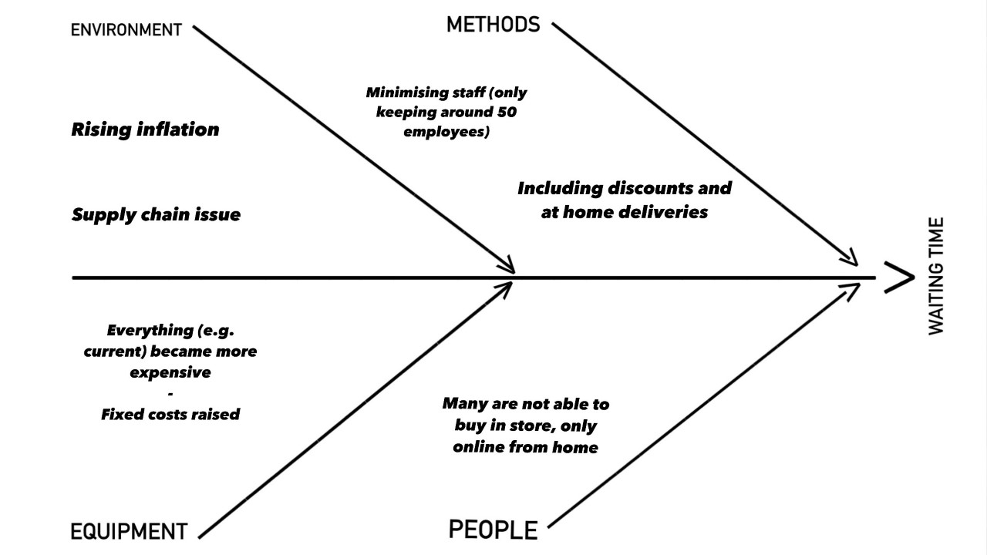
The fishbone diagram for T M Lewis

Slide 5

Alternative Solutions
-slow down production
-include discounts
-include at home deliveries
-minimising staff

