Slide 1

Physical education is considered important for a child's physical literacy and long-term health and well-being.
How utilizing a range of teaching styles and models may assist a teacher in supporting young people's literacy and overall health and well-being.

Slide 2
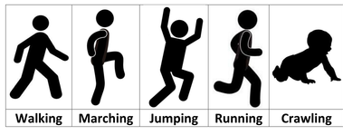
what is a teaching style?
Demonstrate mobility ability (different situations = different movements -
Experiences created by various teaching styles that teachers use by making the experiences challenging and beneficial.
Accomplish the roles and functions of physical education
Bolali (2014)

Slide 3
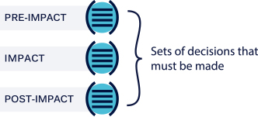
Anatomy of teaching style
Pre impact- Planning before each lesson
Impact – Decisions that implement what was planned before the session.
Post impact- Analyzing and evaluating the entire session.
Spectrum of teaching styles (2019)

Slide 4
Correct or acceptable way to perform the task
Teaching styles Separated in to two
Reproduction styles-A-E
Production styles- F-K
Feedback is specific
Reproduction styles – A-E
Solving problems
Feedback- Produce new ideas
Direct instruction
Teacher centred
Production styles – F-K
New information- Learner
Ideas- New to the teacher

Slide 5
Teaching styles
Command style – Learner responds immediately to the task provided by the teacher.
Practice style- Learner practices the task that's been provided by the teacher.
Reciprocal style- learner's work together in pairs, take turns to observe each other.
Self-check style - Learner's evaluate their own learning by comparing their performance against a self-check performance criteria.
Inclusion style- Learner is provided with tasks with different set levels of difficulty- Learner's decision
Guided discovery style- Learner's set with questions that need to be solved to discover the solution.
Divergent problem-solving style- Learner provided with questions that need to be answered to discover many solutions.
Individual programmed learner design style- Learner or learners create a unique learning programme, teacher's assistance required if needed.
Based on Mosston and Ashworth (1986) Teaching physical Education.

Slide 6
What does each style focus on?
Teaching style | Focus
Command | Motor development
Practice | Motor development and autonomy
Reciprocal | Cognitive, social and motor
Self-check | Motor and cognitive
Inclusion | Differentiation, motor and cognitive
Guided discovery | Cognitive and motor development
Divergent problem solving | Independent thinking, social, teamwork
Individual programmed design | Planning and cognitive
Learner initiated | Responsibility, social and personal
Self-check | Social and cognitive

Slide 7
Welsh National Curriculum (2008)
"In order to extend their learning, learners should experience a variety of learning and teaching styles."(WAG, 2008).
"Schools should use material in ways suitable for the learners’ age, experience, understanding and prior achievement to engage them in the learning process." (WAG, 2008).
"For more-able and talented learners working at higher levels, schools should provide greater challenge by using material in ways that extend breadth and depth of study and opportunities for independent learning." (WAG, 2008).
As learners progress and develop a range of teaching styles can be introduced to the learners to experience different ways things can be done.

Slide 8
Outcomes of different styles being used
Learner's preferred certain styles for specific activities
Command style - Karate class
Inclusion style - Racquetball
Self-check and divergent style – fitness classes
Guided discovery style - gymnastics
Results found by Chatoupis (2009)
Chatoupis, C. ( 2009). Contributions of the spectrum of teaching styles to research on teaching.

Slide 9
Importance of using a range of teaching styles?
Each style has its own benefits
Students needs are met
Different styles can be used to challenge and set goals for learners
Teachers can expect benefits for themselves
Learner's experience different ways activities can be done
Activities are student led or teacher led (opportunity to explore)
Mosston and Ashworth spectrum of teaching styles (2002).

Slide 10
Implications of teaching in different styles
Command style- Power to control behavior
Practice style- Could only be effective for learning basic motor skills
Reciprocal style- Can sometimes only have a positive effect on some social development
Self-check and inclusion styles- The emotional development in not clear.
How is there implications?
Teachers could only teach in one style
Lack of control
Lack of understanding
Insufficent time to conduct tasks
Time between each session- interest lost and no effect

Slide 11
What is a pedagogical model?
Can identify learning outcomes and how they can be achieved through teaching strategies
What does it offer?
Contribute to educational benefits
Provides benefits across different domains

Slide 12
Pedagogical models
These are the teaching models
Teaching games for understanding -(TGFU; Bunker and Thorpe, 1989).
Cooperative learning -(Dyson and Casey, 2012)
Sport education- (Siedentop, 1995)
Games making- (Casey, Hastie and Rovegno, 2010)

Slide 13
Teaching games for understanding model
Learner and game centred apporach
Concentrates on develping learner's abilities in game situations
Learner's develop technique development and tactics of games
Empashizes on reducing the technical demands of the game
Modified games (Thorpe, 1990)

Slide 14
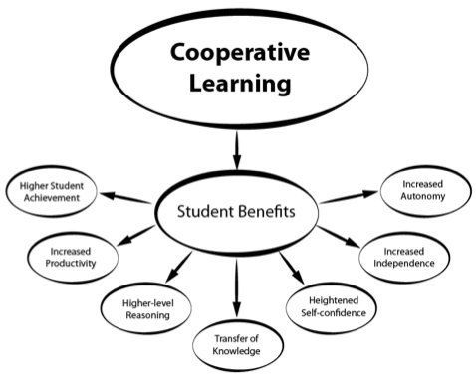
Co-operative learning – Instructional model
Improved academic achievement
Developemnt of social skills
Covers a lot of areas- disabilities
Learner's work together to get the task done
Edcation theory and practice (2016)

Slide 15
Sport education model
Provides learners with sporting experiences
Learn other aspects of sport not just the physical side of it
Learners can take responsibility- more self-directed and not teacher led
Encourages learners to stay active through childhood into adulthood
Different roles can be attempted
Siedentop, (1994)

Slide 16
Teaching games model
Learning in this model occours through;
Self disocovery
Interaction
Exploration
Usually group centred tasks
Different outcome each time due to learner's differences in term of learning improvement

Slide 17
Conclusion
By including each teaching style and using them to explore how they work in different teaching models, you have the best chance to improve a learner as a whole and contribute to providing them with a range of knowledge and understanding to develop their physical literacy journey.
Learners could enjoy taking part in physical activity if they enjoy doing different sporting activtities using different teaching styles.
Encourages learners to part take in physical acitivty. Provides knowledge on how physical activtiy can contribute to 4 different domains and not just the physical side of it.
Improvments can be seen from using different styles in specific activties. A certain teaching style might not work aas good as another teaching style in a specific activtity. It will show in the learner's improvement.

Slide 18
Resources
Welsh assembly government (2008)., Wales National Curriculum for Physical Education: Key stage 1-4. Document available at https://hwb.gov.wales/curriculum-for-wales-2008/key-stages-2-to-4/physical-education-in-the-national-curriculum-for-wales (Acsessed on 11th of January 2020).

Slide 19
References
Chatoupis, C. ( 2009). Contributions of the spectrum of teaching styles to research on teaching. Studies in physical culture and tourism. Pp 1-13.
Dyson, B., and Casey, A. (2012). Cooperative learning in physical Education. Routledge studies.
Hardy, C.A., and Mawer, M. (1999). Learning and teaching in physical education. Taylor and Francis e-library.
Kirk, D. (2013). Educational value and models based practice in physical education. Educational philosophy and theory.
Kirk, D., and Macphail, A. (2002). Teaching games for understanding and situated learning : Rethinking the bunker- Thorpe model. Journal of teaching in Physical Education, Human kinetics. Pp 177-192.
Mosston, M., Ashworth,S.(2008). Teaching physical education. First online edition.
Perlman, D. (2010). Change in Affect and needs satisfaction for amotivated students within the sport educational model. Journal of teaching in physical education. Pp 433-445
Vidoni, C., and Andre M. (2019). Fifth graders social interactions in a student designed games unit. Early child development and care. Pp 1-11.

