Slide 1


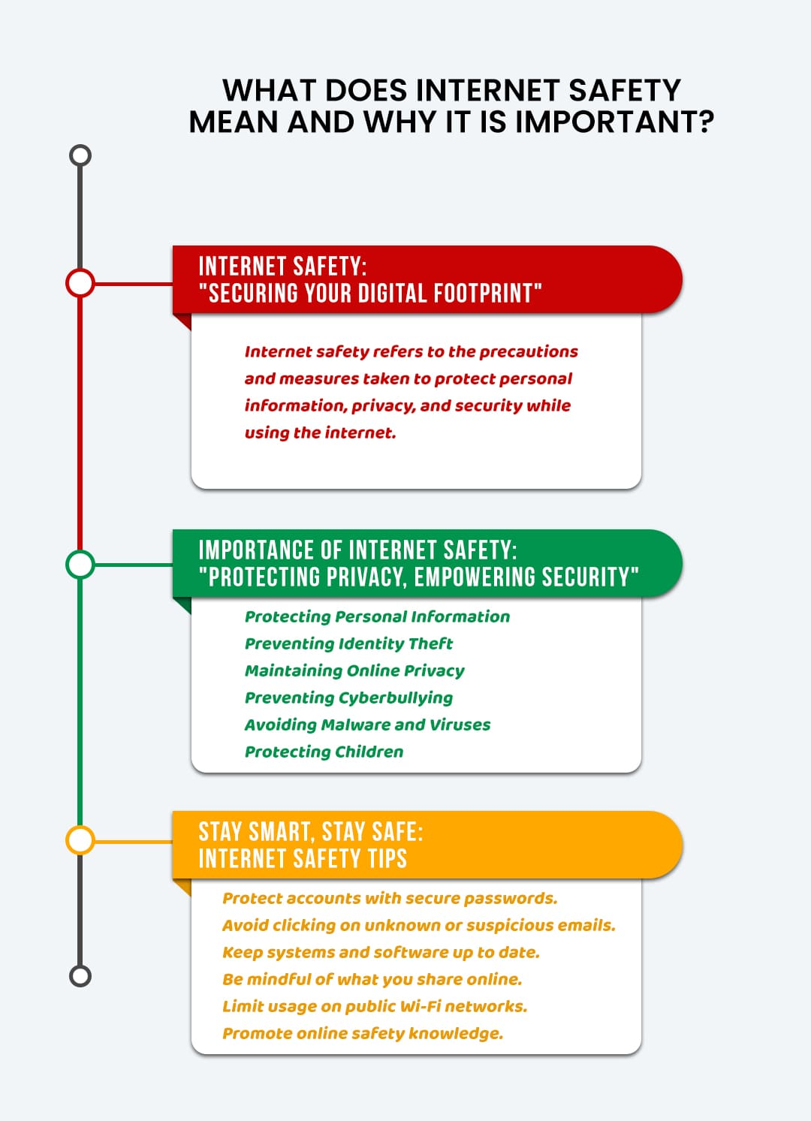
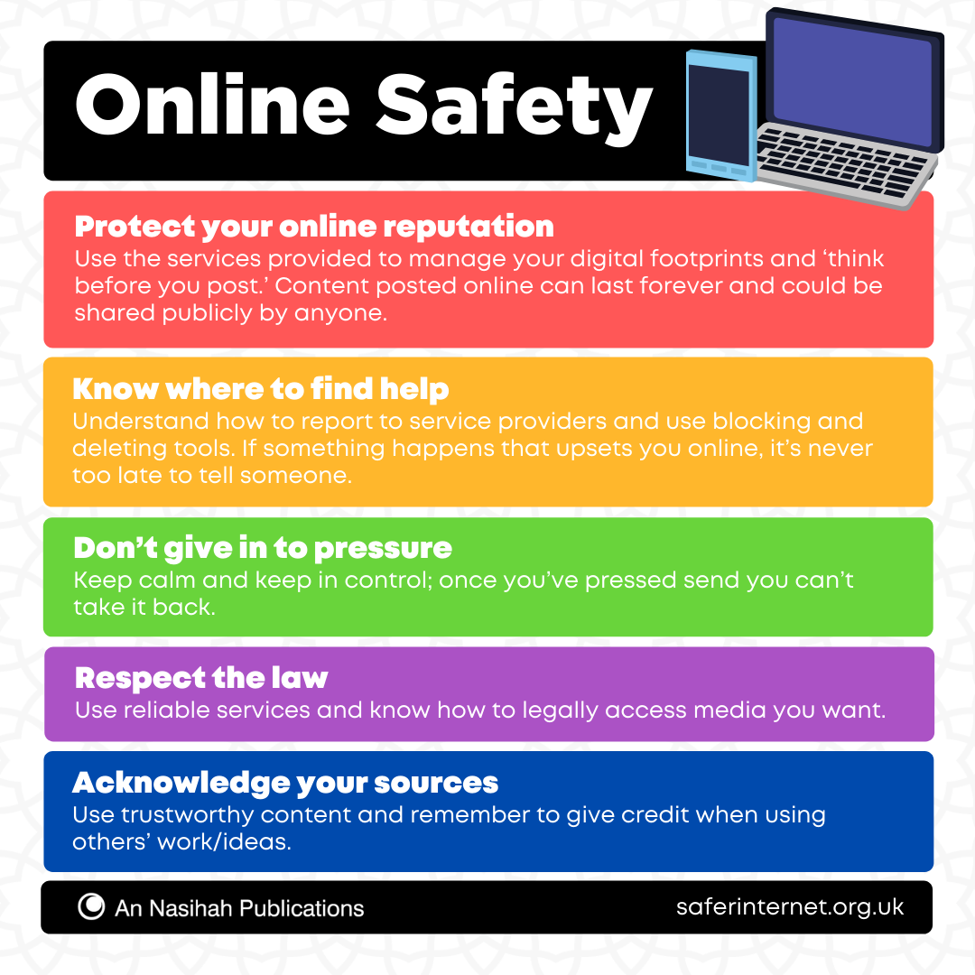
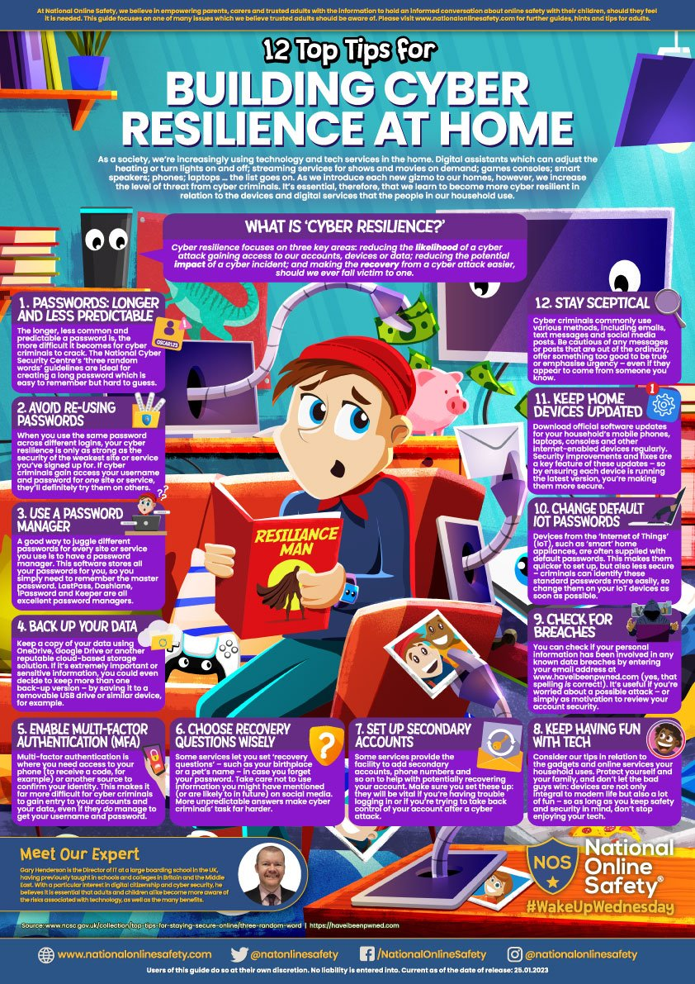
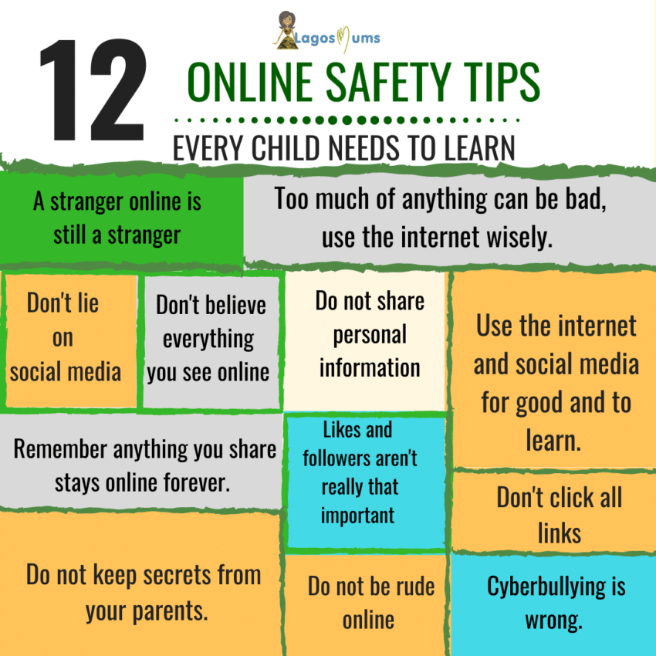
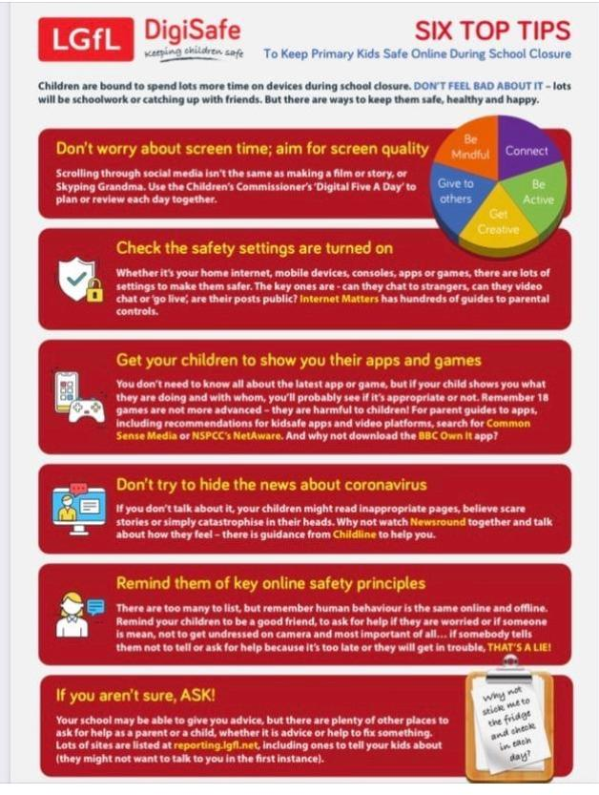
Basic digital safety
Ken prince(2326288)
Safety at home
SAFETY AT HOME
Safety AT public place
SAFETYAT PUBLIC PLACE
SA
Safety at work
SAFETY AT WORK

Slide 2
LCLM4002 – DIGITAL SKILLS AND RESEARCH METHODS
ASSIGNMENT 1 TASK 2 – INFORMATIVE POSTER INDIVIDUAL PRESENTATION
Student Name: Ken Prince
Lecturer Name: Fernando Suneth
Cert He Business Skills Level 4

Slide 3
LCLM4002 – DIGITAL SKILLS AND RESEARCH METHODS
Assignment 1 Task 2 – Informative Poster Individual presentation
Student Name: ken prince (2326288)
Lecturer: Fernando Suneth

