Slide 1

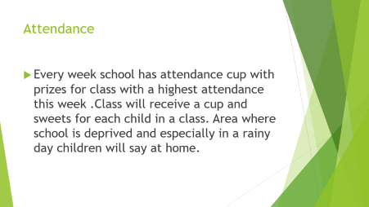


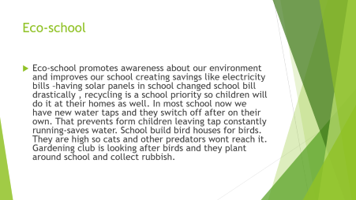
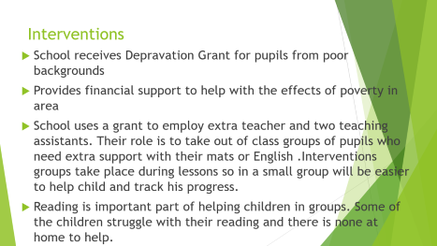
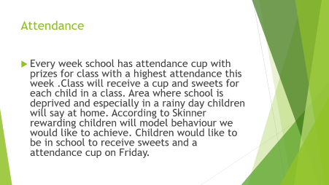


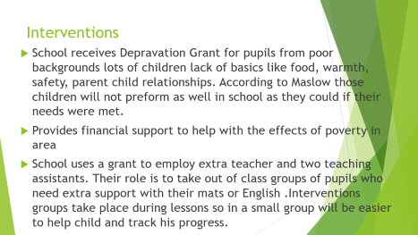
The hidden curriculum involves all the incidental lessons that students learn at school. It is sometimes called the ‘unofficial curriculum’ – and includes the lessons about behaviour, personal relationships, the use of power and authority, competition, sources of motivation and so on that students learn at school.
These lessons can be either positive or negative in terms of promoting a sustainable future.(http://www.unesco.org/education/tlsf/mods/theme_a/popups/mod05t01s01.html)

Slide 2
Eco-school
Eco-school promotes awareness about our environment and improves our school creating savings like electricity bills –having solar panels in school changed school bill drastically , recycling is a school priority so children will do it at their homes as well. In most school now we have new water taps and they switch off after on their own. That prevents form children leaving tap constantly running-saves water. School build bird houses for birds. They are high so cats and other predators wont reach it. Gardening club is looking after birds and they plant around school and collect rubbish.

Slide 3
Classes for Parents
School provides range of different classes for parents of pupils. From sewing classes, home work club, reading club, lean English for families with different home language, Welsh classes etc. Teachers and staff are always willing to help and put extra time for children who straggle and their parents. Many times parents can’t cope with their children's home work and their behaviour so our home work club will the strain of them so time after school will be more enjoyable.

Slide 4
Erasmus
The friends and memories last a lifetime. The Erasmus exchange program is one of the greatest culture and character building programs that you can have in your whole life. This directory is designed to help you explore your potential Erasmus destinations and be informed before you go.

Slide 5
Attendance
Every week school has attendance cup with prizes for class with a highest attendance this week .Class will receive a cup and sweets for each child in a class. Area where school is deprived and especially in a rainy day children will say at home. According to Skinner rewarding children will model behaviour we would like to achieve. Children would like to be in school to receive sweets and a attendance cup on Friday.

Slide 6
Interventions
School receives Depravation Grant for pupils from poor backgrounds lots of children lack of basics like food, warmth, safety, parent child relationships. According to Maslow those children will not preform as well in school as they could if their needs were met.
Provides financial support to help with the effects of poverty in area
School uses a grant to employ extra teacher and two teaching assistants. Their role is to take out of class groups of pupils who need extra support with their mats or English .Interventions groups take place during lessons so in a small group will be easier to help child and track his progress.
Reading is important part of helping children in groups. Some of the children struggle with their reading and there is none at home to help.

Slide 7
Interventions
As well as
Uniform
Religious believes
Gender
Values
Hard work
School rules

Slide 8
References
School “A”
http://www.unesco.org/education/tlsf/mods/theme_a/popups/mod05t01s01.html

