Slide 1
Week 4
From Brief to First Class Posters
LCLM5003 Project Proposal Feedback

Slide 2
Learning Objectives:
After completion of this session, you should be able to:
Understanding the assessment brief
Understand what markers look for
How to improve critical depth
Be able to design posters
Understand critical Reflection
Live feedback and action planning

Slide 3
Understanding the Assessment Brief
Difference between description and analysis
Part A vs Part B focus
Common student misunderstandings
Importance of scope and justification

Slide 4
Mapping Marking Criteria to Poster
Knowledge & Understanding → Context & Scope
Cognitive Skills → Risks, Trade-offs
Practical Skills → Methodology
Transferable Skills → Design & Clarity

Slide 5
What First-Class Posters Do Differently
Analytical language (therefore, however)
Strategic trade-offs
Long-term value focus
Clear theory application

Slide 6
Poster Design That Gets Marks
Clear colour coding
Limited text per section
Readable from 1 metre
Logical flow

Slide 7
Academic Writing for Posters
Concise sentences
Evaluative verbs
Avoid storytelling
Focus on decision rationale

Slide 8
Referencing & Academic Integrity
Harvard style
5–8 key sources
Place references in one panel
Accuracy matters

Slide 9
Peer Review Activity
Review posters using:
1. One strength
2. One area to deepen analysis
3. One suggestion to improve marks

Slide 10
Action Plan & Final Tips
• Identify 3 improvements
• Fix 1 major weakness
• Keep 1 strong feature
Strong posters show judgement, not volume.

Slide 11

Short Break
10 mins
Break time

Slide 12
Reflection: Overview
What is Reflection
A model to develop a critical reflection

Slide 13
What is Reflection
The way that we learn from an experience in order to understand and develop practice - (Jasper, 2003)
“a tool to help gain a deeper understanding of something that has happened, and it also helps to gain new perspectives” by deliberately thinking about an experience to learn from it and improve future actions.
This definition is based on Gibbs’ (1988) experiential learning model, which emphasizes that learning occurs through thoughtful analysis of past experiences

Slide 14
Why Reflect?
It is not sufficient simply to have an experience in order to learn. Without reflecting upon this experience, it may quickly be forgotten, or its learning potential lost. It is from the feelings and thoughts emerging from this reflection that generalisations or concepts can be generated. And it is generalisations that allow new situations to be tackled effectively - (Gibbs, 1988)
Learning requires reflection—without it, experiences may be forgotten or lose their educational value.
Reflection generates concepts that help apply past learning to new situations effectively.

Slide 15
From an Academic point of view
Reflection involves
Making connections –
between what you already know and what you are learning
between theory and practice
between what you are doing and how and why you do it.
Become an active and aware learner
become more engaged,
take responsibility for your own learning and
understand how you learn best

Slide 16
Types of Reflective Writing
Informal
Diary entries
Blogs
Formal (critical)
Reflection on Learning experience
Reflections on practice
Portfolios
Placement reports

Slide 17
Models for Critical Reflection
Critical reflection usually contains:
  Description (What?)
  Analysis and evaluation (Why? So what)
  Conclusion (e.g. Now what?)
What?
So what?
Now what?
(Borton, 1970)

Slide 18
Step One – Identify Aspects to Reflect on:
What happened?
This could be one or several texts, ideas or activities that are outstanding or meaningful in some way e.g. a particularly challenging or rewarding seminar interaction; a research article, event or case study that had an impact on your thinking or helped you learn something new
For greater depth, focus on one specific aspect or point of a more comprehensive event or issue
Describe the context, and your initial response

Slide 19
Step Two– Analyse the Experience:
So what?
So what is the impact/importance of this?
Consider the significance of the situation or issue from a variety of perspectives:
  What was positive about it? What was negative?
  How did this challenge your views, or help develop your knowledge or skills?
So what other information/theories/models/literature can you use to help understand the situation or issue?

Slide 20
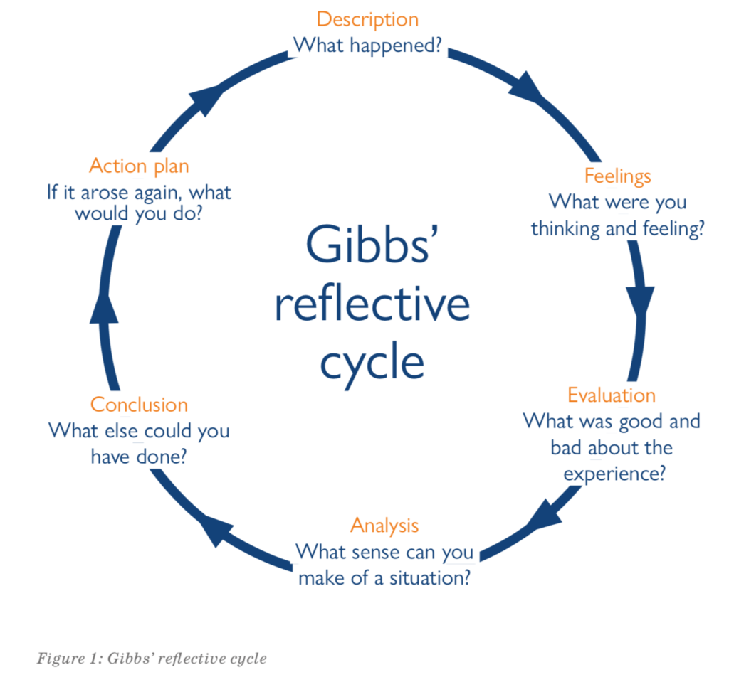
Gibbs’ Reflective Cycle Explained
Gibbs' Reflective Cycle is a well-established theoretical model that facilitates structured reflection, often applied in contexts such as experiential learning, professional development, and self-improvement. The model guides individuals through a systematic process of reflection, helping them critically evaluate their experiences.
This cycle is particularly valuable in educational, healthcare, and professional development environments, where continuous learning and growth are essential. It provides a structured approach to analyzing both successes and challenges, enabling individuals to identify areas for improvement and enhance their overall performance or behavior over time.
By encouraging critical self-reflection, Gibbs’ Reflective Cycle fosters ongoing personal and professional development, supporting individuals in making informed decisions and enhancing their effectiveness in various contexts.
Notes:
PEEL model can be explained

Slide 21
Sources of evidence for your reflections
Yourself as an individual. What you think, what you know and how you feel
Your experience(s). These can be from seminars and lectures on the module, your broader study and/or work.
Your reading: theory, empirical research, statistics, business case studies etc. Focus on how this relates to practice/the concrete issue that you chose to reflect on.

Slide 22
Linking theory to practice/experience
CE (Concrete experience)
(Doing/experimenting something)
RO (Reflective observation)
(thinking about the experience)
AC (Abstract conceptualisation)
(learning from the experience)
AE (Active experimentation)
(Planning/trying out what you have learned)
(Kolb’s Learning Cycle,1984)

Slide 23
Planning your reflective assignment
-The work you do in your workshop class for your weekly reflections is just the starting point for your assignment
For your assessed reflection, you should revise this with your marking criteria in mind; for example, you should:
-develop your critical analysis by supporting your points with more relevant examples and references to your further reading on the topic
-strengthen your evaluation-so what is the overall significance of this issue? What other implications can you think of? What else do you need to learn?
-polish your expression, e.g. highlight and reduce repetition; increase concision; proofread with a focus on sentence structure, word choice, punctuation

Slide 24
Introduction
Introduction
The introduction to a reflective assignment can include:
-general context for the reflection
-assignment aim/focus
-an overview of assignment structure, including reflective models used (if any)
Description (section 1)
Analysis and evaluation (section 1)
What?
So what?
Now what?
Conclusion (section1)
Description (section 2,3,… etc.)
Structuring a reflective assignment
Analysis and evaluation
(section 2,3…, as relevant)
Conclusion
(section 2,3… as relevant)
Concluding Remarks
The overall conclusion to a reflective assignment can include:
-a summary of key lessons learned from the different sections
-an overview of how these will be used in the future and any action plans
Concluding Remarks (overall)
References
Check which referencing style you need to use.
REMEMBER the template above provides general guidance so feel free to adapt to your own needs (in keeping with your assignment guidelines).

Slide 25
The language of reflective writing
Description | One of the most challenging sessions for me was... A significant learning experience was... A text that I found particularly interesting was…
Analysis/evaluation | This could be interpreted as … One of the reasons why I found this so useful/surprising/ significant may be related to the concept of […], as defined by Y… One of the theories that helped me understand this situation is X’s…
Conclusion/action plan | As a result of this experience, I have learned that ... This knowledge will inform my future practice by ... This experience has changed the way I think about… On reflection, this theory has helped me understand that…

Slide 26
Other Reflective Models
Driscoll’s Model (1994)
What? – What happened?
So What? – What did you learn?
Now What? – How will you apply this in the future?
Kolb’s Experiential Learning Cycle (1984)
Concrete Experience – Engage in an experience.
Reflective Observation – Reflect on the experience.
Abstract Conceptualization – Draw conclusions.
Active Experimentation – Test the conclusions in future actions.
Schon’s Reflective Practice (1983)
Reflection-in-action – Reflect during the experience.
Reflection-on-action – Reflect after the experience.
Borton’s Reflective Model (1970)
What? – What happened?
So What? – What did you learn?
Now What? – What will you do next?
Johns’ Model of Reflection (1995)
Focuses on detailed questions:
  Description, Feelings, Evaluation, Analysis, Conclusion, Action Plan.
Rolfe et al.’s Reflective Model (2001)
What? – What happened?
So What? – What is the significance?
Now What? – What will you do differently?

Slide 27
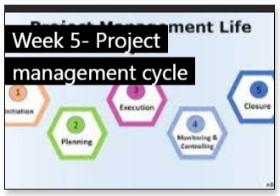
Next Week …

Slide 28


Traffic Light it
 | Where is your learning at ?
Red | I have misunderstood some of the topics. (write down 2 questions that you need help with)
Amber | I have understood most of the topics so far (write down 1 question and 1 key theme you have understood)
Green | I have understood the topics so far (write down 2 key themes from the lesson to show your understanding)

Slide 29

Quiz Time!!
Scan the Code
Or
Go to joinmyquiz.com

