Slide 1
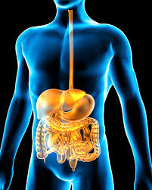
Amina Bibi 1807446
BMHP5003
Rachel Rivers
Digestive system

Slide 2

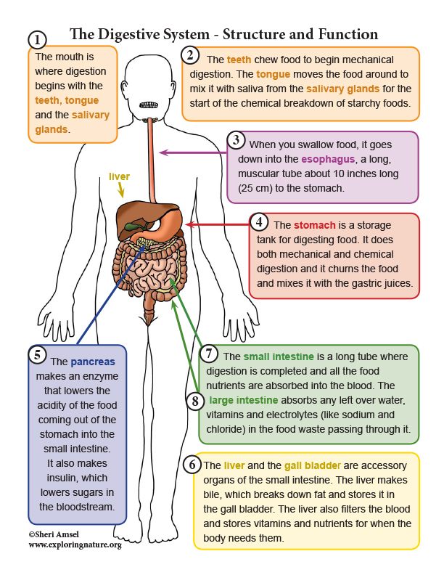
Introduction
During this presentation it will talk about the function of the digestive system and how that works with our body everyday.
The human digestive system consists of the gastrointestinal tract plus the accessory organs of digestion.
What is the digestive system?
The digestive system is there to breakdown food into nutrients which then passes into the circulatory system and are taken to where they are needed in the body. The digestive system is made up of organs that help break down and absorb our foods.
The importance of the digestive system
The digestive system is a very important part of the body for breaking down foods and uses it for energy growth and cell repair.
The system is important to break down food into nutrients, which the body uses for energy, growth and cell repair. (Digestive System (for Parents) - Nemours 2022)
The important part of the digestive system is the small intestine as it serves both for the digestion and absorption.
The three main functions of the gastrointestinal tract, including transportation digestion and absorbation of food.
The digestive system is essential for breaking down foods the digestive enzymes are cataylsts that enable molecules to change forms. (Your Digestive System (for Kids) - Nemours Kids Health, 2022)

Slide 3
What diseases effect the digestive system
Coeliac disease is a condition where the immume system attacks its own body from taking in the nutrients. Coeliac disease is caused by an adverse reaction to gluten, which is a dietary protein found in 3 types of cereal: (Works, 2022)wheat. ,barley. ,rye.
coeliac disease is an autoimmune condition. This is where the immune system (the body's defence against infection) mistakenly attacks healthy tissue.
In coeliac disease, the immune system mistakes substances found inside gluten as a threat to the body and attacks them. (NHS choices)
This damages the surface of the small bowel (intestines), disrupting the body's ability to take in nutrients from food. (Hirsch, Digestive system (for parents) - nemours kidshealth 2022)
It's not entirely clear what causes the immune system to act this way, but a combination of genetics and the environment appear to play a part.
here's no cure for coeliac disease, but following a gluten-free diet should help control symptoms and prevent the long-term complications of the condition.
Even if you have mild symptoms, changing your diet is still recommended because continuing to eat gluten can lead to serious complications. This may also be the case if tests show that you have some degree of coeliac disease even if you do not have noticeable symptoms.
It's important to ensure that your gluten-free diet is healthy and balanced
(Your Digestive System (for Kids) - Nemours Kids Health, 2022)
An increase in the range of available gluten-free foods in recent years has made it possible to eat both a healthy and varied gluten-free diet.
Complications of coeliac disease only tend to affect people who continue to eat gluten, or those who have not yet been diagnosed with the condition, which can be a common problem in milder cases.
Potential long-term complications include:
Weakened bones.

Slide 4

How to protect your digestive system
To keep your digestive system healthy and avoid problems eat better high fiber diet.
Be sure you're getting both soluble and insoluble Fiber
Minimize your intake of foods high in fat. ...
Select lean meats. ...
Add probiotics to your diet. ...
Follow a regular eating schedule. ...
Drink plenty of water.
(Digestive System (for Parents) - Nemours Kids Health, 2022)
How can you protect yourself from celiac disease?
You cannot prevent celiac disease. But you can stop and reverse the damage to the small intestine by eating a strict gluten-free diet. Digestive System (for Parents) - Nemours Kids Health, 2022)

Slide 5
References
Hirsch, L. (ed.) (2022) Digestive system (for parents) - nemours kidshealth, KidsHealth. The Nemours Foundation. Available at: https://kidshealth.org/en/parents/digestive.html (Accessed: October 21, 2022).
OpenStax, L.L.& (no date) Anatomy and physiology II, Digestive System Processes and Regulation | Anatomy and Physiology II. Available at: https://courses.lumenlearning.com/suny-ap2/chapter/digestive-system-processes-and-regulation/ (Accessed: October 21, 2022).
Human digestive system (2022) Wikipedia. Wikimedia Foundation. Available at: https://en.wikipedia.org/wiki/Human_digestive_system (Accessed: October 21, 2022).
Digestive system (no date) healthdirect. Healthdirect Australia. Available at: https://www.healthdirect.gov.au/digestive-system (Accessed: October 21, 2022).
(Inflammatory bowel disease clinic) Inflammatory bowel disease clinic (no date) Digestive system and its function | IBD Clinic. Available at: http://www.ibdclinic.ca/what-is-ibd/digestive-system-and-its-function (Accessed: October 21, 2022).
(no date) NHS choices. NHS. Available at: https://www.nhs.uk/conditions/coeliac-disease/ (Accessed: October 21, 2022).
Hirsch, L. (ed.) (2022) Digestive system (for parents) - nemours kidshealth, KidsHealth. The Nemours Foundation. Available at: https://kidshealth.org/en/parents/digestive.html (Accessed: October 21, 2022).

