Slide 1

M
Extreme learning machine
- Proposal
Haoyi Sun
1904101

Slide 2
Project Background
What is the ELM?
01
^{CONTENT}
02
Aims & Objectives
Methodology & Experiment
Expected Outcomes
03
Notes:
www.515ppt.com

Slide 3
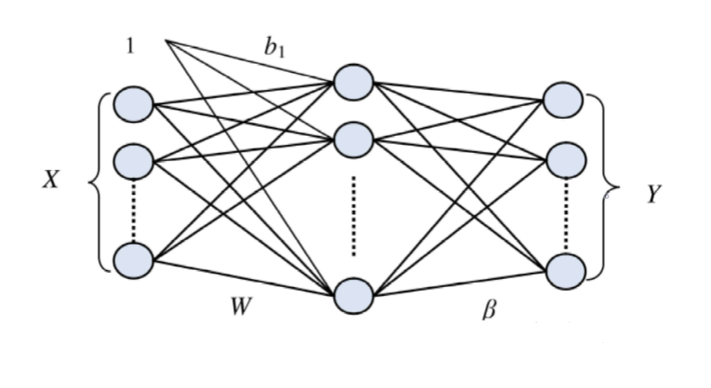
⁰¹
Extreme Learning
Machine(ELM)
* ELM is a multi-layer perceptron model proposed by Huang in 2006 in order to efficiently process large amounts of replicated data.
* ELM is a learning algorithm and one of single-hidden layer feedforward neural networks (SLFNs).
* ELM is a one-time learning algorithm.
延时符

Slide 4
⁰¹
Extreme Learning
Machine(ELM)
*The ELM principle
--- is that under the premise that the activation function is infinitely differentiable, the weights (w) and offsets (b) of the input layer can be randomly determined, so the relative hidden layer output matrix (H) can be randomly generated.
延时符

Slide 5

⁰¹
Extreme Learning
Machine(ELM)
*The ELM Improved point
--- According to the calculation process of ELM algorithm, we can get
It is known from the formulas that the error of the ELM algorithm comes from the output matrix ( ) and the generalized inverse matrix ( ), and a conjecture is proposed—the error of the ELM algorithm comes from the generalized inverse matrix of the hidden layer output matrix, which also is the error of the pseudo inverse matrix.
*The ELM calculation process
--- In the training set, given the input X and output T, given by

Slide 6
⁰²
To improve the accuracy of Extreme learning machine (Elm), which is a learning algorithm and one of single-hidden layer feedforward neural networks (SLFNs).
^{Aims}

Slide 7
⁰²
Objectives
To implement ELM with the innovative point (based on generalized inverse matrix and Lasso Regression) using code in MATLAB;
To comprehend the theory and find innovative points;
3
2
4
To adjust parameters and improve the accuracy of ELM.
To research SLFNs and the trends of Extreme learning machine;
1
ELM
延时符

Slide 8
⁰³
Methodology & Experiment
How can we improve the accuracy of ELM?
In order to find the related properties linearly related to the error ( ) in
the matrix , the L1 norm, F Norm, 1 Norm (column and norm),
2 Norm (spectrum norm), and kernel norm of the matrix M are obtained.
A preliminary comparison of these norms is then performed.
In the training set, the control variable method is used for the following
comparison experiments, the purpose is to find and prove that a certain
property(L1 Norm) of the matrix M is linearly related to the algorithm error.

Slide 9
⁰³
Methodology & Experiment
How can we improve the accuracy of ELM?
Step 1: Definition matrix , finding a certain property of
matrix ( ), and reduce the matrix error by improving this property.
It is known after the experiment that its L1 Norm is linearly related to
the error ( );
1
2
Step 2: By improving the L1 norm of matrix ( ), the error of the generalized
inverse matrix ( ) is reduced, and finally the purpose of reducing the error
( ) of the ELM algorithm is achieved. Because the parameters in the elm
algorithm correspond one-to-one, a set of parameters of the optimized ELM
algorithm is obtained.

Slide 10
⁰³
Expected Outcomes
It is expected that the improvement of ELM will:
*Findings and experiments show that the L1 norm of the M matrix is linearly
related to the algorithm error;
*Find a way to reduce the error of the algorithm by reducing the L1 norm of
the M matrix;
* Finally, while ensuring efficient processing of replicated data, the accuracy
of the ELM algorithm is improved.

Slide 11
Extreme learning machine(ELM):
  * one of single-hidden layer feedforward neural networks (SLFNs)
  * a one-time learning algorithm
Aims & Objectives:
  * To improve the accuracy of Extreme learning machine (Elm)
  * Find an index that is linearly related to the algorithm error, and improve the index to reduce the error.
Methodology:
  * Using the controlled variable method to find the appropriate index—the norm. Then finding a suitable method to modify the index, and ultimately achieve the goal of reducing algorithm error.
Summary

Slide 12
Thanks for
listening ☺
Haoyi Sun
延时符
Notes:
www.515ppt.com

