Slide 1
Affordances, physical literacy and outdoor learning
March 2018
Desks to Dens

Slide 2
Session outline
Recap physical literacy
Introduce theory of affordances
Explore affordances in the outdoors and how this relates to physical literacy

Slide 3

What is
Physical Literacy?
Physical literacy can be described as the motivation, confidence, physical competence, knowledge and understanding to value and
take responsibility for engagement in
physical activities for life.
Whitehead, M. 2016.

Slide 4
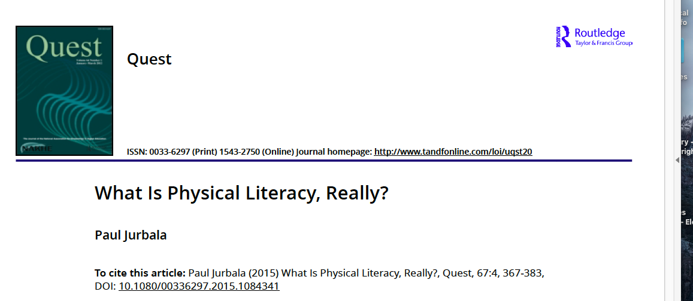

Slide 5
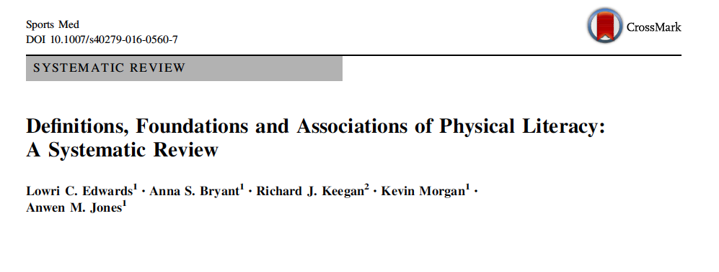

Slide 6
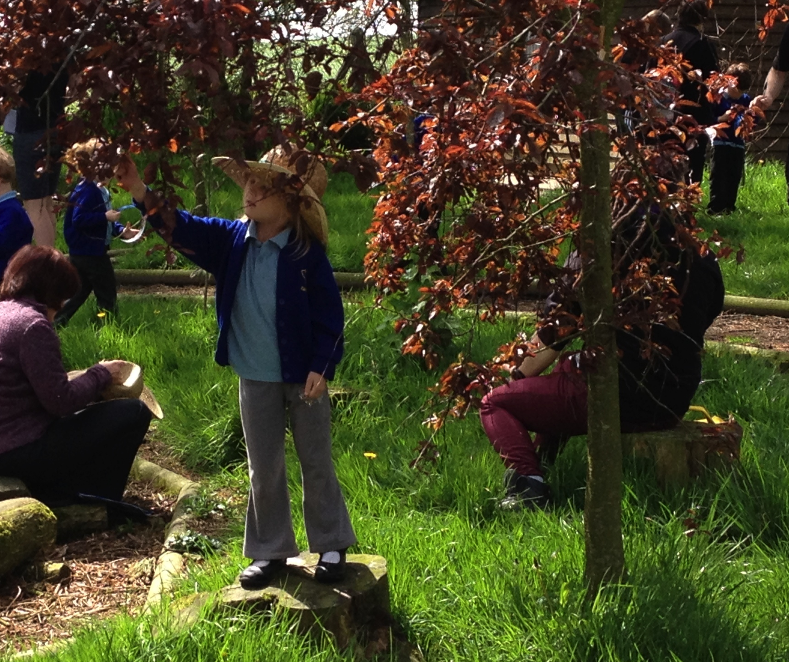
Notes:
Holistic concept….

Slide 7
Australian definition of physical literacy
Core: Physical literacy is lifelong holistic learning acquired and applied in movement and physical activity contexts.
Constitution : It reflects ongoing changes integrating physical, psychological, cognitive and social capabilities.
Importance: It is vital in helping us lead healthy and fulfilling lives through movement and physical activity.
Aspiration: A physically literate person is able to draw on their integrated physical, psychological, cognitive, and social capacities to support health promoting and fulfilling movement and physical activity - relative to their situation and context - throughout their lifespan

Slide 8
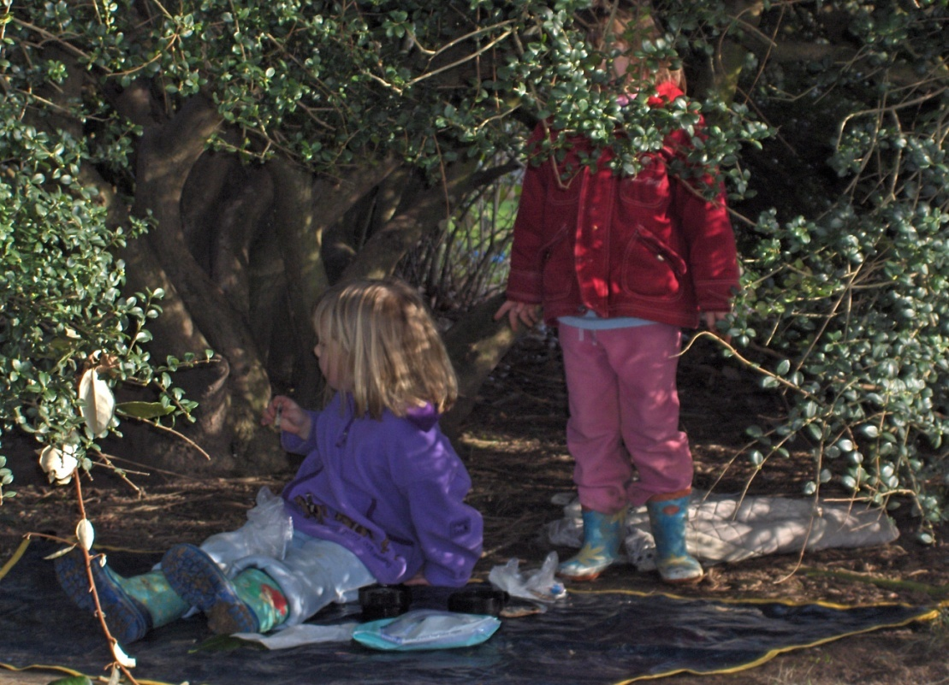


A Physical Literacy perspective
It is through physical ‘embodiment’ that humans ‘create themselves as they interact with their surroundings’ (Whitehead, 2010:26).
Notes:
If we take a physical literacy perspective then the experiences that we have are crucial for the development of who we are and how we learn and develop, therefore the environment that we interact with is extremely important

Slide 9
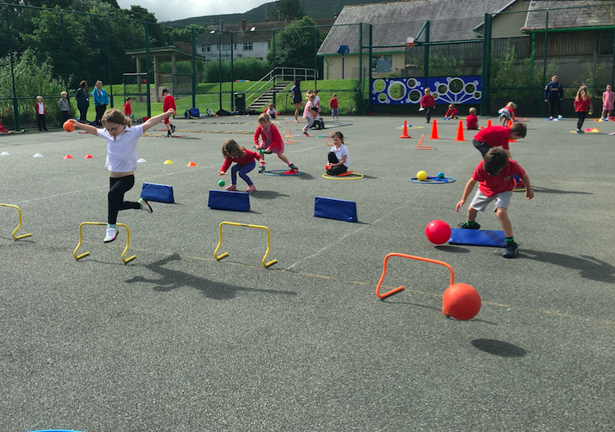
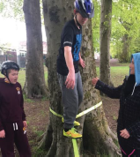
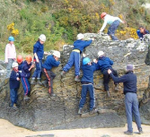
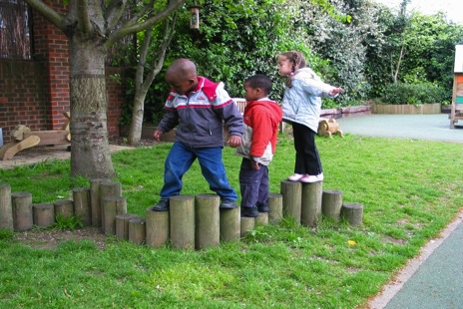
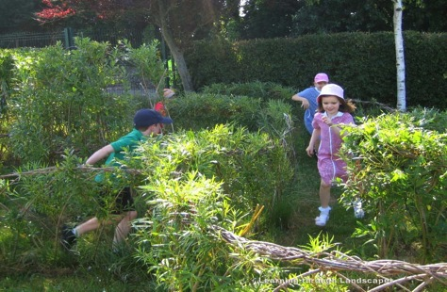
Affordance theory states that the world is perceived not only in terms of object shapes and spatial relationships but also in terms of object possibilities for action (affordances) — perception drives action. J. J. Gibson (1904-1979)
We need to ensure that children are given the opportunities to experience a wide variety of affordances from early childhood to ensure good motor development.
Notes:
You are all aware of affordance theory….
Studies of the affordances of the home show that more opportunities in the home improve motor development and learning readiness,
Studies in Scandanavia show that children in pre schools that move in natural settings have better motor development due to the rich variety of affordances that nature offers.

Slide 10
The theory of affordances
”The affordances of the environment are what it offers to the animal, what it provides or furnishes…”
However they are relevant to the animal...eg. Solid ground give support for animals to stand, walk run etc. But a marsh land and water is sink-into- able into depending on the weight of the animal ...or supporting of weight if you are a bug
                Gibson p 127

Slide 11
Task
What are the affordances of these for adults, children and animals ?
Lake
Beach
Tree
Carpark
Can you think of some more?

Slide 12
How does this relate to physical literacy?
Discuss in pairs …..
Considering the theory of affordances …..how does the outdoors make a unique contribution to physical literacy?

Slide 13

NEXT WEEK….
What are your questions??
School visit…observing children in the Foundation Phase

Slide 14
Practical
Lets do some more activities…....
Audit of the site…in relation to the affordances
Draw a map if the site
Treasure hunt

