Slide 1
People

Slide 2
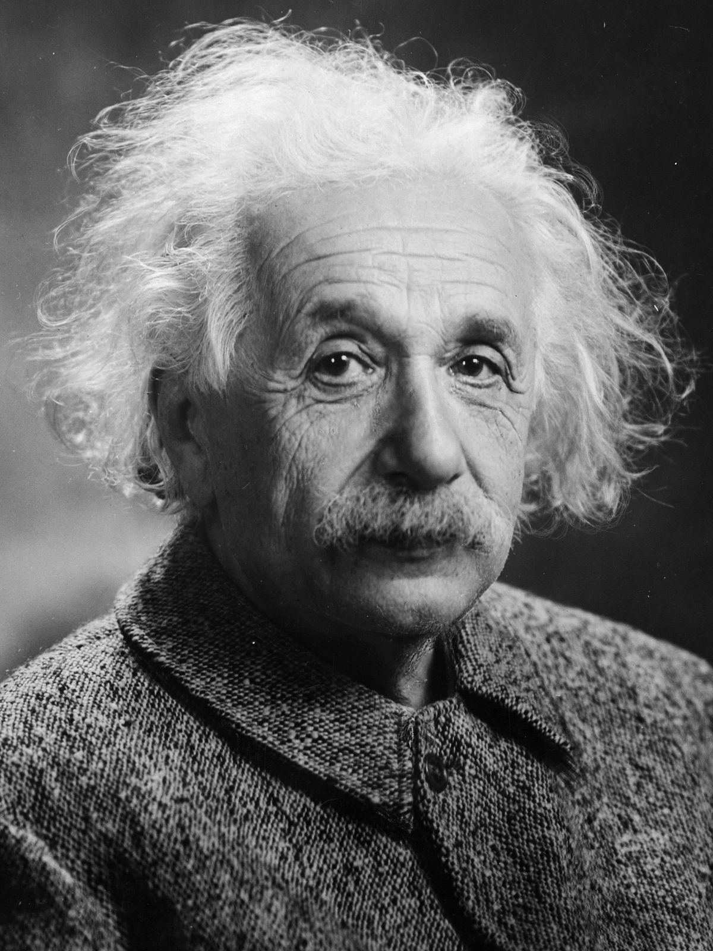
People
If you can’t explain it simply , you don’t understand it well enough
Possibly the most overlooked!
“People are our most valuable asset”
Skilled in the specialisms required.
Able to see the higher level interactions.
Able to communicate with other disciplines.
Able to share knowledge

Slide 3
Exercise: Complexity and Humans
You are about to be shown a series of 4 slides
Each slide presents a sentence
Your task is to count the number of occurrences of the letter “f” in each sentence
Each sentence will become longer – but you will be given pro-rata more time in which to count
Time 5 minutes
How many f’s
Slide
A
B
C
D
Count
Notes:
This exercise is described in the exercise trainer notes.

Slide 4
A
Systems Engineering is the foundation of future success.

Slide 5
B
Followers of Systems Engineering offer a lot of hope for the future prosperity of the country.

Slide 6
C
Those organizations that follow Systems Engineering rigorously reap significant benefits in terms of profitability, performance and on time delivery of
of products that both satisfy and delight their customers.

Slide 7
D
The application of Systems Engineering approaches in the design of systems, that permit sustained, reliable, operation, in a wide range of future operating environments, has been demonstrated to deliver substantial business advantage in highly competitive narrow markets by offering non-ephemeral holistic solutions of a unique countenance that totally satisfy multi-stakeholder customers.

Slide 8
A
Systems Engineering is the foundation of future success.
3

Slide 9
B
Followers of Systems Engineering offer a lot of hope for the future prosperity of the country.
8

Slide 10
C
Those organizations that follow Systems Engineering rigorously, reap significant benefits in terms
of profitability, performance and
on time delivery of
of products that both satisfy and delight their customers.
9

Slide 11
D
The application of Systems Engineering approaches in the design of systems, that permit sustained, reliable, operation, in a wide range of future operating environments, has been demonstrated to deliver substantial business advantage in highly competitive narrow markets by offering non-ephemeral holistic solutions of a unique countenance that totally satisfy multi-stakeholder customers.
8

Slide 12
The Trap
C
Those organizations that follow Systems Engineering rigorously, reap significant benefits in terms of profitability, performance and on time delivery of
of products that both satisfy and delight their customers.
Should be 8 ………but is 9!

Slide 13
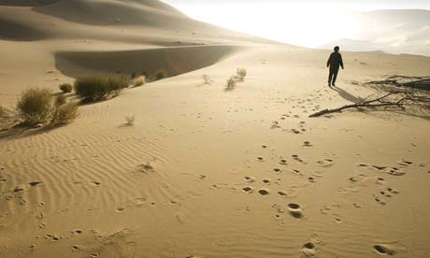
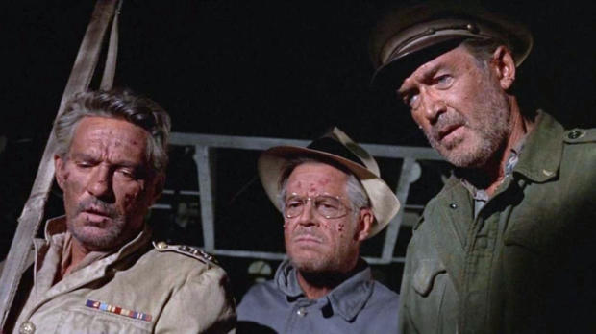
Reaching a consensus
Marooned in the desert exercise!

Slide 14
The situation
It is approximately 10.00 a.m. in mid-July and you have just crash-landed in the Sonora. Desert in the south-west United States of America. Your light twin-engine plane, containing the bodies of the pilot and co-pilot, has completely burnt out, and only the frame remains. None of the rest of you has been injured.
The pilot was unable to notify anyone of your position before you crashed. However, ground sightings taken shortly before the crash suggested that you are about 65 miles off course from your originally filed flight plan. A few moments before the crash, the pilot indicated that the nearest known habitation was a mining camp 70 miles away to the north-north-east.
The immediate area is quite flat and appears to be rather barren, except for occasional cacti. The last weather report indicated that the temperature would reach 110°F, which means that the temperature within a foot of the surface would hit 130°F.
You are dressed in lightweight clothing: a short-sleeved shirt, shorts, socks and leather shoes. Everyone has a handkerchief. Collectively your pockets contain 3 dollars in change, 100 dollars in notes, a packet of cigarettes and a ballpoint pen.

Slide 15
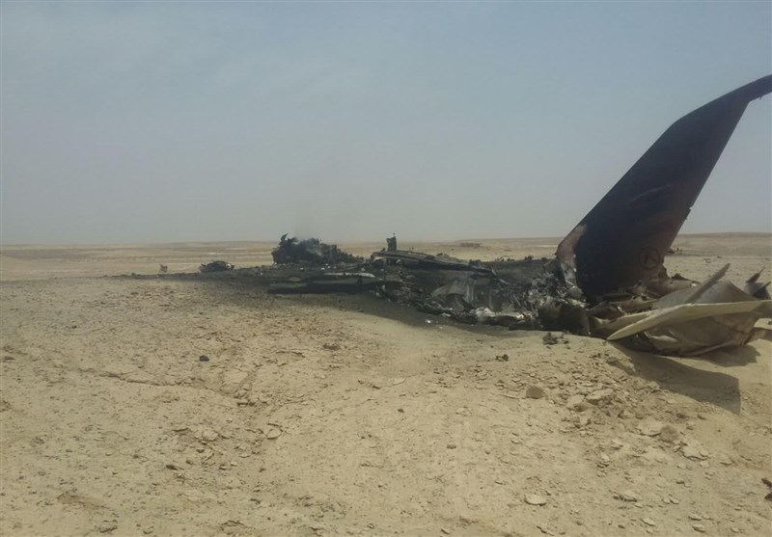
The list!
Torch (4 battery size)
Jack-knife
Sectional air map of crash area
Plastic raincoat (large size)
Magnetic compass
Bandage kit with gauze
.45 calibre pistol (loaded)
Parachute (red and white)
Bottle of salt tablets ( 1000)
1 quart of water per person
Book entitled ''Edible Animals of the Desert"
2 pairs of sunglasses per person
2 quarts of 180 proof vodka
1 overcoat per person
Cosmetic mirror
Before the plane caught fire, your group was able to salvage these items:
The situation described above is based upon over two thousand cases in which men and women lived or died depending upon the survival decisions they made. Your own 'life' or 'death' will depend upon how well your group can share its present knowledge of a relatively unfamiliar problem so that the team can make decisions leading to your survival.

Slide 16
The Problem
How would you use the items to maximise your chance of survival?
  You’ll be given a list of 15 items
  Rank the items in order of importance, starting with 1 for the most important down to 15 for the least important.
You may assume that the number of survivors is the same as the number of members in your team and that they have decided to stick together.
What You Have To Do
First of all you should tackle the problem by yourself, recording your individual ranking in the table provided. After everyone has finished, repeat the exercise together with the rest of the team to produce a team consensus ranking.
At the end of the exercise you will be able to compare your own ranking with those of the other members of the group and, more importantly, with that reached by the group as a whole. ln addition, you will be able to compare your decisions with that of an expert in desert survival.

Slide 17
Decisions by Consensus
This is an exercise in team decision making. Your group is to employ the method of team consensus in reaching its decision.
This means that the prediction for each of the survival items must be agreed upon to some extent by each group member before it becomes part of the group decision.
Consensus is difficult to reach. Therefore, not every ranking will meet with everyone's complete approval. Try, as a team, to make each ranking one with which all team members can at least partially agree. Here are some guides to use in reaching consensus:
Avoid arguing for your own individual judgments. Approach the task on the basis of logic.
Avoid changing your mind only in order to reach agreement and avoid conflict. Support only solutions with which you are able to agree somewhat, at least.
Avoid 'conflict-reducing' techniques such as majority vote, averaging or trading in reaching decisions.
View difference of opinion as helpful rather than as a hindrance in decision making.
View your initial agreement as suspect

Slide 18
The list!
Torch (4 battery size)
Jack-knife
Sectional air map of crash area
Plastic raincoat (large size)
Magnetic compass
Bandage kit with gauze
.45 calibre pistol (loaded)
Parachute (red and white)
Bottle of salt tablets ( 1000)
1 quart of water per person
Book entitled ''Edible Animals of the Desert"
2 pairs of sunglasses per person
2 quarts of 180 proof vodka
1 overcoat per person
Cosmetic mirror
Before the plane caught fire, your group was able to salvage these items:
The situation described above is based upon over two thousand cases in which men and women lived or died depending upon the survival decisions they made. Your own 'life' or 'death' will depend upon how well your group can share its present knowledge of a relatively unfamiliar problem so that the team can make decisions leading to your survival.

Slide 19
Judgement analysis by spreadsheet
Pairwise comparison technique
Link to pairwise comparison spreadsheet

Slide 20
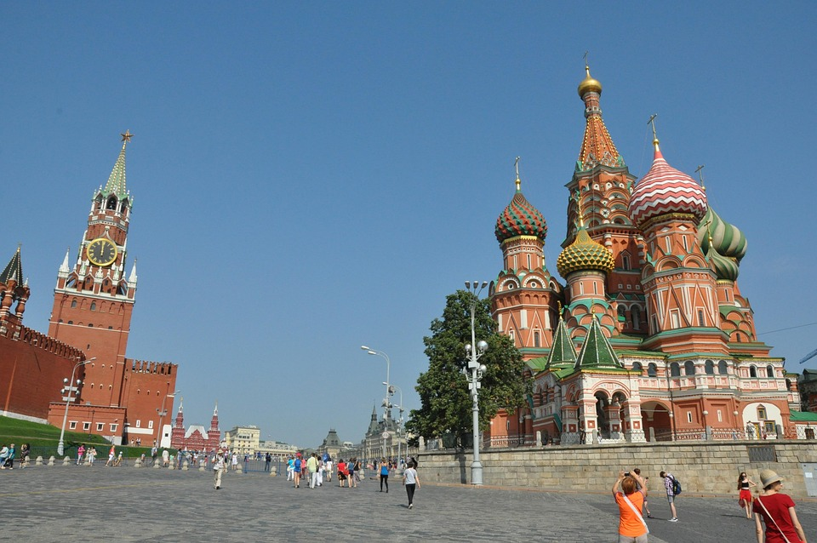
Or try going to MoSCoW……………

Slide 21
MoSCoW Prioritisation
The MoSCoW prioritization technique is a widely used method in project management and software development to prioritize tasks and requirements effectively. The acronym MoSCoW stands for Must have, Should have, Could have, and Won’t have, each representing a level of priority.
Key Categories in MoSCoW
Must have: These are critical requirements essential for the project's success. Without them, the project is considered a failure.
Should have: These are important but not critical features. They are high-priority but less time-sensitive than "Must have" items.
Could have: These are desirable features that can be included if time and resources allow but do not impact the project's success if omitted.
Won’t have: These are the lowest-priority features, agreed to be excluded from the current delivery cycle but may be considered for future iterations.

Slide 22
Benefits
Benefits of MoSCoW Prioritization
This method offers several advantages:
Clear prioritization: It provides a structured framework to distinguish between essential and non-essential tasks.
Simplified decision-making: By categorizing tasks, teams can focus on critical items, reducing time spent on less important ones.
Enhanced communication: It creates a shared vocabulary among stakeholders, aligning expectations and minimizing conflicts.
Improved stakeholder management: Stakeholders gain clarity on what to expect, fostering better collaboration.
Flexibility: Requirements can shift between categories as the project evolves, making it ideal for agile methodologies.
Effective resource allocation: Teams can allocate resources based on priority, ensuring critical tasks are completed first.
Risk management: By focusing on "Must have" tasks, the method mitigates risks of project failure.

Slide 23
How to do it
Implementation Steps
List all project requirements.
Collaborate with stakeholders to categorize each requirement into Must Have, Should Have, Could Have, and Won’t Have.
Facilitate discussions to resolve disagreements on categorization.
Document and share the prioritization with all stakeholders.
Regularly review and adjust priorities as the project progresses.

Slide 24
Pitfalls
Common Mistakes to Avoid
Overloading the "Must have" category can lead to confusion and delays. Maintain a balanced distribution across categories.
Misinterpreting "Won’t have" as unnecessary. These features may add value in future cycles and should not be overlooked.
The MoSCoW method is a simple yet powerful tool for managing project priorities, ensuring clarity, and aligning stakeholder expectations. It is particularly effective in agile environments and can be applied across various industries to enhance project outcomes.

Slide 25
Scoring the Decision
The Expert:
Alonzo W Pond, MA, is the desert survival expert who has contributed the basis for the item ranking. He is the former Chief of the Desert Branch of the Arctic, Desert, Tropic Information Centre of the Air Force University at Maxwell Air Force Base.
During World War II, Mr. Pond spent much of his time working with the Allied Forces in the Sahara on desert survival problems. While there as Chief of the Desert Branch, he encountered the countless survival cases that serve as a basis of the rationale for these rankings.
Alonzo W. Pond - Wikipedia

Slide 26
The Expert Ranking and Rationale:
No. 1 - Cosmetic Mirror
Of all the items, the mirror is absolutely critical. It is the most powerful tool you have for communicating your presence. In sunlight a simple mirror can generate 5 to 7 million candle-power of light. The reflected sunbeam can even be seen beyond the horizon. If you had no other items you would still have better than an 80% chance of being spotted and picked up within the first 24 hours.
No. 2 - One Topcoat per Person
Once you have a communication system to tell people where you are, your next problem is to slow down dehydration. Forty per cent of the body moisture that is lost through dehydration is lost through perspiration and respiration. Moisture lost through respiration can be cut significantly by remaining calm. Preventing the hot, dry air from circulating next to the skin can cut moisture lost through perspiration. The topcoats, ironic as it may seem, are the best available means for doing this. Without them survival time would be cut by at least a day.
No. 3 -One Quart of Water per Person
You could probably survive 3 days with just the first 2 items. Although the quart of water would not significantly extend the survival time, it would help to hold off the effects of dehydration. It would be best to drink the water as you become thirsty, so that you can remain as clearheaded as possible during the first day when important decisions have to be made and a shelter erected. Once dehydration begins it would be impossible to reverse it with the amount of water available in this situation.

Slide 27
The Expert Ranking and Rationale:
No. 4-Torch (4 Battery Size)
The only quick, reliable night signalling device is the torch. With it and the mirror you have a 24-hour signalling capability. It is also a multiple use item during the day. The reflector and lens could be used as an auxiliary signal device for starting a fire. The battery container could be used for digging or as a water container in the distillation process (see plastic raincoat).
No 5 - Parachute (Red and White)
The parachute can serve as both shelter and signalling device. The square cactus could serve as a tent pole and the parachute shrouds as tent ropes. Double or triple folding the parachute would give shade dark enough to reduce the temperature underneath it by as much as 20%.
No. 6 - Penknife
Although not as crucial as the first 5 items, the penknife would be useful for rigging the shelter and for cutting up the very tough barrel cactus for moisture. Its several other uses give it the high ranking.

Slide 28
The Expert Ranking and Rationale:
No. 7 - Plastic Raincoat (Large Size)
In recent years the development of plastic, non-porous materials have made it possible to build a solar still. By digging a hole and placing the raincoat over it the temperature differential will extract some moisture from urine soaked sand and pieces of barrel cactus and produce condensation on the underside of the plastic. By placing a small stone in the centre of the plastic a cone-shape can be formed and cause moisture to drip into the flashlight container buried in the centre of the hole. Up to a quart a day could be obtained in this way. This would be helpful, but not enough to make any significant difference. The physical activity required to extract the water is likely to use up about twice as much body water as could be gained.
No. 8 - 45 Calibre Pistol (Loaded)
By the end of the second day speech would be seriously impaired and you might be unable to walk (6 to l 0% dehydration). The pistol would then be useful as a sound signalling device and the bullets as a quick fire starter. The international distress signal is three shots in rapid succession. There have been numerous cases of survivors going undetected because they couldn't make any loud sounds.
No. 9 - A Pair of Sunglasses per Person
In the intense sunlight of the desert photothalmia and solar retinitis (both similar to the effects of snow blindness) would be serious problems especially by the second day. However, the dark shade of the parachute shelter would reduce the problem, as would darkening the area around the eyes with soot from the wreckage. Using a handkerchief or compress material as a veil with eye slits cut into it would eliminate the vision problem. Sunglasses, however, would make things more comfortable.

Slide 29
The Expert Ranking and Rationale:
No 10-Bandage Kit with Gauze
Because of the desert's low humidity, it is considered one of the healthiest (least infectious) places in the world. Due to the fact that blood thickens with dehydration, there is little danger from bleeding unless a vein is severed. In one well-documented case, a man lost and without water, who had torn off all his clothes and fallen among sharp cactus and rocks until his body was covered in cuts, didn't bleed until he was rescued and given water. The kit materials might be used as: rope, or for wrapping your legs, ankles, and head, including face, giving further protection against dehydration and sunlight.
No. 11 - Magnetic Compass
Aside from the possibility of using its reflective surfaces as an auxiliary signalling device, the compass is of little use. It could even be dangerous to have around once the effects of dehydration take hold. It might give someone the notion of walking out.
No. 12 - Sectional Air Map of the Area
Might be helpful for starting a fire, or for toilet paper. One person might use it for a head cover or eyeshade. It might have entertainment value. It is, however, essentially useless and perhaps dangerous because it too might encourage walking out.

Slide 30
The Expert Ranking and Rationale:
No. 13 - Book Entitled "Edible Animals of the Desert"
The problem confronting the group is dehydration, not starvation. Any energy expended in hunting would be costly in terms of potential water loss. Desert animals, while plentiful, are seldom seen. They survive by lying low, as should the survivors. If the hunt were successful, the intake of protein would cause an increase in the amount of water used to process the protein in the body. General rule of thumb - if you have useful information, it would be difficult to adjust your eyes to reading and remain attentive as dehydration increases.
No. 14- 2 Quarts of 180 Proof Vodka
When severe alcoholism kills someone, they usually die of dehydration. Alcohol absorbs water. The body loses an enormous amount of water trying to throw off the alcohol. We estimate a loss of 2 to 3 oz. of water per oz. of alcohol. The vodka consumed would be lethal in this situation. Its presence could cause someone in a dehydrated state to increase his problem. The vodka would be helpful for a fire or as a temporary coolant for the body. The bottles might also be helpful. All in all, the vodka represents more dangers than help.
No. 15 - Bottles of Salt Tablets (1,000 Tablets)
Widespread myths about salt tablets exist. The first problem is that w'ith dehydration and loss of water, blood salinity increases. Sweat contains less salt than extra cellular fluids. Without lots of extra water the salt tablets would require body water to get rid of the increased salinity. The effect would be like drinking seawater. Even the man who developed salt tablets now maintains they are of questionable value except in geographical areas where there are salt deficiencies .

Slide 31
The result!
Cosmetic mirror
One overcoat per person
One quart of water per person
Torch (4 battery size)
Parachute (Red and White)
Jack knife
Plastic raincoat (XL)
.45 Calibre pistol
Pair of sunglasses per person
Bandage kit with gauze
Magnetic compass
Sectional air map of the area
Book entitled “Edible Animals of the Desert.”
180 Proof Vodka
Bottle of salt tablets
How close did you get individually?
How close did you get by consensus?
How close did you get by pairwise?
Link to DAH answers

Slide 32
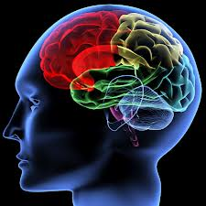
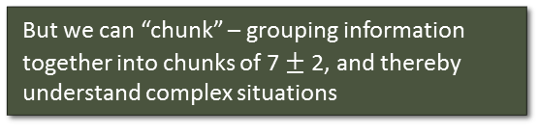
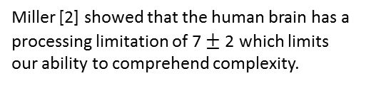
Complexity
Complexity lies at the heart of the problem because humans cannot easily handle complexity.
In order to satisfy customer needs and expectations (perceived and actual), organizations are designing increasingly more complex products and services.
Pre-frontal Cortex
Limbic System
Brain Stem
Miller [2] showed that the human brain has a processing limitation of 7 $±$ 2 which limits our ability to comprehend complexity.
The increased complexity increases the opportunity for an error and makes errors more difficult to find. These errors, if undetected, will result in undesirable emergent behaviour
But we can “chunk” – grouping information together into chunks of 7 $±$ 2, and thereby understand complex situations
[2] Miller, G. A. (1956). "The magical number seven, plus or minus two: Some limits on our capacity for processing information". Psychological Review. 63(2): 81–97. PMID 13310704. doi:10.1037/h0043158.

Slide 33
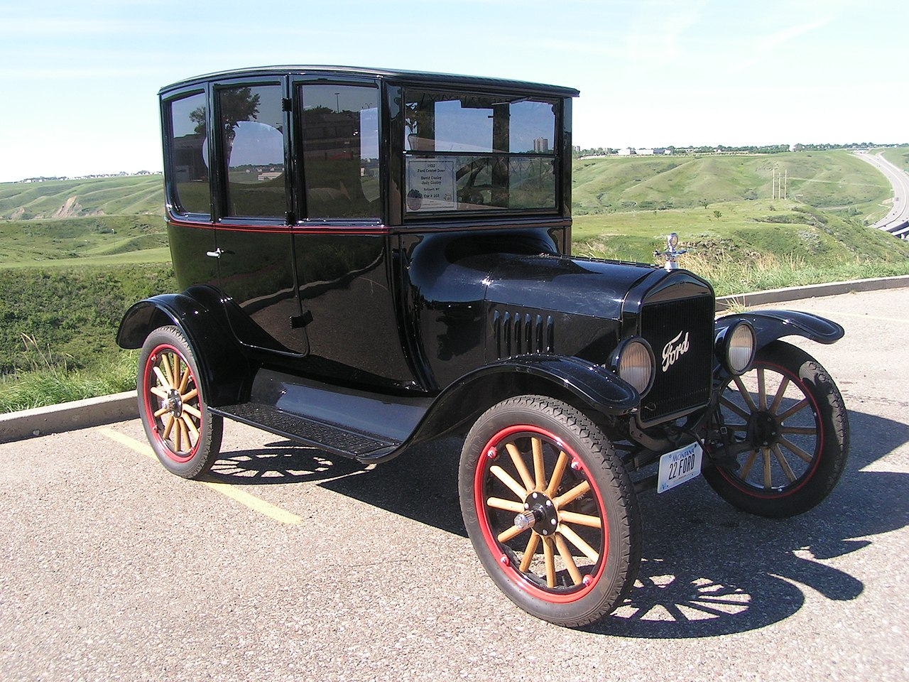
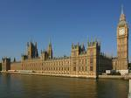
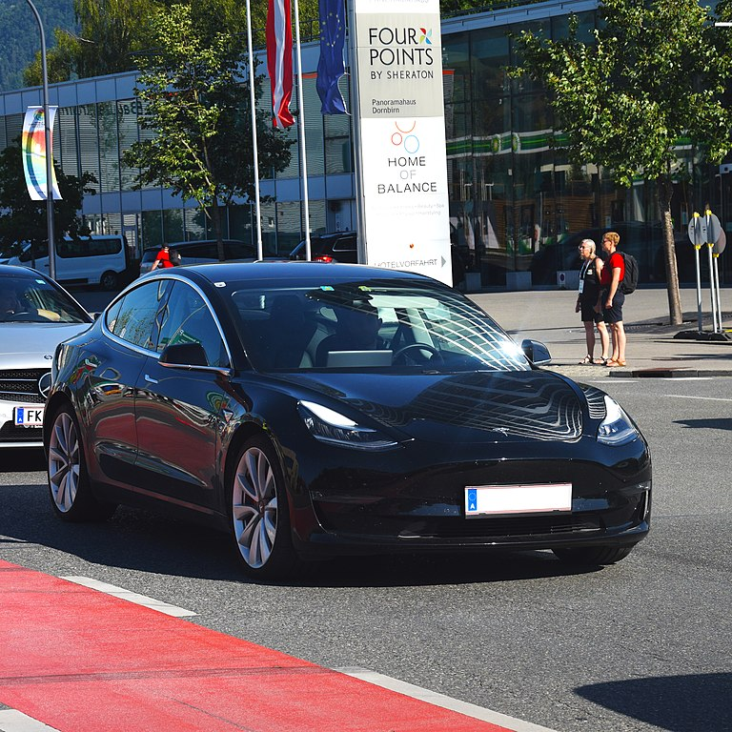
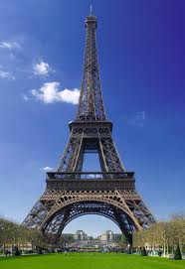
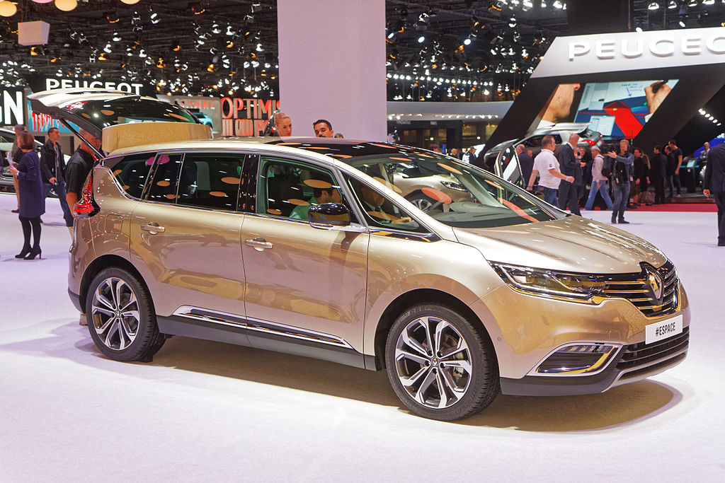
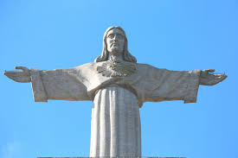
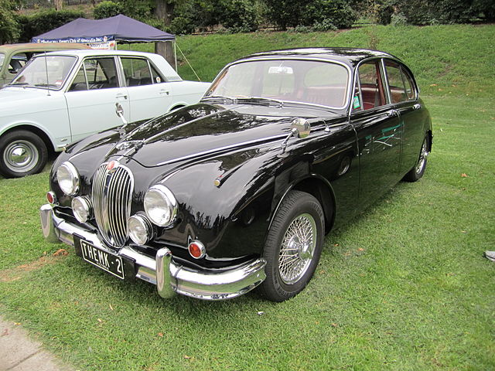
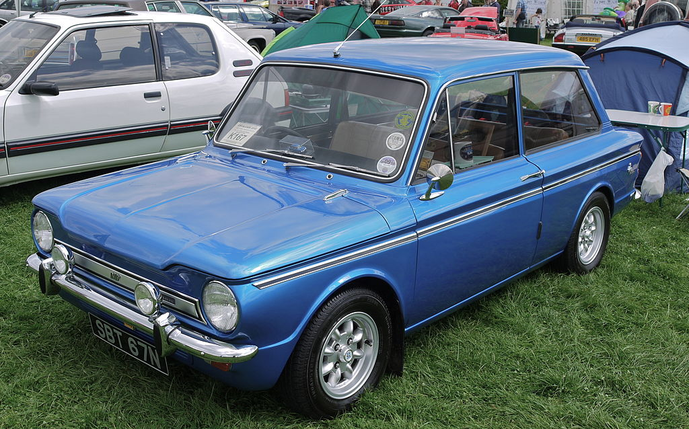
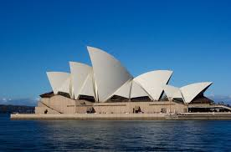
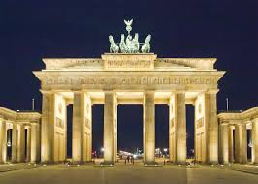
Exercise: People
Capital Cities
  Part 1: individually, list as many Capital Cities of the world as you can in two minutes
  Part 2: in small teams, use your individual lists to create a team list – time five minutes
Car manufacturers
  Part 1: individually, list as many car manufacturers, past and present, as you can in two minutes
  Part 2: in small teams, use your individual lists to create a team list – time five minutes
Notes:
THE RECKONING
•
Review the answer sheet.
•
Give yourself one point for each correct individual answer.
•
Score the group answer.
•
Complete the following chart
Bush (snr & jnr), Clinton, Reagan, Nixon, Lincoln, Roosevelt, Johnson, Ford, Carter
Washington, Eisenhower, Adams, Kennedy...

Slide 34
Sharing Knowledge
Uncertain
knowledge
Extent of
my knowledge
Gaps in my knowledge
Team knowledge is greater and fills the gaps

Slide 35
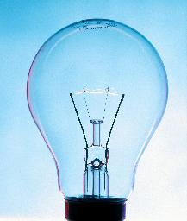
Creating Knowledge
Working as a team will cause us to share knowledge but
  System Design often requires us to be creative
We can be individually creative, BUT we are better when we work as a team
  Voicing my ideas can help other team members to be more creative and vice versa

Slide 36
People and Tools in Systems Engineering
PEOPLE
Systems Engineering is for the people and it’s a team sport!
People are essential - they generate the information required
Teams are better than individuals because of
  the sharing of knowledge and expertise
  the information and knowledge generated by working together
System design and development can involve many disciplines. Hence for complex multi-disciplinary systems we have to have highly skilled multi-disciplinary teams
For a multi-disciplinary team to deliver, they must be able to communicate with each other to share information and have a common understanding to avoid having different perceptions
TOOLS
Processes tell you what to do and when to do it (may also say who does it) – they should not specify how to do it – this is the job of tools
BUT we need a set of tools that all teams members can use, with confidence, that allow us to handle the complexity of the system but at the same time are simple enough for the whole team to use – we need generalist systems tools
Systems Engineering tools are primarily communication devices that allow different disciplines to explore systems issues, often by building abstract models. They are scalable (any size of system), universal (any type of system) and above all simple (anybody can use them)

