Slide 1
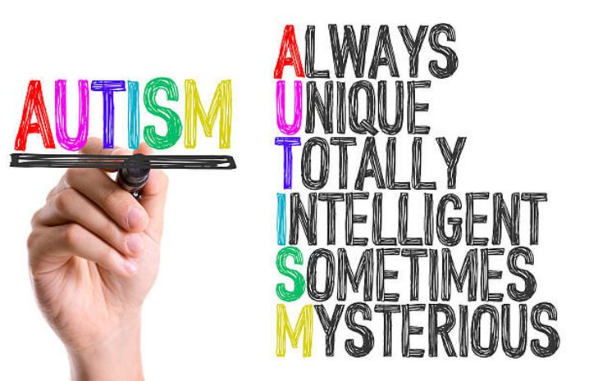
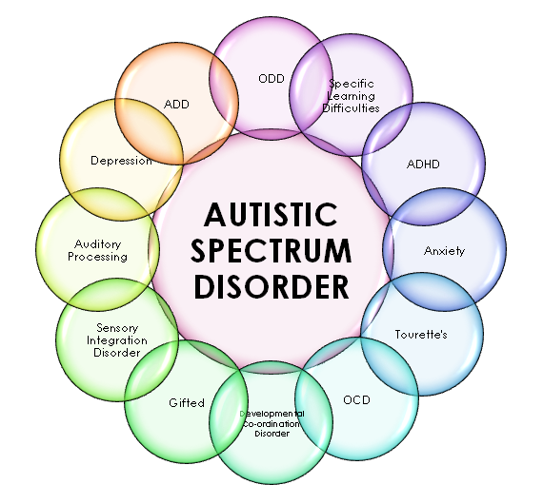
ECES5006/C
All Means All
Mae Pawb yn Golygu Pawb
Sesiwn 7 / Session 7

Slide 2

Deilliannau Dysgu/Learning Outcomes
CYDRADDOLDEB
CYFIAWNDER
Dadansoddi materion yn ymwneud ag arfer dda ar gyfer cynhwysiant.
Analyse issues relating to good practice for inclusion.

Slide 3

Deilliannau Dysgu/Learning Outcomes
Adnabod a dangos gwerthfawrogiad o’r ystod o werthoedd, agweddau a sgiliau sydd eu hangen i fyw mewn cymdeithas amrywiol.
Recognise and show appreciation of the range of values attitudes and skills needed to live in a diverse society.

Slide 4


Deilliannau Dysgu/Learning Outcomes
Critically engage with issues of diversity from a legislative, historical and contemporary perspective.
Mynd i’r afael yn feirniadol â materion amrywiaeth o safbwynt deddfwriaethol, hanesyddol a chyfoes.

Slide 5
Awtistiaeth/Autism
Beth yw pwysigrwydd enw?
  Awtisiaeth
  Anhwylder Sbectrwm Awtistiaeth
  Cyflwr Sbectrwm Awtistiaeth
  Syndrom Asperger
  Y term cyffredin i ddefnyddio yw awtistiaeth neu ASA.
What’s in a name?
  Autistic/with autism
  Autistic Spectrum Disorder (ASD)
  Autistic Spectrum Condition
  Asperger’s Syndrome
Terms used may vary but general consensus is to use autism or ASD.
(Kenny et al, 2016)

Slide 6
Cynhwysiant – Pam? Inclusion Matters
1 ymhob 100 (700, 000) ac yn tyfu.
35% o blant yn adrodd mai bwlio yw’r rhan gwaethaf o ysgol.
Nid yw 63% o rieni yn teimlo mai ysgol yw’r lle gorau i gefnogi eu plant Awtistig.
Mae 17% o blant gyda ASA wedi’u heithrio o ysgol.
1 in 100 (700, 000 in UK) and growing
35% of children with ASD say the worst thing about school is being picked on.
63% of parents feel their child with ASD in not in the kind of school which best supports them.
17% of children with ASD have been suspended from school.
(National Autistic Society, 2017)

Slide 7
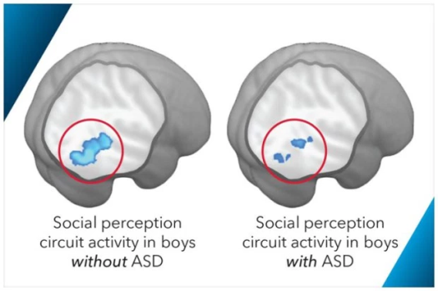
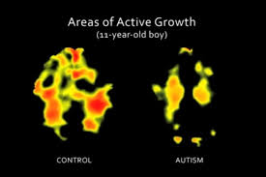
Beth yw awtistiaeth?
So, what is autism?
Cyflwr gydol oes sy’n effeithio ar allu person i ddatblygu sy'n effeithio ar sut mae person yn cyfathrebu gyda phobl eraill ac yn dylanwadu ar sut maent yn profi’r byd o’i hamgylch.
Mae awtistiaeth yn cael eu adnabod fel oediad datblygiad niwro sy’n gallu amrywio yn nhermau difrifoldeb a gallu meddyliol.
“Autism is a lifelong, developmental disability that affects how a person communicates with and relates to other people, and how they experience the world around them.”
(National Autistic Society, 2017).
“Autism is recognised as neuro-developmental delay or damage that can present with varying degrees of severity and varying levels of intellectual functioning”
(Seach, 2011 cited in Knowles, 2011)

Slide 8
Adnabod Awtistiaeth/Identifying Autism
Nid yw rhieni neu athrawon yn gallu penderfynu – rhaid cael diagnosis meddygol.
Byddai diagnosis 'arfer orau' yn cynnwys ymateb aml-asiantaethol.
Mae awtistiaeth difrifol iawn (oedd yn cael ei alw'n ‘glasurol') fel arfer wedi ei adnabod erbyn 3 mlwydd oed.
Gall eraill (ee gyda'r math oedd yn cael ei alw'n 'Asperger') gael ei adnabod llawer yn hwyrach gan fod ganddynt y gallu i weithredu ar lefel uwch (er nid yw hyn bob tro yn cyfateb i lai o angen)
            Baron-Cohen, 2008
Cannot be diagnosed by parents or teachers alone – it is a medical diagnosis.
A ‘best practice’ diagnosis would involve a multi-disciplinary approach.
More severe autism (previously called ‘classic’) is usually diagnosed by age 3.
Those with different forms (such as that previously known as ‘Asperger’) may be diagnosed much later due to their ability to function at a higher level (although this does not always equal lower need).
Baron-Cohen, 2008

Slide 9
Ymyrraeth Gynnar/Early Intervention
Mae adnabod cynnar yn galluogi ymyrraeth cynnar.
Gall arwyddion cynnar gynnwys:
  Oedi mewn gallu i rannu ffocws e.e. ar wrthrych
  Oedi neu wrthod cymryd rhan mewn chwarae rôl
  Anhawster cymryd tro
  Oedi mewn adnabod enw eu henwau eu hunain
  Llai o gopïo oedolion ac eraill
  Oedi mewn cyfathrebu llafar neu gyfathrebu di-eiriau
  Ymddygiad adroddus anarferol
  Sylw wedi hoelio gan rywbeth gweledol ddiddorol
  Newidiadau mawr i dymer
  Lai, Lombardo a Baron-Cohen, 2014
Early identification allows early intervention.
Early indicators may include:
  Delay in ability to share a focus e.g. on an object
  Delay or refusal to engage in pretend play
  Difficulties in turn taking
  Delay in recognising own name
  Decreased imitation
  Delayed verbal and non-verbal communication
  Motor delay
  Unusual repetitive behaviours
  May be ‘transfixed’ by something visually interesting
  Extreme changes to mood
  Lai, Lombardo and Baron-Cohen, 2014

Slide 10
Gallai nodweddion ASA gynnwys…
Characteristics of ASD (may) include…
Mae nodweddion ASA yn gallu effeithio ar ardaloedd o:
  Gyfathrebu llafar neu di-eiriau
  Rhyngweithio cymdeithasol
  Ymddygiad annisgwyl neu ailadroddus, diddordebau cryf a rheolweithiau
  Ymateb synhwyrol
Characteristics may be apparent in the areas of:
  Verbal and non-verbal communication
  Social Interaction
  Repeated and unusual behaviours, interests and routines
  Responses to sensations
(Reed, Lannen and Lannen, 2016 cited in Peer and Reid, 2016)
Adlewyrcha ar y rhestr o nodweddion. Sut gall y rhain effeithio ar blentyn mewn awyrgylch ysgol?
Reflect on the list of characteristics provided. Can you think of any examples of how this may affect a child in a school environment?

Slide 11
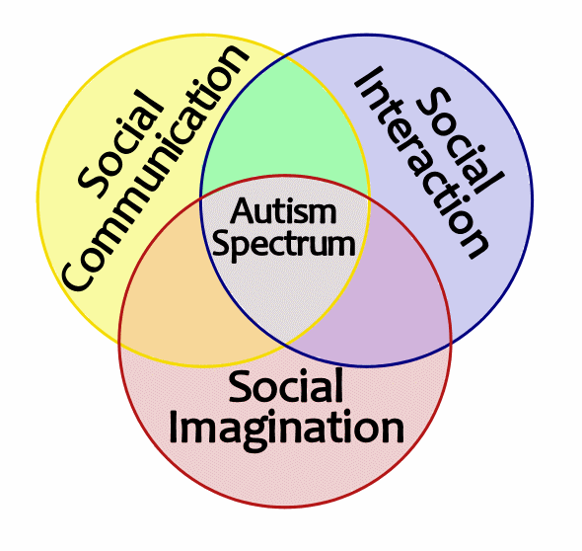
Triawd o Amhariadau
Triad of Impairments (Wing and Gould, 1978)
Source: Brierley, 2013

Slide 12

Gor-ymateb i'r Synhwyrau/Sensory Overload

Slide 13
Effaith ar Ddysgu/Impact on Learning
Adfyfyria ar y rhestr o nodweddion isod. Sut allai rhain effeithio ar blentyn mewn amgylchedd ysgol?
Yn y blynyddoedd cynnar, efallai bydd anawsterau copïo synau neu symudiadau.
Canolbwyntio am adegau byr yn unig neu gor-ganolbwyntio ar un peth yn unig.
Anawsterau cyd-weithio ag eraill.
Anawsterau deall syniadau abstract (e.e. efallai na fydd chwarae rôl yn gwneud synnwyr)
Anawsterau deall y cysyniad o amser a threfn digwyddiadau.
Reflect on the list below. How can these affect children in a school setting?
In the early years, children may not be able to imitate sounds, gestures or movements.
Short attention span or inability to focus OR concentrate on one thing intensely.
Difficulties working collaboratively with others.
Difficulty with abstract ideas (pretend or role play may not make sense)
Difficulties grasping the concept of time and order of events.
(Reed, Lannen and Lannen, 2016 cited in Peer and Reid, 2016)

Slide 14
Ymyrraethau Cyffredin/Common Interventions
Therapi cerddoriaeth
Therapi celf
Therapi iaith a lleferydd
***Ymyrraeth Ymddygiad Cynnar a Dwys (e.e. ABA)***
TEACCH
Dysgu sgiliau cymdeithasol
Meddygyniaeth a deiet
Baron-Cohen, 2008
Music therapy
Art therapy
Speech and Language therapy
***Early intensive behavioural interventions (e.g ABA)***
TEACCH
Social skills teaching and ‘mindreading’
Medicines and diet
Baron-Cohen, 2008

Slide 15
Cefnogaeth Cyfathrebu a Iaith
Communication and Language Support
Mae angen cyfleodd ar gyfer:
  Sicrhau awyrgylch cyfathrebu cyfoethog sy’n annog cyfathrebu digymell
  Gallu dal a chadw sylw oedolion mewn ffyrdd positif a gofyn am gymorth
  Ffyrdd i fynegi emosiwn
  Effeithio ar deimladau eraill
  Gallu dilyn syniadau eraill
  Datblygu annibyniaeth
Children with autism need opportunities for:
  A communication rich environment which encourages spontaneous communication
  To gain and maintain adult attention in positive ways and ask for help;
  Ways to express emotions;
  Influencing the feelings and actions of others;
  Following the ideas of others;
  Developing independence.
    Seath, 2011 cited in Knowles, 2011

Slide 16
Systemau Gweledol o Gyfathrebu
Visual Systems of Communication
Rhai esiamplau:
Picture Exchange Communication System (PECS).
Y dull TEACCH
Trafodwch:
  Beth yw manteision posibl y dulliau?
  Beth yw anfanteision posibl y dulliau?
Some examples:
Picture Exchange Communication System (PECS).
TEACCH approach
Discuss:
  What are the possible benefits of each approach?
  What are the possible drawbacks of each approach?

Slide 17
Modelu defnydd positif o iaith
Modelling positive language use
Osgoi iaith llythrennol.
Rhoi dewisiadau syml yn hytrach na sefyllfaoedd pen-agored.
Osgoi gor-ddefnyddio awgrymiadau, cwestiynau neu ail-adrodd.
Dangos bod ymdrechion cyfathrebu'r plant yn cael eu gwerthfawrogi.
Avoid literal language.
Give simple choices rather than present open ended scenarios.
Avoid over-use of prompts, questions or repetition.
Show children their efforts to communicate are valued.
    Seath, 2011 cited in Knowles, 2011

Slide 18

Beth sy’n digwydd?/What’s happening?
“Ble mae Mrs. Clarke?”
  “Dyw hi ddim o gwmpas heddiw.”
“Ble mae Mrs. Clarke?” (Edrych yn ddryslyd)
  “Dwi wedi dweud! Dyw hi ddim yma heddiw.”
“Ble mae Mrs. Clarke?” (Dechrau cynhyrfu)
“Paid gofyn eto! Rwyf wedi dweud – dyw hi ddim yma, mae hi'n sâl!”
“Where’s Mrs. Clarke?”
  “She’s not around today.”
“Where’s Mrs. Clarke?” (Looks confused)
  “I told you - she’s not in today.”
“Where’s Mrs. Clarke?” (Begins to get agitated)
  “Don’t keep asking me, I’ve told you she’s not here, she’s sick!”

Slide 19
Rhyngwaith CymdeithasolSocial Interaction
Rhai esiamplau o gefnogaeth:
  Cylch ffrindiau neu system 'buddy
  Storiau Cymdeithasol
Trafodwch:
  Beth yw manteision posibl y dulliau?
  Beth yw anfanteision posibl y dulliau?
Some examples of support:
  Circle of friends or ‘buddy’ systems
  Social stories
Discuss:
  What are the possible benefits of each approach?
  What are the possible drawbacks of each approach?

Slide 20

Synhwyro, Teimlo, Symud
Sensing, Feeling and Moving

Slide 21

PDA Pathalogical Demand Avoidance
Tasg ymchwil / Research task
Beth yw PDA?
Sut mae’n cael ei
Sut mae PDA yn creu rhwystrau i ddysgu?
A yw’r strategaethau awtistiaeth arferol yn cefnogi PDA?
Dyma rhai dolenni i ddechrau:
pda (autism.org.uk)
PDA Society – Pathological Demand Avoidance – Part of the Autism Spectrum
(22) Introduction to PDA (Pathological Demand Avoidance) - YouTube
What is PDA?
How is it diagnosed?
How could PDA create barriers to learning?
Do the usual autism support strategies work or hinder PDA?
Here are some links to start:
pda (autism.org.uk)
PDA Society – Pathological Demand Avoidance – Part of the Autism Spectrum
(22) Introduction to PDA (Pathological Demand Avoidance) - YouTube

Slide 22
Darllen Pellach Defnyddiol
Useful Follow Up Reading
Chapter 11 – ‘Transition Planning’ in Plimley, L., Bowen, M., & Morgan, H. (2007) Autistic Spectrum Disorders in the Early Years, London: Paul Chapman Publishing.
Baron-Cohen, S. (2008) Autism and Asperger Syndrome, Oxford: Oxford University Press.
Seach, D. (2011) ‘Children with autism and Asperger’s syndrome’ (Chapter 11) in Knowles, G. (ed) (2011) Supporting Inclusive Practice, London: Routledge.

Slide 23
Llyfryddiaeth
Bibliography
Baron-Cohen, S. (2008) Autism and Asperger Syndrome, Oxford: Oxford University Press.
Kenny, L., Hattersley, C. , Molins, B. (2015) Which terms should be used to describe autism? Perspectives from the UK autism community, Autism, Vol. 20(4), pp. 442-62. Available at: http://journals.sagepub.com/doi/pdf/10.1177/1362361315588200
Lai, M., Lombardo, M. & Baron-Cohen, S. (2014) ‘Autism’ The Lancet, Vol.383, March 2014, pp.896-910.
National Autistic Society (2017) Autism Week Resouece Pack, Available at: www.autism.org.uk/.../nas-upper-secondary-autism-awareness-pack-all-region.ashx? (Accessed 2/8/17).
National Autistic Society (2017) Autism Facts and History, Available at: http://www.autism.org.uk/about/what-is/myths-facts-stats.aspx (Accessed 2/8/17).
Peer, L. & Reid, G. (eds) (2016) Special Educational Needs: A guide for inclusive practice, London: Sage.
Plimley, L., Bowen, M., & Morgan, H. (2007) Autistic Spectrum Disorders in the Early Years, London: Paul Chapman Publishing.
Seach, D. (2011) ‘Children with autism and Asperger’s syndrome’ (Chapter 11) in Knowles, G. (ed) (2011) Supporting Inclusive Practice, London: Routledge.

