Slide 1
The Book (and Beyond)
Notes:
On this slide are the images of the 20th-century German author Walter Benjamin
I wanted to start with Benjamin as a sort of entrée into thinking about archives more generally
A member of the Frankfurt School of social research, Benjamin is perhaps best known for his writings on media in essays such ‘The Work of Art in the Age of Mechanical Reproduction’
Alongside this, though, Benjamin was an archives devotee
Although not an historian by training, Benjamin wrote extensively on the philosophy of history, including a famous essay that I’ll quote from later on.
Benjamin was also fascinated by the history of photography and his adopted hometown Paris, where he – a Jewish Marxist – was exiled after the Nazis’ ascension to power.
Onscreen are images of Benjamin’s library card at the Bibliothèque Nationale, Paris and him beavering away on one of his many visits to its archives

Slide 2
Overview
History of the Book: Terminology and Historiography
Theories of Communication and Authorship
Digital Approaches to Book History and Histories of Reading

Slide 3
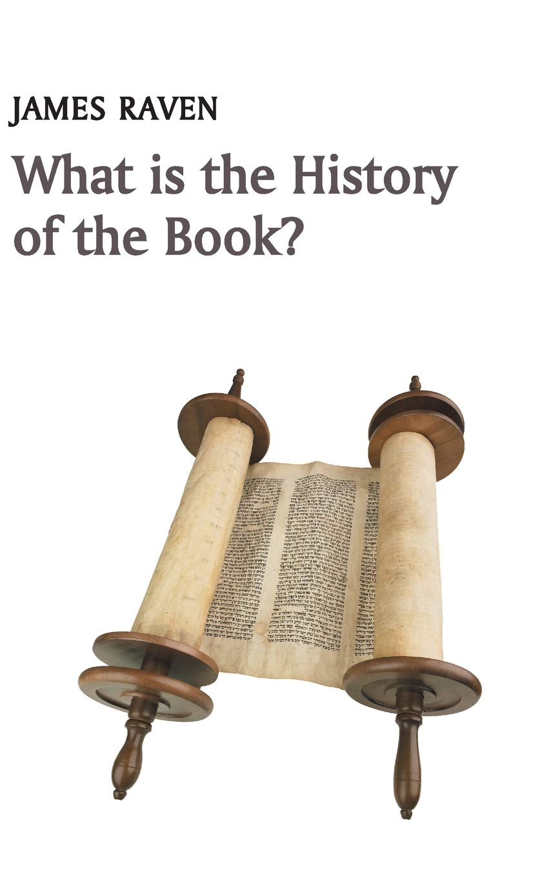
What is the history of the book?
History of the Book:
Terminology and Historiography

Slide 4
“Book history of ‘the history of the book’ aspires to study the historical consequences of the production, dissemination and reception of texts, in all the material [and electronic – ed.] forms, across all societies and in all ages.”

Slide 5
But what is a book (anyway)?
Why might this outwardly banal question be of consequence?
What distinguishes books from other written media?

Slide 6
Book, n.
A portable volume consisting of a series of written, printed, or illustrated pages bound together for ease of reading.
In modern use the pages are typically printed and made of paper, and are usually trimmed to a uniform rectangular or square shape, sewn or glued together along one side to form a flat or rounded back, and encased in a protective cover, but other materials and construction methods may be used. In early and historical use, and with reference to non-Western cultures, book may refer to a literary work in portable form written on a wide variety of other materials (as vellum, parchment, papyrus, cotton, silk, palm leaves, bark, tablets of wood, ivory, slate, metal, etc.), and put together in any of a number of forms (as a scroll, or as separate leaves which may be hinged, strung, stitched, or glued together).

Slide 7
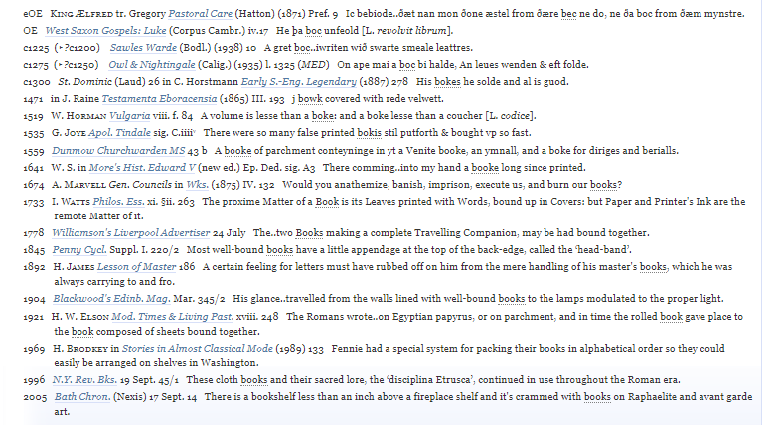
Book, n.

Slide 8
A Book is (also) …
An object
A medium for transmission of information
A mode of communication
A form of technology
A composite of different organic materials
A personal effect/belonging

Slide 9
What distinguishes books from earlier forms of written media?

Slide 10
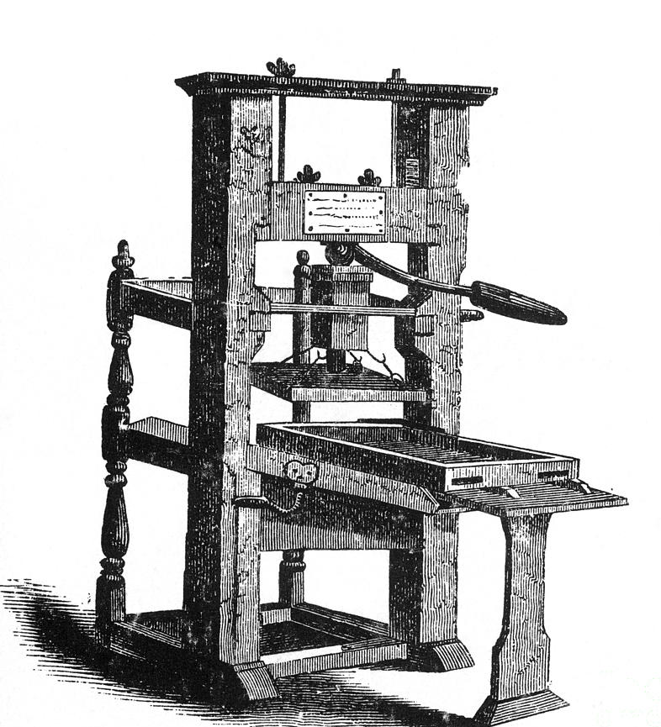
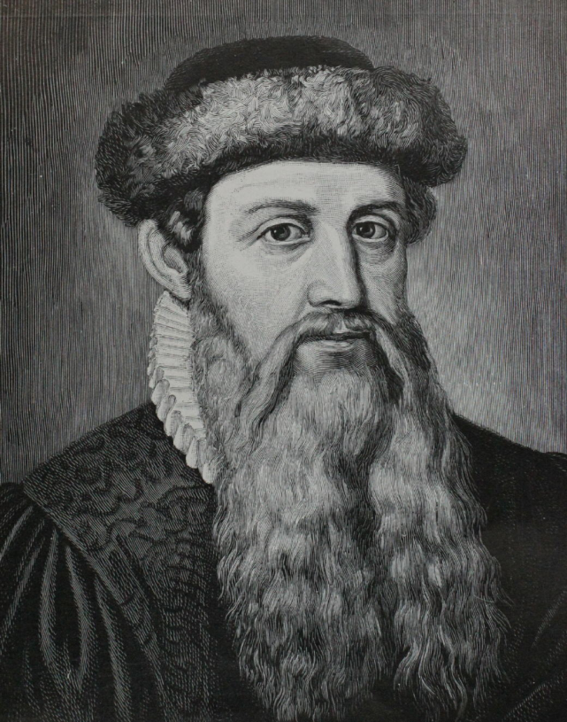
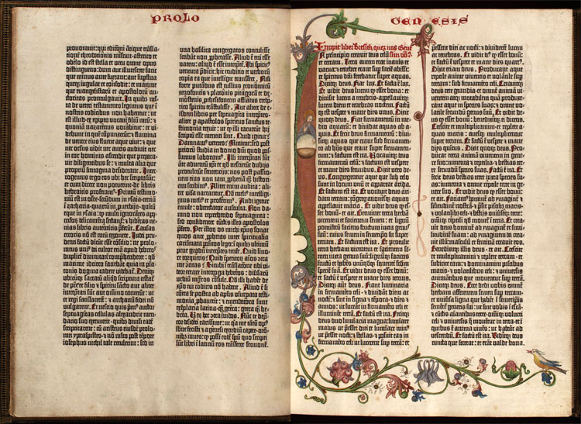
Gutenberg Bible; printing press ‘invented,’ c. 1440s

Slide 11
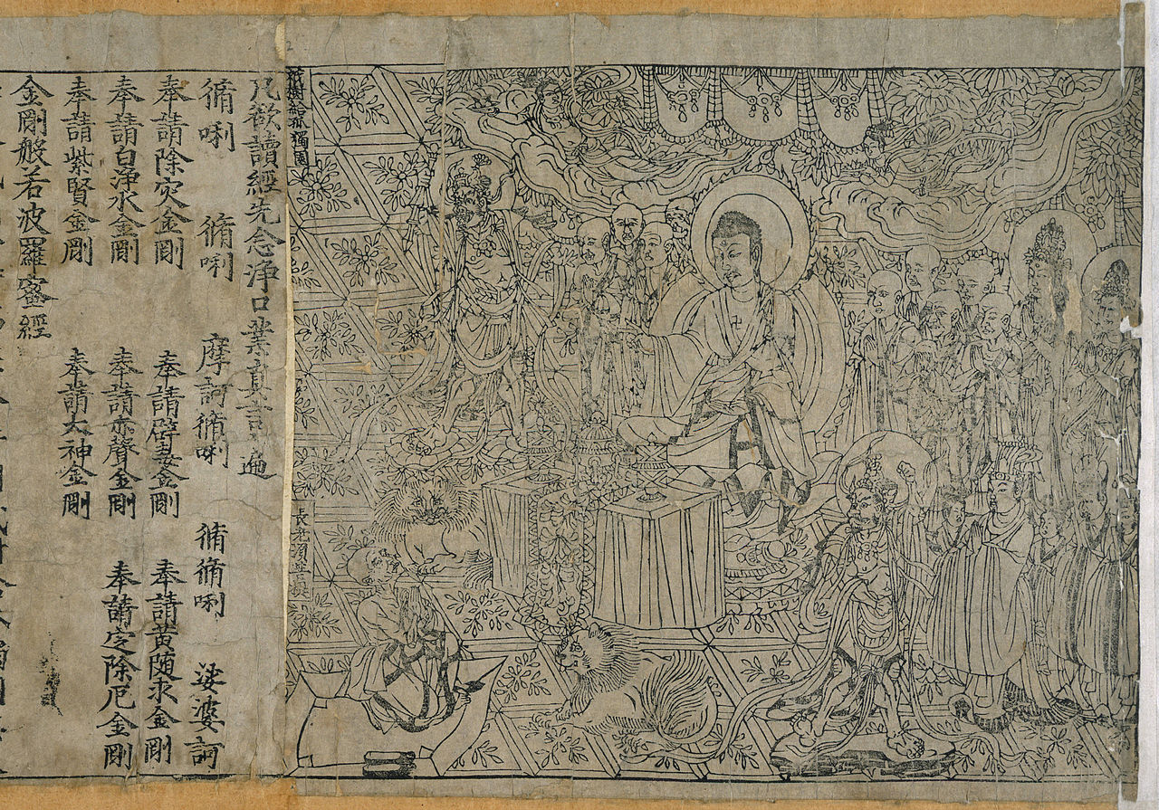
Frontispiece of the Diamond Sutra from Tang-dynasty China, 868 ACE (British Museum), widely seen as the earliest extant printed book

Slide 12
What distinguishes books from earlier forms of written media?
What is meant by the following terms?
Manuscript
Codex
Codicology
Calligraphy
Palaeography
Cartulary
Incunabula
Bibliography

Slide 13
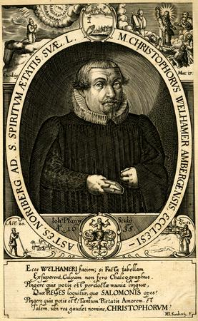
Incunabula = ‘books’ made before 1501
1500 as the limit of the period of incunabula first adopted in 1643 by Johann Saubert’s his history of the Nuremberg library (Historia Bibliothecae Noribergensi) – an early exercise in the history of the book
Fairly arbitrary cut off – but the product of early attempts at the history of the book (or bibliography)

Slide 14
Varieties of Bibliography
(as in the study of books)
Enumerative = gathering together all information relevant to a book’s theme/topic
Descriptive = close physical description of books and other printed objects: a systematic report concerning their type, paper, printing, illustrations, and binding, and how the circumstances of their publication and distribution may have affected their physical appearance
Textual = interpretation of a book’s printed content; analysis of text’s transmission from author to print edition(s); goal of recovering most accurate text as originally conceived by an author perhaps with intention of producing a new critical edition
Historical = exploring social, economic, political context in which books were produced, using external source

Slide 15

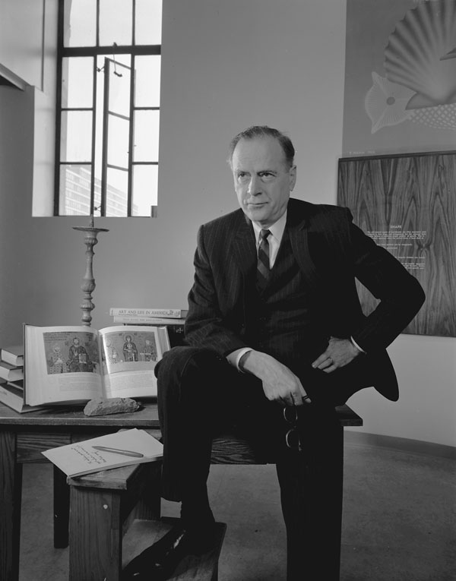
Four epochs of book history
Oral tribe culture
Manuscript culture
Gutenberg galaxy
Electronic age
“The invention of typography confirmed and extended the new visual stress of applied knowledge, providing the first uniformly repeatable ‘commodity,’ the first assembly-line, and the first mass-production.”
Marshall McLuhan, The Gutenberg Galaxy (1962)

Slide 16
2. Theories of Communication and Authorship

Slide 17
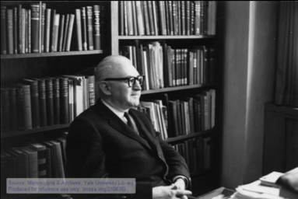
Laswell’s
Model of Communication
‘5Ws’
"Who says What to Whom in Which Channel with What Effect".
Harold Laswell (1902–1972)

Slide 18
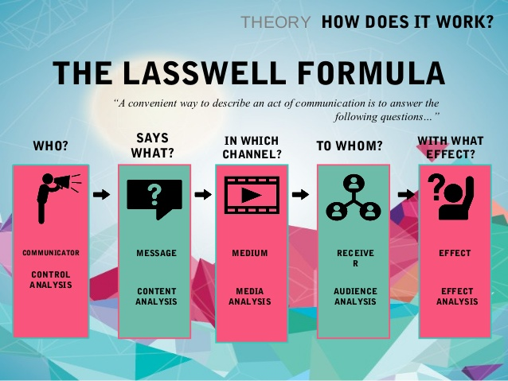

Slide 19
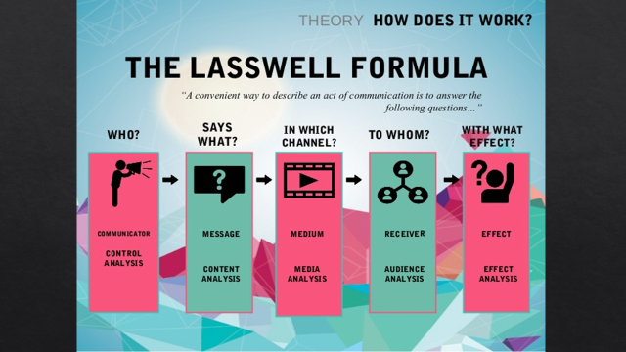
Laswell’s ‘5Ws’
“
How are the above relevant to historians of the book?
What methodological and theoretical considerations might complicate the ‘5 ws’s?

Slide 20
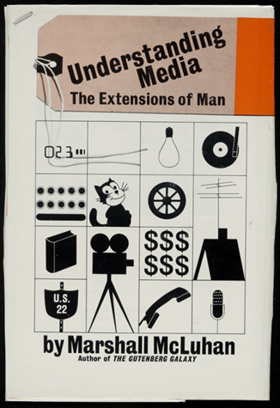
In Which Channel ….
“In a culture like ours it is sometimes a bit of a shock to be reminded that, in operational and practical fact, the medium is the message. This is merely to say that the personal and social consequences of any medium—that is, of any extension of ourselves— result from the new scale that is introduced into our affairs by each extension of ourselves, or by any new technology.”
Marshall McLuhan, Understanding Media (1964)

Slide 21
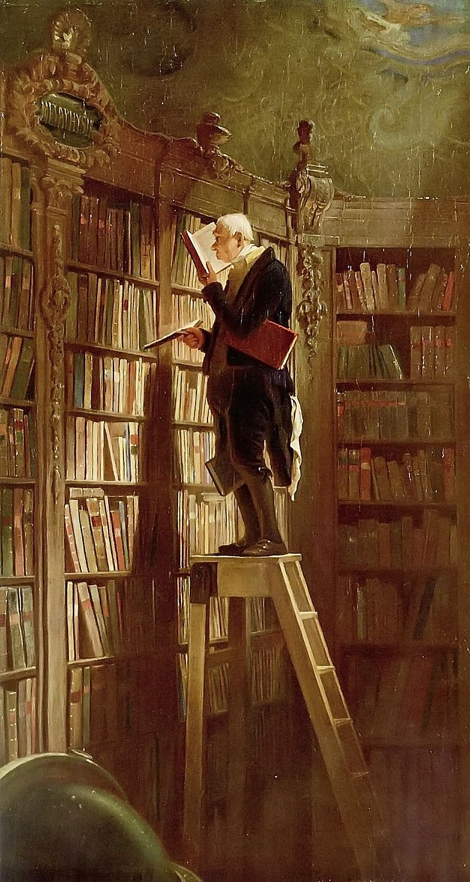
To Whom…
Carl Spitzweg, The Bookworm (1859)

Slide 22
"Who says What to Whom in Which Channel with What Effect".
Who are ‘the who’ in the first part of the formulation? Who ‘makes’ a book?

Slide 23

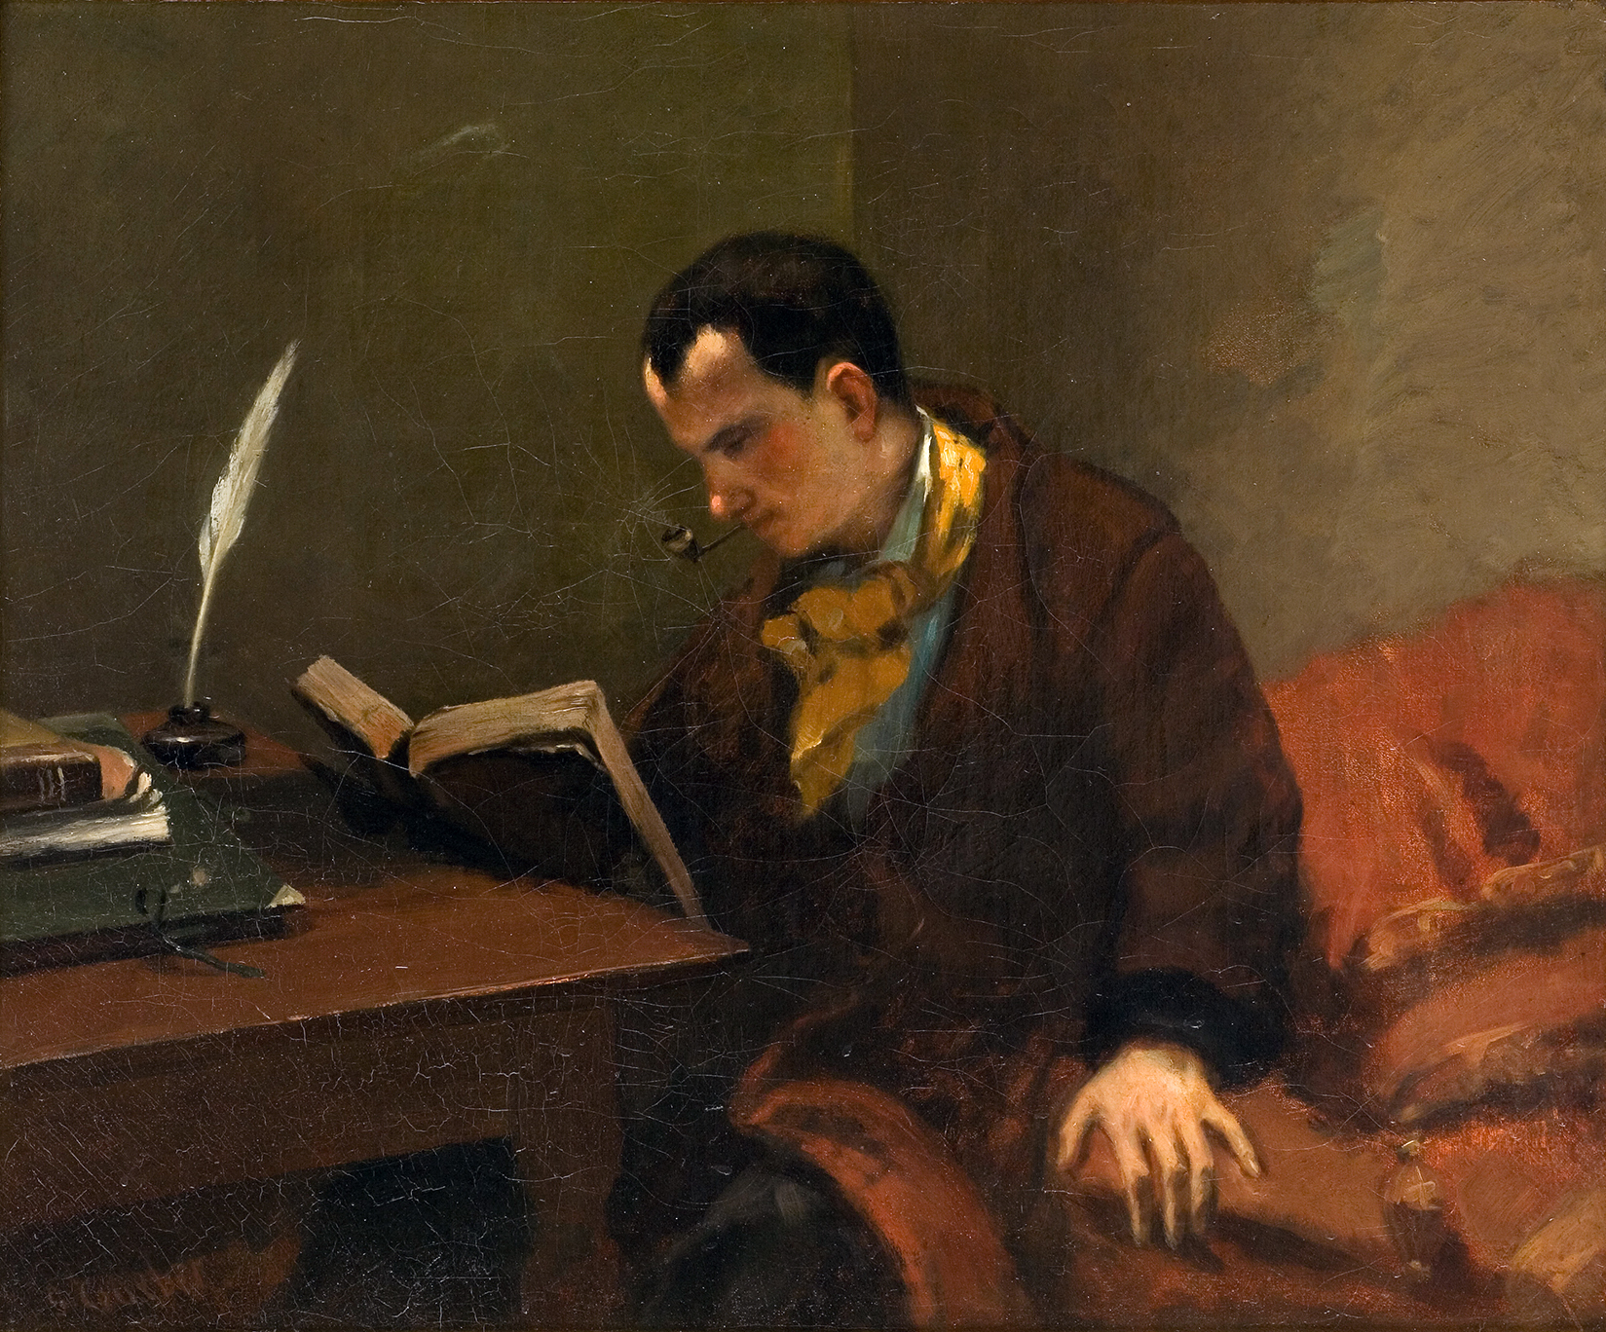
The Author (L’auteur)
John Butler Yeats
Portrait of WB Yeats, c. 1888
Gustave Courbet,
Portrait of Charles Baudelaire, c. 1847

Slide 24


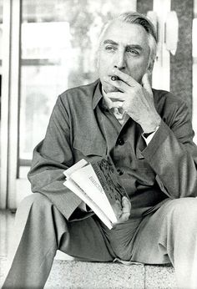
Roland Barthes, ‘The Death of the Author’ (1967)
‘The author rules in literary history, in biographies of writers, in magazine interviews, and even in the awareness of literary men, anxious to unite, by their private journals, their person and their work; the image of literature to be found in contemporary culture is tyrannically centred on the author, his person, his history, his tastes, his passions.’

Slide 25
Roland Barthes, ‘The Death of the Author’ (1967)
‘The Author is supposed to feed the book — that is, he pre-exists it, thinks, suffers, lives for it; he maintains with his work the same relation of antecedence a father maintains with his child.’

Slide 26
Who ‘makes’ a book?
Author
Scribe
Typist
Commissioning editor
Copy editor
Peer reviewer
Typesetter
Software engineers
Paper manufacturer
Cover artist
People who transport books
Booksellers
Authors of previous books - intertextuality

Slide 27
Roland Barthes, ‘The Death of the Author’ (1967)
Author privileged in literary history despite the fact that:
‘We know that a text does not consist of a line of words, releasing a single "theological" meaning (the "message" of the Author-God), but is a space of many dimensions, in which are wedded and contested various kinds of writing, no one of which is original: the text is a tissue of citations, resulting from the thousand sources of culture.’

Slide 28
Roland Barthes, ‘The Death of the Author’ (1967)
Whereas …
‘The reader is a man without history, without biography, without psychology; he is only that someone who holds gathered into a single field all the paths of which the text is constituted. … The reader has never been the concern of classical criticism; for it, there is no other man in literature but the one who writes. We are now beginning to be the dupes no longer of such anti-phrases, by which our society proudly champions precisely what it dismisses, ignores, smothers or destroys; we know that to restore to writing its future, we must reverse its myth: the birth of the reader must be ransomed by the death of the Author.’

Slide 29
Histories of Reading
In what sense might ‘the reader’ be ‘without history’?
What methodological challenges might be associated with histories of reading? Are there any challenges which might relate to the medieval period specifically?
How does one write a history of reading?

Slide 30
3. Digital Approaches to Book History
How might digital technologies enhance histories of books and readership?
What methodological potentialities might be available through websites, databases and suchlike?

Slide 31
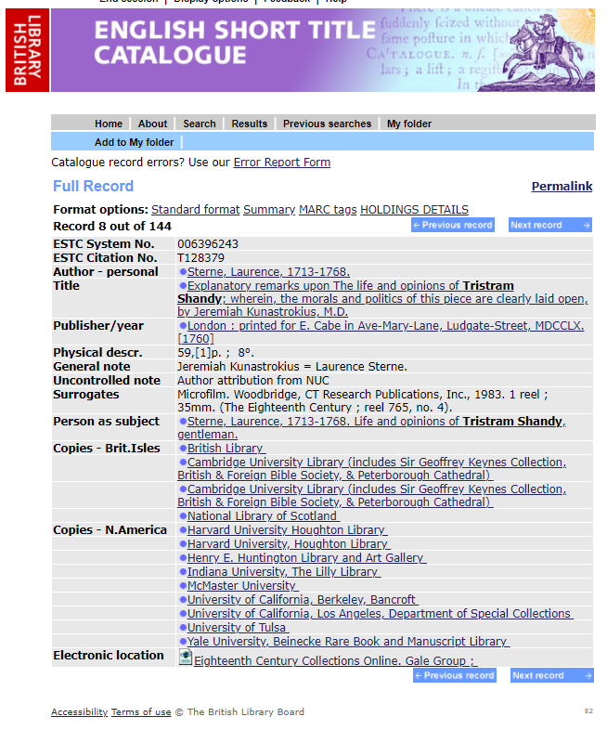
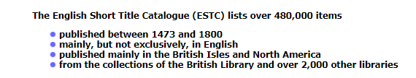
Digital Approaches to Histories of the Book
Short Title Catalogue (STC) = systematic (and coded) record of printed books extant in libraries and collections
Eighteenth-Century STC developed on CD-Rom 1992
Subsumed into English Short Title Catalogue
Enumerative approach

Slide 32
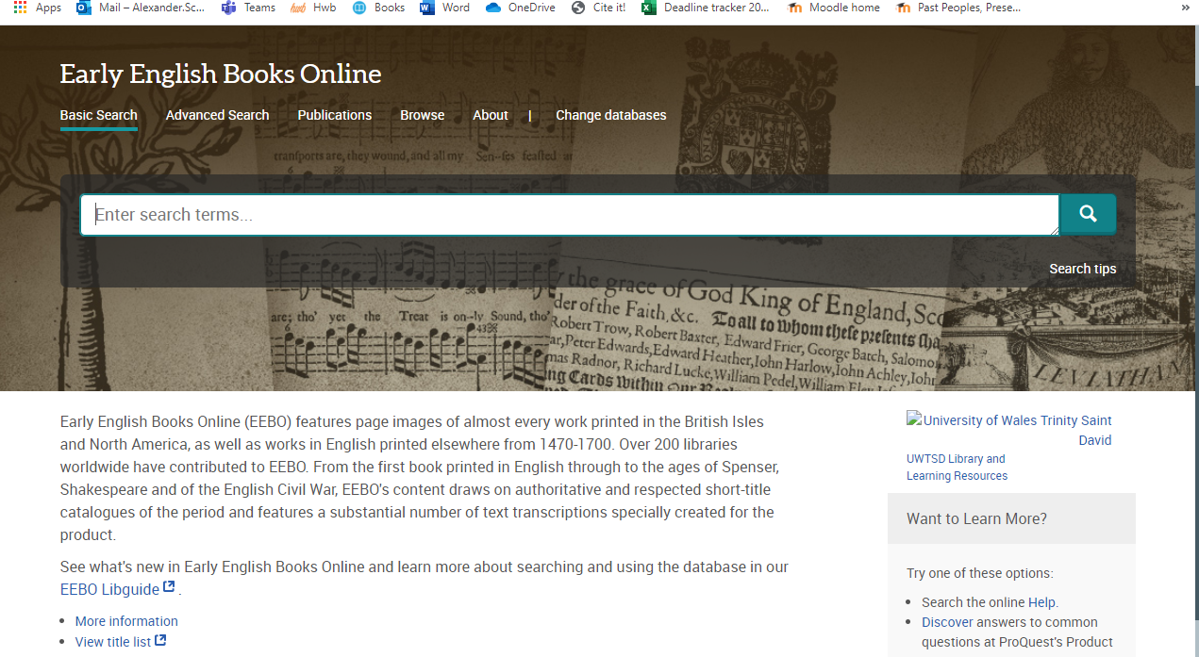
EEBO

Slide 33
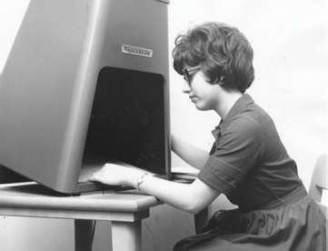
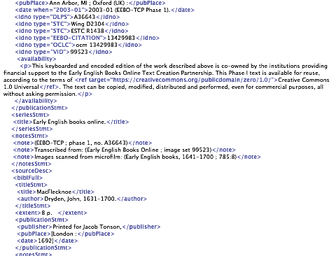
‘How to Think About EEBO’
‘The story, in a nutshell. Catalogues took books off the shelves. Microfilm took pages out of books. Transcription and markup freed words from the page. Collection and standardization dissolved those words into data. Early print’s realization as data opened a new horizon of study that we’re still just beginning to survey.
‘… Now that we have EEBO in full-text form, what do we do with it?’
- Michael Gavin, 'How to Think About EEBO,' Textual Cultures, 11:1–2 (2017 [2019]): 70–105.

Slide 34
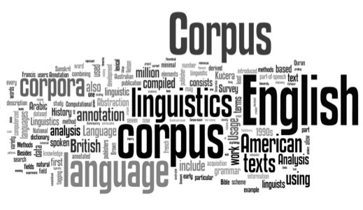
Corpus Linguistics

Slide 35
‘Death of the Document’?
CODED FILES:
‘When combined with the archival research of the short-title catalogues (themselves scholarly projects of the highest quality) the result is a collection of files — files, not documents nor texts — that fold discourse into history in a remarkable way, combining “real life” sociological information about names, books, places, and dates, with the formal and lexical features of the texts that record that information. Scale is absolutely essential here. It matters that these projects aspired to comprehensiveness.’
Michael Gavin, 'How to Think About EEBO,' Textual Cultures, 11:1–2 (2017 [2019]): 70–105.

Slide 36
‘Death of the Document’?
‘The archive of early print is now remediated as a collection of networked particulars. Everything is connected to everything else, at both the supra-textual levels of biographical and geographical metadata, as well as at the sub-textual levels of parts, down to the individual words and characters. Each item in the collection exists in relation to every other and is therefore available for re-formulation as data.’
Michael Gavin, 'How to Think About EEBO,' Textual Cultures, 11:1–2 (2017 [2019]): 70–105.

Slide 37
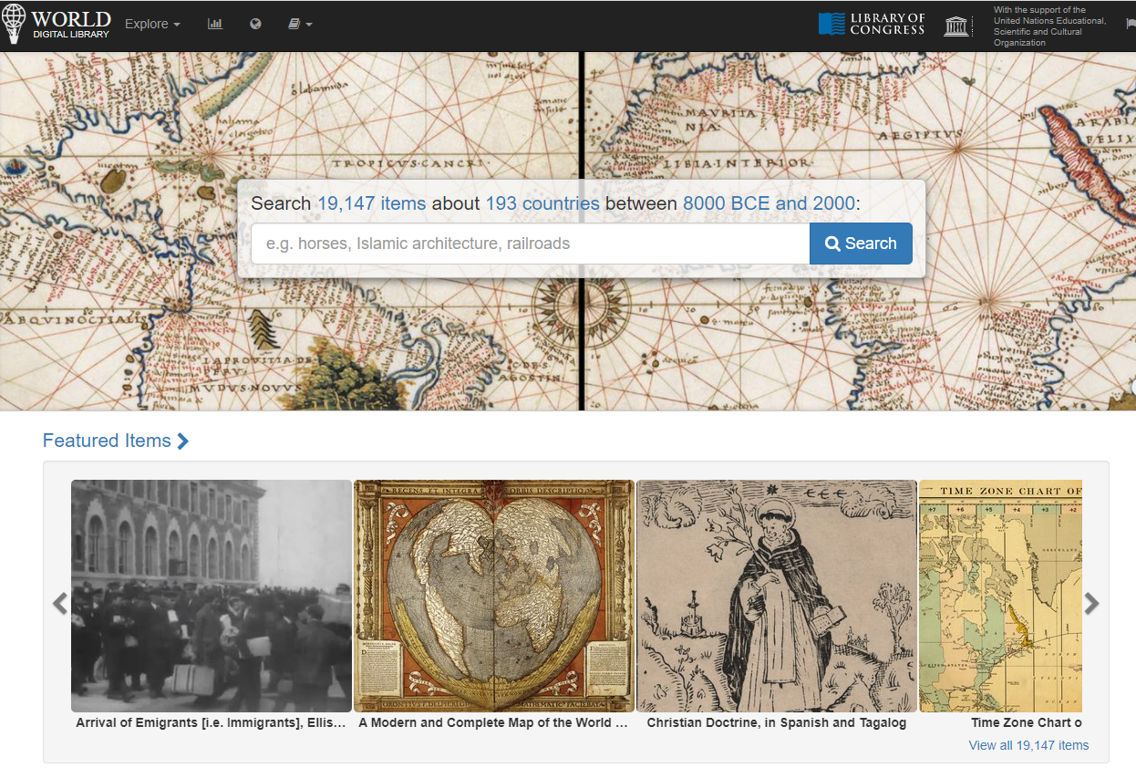
World Digital Library

Slide 38
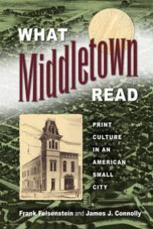
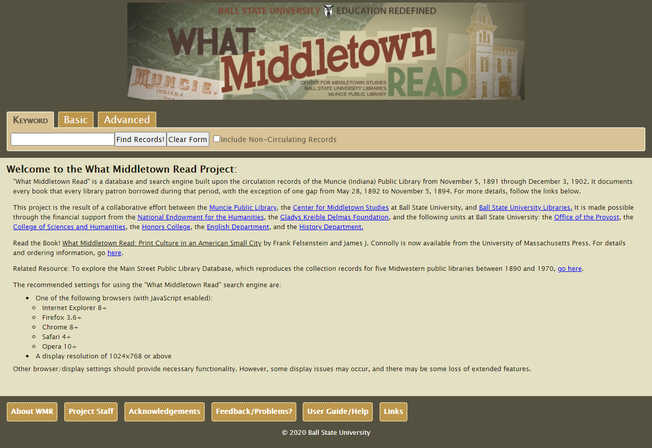
Digital Approaches to History of Readers

Slide 39
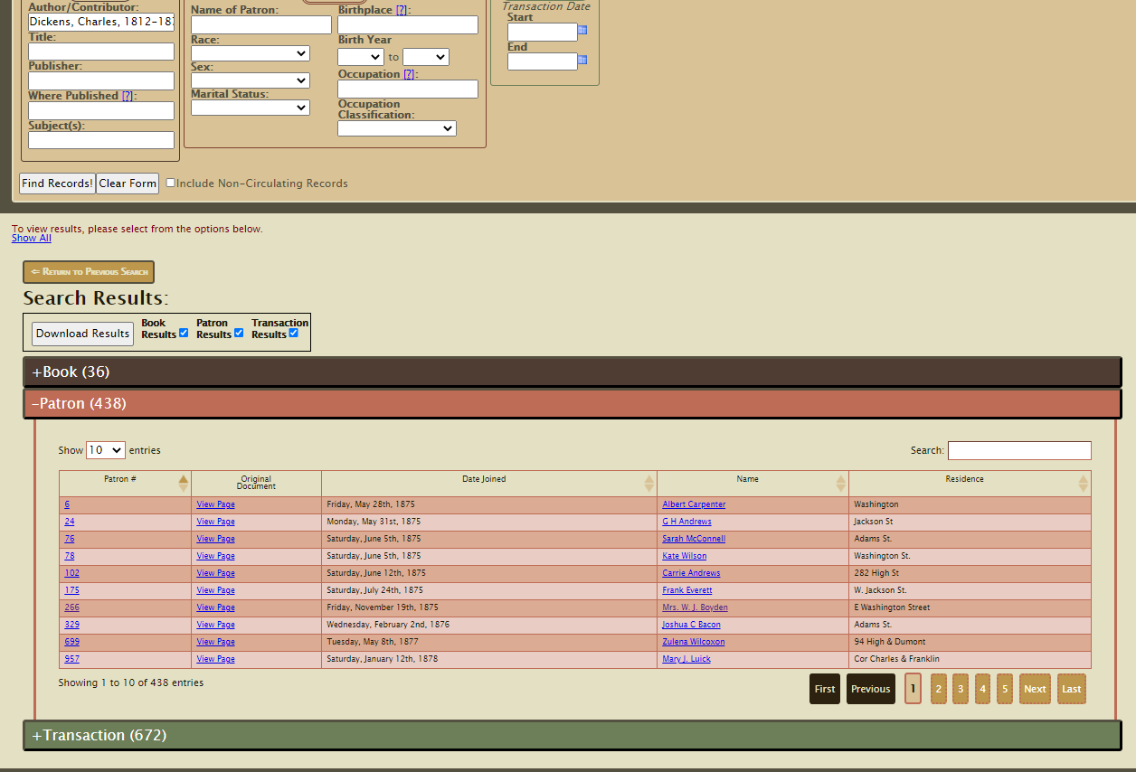

Slide 40
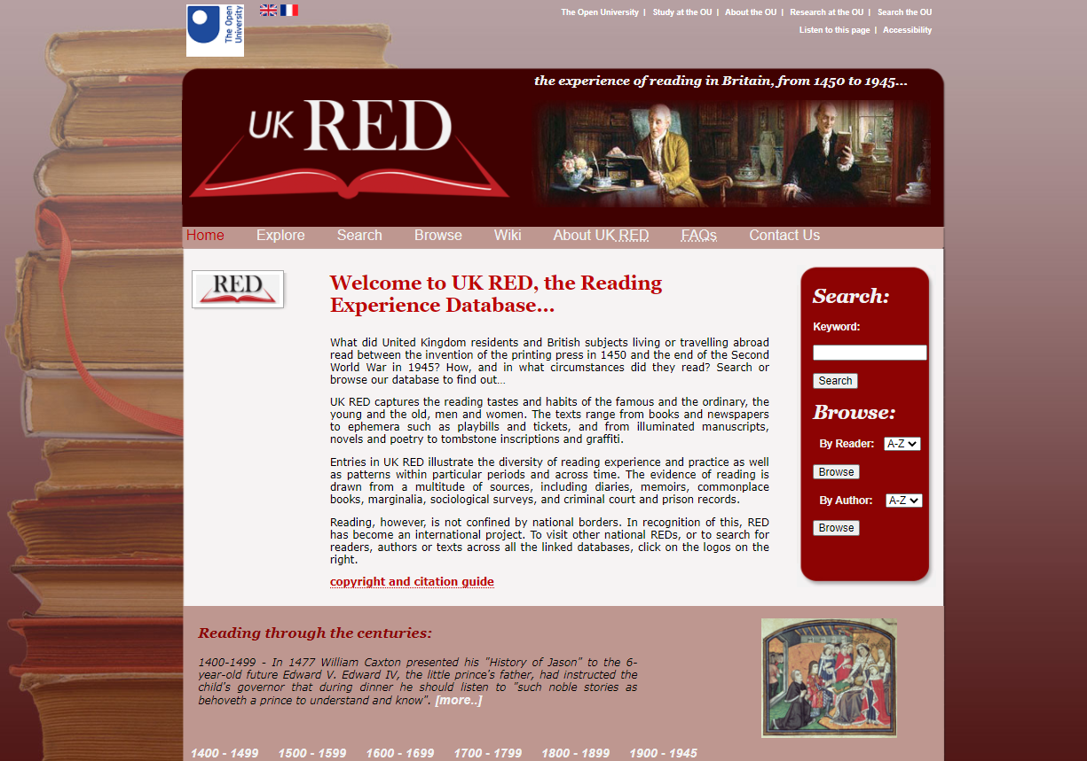
UK Reading Experience Database (UK-RED).

Slide 41


Slide 42

‘History of Audiences’

Slide 43


